Slide 1
HOW THE GREAT WAR CHANGED KENT
CENTRE FOR RESEARCH IN KENT HISTORY & ARCHAEOLOGY

Slide 2
Kent on the Front Line
PRINCIPAL PORTS FOLKESTONE , DOVER & RICHBOROUGH. OVER 10 MILLION SUCCESSFULLY TRANSPORTED DURING WAR
RN - CHATHAM, SHEERNESS & DOVER
RNAS WESTGATE & EASTCHURCH MAIDSTONE, CANTERBURY , CHATHAM, DOVER & HYTHE – GARRISONS & RN DIVISION
AIRFIELDS – LYMPNE, DYMCHURCH & JELLANDS FIELD
DEFENCE OF REALM ACT 8 AUGUST INTRODUCING RESTRICTED ACCESS- KENT BECOMES A MILITARISED ZONE
AIR RAIDS THROUGHOUT KENT

Slide 3
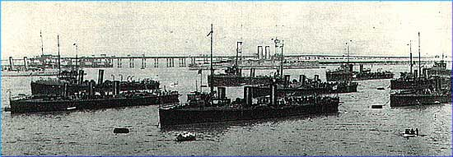
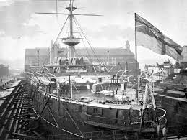
Dover Patrol
H.M. Dockyard Chatham

Slide 4
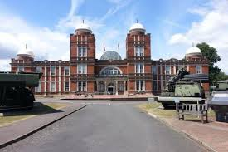
Royal Engineers Chatham

Slide 5
Mobilisation
TERRITORIAL FORCE VAD TRAINING EXERCISES & AMALGAMATION WITH ST. JOHN’S & RED CROSS 8 AUGUST 1914
TERRITORIALS MOBILISED FOR HOME SERVICE – AFFECTS INDUSTRY IN KENT
QORWK RECEIVES 3,000 VOLUNTEERS BY END AUGUST
3 NEW ARMY SERVICE BATTALIONS RAISED BY THE BUFFS BY END SEPTEMBER 1914
ADMIRAL CHARLES PENROSE FITZGERALD & THE WHITE FEATHER LADIES OF FOLKESTONE

Slide 6
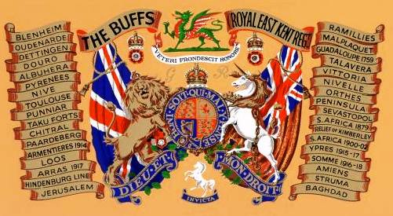

Slide 8
Mobilisation
1.5 ADDITIONAL WOMEN IN EMPLOYMENT DURING WAR – 44% IN INDUSTRY
NURSING SEEN AS ‘SUITABLE’
750,000 MADE REDUNDANT BY 1919
POST WAR EMPLOYMENT LEVEL IS 30% - LOWER THAN BEFOREWAR
PRE & POST WAR DOMESTIC SERVICE IS LARGEST SECTOR . DEMAND OUTSTRIPS SUPPLY IN 1920’S. POST WAR SINGLE MAIDS PRE WAR HOUSEHOLDS
MAJOR HOUSEHOLDS LOST THROUGH DEATH DUTIES
SHIFT TO COMMERCIAL & INDUSTRIAL EMPLOYMENT FOLLOWS

Slide 9
© IWM (Q 42033)
Women at work during the First World War
The First World War substantially increased the numbers of women in paid work and the range of jobs that they undertook. The majority of women supported the war effort by working in industry.

Slide 10
Faversham Explosion
APRIL 2ND 1916 200 TONS TNT EXPLODE 105 MEN KILLED
AS A SUNDAY NO WOMEN AT WORK

Slide 11
© IWM (Art.IWM ART 1179)
The Women's Land Army and German Prisoners by Randolph Schwabe
Women took on jobs that had previously been done by husbands, brothers and fathers, who were now absent, as well as keeping households and families together. This painting shows two women of the Women's Land Army and two German prisoners-of-war doing important agricultural work.

Slide 12
Agriculture
BRITAIN’S STRATEGIC WEAKNESS – 40% FOOD IMPORTED & UP TO 60% OF WORKING CLASS STAPLES
PRODUCTION SWITCHED TO ARABLE FROM LIVESTOCK
WOMEN, ADOLESCENTS, ALIENS & POWs REPLACE MANY FARM WORKERS
FARMING ONLY PROFITABLE IN WARTIME
AGRICULTURAL ACTS OF 1920 BROKE UP LARGE ESTATES – FARM SIZES REDUCED AND NEW LANDOWNERS WITH MORTGAGES LOSE OUT WHEN WARTIME SUPPORT WITHDRAWN

Slide 13
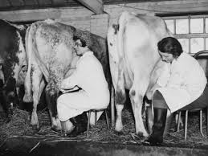

Slide 14
© IWM (Art.IWM PST 4881)
Women Wanted Urgently
A number of the leading Suffragettes played an important role in setting up women-only organisations to support the war effort. Their success influenced the decision to create branches of the armed services for women. The first of these was the Women’s Army Auxiliary Corps (WAACs), which was formed in January 1917.

Slide 16
Industry
TILLING STEVENS SWITCHED TO WAR PRODUCTION SEPTEMBER 1914
SHARP’S MAIDSTONE SWITCHED TO DRIED VEGETABLE PRODUCTION
ROOTE’S AERO ENGINE REPAIRS – LEN WORKS, MAIDSTONE
CHATHAM DOCKYARD EXPANDS WORKFORCE
1916 -1918 CONSCRIPTION & MANPOWER CRISIS – INDUSTRIAL EXEMPTIONS LOWERED & AGE RAISED
DILUTION – INDUSTRIAL RELATIONS

Slide 17
Globalisation?
IMPERIAL SOLDIERS – GARRISON & HOSPITALS
FOLKESTONE – US ARMY ON PARADE 30 APRIL 1918
US ARMY SEGREGATED – BLACK AMERICAN SOLDIERS GIVE A MINSTREL SHOW IN SWANSCOMBE – 4 JULY 1918
LABOUR BATTALION ON PARADE SWANSCOMBE AUGUST
MILITARY SERVICE CONVENTION
MAIDSTONE’S ALIENS- FRIENDLY & ENEMY (BARONESS ORCZY – BEARSTED)
REFUGEES IN KENT – BELGIANS TO SERBIANS

Slide 19
Demobilisation
SOME EARLY DEMOBILISATION TO ASSIST FOOD PRODUCTION
10,000 SOLDIERS MARCH IN FOLKESTONE PROTESTING AGAINST DELAY IN DEMOBILISATION – JANUARY 1919
CHATHAM DOCKYARD COMMENCES DISCHARGE OF WOMEN WORKERS – FEBRUARY 1919
MAIDSTONE TRAM CONDUCTRESSES KEEP THEIR JOBS – AUGUST 1919
SEX DISQUALIFICATION (REMOVAL) ACT 1919, HOWEVER-
END WAR FORMALISED MARRIAGE BARS IN TEACHING, NURSING & CIVIL SERVICE WITH UNOFFICIAL BARS IN SOME COMMERCIAL COMPANIES

Slide 20
SUFFRAGE & CONCLUSION
REPRESENTATION OF THE PEOPLE ACT 1918 – MEN & SOME WOMEN
DID WAR CAUSE CHANGE OR DID PEACE CONFIRM PRE-WAR TRENDS IN SUFFRAGE & LABOUR REPRESENTATION?
ECONOMIC DOWNTURN 1920/21 PREVENTED SOCIAL REFORM IN, FOR EXAMPLE HOUSING – LLOYD GEORGE’S ‘ADDISON SCHEME’ AND THE GEDDES’ AXE
PRE WAR DECLINE IN BRITISH TECHNOLOGY
BY 1928 UNDERLYING CHANGES RATHER THAN DRAMATIC OVERHAUL OF SOCIETY

