Slide 1
A collective investment in Lived Experience Practice: n examining a co-produced steering group within a mental health peer worker project
European Conference on Mental Health
2nd-4th October 2019
Belfast. Northern Ireland
Victoria Stirrup. Researcher and PhD candidate
Canterbury Christ Church University
Victoria.stirrup@Canterbury.ac.uk

Slide 2
Peer Support and Lived Experience Practice
“a system of giving and receiving help founded on the key principles of respect, shared responsibility, and mutual agreement of what is helpful”
(Mead et al,. 2001:135).
LXPs work in services including:
Community teams
Crisis Resolution and Home Treatment
Day Treatment Teams
In-patient wards

Slide 3
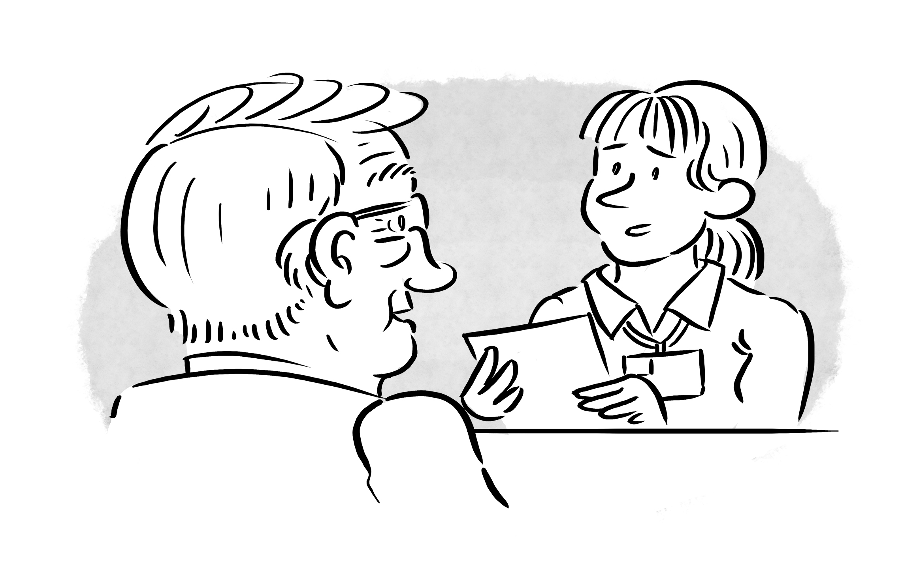
PhD research aims
Aim:
to develop a theory of context specific organisational support for the new role of Lived Experience Practitioner.
Research Questions:
How is Lived Experience Practitioner practice supported within an organisation?
What characterises this social process?

Slide 4
“Excellent informants have been through, or have observed, the experience under investigation”
(Spradley, 1979, p230)

Slide 5
Constructivist Grounded Theory- guided by Charmaz (2014)
Raw data
Abstraction
Open (gerund) coding:
Line-by-line coding
Fractures data into individual units
Focused coding:
Larger segments of text
Raises analytic level of open codes
Constant comparison:
Between instances
Focused and open codes
Focused and focused codes
Memos
Refining categories:
Theoretical coding
Higher level concepts
The move from raw data to theoretical abstraction
Notes:
Open (gerund) coding:
Line-by-line coding
Fractures data into individual units
Focused coding:
Larger segments of text
Identifies relationships and patterns in data
Raises analytic level of open codes
Axial coding:
Regrouping all focused codes
1: Conditions- the circumstances that form the structure of the studied phenomenon
2: Actions/ interactions- Participants routine and strategic responses to events
3: Consequences- “why?”, “where?” How come?”
Constant comparison:
Between open and open codes
Focused and open codes
used and focused codes
Memos
Refining categories
Theoretical coding
Establishing tentative categories
Higher level categories
Explore properties/conditions/ dimensions

Slide 6
Findings- Theoretical categories
Super-ordinate core categories:
A collective investment in LXP roles
A liminal identity of LXP
Theoretical categories:
Establishing a collective consciousness
Responding to preconceptions
Adopting a strengths-based approach
Being solution focused
Assessing alignment

Slide 7
Example of the LXP project steering group
“Nothing about us without us” (Charlton, 1998).
Membership: LXPs, Service Director, links to staff networks, HR and OD
link, service managers
Social networks: Links to staff networks
Co-delivery: LXPs training staff/ volunteers (LXP led
boundaries training)

Slide 8
“So, (line manager) knew of my interest …I guess since then…I’ve tended to be in the sort of like steering groups or committees.”
(Participant 1)
“so, I just took that opportunity and put myself forward to join the working group to look at peer support and how it would benefit service users as well as the organisation”.
(Participant 7)
3-part schema (Lejano, 2008)
Identity and Activities of self
Identity and Activities of self vis-à-vis another
Joint activities of self and other

Slide 9
“one of my remits was to come in and provide some, steering group, leadership ….….well it was very clearly about working to get the right people involved in the steering group.
…and some interface issues around the steering group…..”
(Participant 3)
“well I get e-mails from (Lead LXP), erm, to do like steering groups…
…you can go to steering meetings if you wanted to… I just, I don’t …I find them boring
…Like the agendas- All this talk, it’s just a lot of er, politics…because we’re very much a political organisation now.”
(Participant 8)

Slide 10
“I guess my role … service director …I suppose I’ve been there as an executive sponsor for it [the LXP project]. I sit on the steering group, I’ve been on the steering group on and off throughout.”
(Participant 4)
“the steering group wouldn’t know how to run the project. So, that’s the biggest thing we are doing this year, we are working on the operational policy”
(Participant 10)

Slide 11
Implications and conclusion
Flexibility vs control:
Supportive and resourced environments are needed (Byrne et al, 2016).
Transposing the mutuality and reciprocity that characterise peer support onto the NHS (Faulkner and Basset, 2012).
The LXP project steering group extends beyond its traditional governance remit by being flexible in membership.

Slide 12
Thank you
Questions? Thoughts? Comments?
Contact:
Victoria Stirrup
School of Nursing, Midwifery and Social Work
Canterbury Christ Church University
Canterbury, UK
Victoria.stirrup@Canterbury.ac.uk

Slide 13
Byrne, L., Roper, C., Happell, B., & Reid-Searl, K. (2016). The stigma of identifying as having a lived experience runs before me: Challenges for lived experience roles. Journal of Mental Health, 1–7.
Charlton J. 1998. Nothing about us without us. University of California Press.
Charmaz, K. (2014) Constructing Grounded Theory. 2nd Ed. London: Sage
Davison, L., Chinman, M., Sells, D. and Rowe. M. (2006) Peer Support Among Adults with Serious Mental Illness: A Report From the Field. Schizophrenia Bulletin. 32 (3): 443-450
Faulkner, A., and Basset, T. (2012) A long and honourable history. Journal of Mental Health Training, Education and Practice. 7(2):53-59
Gillard, S., Foster, R., Gibson, S., Goldsmith, L., Marks, J., White, S. (2017) Describing a principles-based approach to developing and evaluating peer worker roles as peer support moved into mainstream mental health services. Mental Health and Social Inclusion. 21(3):113-143

Slide 14
Lejano, R (2008) The phenomenon of collective action: modelling institutions as structures of care. Public Administration Review 68(3): 491–504.
Mead, S., Hilton, D., & Curtis, L. (2001). Peer support: A theoretical perspective. Psychiatric Rehabilitation Journal, 25(2), 134–141.
Moran, G., Russinova, Z., Gidugu, V., Yeon Yim, Y, and Sprague, C. (2012) Benefits and Mechanisms of Recovery Amongst Peer Providers with Psychiatric Illness. Qualitative Health Research. 22(3): 304-319.
NICE. Psychosis and schizophrenia in adults: treatment and management. NICE clinical guideline 178—Issued: February 2014. [accessed 04/03/2014] http://www.nice.org.uk/CG178
Repper, J., and Carter, T. (2010) A review of the literature on peer support in mental health services. Journal of Mental Health, 20(4):392-411.
Spradley, J. (1979) The Ethnographic Interview. Michigan: Holt, Rineheart, and Winson.

