Slide 1
The Cassandra Project- Building a Sustainable Workload Activity Model for Future Community and District Nursing Workforce Capacity Planning
Carrie Jackson
Director England Centre for Practice Development

Slide 2
Acknowledging the team
Professor Alison Leary, Chair Healthcare and Workforce Modelling, LSBU
Prof Kim Manley CBE, Chair Practice Development and Innovation, ECPD
Dr Toni Wright, Principal Research Fellow
Anne Martin, Research Fellow
Tricia Leadbetter, Research Fellow
Key: DCN- District & Community Nurses
GCN – General Community Nurses

Slide 3
Presentation will cover
2 year mixed methods study to evaluate the impact of a community nursing workload activity tool to underpin decisions about safe staffing levels.
Funded by NHSE and HEE regional level
Phase 1 Published BJCN March 2015

Slide 4
Setting the Scene- Background

Slide 5
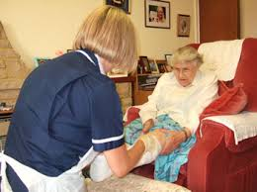
Background – The DCN Workforce Issues
NHS Five Year Forward View
Shift away from hospital care
Care close to or in the home
New models of care delivery
Flexible high quality innovative workforce
More District and Community Nurses needed
Different skill set

Slide 6
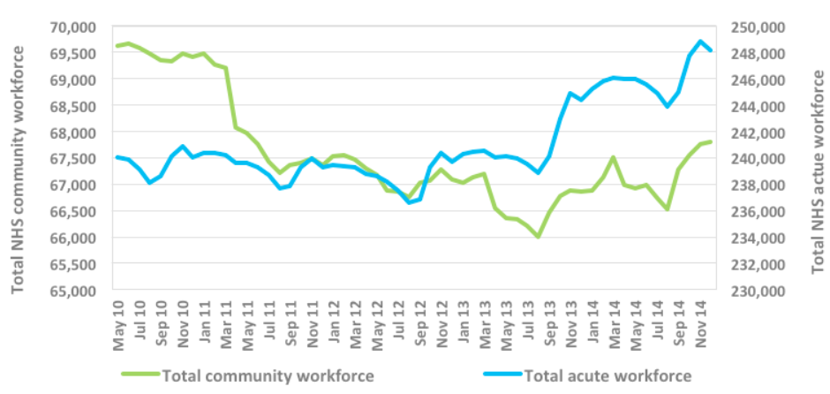
Reality - Declining DCN Numbers
DCN reduction from 13,000 to 7,500 in 10 yrs
Over 4 years GCNs >by over 3,300- 2,000 are district nurses- 28% decrease
45% over the age of 45 approaching retirement
Downgrading 1,545 band 7 and 1,317 band 8 nurses
Regional variations-East of England >903 DCNs >twice national average
RCN Frontline First- The Fragile Frontline 2015
Source: (HSCIC, 2014)

Slide 7
Understanding the role- clear as mud
Poor understanding of DCN roles
Wide variation in numbers of roles and bandings
Lack of consensus around definitions used to describe activities –
(1) service (what is being done, how frequently it involves contact with clients
(2) population served (and its density)
Further compounded by variation in how ‘caseloads’ are defined
Size and skill mix of staffing levels determined historically based on custom around patient caseload

Slide 8
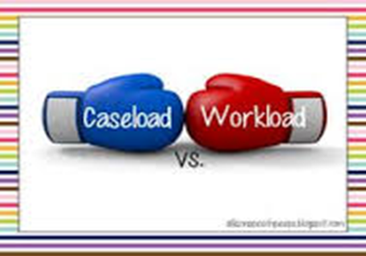
Case Load Issues
Large number of older people, with complex multi-morbidities, polypharmacy and myriad of psychosocial needs
Higher levels of dependency -70% of the health service budget and time to manage
Heavy caseloads -workload inconsistently distributed
Poor/inappropriate referrals
Inability to state when capacity has been reached
Contact time varies across the country – not evidence based
25 clients per caseload- varying acuity
Not possible to respond to variations in workload by redistributing nursing time to where it is most needed

Slide 9
Workforce Models -False Assumptions about (Community) Nursing
We can rely on historical patterns to predict the future requirements
Nursing is application of a simple linear task based physical skill set occupying time (Leary 2011, 2015, Jackson et al 2015)
Most current IT systems e.g. RIO, System One are diary based linear tools
Linear methods do not capture complex work well (De Leon 1993; Raiborn 2004)
Measuring workload based on counting patient contacts alone does not clearly demonstrate the full workload of nurses–bulk of work “unseen” (QNI 2014)

Slide 10
Missed Care Defined
Required patient care that is omitted (either in part or in whole) or delayed’ in response to ‘multiple demands and inadequate resources’.
(Kalisch et al (2009: 1510)
Negative consequences for patient outcomes
Notes:
Acute hospital settings
8 variables
shift type,
nursing resource allocation,
health professional communication, workload intensity,
workload predictability,
the nurses' satisfaction with their current job and their
intention to remain working (Blackman et al 2015)

Slide 11
Conclusion
Need new capacity and demand tools to measure and reflect the complexity of workload and output, maximising the potential of the existing workforce to enable planned growth

Slide 12
The Cassandra Project Objectives
Adapt the Cassandra Matrix® workload activity tool (Leary 2011) specifically for the community nursing context with DCNs
Pilot across 6 community organisations across Kent, Surrey and Sussex DCNs (bands 5-7)
Undertake a utility evaluation of the tool to provide proof of concept as a model to predict and plan for optimum community nursing caseload activity within a whole system.
Aggregate the data sets to identify patterns that might impact on caseload management including identification of care left undone

Slide 13
Our Assumptions

Slide 14
Methodology
Emancipatory Practice Development (ePD)
Informed by critical realism to understand real world issues
Formative implementation and process evaluation
Strengthen or improve the tool being evaluated
examine the delivery of the tool
quality of its implementation
assessment of the organizational context, personnel procedures, inputs, processes and outputs
alternative delivery procedures
tool fidelity

Slide 15
Methods
Cassandra Matrix ® Workload Activity Tool (adapted) (Leary 2011)
Pre and post workload activity survey to capture what difference it made to their self awareness of their role and contribution to care delivery.
Process evaluation workshops with stakeholder organisations
BOS survey pre and post workload activity using CCCIs framework (Guba and Lincoln 1989)

Slide 16
What does the Cassandra Tool do?
Web based tool used in ‘real time’ as practitioners carry out their daily work using computers, phones or tablets to input their activity
Intervention, context, time, people, care left undone/activity left undone
Six main categories of intervention:
Case management
Clinical admin
Non-clinical admin
Physical
Psychological
Social

Slide 17
What does the tool look like?

Slide 18
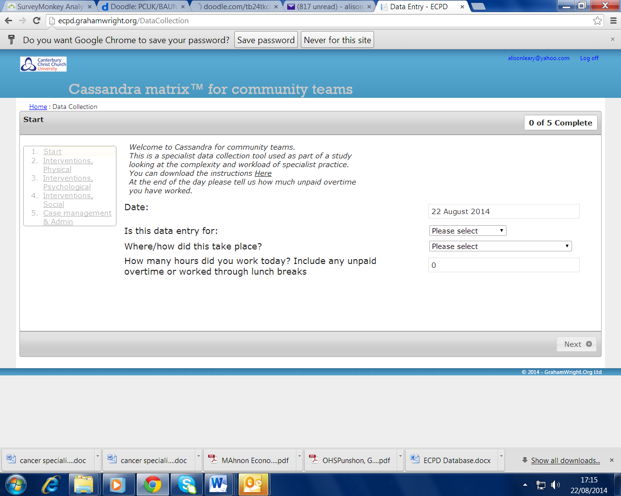
Input data for each care episode

Slide 19
Findings
Approx. 11,000 points of data
7,629 interventions collected in 58 regularly used categories
Issues with collection (not enough for a “big data” study) but shows complexity of care
112 examples of care left undone

Slide 20
Intervention by Location
76 % of care delivered in the home
24% in other areas

Slide 21
Spread across the intervention spectrum (2x context)

Slide 22
Areas highlighted with less input?
Continence management
Falls assessment/prevention
Advanced care planning
Safeguarding
Social needs assessment
Cannot generalise as you need big data to do this
Tool does capture care missed/left undone so economic cost may be applied

Slide 23
Why is this different?
Models a complex system
Relies on understanding relationships not just tasks that occupy time
This includes modelling “negative space” ie work left undone
Is more sensitive than averages
Can be used to construct optimum caseload “blackbox”
Is iterative, takes longer and requires large amounts of data to look for patterns

Slide 24
Mathematical Modelling Applied to Nursing
Garbage data
Great model
Garbage results
Poor decisions
Great data
Garbage model
Garbage results
Poor decisions
Great data
Great model
Great results
INSIGHT!

Slide 25
Modelling is about building a representative “whole system” rather than trying to measure bits

Slide 26
What pilot sites said about its utility
It shows what we are actually doing
We had really enthusiastic motivated nurses who could see how they could use the tool to support their workload planning
It is a good tool to use because it provides nurses with the systematic evidence needs to raise awareness of the impact that nurses are having at the front line as well as providing data that evidences skill mix and workforce development issues

Slide 27
Limitations
Project timescale
Winter pressures
Gaining consistent membership of steering group and pilot sites from the start
IT issues in one site- champions, web support

Slide 28
Next Steps
Develop data ontology for community nursing
Data collection allowing for pattern recognition through NIHR bid
Optimum caseload calculations using stochastic methods
Detailed analysis of workforce resourcing patterns and gap analysis
Economic impact assessment through Burdett Trust programme at RCN
NICE Safer Staffing guidelines

Slide 29
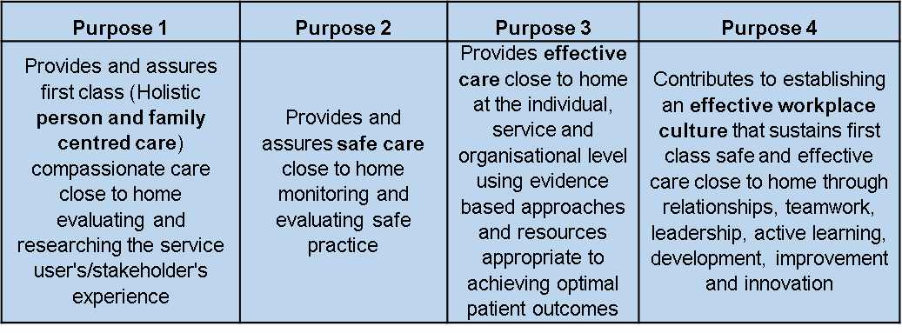
Other developments
Sophia workload activity tool for community mental health teams
Career Competence Framework ready to test (bands 5-8)- QNI
CPD Impact Tool (Health Education England)- 4 theories of transformation

Slide 30
Key References
Jackson, C. et al. (2015) ‘Making the complexity of community nursing visible: the Cassandra project’. British Journal of Community Nursing, March, 20 (3), 126-133.
Leary. A. (2011) ‘Proving your worth: Alison Leary has tips on how nurse specialists can demonstrate added value’. Nursing Standard. 25 (31).
Leary, A. et al. (2014) ‘The work left undone. Understanding the challenge of providing holistic lung cancer nursing care in the UK’. European Journal of Oncology Nursing. 18. 23-28.

Slide 31
Thank you!
@ECPDCarolyn
@ECPD3
#WePracticeDevelopers
http://www.canterbury.ac.uk/health-and wellbeing/england-centre-for-practice-development/england-centre-for-practice-development.aspx
www.facebook.com/groups/ecpd1
Carolyn.Jackson@canterbury.ac.uk

