Slide 1
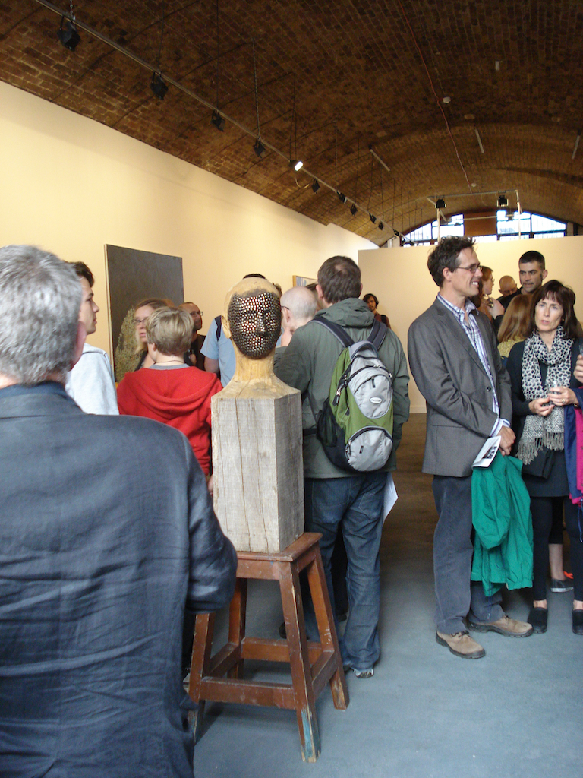
The object says it all:
intertexuality in artistic practice
Tim Long

Slide 2
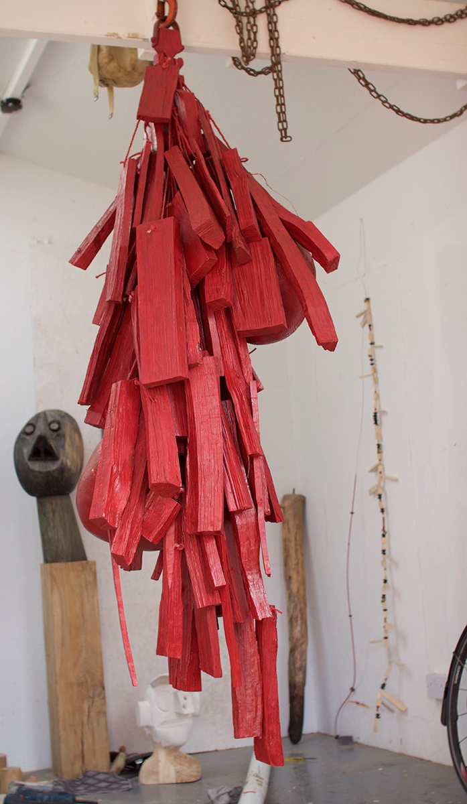
?
What is the text/object I make saying and doing?
What need does the object fulfil for me?

Slide 3
Julia Kristeva’s use of the term ‘intertextuality’ proposes the presence of multiplying meanings present in a ‘text’.
In this discussion the ‘text’ is an art object, sound work, film, and a written text.
Kristeva J, Revolution in Poetic Language, Columbia University Press, 1984

Slide 4
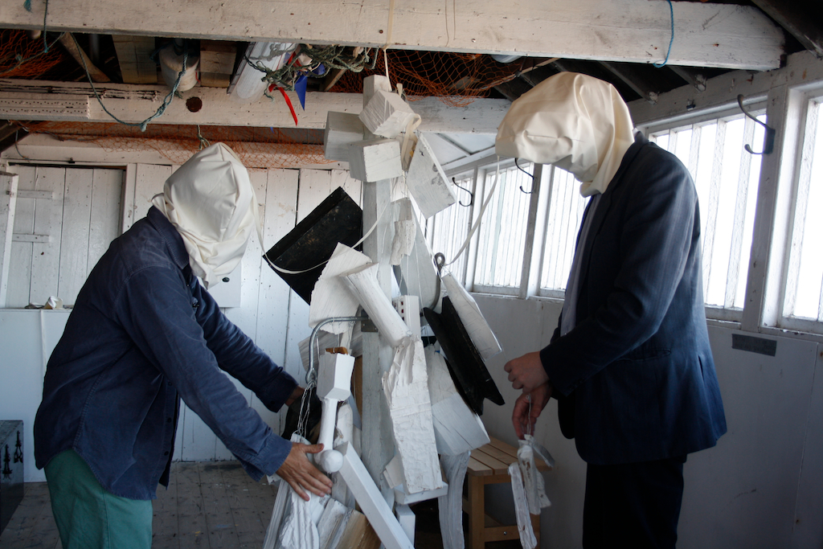
Reminder
I need to apply Kristeva's theory to the interpretation of art objects and my own art practice.

Slide 5
Background and related reading (the question of the subject)
1960s Continental philosophy and Kristeva’s references for a psycholinguistic theory
Ferdinand de Saussure: sign/signifier/signified/referent
Sigmund Freud: oedipal triangle, theory of the unconscious
Roland Barthes: heteronomy, the intertext
Mikhail Bakhtin: dialogical principle, chronotope, heteroglossia
Jaques Derrida: différance, deconstruction Michel Foucault: knowledge, power, and sexuality Jacques Lacan: psychoanalysis and post-structuralism
Deleuze and Guattari: schizoanalysis

Slide 6
Kristeva proposes that subjectivity is constructed through a signifying process.
Kristeva combines the psychoanalytic concept of a divided subject with structuralist concept of language (as signification).

Slide 7
The semiotic: the bodily drive as it is discharged in signification (significance). The semiotic is associated with the tones and movements of signifying practices.
As the discharge of drives the semiotic is associated with (and mediated through) the maternal body, the first source of rhythms.

Slide 8
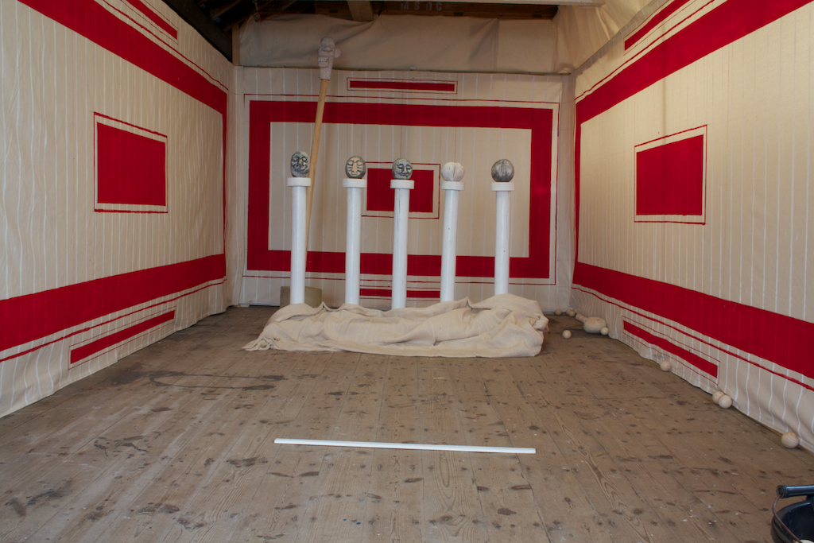

Slide 9
Postulations
A subject is the absorption and transformation of a text.
A text/object is a signifying practice.
A text is a process that proposes a subject (Kristeva’s subject as process/trial).

Slide 10
Kristeva identifies a modern period of rupture, that is exposed and explored through texts by Joyce, Kafka, Artaud, and Mallarmé.
The study of rupture, of the notion of a split subject is elaborated for example through the depictions of the human form in cubism.

Slide 12
The Freudian angle and the production of a subject and the role of the object.
‘Drives are material, but they are not solely biological since they both connect and differentiate the biological and the symbolic within the dialectic of the signifying body invested in a practice. Neither inside nor outside, drives are neither the ideational interior of a subject of understanding, nor the exteriority of Hegelian Force. Drives are, instead, the repeated scission of matter that generates significance, the place where an always absent subject is produced.’ RIPL p. 167

Slide 13
‘The Freudian theory of drives may be viewed as a transition from the psychical to the somatic, as a bridge between the biological foundation of signifying functioning and its determination by the family and society.’
p. 167 Kristeva, J, Revolution in Poetic Language, Columbia University Press, 1984

Slide 14
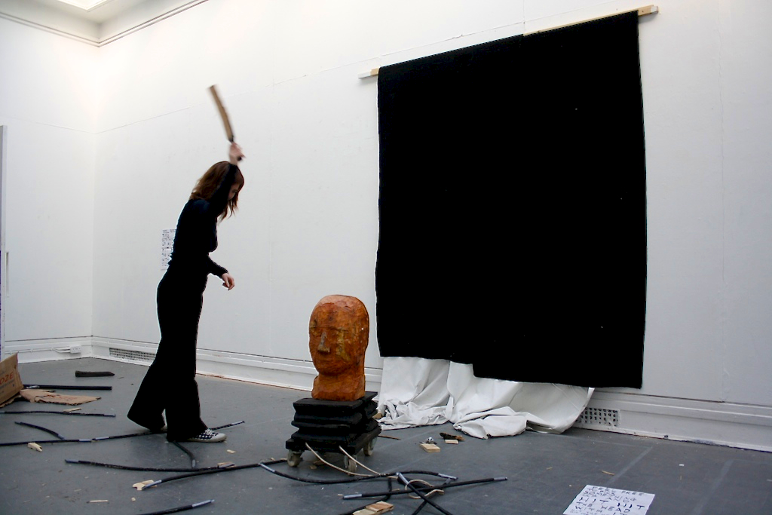
If drives are material then art objects are attributes of drives.

Slide 15
drive
material body maternal body
Matter
signifying practice
scission/rupture
text object
intertext
absorption and transformation
start again…

Slide 16
