Slide 1
To be or not to be – ‘insider/outsider positionality’: Methodological challenges in researching a group of Iraqi Kurdish migrants in the UK
Chra R Mahmud
Ph.D. Researcher & Sessional Academic
Canterbury Christ Church University

Slide 2
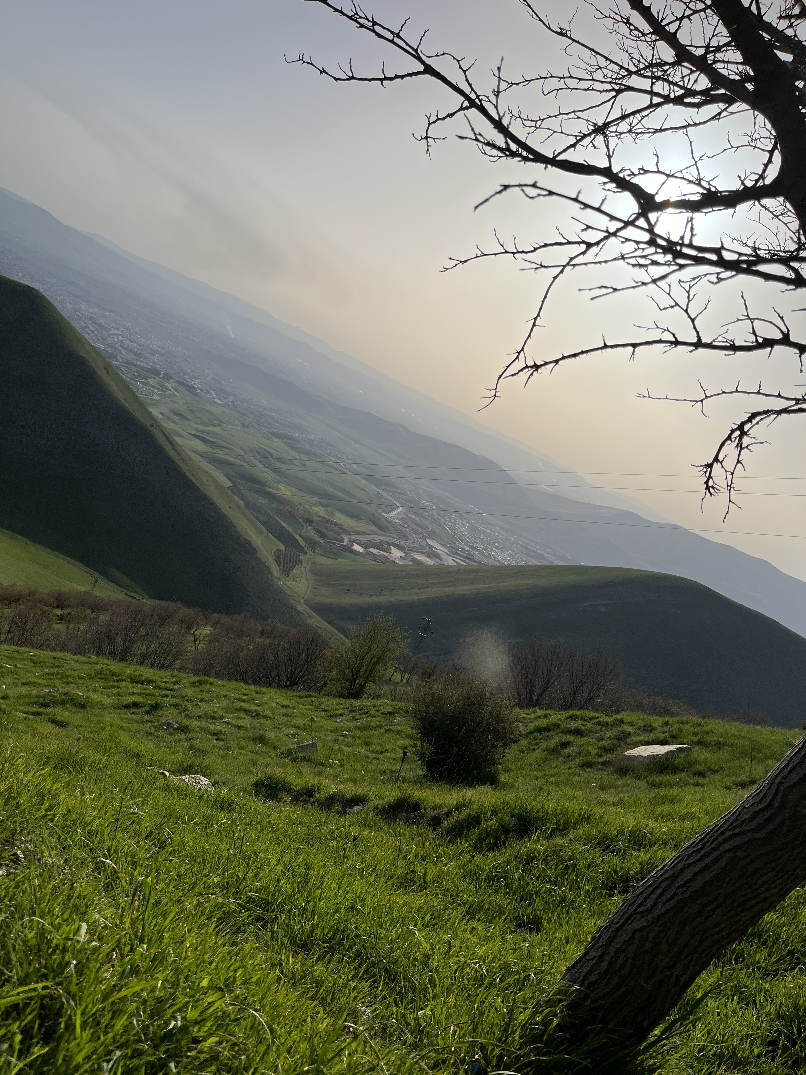
Outlook
The Research Background
Research Questions
Theoretical Framework
Findings and Discussion
Conclusions
Notes:
In this talk I try to address the following research questions:
• How do insider and outsider perspectives affect research on the Kurdish community?
• What dilemmas and challenges do researchers face when studying their community, and how do these experiences shape their identities?

Slide 3
The Research Background
Examining the lived experiences of a group of Iraqi Kurdish migrants in the UK
Multidisciplinary research, influenced by the postcolonial, post human and nonessential standpoints
Qualitative in nature, following an ‘interpretive constructivist’ approach (Holliday 2016).
Multimodal data (spoken, written and visuals)
Thematic and Reflexive Thematic Analysis (Braun & Clarke, 2006, 2019)

Slide 4
The Research Questions
What it means to be an insider or/and outsider researcher?
How are the researcher’s status and identity negotiated and navigated throughout the research processes?

Slide 5
Positionality Theory
Positionality is about ‘where the researcher is coming from’
ontological and epistemological assumptions, and human nature and agency (Holmes, 2020, p.1-2).
Identifying Positionality:
researcher's relation to study subject
connection with research participants
role in research context and process (Malterud, 2001; Fleming, 2018 ).
Benefits of Acknowledging Positionality:
heightened self-awareness in research.
awareness of potential biases.
deeper understanding of research outcomes.

Slide 6
Insider, Outsider, or In-between
Insider researchers are those
who are considered part of the groups they study (Trowler, 2011; Kanuha, 2000),
have distinctive access and actively work together to produce knowledge (Chhabra, 2020; Humphrey, 2007; Hellawell, 2006).
Outsider researchers are those
who conduct studies within communities or groups they do not belong to (Bridges, 2017; Hellawell, 2006)
In-between researchers refer to those
who occupy a position that falls between being a complete insider and a complete outsider within the specific groups or communities they study (Kerstetter, 2012).

Slide 7
Findings and Discussion

Slide 8
Murad (Interview 1)
R: Tell me about your experiences dealing with people in your community and work placement, is there any story that you might find interesting to share?
Murad: Throughout my career, I have had the opportunity to work closely with people from various backgrounds, and I've been actively serving as a counsellor since 2014. Remarkably, I can confidently state that I have never encountered any unpleasant experiences in all this time.
R: Are you implying that you have not even experienced any instances of ‘othering’?
Murad: Not even once.

Slide 9
Researcher’s Reflection on Murad’s First Narrative
The time I spent with Murad was both enlightening and unexpectedly challenging. It was during our interactions that I found myself facing a situation I had never anticipated, and it left me feeling uncertain about the path forward. I found myself in a complex and challenging position, where the lines between being an insider and an outsider blurred. Initially, I had believed that my insider status would provide me with unique insights into the participants’ experiences. However, as events unfolded, it became evident that my initial assumptions were flawed. This unexpected turn of events prompted me to re-evaluate my approach to the research and forced me to navigate uncharted territory in my role as a researcher.

Slide 10
Murad (Follow-up Interview)
R: Is there anything else you would like to add that you might not have mentioned earlier?
Murad: Let me share something that I hadn't revealed before. In my role as the leader of the opposition party within the [...], based in London, I view my journey as an asylum seeker who arrived without English proficiency, now I am a fluent English speaker, and this is a significant accomplishment. Nevertheless, I face persistent challenges from racist individuals within my own party. Despite their outward display of friendliness and kindness, their actions behind my back are deceitful and harmful. It's as if they wear a mask of benevolence while concealing malicious intentions.
R: So, if I understand correctly, this experience is akin to ‘othering,’ right?
Murad: I term it as ‘colonial racism’ [...].

Slide 11
Researcher’s Reflection on Murad’s Follow-up Interview
My interaction with Murad presented an unexpected challenge that left a lasting impact on my research experience and my own personal narrative. It positioned me in a unique and somewhat ambiguous role, straddling the boundary between being an insider and an outsider, blurring the lines of my identity as either a participant or a mere observer. Initially, I held the belief that my insider status would provide me with special insights into the experiences of the participants. However, this belief was sharply challenged during my initial interview with Murad, as he still regarded me as an outsider despite our shared migrant backgrounds. As someone who has faced various obstacles on my own educational and professional journey as a migrant, I had a gut feeling that Murad might be holding back some information. This curiosity drove me to delve deeper into our discussions. When I probed Murad for more insights, I was pleasantly surprised by his openness and willingness to share the challenges he was facing within his organization. This experience underscored the vital significance of trust-building in our research process.

Slide 12
Amjad (Interview 1)
R: You mentioned that you have undergone changes over the years, particularly transitioning from being religious to being non-religious. Would you be open to sharing more about this significant experience?
Amjad: I find this topic deeply personal, and honestly, I prefer not to discuss it further.

Slide 13
Researcher’s Reflection on Amjad’s First Interview
Amjad’s stories about how his identity has changed over time have a deep impact on me. I’m curious about why he sees this part of his life as very personal, especially when he’s been open about even more sensitive topics regarding his identity and family. This curiosity drives me to dig deeper into his experiences, not just to understand them, but to thoroughly explore all the different aspects of his evolving identity.

Slide 14
Amjad (Follow-up Interview)
R: You are talking about interesting stories, which I think they are linked to your religious identity. Are you still sure you would like to skip my question about your identity shift from being religious to none religious?
Amjad: This was tough, perhaps the hardest decision I have ever made in my life. I endured a prolonged and arduous period where I questioned everything. I used to engage in hours of conversation with God daily. However, I eventually came to feel that the story of the Kaaba was fabricated and lacked authenticity. For me, I believe God resides within me, making traditional prayers incongruent with my beliefs about divinity. I harbour no regrets about my decision; in my view, religion is more intertwined with culture than true spirituality.

Slide 15
Researcher’s Reflection on Amjad’s Follow-up Interview
Finally, Amjad has graciously opened-up to me, and offered intriguing insights into the questions that had been on my mind. Given the delicate nature of discussing religious beliefs, it is possible that Amjad was concerned that sharing his views might unintentionally create challenges or conflicts with my own deeply held beliefs. As a result, he may have opted to keep this aspect of his identity to himself, seeking to preserve a sense of security and avoid any potential negative perceptions from me, especially since I occupy the role of an insider researcher.

Slide 16
Discussions and conclusion
Insiders and outsiders in research are fluid roles, not rigid categories.
Navigating this dynamic requires balancing participant perspectives and managing potential influences (Palaganas et al., 2017).
Building genuine relationships relies on self-awareness and reflexive approaches, fostering better outcomes.
Broadened Perspectives: Reflexivity enhances understanding, authenticity, and empathy in research.
appreciating the complexity of human experiences.
Balancing insider and outsider perspectives is vital, with attention to trust, power dynamics, and strategic choices (Råheim et al., 2016).
Developing flexibility in dual roles enhances relationships and research outcomes (Alvesson & Sköldberg, 2009).

Slide 17
Thank you for your attention

Slide 18
Reference List
Alvesson, M., & Skoldberg, K. (2009) Reflexive Methodology: New Vistas for Qualitative Research (2nd ed.). London: Sage.
Braun, V., & Clarke, V. (2006) ‘Using Thematic Analysis in Psychology’, Qualitative Research in Psychology, 3(2), pp. 77-101. doi: 10.1191/1478088706qp063oa.
Braun, V., and Clarke, V. (2019) ‘Reflecting on Reflexive Thematic Analysis,’ Qualitative Research in Sport, Exercise & Health, 11 (4), pp. 589–97. doi: 10.1080/2159676X.2019.1628806.
Bridges, David. (2017) ‘“Nothing about us without us”: The ethics of outsider research,’ In Philosophy in Educational Research. New York: Springer. doi.org/10.1007/978-3-319-49212-4_20.
Chaudhry, V. (2018)’ Centering embodiment in disability research through performance ethnography’, Qualitative Social Work. 18. 147332501876772. 10.1177/1473325018767728.
Chhabra, G. (2020). Insider, Outsider or an In-Betweener? Epistemological Reflections of a Legally Blind Researcher on Conducting Cross-National Disability Research. Scandinavian Journal of Disability Research, 22(1), 307–317.DOI: https://doi.org/10.16993/sjdr.696.
Fleming, J. (2018) ‘Recognizing and Resolving the Challenges of Being an Insider Researcher in Work-Integrated Learning,’ International Journal of Work-Integrated Learning, Special Issue, 2018, 19(3), pp. 311-320
Hellawell, D. (2006) ‘Inside-out: Analysis of the insider-outsider concept as a heuristic device to develop reflexivity in students doing qualitative research,’ Teaching in Higher Education, 11(4), 483-494. doi:10.1080/13562510600874292,
Holliday, A. R. (2016) ‘Studying Culture’, in Hua, Z. (ed.) Research Methods in Intercultural Communication. Wiley, pp. 23-36.
Holmes, A. G. D. (2020) ‘Researcher Positionality - A Consideration of Its Influence and Place in Qualitative Research - A New Researcher Guide,’ Shanlax International Journal of Education, 8(4), pp. 1-10. doi. 10.34293/ education.v8i4.3232.
Humphrey C (2007) Insider-Outsider: Activating the hyphen. Action Research 5(1): 11–26.
Kanuha, K. V. (2000). "Being" native versus" going native: Conducting social work research as an insider. Social Work, 45(5), 439-447
Kerstetter, K. (2012) ‘Insider, Outsider, or Somewhere Between: The Impact of Researchers’ Identities on the Community-Based Research Process,’ Journal of Rural Social Sciences, 27(2). Available at: https://egrove.olemiss.edu/jrss/vol27/iss2/7.
Malterud, K. (2001) ‘Qualitative Research; Standards, Challenges and Guidelines’, The Lancet, 358, pp. 483-488.
Palaganas, E. C., Sanchez, M. C., Molintas, M. P., & Caricativo, R. D. (2017). Reflexivity in Qualitative Research: A Journey of Learning. The Qualitative Report, 22(2), 426-438. https://doi.org/10.46743/ 2160-3715/2017.2552
Råheim, M., Magnussen, L. H., Sekse, R. J., Lunde, Å., Jacobsen, T., & Blystad, A. (2016) ‘Researcher-researched relationship in qualitative research: Shifts in positions and researcher vulnerability,’ International journal of qualitative studies on health and well-being, 11, p. 30996. https://doi.org/10.3402/qhw.v11.30996.
Trowler, P. (2011) ‘Researching your own institution: Higher education’. Retrieved from http://www.bera.ac.uk/resources/researching-your-own-institution-higher-education.

