Slide 1
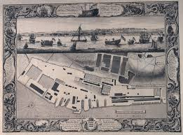
CHATHAM DOCKYARD
AT THE HEART OF INDUSTRY AND SEAPOWER

Slide 2
ROYAL DOCKYARD
FOUNDED 16TH CENTURY C 1570
FOLLOWED CHOICE OF MEDWAY AS A SAFE ANCHORAGE & SUPPLY CENTRE
HENRY VIII – SAFE ANCHORAGE FROM WEATHER
JILLINGHAM WATER & CHATHAM REACH
‘CAULKING & GROUNDING’ – PRIVY COUNCIL 1550
CAREENING & BREAMING
ROCHESTER STOREHOUSE 1550
TUDOR DOCKYARD 1570 – MAST POND
FIRST DRYDOCK 1581- OAR PROPELLED GALLEYS

Slide 3
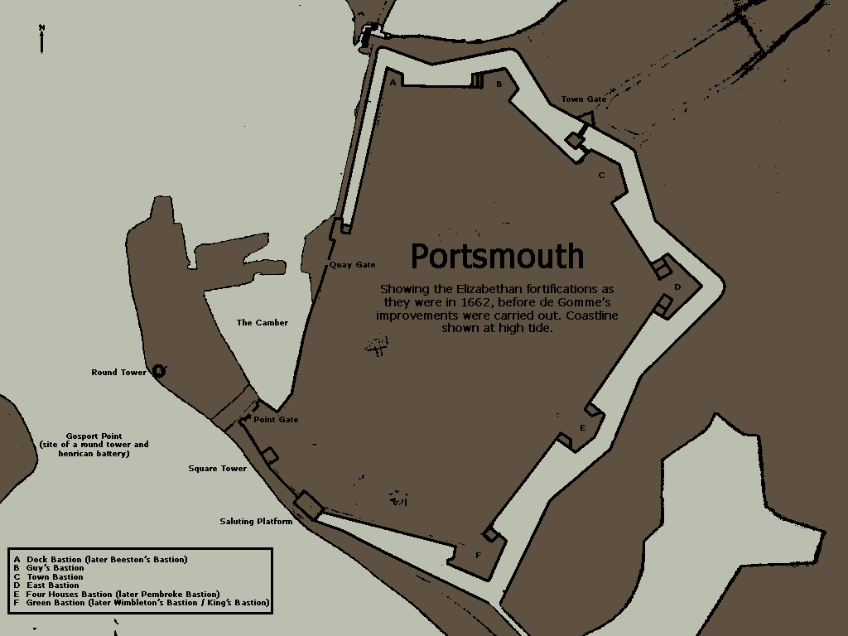
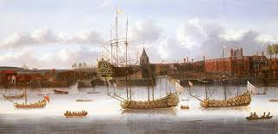
CHATHAM’S RIVALS
PORTSMOUTH FOUNDED BY HENRY VII
DEPTFORD- FOUNDED BY HENRY VIII

Slide 4
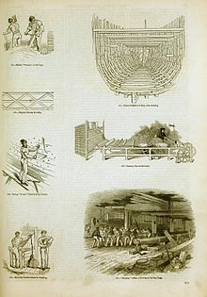
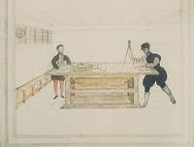
MATTHEW BAKER
MATTHEW BAKER – MASTER SHIPWRIGHT 1572

Slide 5
CHATHAM’S PRIMACY
ADMIRAL MUNSON – CHATHAM SAFER WITH
HIGHER SPRING TIDE
1611 – STATE ENQUIRY
LODGING ALLOWANCE ATTRACTED SKILLED WORKERS & GREW TOWN
DESPITE WARNINGS OF SILTING –CHATHAM CHOSEN FOR NEW DOCKYARD

Slide 6
SAMUEL PEPYS
1660 – WORKFORCE = 800
PEPY’S FIRST VISIT 1661 – AUDIT
DUTCH WARS & RESTORATION
SHEERNESS DEVELOPED AND UNDER CONTROL OF COMMISSIONER AT CHATHAM

Slide 7
18TH CENTURY
FINANCES RESTORED 1684 & YARD EXPANDED UNDER CHARLES II THEN WILLIAM III
CHATHAM NOW AT HEAD OF ROYAL DOCKYARDS. PORTSMOUTH, WOOLWICH, DEPTFORD & SHEERNESS HAD 5 DRYDOCKS IN TOTAL, CHATHAM 4
ONLY CHATHAM & WOOLWICH HAD ROPEYARD (ROPERY)
18TH CENTURY GLOBAL CONFLICT SAW ENLARGEMENT OF PORTSMOUTH & DEVELOPMENT OF DEVONPORT (PLYMOUTH)
‘BY MID 1700’S DEVONPORT HAD SAME SIZE WORKFORCE
CHATHAM SPECIALISES IN CONSTRUCTION NEW WARSHIPS (INC HMS VICTORY) & HEAVY REPAIR WORK
OTHER YARDS USED FOR MOBILISATION, FITTING OPUT & LIGHTER REPAIR WORK

Slide 8
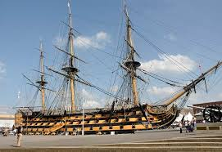
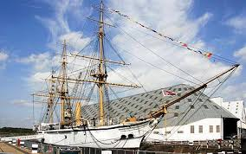
INDUSTRIAL REVOLUTION
DREDGING OF MEDWAY, RECLAMATION & NEW WALLS UNDER GEORGE PARKIN MASTER SHIPWRIGHT
NEW, STONE DRY DOCKS – JOHN RENNIE
MARC BRUNEL’S SAW MILL
ROOFING OF NEW DOCKS & SLIPS

Slide 9
INDUSTRIAL REVOLUTION 2
ERA OF REFORM - MANAGEMENT
1822 FOREMEN REPLACE TWO LEVELS OF SUPERVISOR
1832 SUPERINTENDENTS ACT
RETENTION NAVAL RANK & SENIORITY
WOMEN EMPLOYED IN COLOUR LOFT SINCE 18THC – WIVES OR DAUGHTERS OF THOSE KILLED IN SERVICE
MECHANISATION OF ROPERY INTRODUCED ‘OUTSIDE’ WOMEN IN 1864. NOT SHOWN THE RESPECT OF THE COLOUR LOFT & PAID LESS THAN MEN. HOURS OF WORK TO AVOID ENTERING & LEAVING DOCKYARD WITH MEN- SEGREGATION

Slide 10
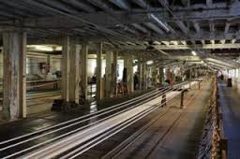
FROM ROPE…

Slide 11
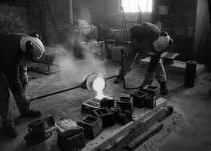
TO IRON & STEEL…

Slide 12
ST MARY’S ISLAND
1862-1885 – LARGEST CIVIL ENGINEERING PROJECT IN SE ENGLAND UNTIL CHANNEL TUNNEL
QUADRUPLES SIZE OF YARD
DEVELOPMENT OF FOUNDRIES, WORKSHOPS & BOLIERMAKING – A LEADING MILITARY INDUSTRIAL COMPLEX
SUPPLEMENTED BY GROWING PRIVATE INVESTMENT IN SHIPYARDS.
PRIVATE CONTRACTORS NEEDED FOR ARMOUR & OTHER SPECIALISED MATERIAL
BY 1885 CHATHAM THE ‘RECOGNISED LEAD GOVERNMENT DOCKYARD’ FOR ANY NEW CLASS OF BATTLESHIP UNTIL…

Slide 13
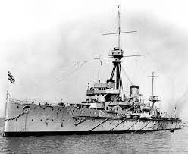
DREADNOUGHT

Slide 14
TOWARDS WW1
CHATHAM LOSES STATUS TO PORTSMOUTH FOR NEW BATTLESHIPS – DEBATE OVER CAPACITY – 8 & 9 SLIPS BIGGER THAN PORTSMOUTH
CHATHAM WORKFORCE RUN DOWN IN 1880’S BY GROWTH OF PRIVATE INDUSTRY & REVIEW OF SELF CONTAINED YARDS IN TIME OF PEACE
NO EFFECTIVE UNIONS – OVER 1000 DISCHAARGED – PRESSURE ON LOCAL POOR RELIEF
1890’S GROWTH IN STRONGER UNION MEMBERSHIP
SUBMARINE CONSTRUCTION , REPAIRS & WOMEN IN DILUTED LABOUR. WORKFORCE REACHES 11,000 1918

