Slide 1
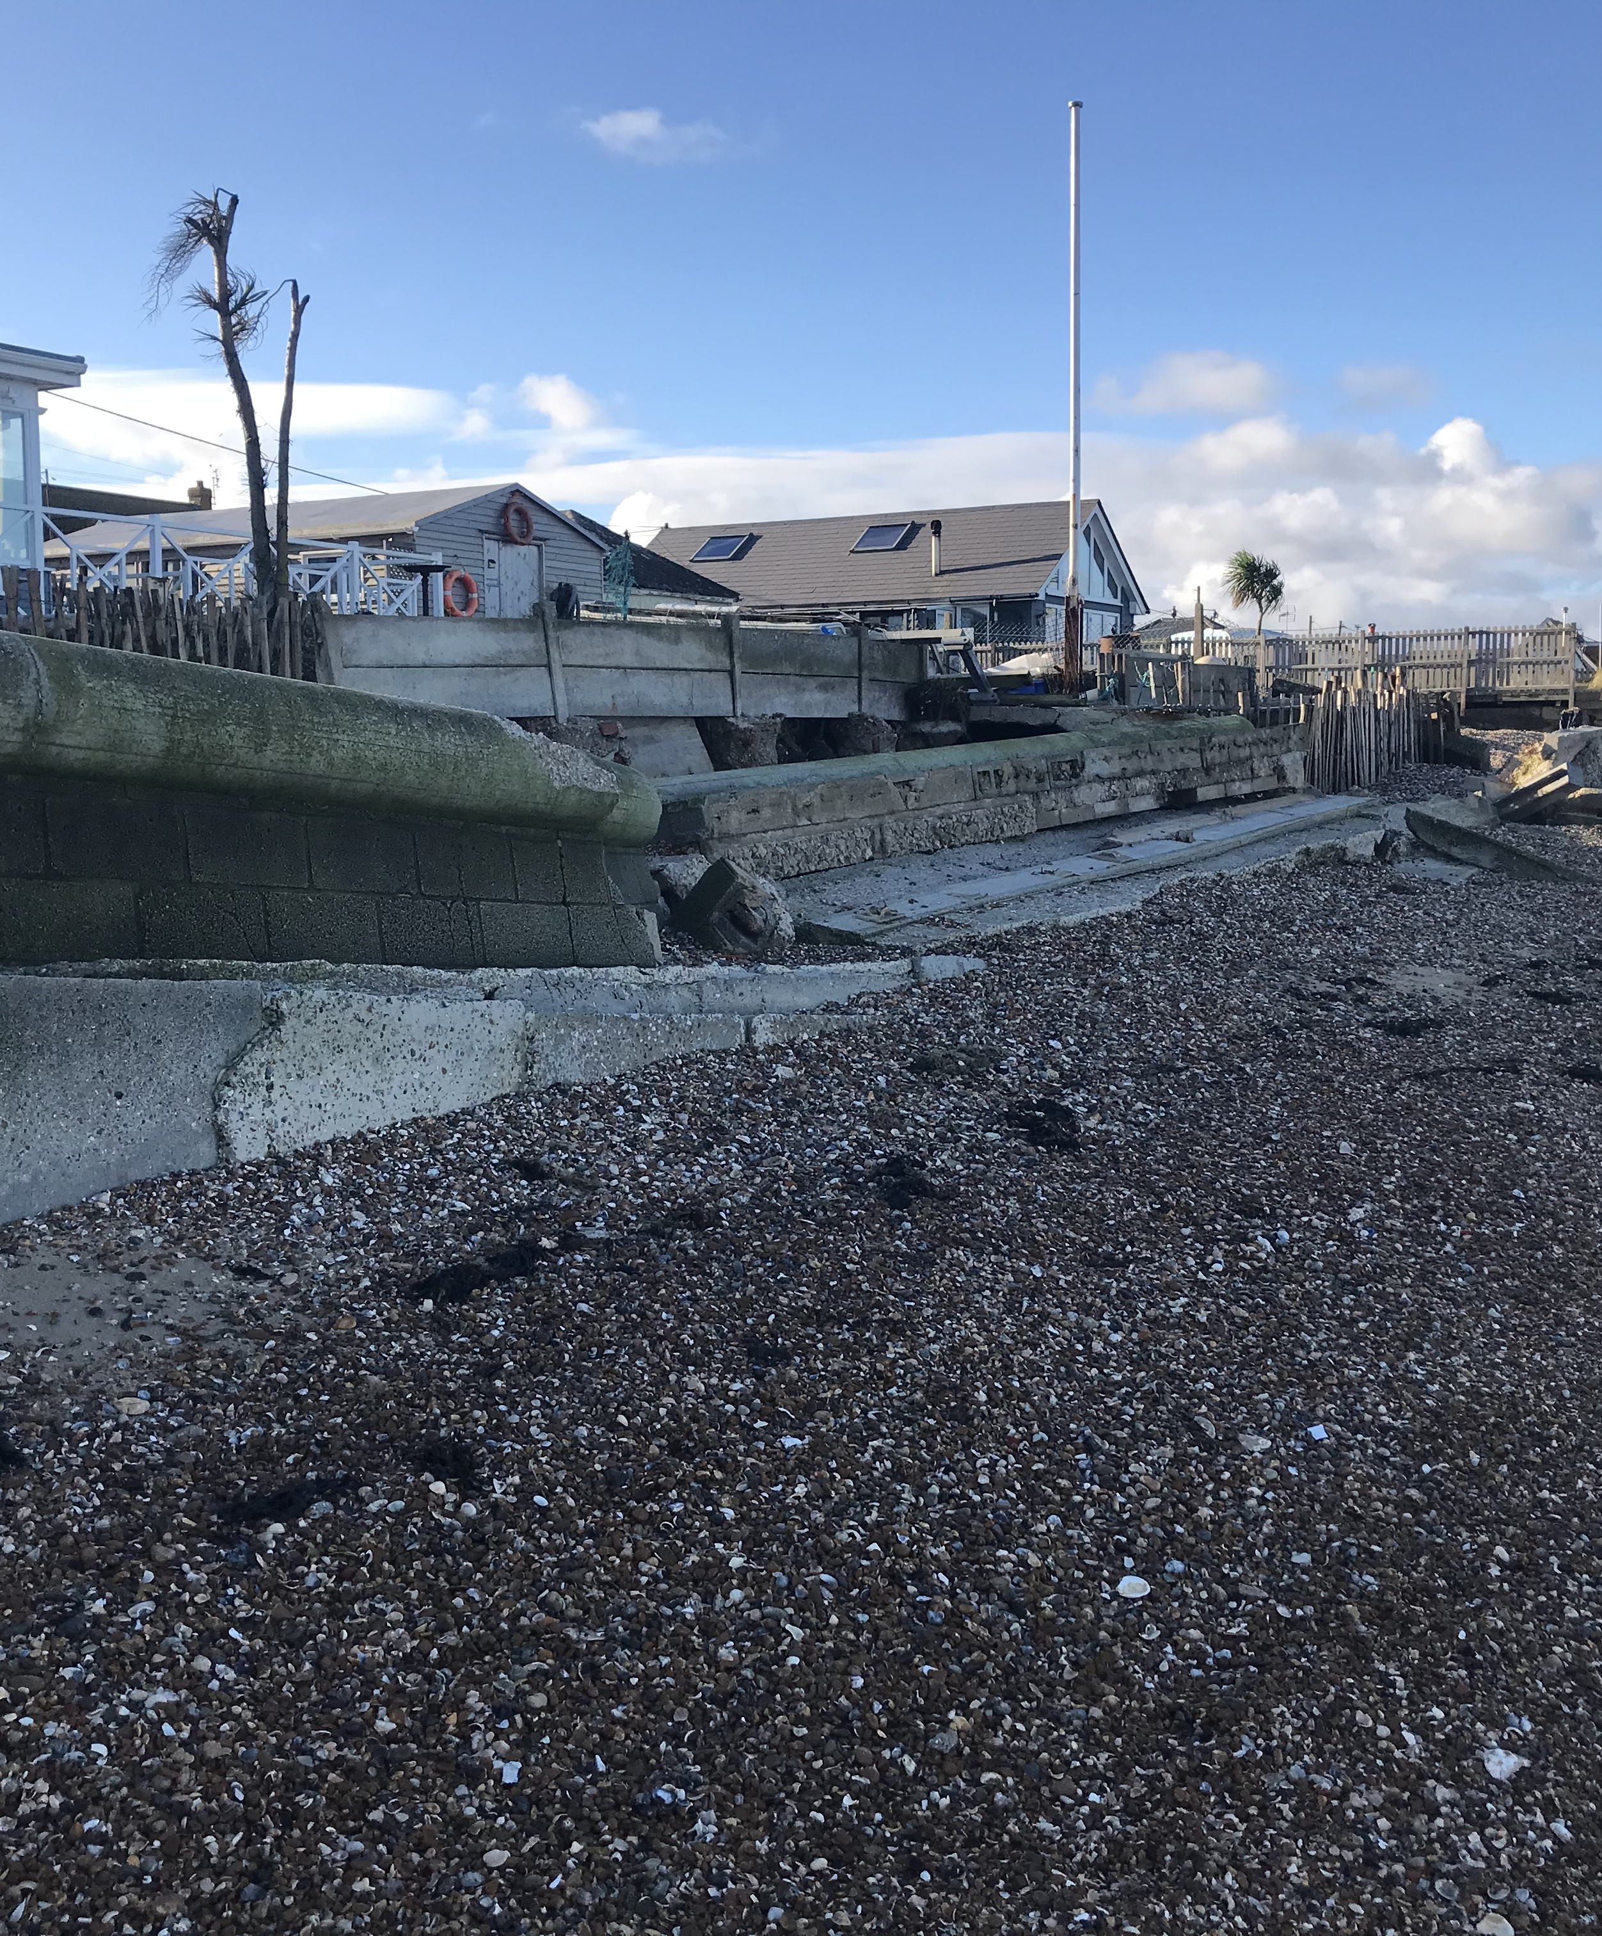
Coastal dwellers and community representation
Dr Chris Blunkell
CCCU Business School
28 June 2024

Slide 2
“Some adaptation discussions and decisions about managing future flooding and coastal change will be inherently political and contentious. Careful attention needs to be paid to developing engagement methods that consider both representation (of community groups and interests) and the representativeness (the extent to which participants represent the wider community.” (EA, 2020)

Slide 3
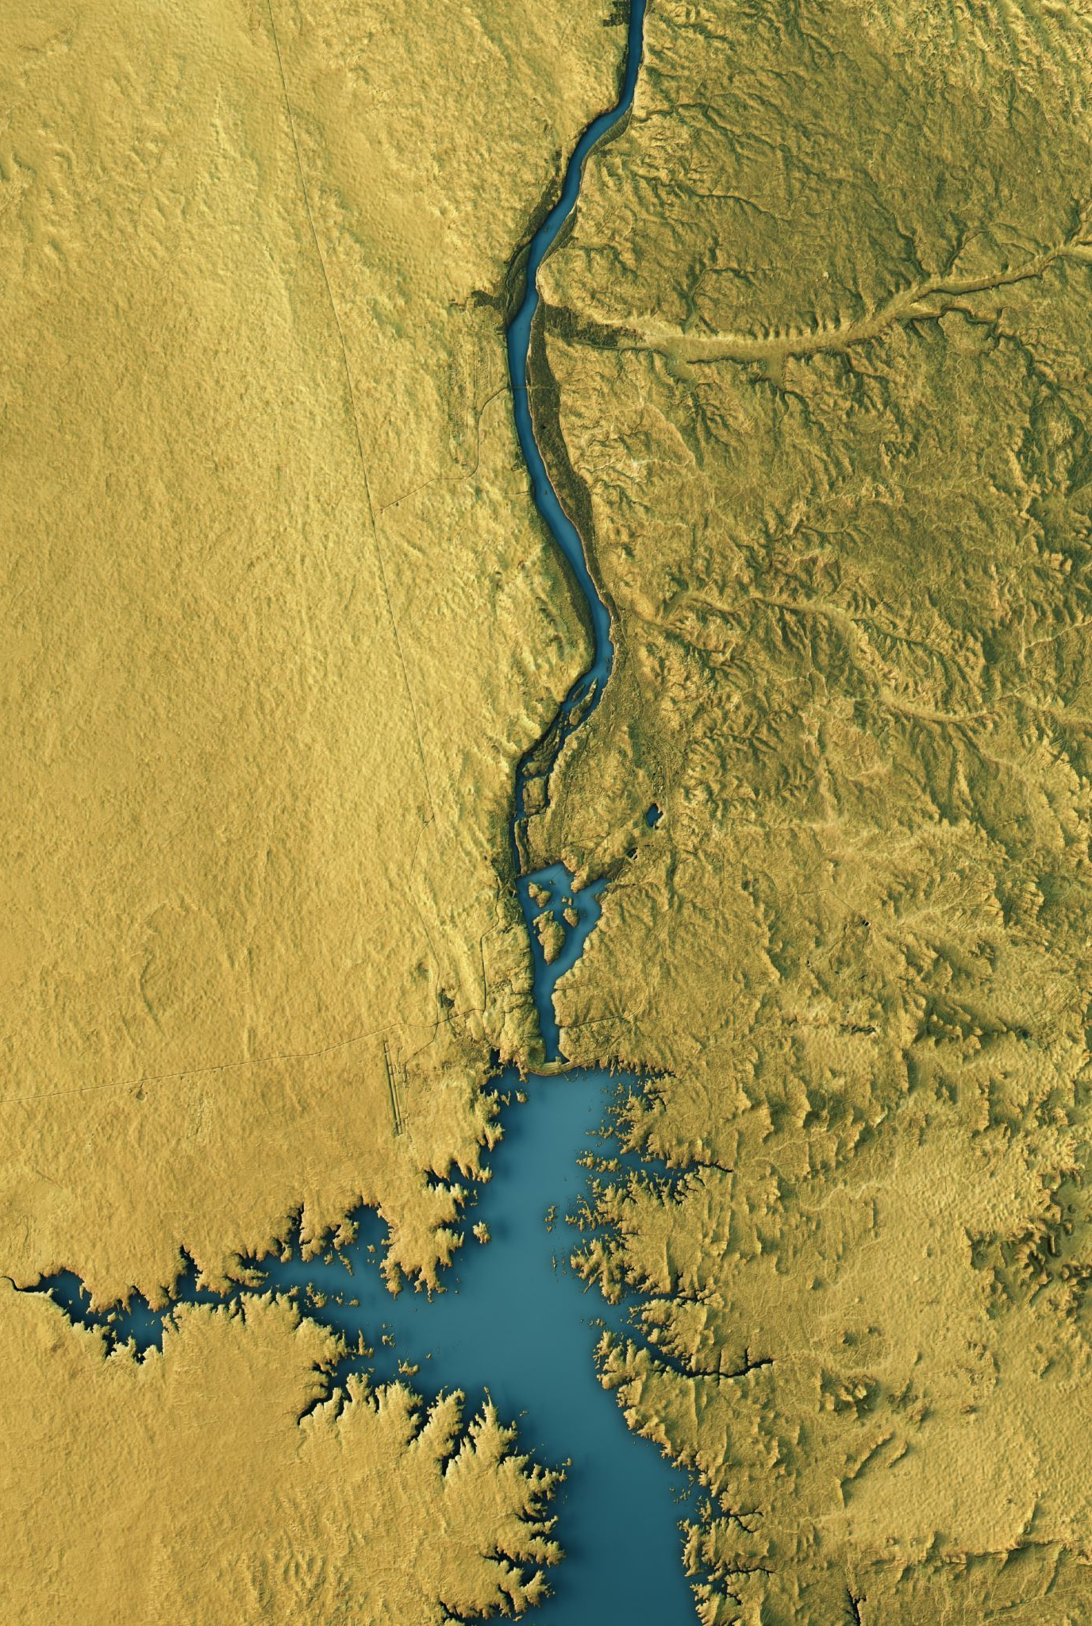
The context
Flood and coastal erosion risk in England is expected to increase as a consequence of rising sea levels associated with climate change and development in areas at risk.
DEFRA has made explicit that government will defend the coast only where it is sustainable to do so, and that it will not compensate individuals for any loss of property.

Slide 4
The issue
Rising seas and coastal erosion could see between 120,000-160,000 properties – both residential and non-residential – at risk by 2050. (Sayers et al. 2023)
Planning for such change has required government to involve property owners in the making of adaptation decisions such as relocation (Tubridy et al. 2022).

Slide 5
Decision making - a tension
Bevan stresses that government owes it to "threatened communities themselves to help them decide what they want their long-term future to be. And we do need to explore the biggest possible range of options and be prepared to innovate if we are to offer communities the best set of choices." (2022)
He adds: "Engagement can be particularly challenging where the options...may be limited..." (Ibid.)

Slide 6
What does this mean?
An evidence review commissioned by government places stress of the importance of learning from these programmes, and recommends a 'co-production methodology' (EA 2019) involving local residents as well as technical specialists and others.
It also suggests a 'discursive approach' to reaching decisions on the course of action to take. Discourses, says Dryzek, are bound up with political practices and power and condition the perceptions and values of those who are subject to them. (2022)

Slide 7
Administrative rationalism
A problem solving-discourse which emphasises the role of the expert rather the citizen in social problem solving, and stresses hierarchy rather than equality or competition.
Home to a particular type of top-down planning involving general purpose policy analysis techniques with Utilitarian Cost Benefit Analysis a typical example.
Public interest reduced to a technical procedure that rests in the hands of experts.
Limited role for the public and no potential for changing the structural status quo.

Slide 8
Democratic pragmatism
Interactive problem solving within the institutional structure of liberal capitalist democracy
Main reason for democratisation comes from need to secure legitimacy for decisions involving a broader public against a backdrop of political disengagement (Hansard Society 2019) and falling trust in government (Monagu and Maplethorpe 2024).
Ideally, the public interest emerges through reasoned dialogue between participants with diverse interests. However, critics have expressed concern on the one hand that such exercises are vulnerable to the ways in which policy makers frame exercises and, on the other, that participants are too often either uninformed or unrepresentative.

Slide 9
Government's evidence review
A stress on:
"Clear, contextual and realistic engagement objectives."
Readiness
Literacy about environmental issues
Local awareness of risks and the need for adaptation
Opportunities to identify and work through emotional and or psychological responses
Capacity for informed appraisal of options
Capacity to collaborate in decision-making

Slide 10
Questions
Who decides what is realistic?
Who sets the options?
Is there a suggestion that people's responses need conditioning if they are to be admissable?
What happens to contest?
The answers to questions such as these will help us determine the nature of government's ambition.

Slide 11
What academic literature says
Limited critical understanding of which participatory approaches work and under what conditions, with few relevant studies conducted on a local scale. (Creed et al. 2018)
Doubts amongst stakeholders as to the robustness of decision-making processes, and in particular how contributions are received from the wider community. (Fletcher 2007)
Public participation in deliberative encounters characterised as ‘problematic’ and ‘tokenistic’. (van der Plank et al. 2022)
In many cases of participatory governance projects and interventions do not live up to their stated objectives. (Turnhout et al. 2015)

Slide 12
TROUBLEMAKERS AND TIMEWASTERS
Government's evidence review concedes that "increased engagement with stakeholders and/or local communities...has the potential to ‘be seen as a threat that may undermine the role of elected representatives and their professional staff...and can thus ‘lead to conflict with existing power structures and political cultures."
More pithily, the review poses the question: "Are some people just ‘troublemakers’ or ‘time wasters?'" (EA 2019)

Slide 13
Experiences of community actors
Interviews with people who represented coastal communities from locations earmarked for change
My own journal
Records of meetings
Email correpondence

Slide 14
A solitary activity...
Community representation in this context typically falls to few people, and sometimes individuals often working alone.
Others having also made commitments may drift away – for example, once it is sensed that a crisis has passed or the issue become less obviously pressing.
Some tend to work alone by preference, although people can also be slow to offer help.

Slide 15
"I went back to the group and said: ‘Look, things are moving and I’m having to make decisions on the run. I can’t keep coming back to you because that automatically puts in a two week delay and I need to answer people."

Slide 16
Shot by both sides
Besides scepticism on the part of authorities with regard to the legitimacy of community representatives, there is also evidence of a lack of faith amongst the very people they seek to represent.
"You’re stuck in the middle trying to explain ‘Look, that’s as much as we can get – I tried to get more, and I think on balance we should go for it’, and they might see it more simplistically because they haven’t been involved in the negotiation, so they’re saying ‘No, we want this, this and this.’ So then you feel like you’re in the middle between these two sides."

Slide 17
The legitimacy question
Community representatives are alert to the difficulties posed by such working arrangements and rely on the support and understanding of those they represent.
Responding appropriately and in timely fashion can preclude representatives 'taking people with them', and in so doing build capacity. Regular meetings for catching up and prioritising can be an important counterweight to this.

Slide 18
The learning requirement
The policy picture is complex and the actors various. For some, if not all, representation requires significant learning – a challenge clearly differentiated by background and existing levels of education, and which can be daunting and require massive effort by way of response.
"I had no idea of the extent to which I would have to learn – it was absolutely huge. The more I scraped the surface the deeper it became, and there was a point early on when I thought: ‘Oh, I can’t do this’. You ask one question, you get an answer that poses three more questions, and you’ve got to go away and research and find out."

Slide 19
The time commitment
Constraints upon time are a key factor in people's decisions on whether or not to participate in collective action.
"Some people it’s time to try and change anything...they think ‘Oh Christ, I’m whatever age I am, sod it – I’m not going to spend the next five years, or ten years, fighting this thing! So, for various reasons, you end up with just a very few people doing it."

Slide 20
Time and work
One interviewee estimated their commitment to have been 13-14,000 hours, and another 8,000. One observed that her involvement had "taken over her life."
Employment type and status is pivotal: one respondent observed that she found it hard to see how anybody who is not freelance or retired could do it. She explains:
"The people I work for, they've now got used to ringing me up and saying: 'Is it alright if we send you some work or are you going to a meeting today?'"

Slide 21
Financial implications
All of those working reported major setbacks in terms of earnings as a consequence of their involvement. One calculated that an already low income had dropped by one third, and another that his earnings had 'plummeted'. Another observed:
"Financially, its crippling. It's cost the earth - tens of thousands of pounds. Obviously, because I freelance, if I don't work I don’t get paid."

Slide 22
Health and wellbeing
One community representative reported being denied badly-needed rest and taking unpaid time off work during a particularly active period. Another referred to the 'emotional stress' that accompanied his efforts:
"In the end I actually blacked out, I had that much stress! At the end of the week, the worst week, I just collapsed. It's never happened before - I was speaking to my wife, and the next thing I know I was on the floor."

Slide 23
Health and wellbeing (cont'd)
There is evidence of guilt associated with this work - the feeling that somehow community representatives are sacrificing their families to this pursuit; through their lack of earnings, or attention, or both. One explained with regard to his family’s increased reliance on his wife’s earnings:
"It actually feeds into your sort of self-esteem that you're not doing work, you're not earning money."
Another that:
"It isn’t until you get to the other end of it that you realise what it's done to you, and what it's done to those around you - and when you look at it like that, you do question in your own mind, was the price too high?

Slide 24
So why do they do it when others don't?
Community representatives appear to share a sense of overbearing and insensitive authority, and of an injustice being perpetrated - of some tacit principle being violated:
"I don't like old people who have worked all their lives being treated like a piece of garbage..."
"The massive injustice of the situation - that was a great motivator..."
"I remember one councillor saying to me 'What are you still doing? You've got what you wanted. I said: 'No I haven't – because it doesn’t change the principle!'"

Slide 25
An unsquarable circle?
What is the legitimacy standard community representatives are expected to satisfy?
How do we free community representatives of the necessity of working alone?
Should deliberative processes accommodate transformational rather than incremental challenge, and how might they?

Slide 26
A UNIVERSITY SHAPED HOLE
A network of universities from coastal areas where losses are anticipated:
To oversee robust and genuine co-production of deliberative processes, resulting decisions and learning
To lead the development of environmental literacy for all actors
To the lead the development of civic literacy for all actors
To provide practical support for community representatives.

Slide 27
CCCU Mission and VALUES
We value
the power of higher education to enrich individuals, communities, and nations
our friendly, inclusive, and professional community of students and staff, preparing individuals to contribute to a just and sustainable future. (CCCU no date [a])

Slide 28
CCCU VISION 2030 – OUR IMPACT
Forge and sustain strong meaningful partnerships
"…benefiting the wider population through our collaborative research, enterprise and active citizenship"
Influence regional strategy, national policy and professional practice
"We will apply our knowledge and research to simulate debate and influence decision making, nationally and internationally."

Slide 29
references
Bevan, J. 2022. When the levee breaks: climate change and the limits of flood protection. Transcript of speech delivered at Telford International Centre, Telford, 7 June 2022. Available from: https://www.gov.uk/government/speeches/when-the-levee-breaks-climate-change-and-the-limits-of-flood-protection [Accessed on 22/2/24].
Creed, R., Baily, B., Potts, J., Bray, M. and Austin, R. 2018. Moving towards sustainable coasts: A critical evaluation of a stakeholder engagement group in successfully delivering the mechanism of adaptive management. Marine Policy 90: 184-193.
Dryzek, J. 2022. The Politics of the Earth: Environmental Discourses. 4th edn. Oxford: Oxford University Press.
Environment Agency (EA). 2019. Community engagement on climate change – an evidence review. From the project: Working together to adapt to a changing climate: flood and coast. Available from: https://assets.publishing.service.gov.uk/media/60916d7be90e076ab6cbde1c/Community_engagement_on_climate_adaptation___report__3_.pdf [accessed 22 February 2024].
Environment Agency (EA). 2020. National Flood and Coastal Erosion Risk Management Strategy for England. London:EA.

Slide 30
references
Fletcher, S. 2007. Representing Stakeholder Approaches in Partnership Approaches to Coastal Management: Experiences from the United Kingdom. Ocean & Coastal Management 50 (8): 606-622.
Hansard Society. 2010. Audit of Political Engagement 16: The 2019 Report. London: Hansard Society.
Montagu, I. & Maplethorpe, N., 2024. Five Years of Unprecedented Challenges: The impact of the 2019-2024 Parliament on public opinion. United Kingdom: NatCen.
Milligan, J., O’Riordan, T., Nicholson-Cole, S. and Watkinson, A. 2009. Nature conservation for future sustainable shorelines: Lessons from seeking to involve the public. Land Use Policy (26): 203–213.
Sayers, P., Moss, C., Carr, S. and Payo, A. 2022. Responding to Climate Change Around England's Coast - the Scale of the Transformational Challenge. Ocean & Coastal Management 225.

Slide 31
references
Tubridy, F., Lennon, M. and Scott, M. 2022. Managed retreat and coastal climate change adaptation: The environmental justice implications and value of a coproduction approach. Land Use Policy 114.
Turnhout, E., Metze, T., Wyborn, C., Klenk, N. and Louder, E. 2020. The politics of co-production: participation, power and transformation. Current Opinion in Environmental Sustainability, 42, pp.15-21.
van der Plank, S., Brown, S., Tompkins, E. and Nicholls, R. 2022. A typology of responsibility for coastal flood risk adaptation. Frontiers in Marine Science: 1-27. doi: 10.3389/fmars.2022.954950.

