Slide 1
Further explorations of enhancing creative problem solving via structured thinking techniques
Ian Hocking and David Vernon
School of Psychology, Politics & Sociology, Canterbury Christ Church University, Canterbury, Kent. CT1 1QU, UK.
Slides: bit.ly/2rpniWi WWW: bit.ly/cncCCCU @psych_ian

Slide 2
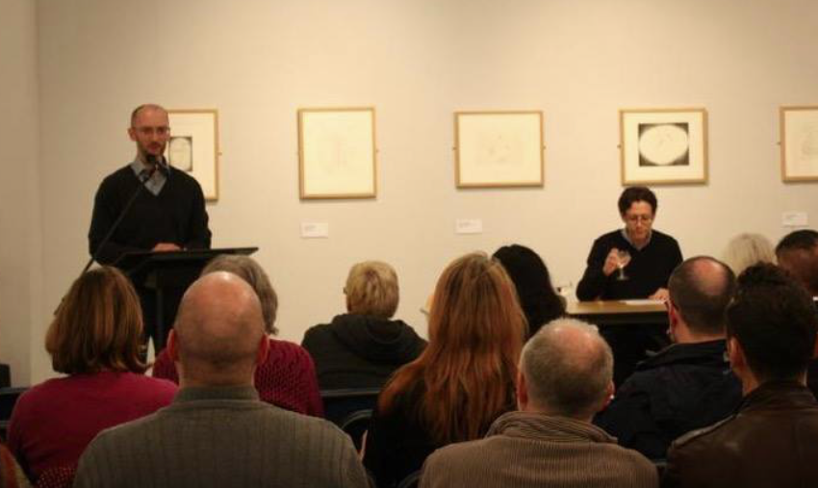
My background
Creative writing
Language
Capacity issues in parsing…creative writing…creativity

Slide 3
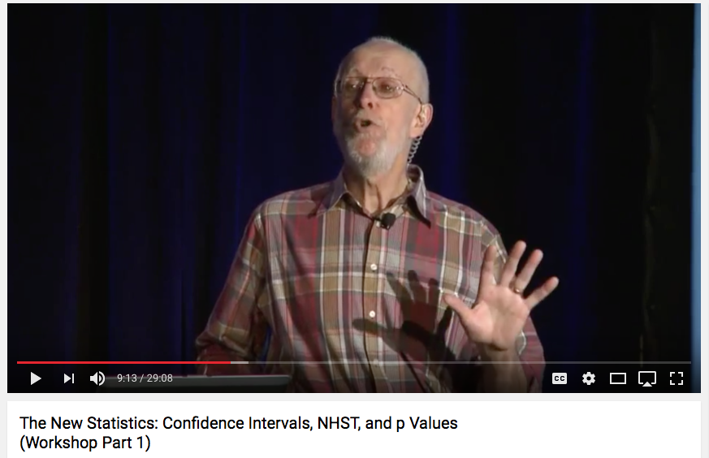
Creative Problem Solving
Every human advance starts with someone being creative
We need a quantitative, cumulative science (Cumming, 2014)

Slide 4
CPS: Three Stages
Finding
Solving
Evaluation
What’s the problem?
What solutions can I come up with?
Which solutions are best?

Slide 5
Problem Finding
Finding
Problem finding/construction an important first stage in creative problem solving (e.g. Nickerson, 1999)
Typical study:
Simple problem: I’m in a new city and need dinner
Participants read problem scenario (Paletz & Peng, 2009, p. 5)
What food do I like? Where can I find a map? Who am I with? Great food or cheap food? What about my allergies? …
Participants produce elaborations/restatements

Slide 6
Problem Solving
Solving
Simple problem: There are mice in my house
Participants read problem scenario (Paletz & Peng, 2009, p. 5)
Participants produce solutions
What devices can I use to catch them?

Slide 7
Measuring Performance
What devices can I use to catch them?
Fluency: How many solutions overall? (Fontenot, 1993)
Flexibility: How many separate ideas? (Sowden & Dawson, 2011)
Originality: How infrequent is the idea compared to others in the sample? (e.g. Mumford et al., 1996)
Quality: How useful/appropriate is the solution? (Getzels & Smilansky, 1983)

Slide 8
Why Might a Technique Help?
Greater effort may produce more original and higher quality solutions (Mumford, Reiter-Palmon, & Redmond, 1994)
Identifying more perspectives increases the probability of finding useful ideas to pursue (Sowden, Pringle, and Gabora, 2015)
Evidence that programmes help (Scott et al., 2004), but what about techniques?

Slide 9
Six Hats
(de Bono, 1989)
Participant puts on metaphorical hats coloured white, green, yellow, black, red, blue (for information, creativity, positives, negatives, emotions, meta)
Participant applies the question words who, what, when, where, how and why
Six Men
(Kipling, 1902)
W
W
W
W
H
W

Slide 10
The Story So Far (1)
Vernon and Hocking (2014)
1. Compared with controls, Six Hats and Six Men improved fluency and originality but not flexibility or quality (simple problem; problem finding)
Consistent with: Structured thinking works
Vernon and Hocking (2016)
2. Compared with placebo, Six Hats and Six Men improved originality; Six Men improved flexibility and fluency (simple problem; problem finding)
Structured thinking is more than ‘empty structure’

Slide 11
The Story So Far (2)
Other data (in submission)
3. Compared with placebo, Six Men improved fluency, beat Six Hats for flexibility but not controls, and similarly beat Six Men but not controls for quality; no effect for originality (complex problem; problem finding)
Six Men less effective for complex problems (when compared to placebo)
4. Compared with controls, Six Hats and Six Men improved fluency, flexibility, and quality; but not originality (complex problem; problem finding)
Structure again generally effective for complex problems (when compared to controls)

Slide 12
The Present Study: Rationale
Given the variety of our findings so far, can we see whether the order of the elements (‘hats’ or ‘men’) influences performance?
For the Six Hats, Paterson (2006) has suggested that ‘certain sequences work better than others’ (p.11), but, as yet, there is no clear evidence to support such a claim
We might expect an Order interaction for Six Hats, less so for Six Men; and Technique main effect where structured thinking is better than controls

Slide 13
‘Complex’ Problem Scenarios
You are a scientist who is studying monkey behaviour in Africa. You see some of the monkeys eating dirt. Usually they just eat leaves and fruit.
Pretend you are a scientist studying climate change using historical geological and fossil evidence. You notice that in the past, a very short period of global warming (say, 20 years) is followed by extremely cold weather for at least 100 years. It looks as though global warming might cause an ice age for the following century.

Slide 14
Method
Participants: 107 (CCCU students, 86 female; mean age = 20 (range 18-25, SD 2.15)
Randomly allocated to Technique condition (between participants variable)
Constrained to use the technique in both Forwards and Reversed versions
Hats, forward: White (information), Green (creativity), Yellow (positives), Black (negatives), Red (feelings), Blue (meta)
Men, forward: Who, What, Why, When, Where, How
Responses entered into text boxes (4 boxes per technique element)
Responses blind-coded

Slide 15
Method

Slide 16
“You are a scientist who is studying monkey behaviour in Africa. You see some of the monkeys eating dirt. Usually they just eat leaves and fruit.”
Participant number 1, response 2 (of 10)
“Try to encourage them to eat the leaves.”
Fluency (overall): 10
Flexibility (for this solution): 1; idea coded as ‘PER_1’
Quality (for this statement; on a scale of 1-5): 3
Originality (for this solution):
= 1 – ( frequency of this idea / total number of ideas)
= 0.3

Slide 17
Results
 | Fluency | Flexibility | Quality | Originality
Six Hats (n=38) | 15.84 (3.91) | 10.32 (2.18) | 2.42 (0.07) | .96 (0.01)
Six Men (n=34) | 18.82 (5.92) | 12.58 (4.06) | 2.77 (0.09) | .96 (0.02)
Controls (n=35) | 15.07 (5.82) | 8.86 (3.17) | 2.92 (0.10) | .97 (0.01)
Means and standard deviations (hot off the press)

Slide 18
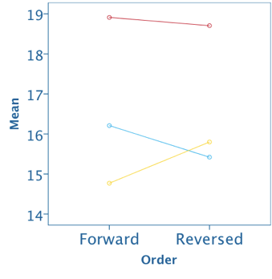
Fluency
Main effect of Technique F (2,104) = 4.88, p = .009
Six Men better than Six Hats (p = .041) and Controls (p = .014)

Slide 19
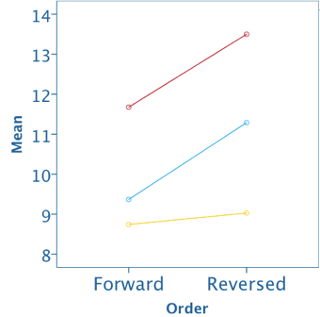
Flexibility
Main effect of Technique F (2,104) = 11.75, p < .001)
Six Men better than Six Hats (p = .01) and Controls (p < .001)
Main effect of Order F (1,104) = 10.05, p = .002)
Reversed shows improvement

Slide 20
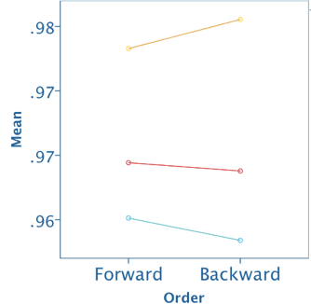
Originality
Main effect of Technique F (2, 104) = 28.33, p < .001
Six Hats worse than Controls (p < .001); Six Men marginally better than Six Hats (p = .062)

Slide 21
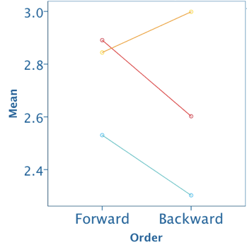
Quality
Main effect of Technique F (2, 104) = 9.23, p < .001
Six Hats worse than Control (p < .001), Six Men better than Six Hats (p = .022)

Slide 22
Conclusions
Six Men were the same or better than Six Hats for fluency, flexibilty and quality. Is this because Six Hats is harder/requires more training? Less suitable for these problems?
Six Hats worst for originality and quality. Why? Controls and Six Men Ps might experience less cognitive load during testing. Are these DVs more sensitive to load?
Why worse than controls, unlike findings of Vernon and Hocking (2014)? In the present study, participants forced to use particular technique elements, losing the advantage of ad hoc selection; VH was problem finding, not solving.

Slide 23
Conclusions
Main effect of Order isn’t so interesting because Control (and the Six Men, somewhat) are not predicted to show Order differences.
Is there another ‘goldilocks’ order for either Six Men or Six Hats that we haven’t tested? Possibly.

Slide 24
Future Directions
Use of technique may sometimes act as a burden
Cognitive load
Complexity of the problem—contributing to load?
Fixed problem effects?
Level of training/familiarity

Slide 25
Thanks
My colleague, David Vernon
Coders
Tammy Dempster
Lynn Nichols

Slide 26
References
Cumming, G. (2014). The New Statistics: Why and How. Psychological Science, 25(1), 7–29. https://doi.org/10.1177/0956797613504966
De Bono, E. (1989). Six thinking hats. Taylor & Francis.
Fontenot, N. A. (1993). The Effects of Training in Creativity and Creative Problem-finding Upon Business People as Measured by Fluency, Flexibility, and Quality of the Problem Statement. The Journal of Social Psychology, 133(1), 11–22.
Getzels, J. W., & Smilansky, J. (1983). Individual differences in pupil perceptions of school problems. British Journal of Educational Psychology, 53(3), 307–316.
Mumford, M. D., Baughman, W. A., Threlfall, K. V., Supinski, E. P., & Costanza, D. P. (1996). Process-Based Measures of Creative Problem-Solving Skills: I. Problem Construction. Creativity Research Journal, 9(1), 63–76.

Slide 27
References
Mumford, M. D., Reiter-Palmon, R., & Redmond, M. R. (1994). Problem construction and cognition: Applying problem representations in ill-defined domains.
Nickerson, R. S. (1999). Enhancing Creativity. In R. J. Sternberg & T. I. Lubart (Eds.), Handbook of creativity. Cambridge: Cambridge University Press.
Paletz, S. B. F., & Peng, K. (2009). Problem Finding and Contradiction: Examining the Relationship Between Naive Dialectical Thinking, Ethnicity, and Creativity. Creativity Research Journal, 21(2–3), 139–151. https://doi.org/10.1080/10400410902858683
Paterson, A. (2006). Dr Edward de Bono’s six thinking hats and numeracy. Australian Primary Mathematics Classroom, 11(3), 11–15.
Scott, G., Leritz, L. E., & Mumford, M. D. (2004). The effectiveness of creativity training: A quantitative review. Creativity Research Journal, 16(4), 361–388.

Slide 28
References
Sowden, P. T., & Dawson, L. (2011). Creative feelings: the effect of mood on creative ideation and evaluation, 393–394.
Sowden, P. T., Pringle, A., & Gabora, L. (2015). The shifting sands of creative thinking: connections to dual-process theory. Thinking & Reasoning, 21(1), 40–60.
Vernon, D., & Hocking, I. (2014). Thinking hats and good men: Structured techniques in a problem construction task. Thinking Skills and Creativity, 14, 41–46. https://doi.org/10.1016/j.tsc.2014.07.001
Vernon, D., & Hocking, I. (2016). Beyond belief: Structured techniques prove more effective than a placebo intervention in a problem construction task. Thinking Skills and Creativity, 19, 153–159. https://doi.org/10.1016/j.tsc.2015.10.009

Slide 29
Appendix

Slide 30
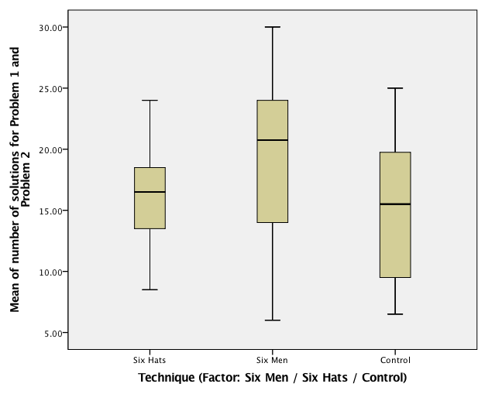

Slide 31
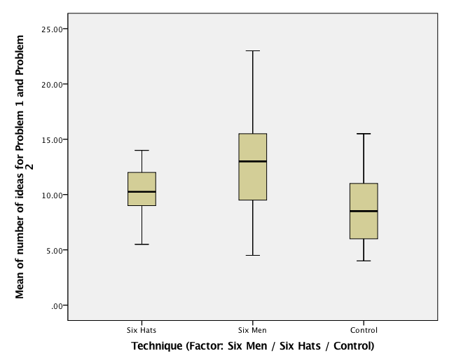

Slide 32
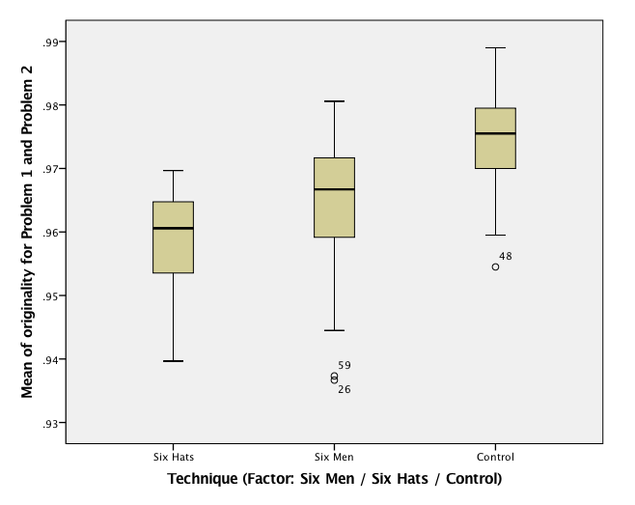

Slide 33
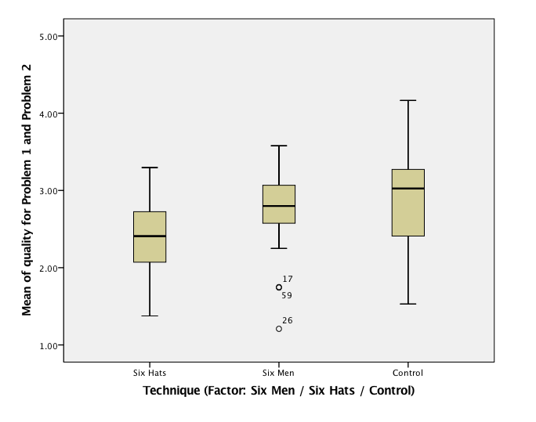

Slide 34
Coding Protocol (1)
Quality/Usefulness of each response (coded on a scale from 1=very low to 5=very high)According to Mumford et al. (1996) high quality responses may be reflected in the definitions of a problem situation that are appropriate and likely to result in a logical, workable approach to the situation. Hence, with regards to quality/usefulness we are interested in appropriate restatements/questions that could lead to logical/workable solutions.
Taking each restatement/question in turn and assess according to the following 5 levels:
very low quality, restatements/questions are not useful or appropriate
low quality, most restatements/questions are not useful and there is little logic and coherence
average quality, some restatements/questions are useful, some logic
high quality, most restatements/questions are useful and logical
very high quality, all restatements/questions are very useful and very logical
Alongside each restatement/question participants have ‘ranked’ their own efforts, simply enter the rank they give each restatement/question into the spreadsheet.

Slide 35
Coding Protocol (2)
Flexibility of overall responses
Based on work assessing the number of different conceptual categories into which the total responses can be classified (Sowden & Dawson, 2011; Wang & Horng, 2002). This involves identifying and generating the conceptual descriptions (e.g., health, diet, boredom, loneliness, time) and then classifying the responses according to the descriptions. Hence, need to identify the conceptual categories and then count them. This provides an ‘overall’ score of flexibility. Need to enter the data into the sheet ‘Flexibility_detailed’ which automatically sums the number of categories – need to keep that in mind if you insert new categories. No need to transfer the total to the ‘Main’ sheet we can do this later with a simple copy and paste.
Originality of each response
Sowden and Dawson (2011) and use a formulaic approach where originality = 1 – the frequency of a given solution / the total sample size. Hence, this will need to be coded on-line in the sense that each response will need to be classified, allocated a code (e.g., HLTH_1 or LOC_1; see ‘Originality_detailed’ sheet) and then we will need to know how many other people in the sample came up with a similar type of restatement/question. So you need to identify what ‘code’ each response should be allocated (may require you to generate more codes) and give it that code.

