Slide 1
Open Access… but not as we know it
Claire Choong
LRS Seminar
6th June 2017

Slide 2
Background: Open Access in the humanities and social sciences
Notes:
https://www.flickr.com/photos/opensourceway/6555466069/
What does Open Access mean in the humanities and social sciences?
Open access monograph publishing is an issue specific to the humanities and social sciences. [?]
Most humanities and social sciences research output is in the form of monographs, whereas the sciences mainly show their output in the form of journal articles.
A monograph and a journal article are very different, and therefore have different ‘needs’ in terms of open access. Journal articles are usually written quite quickly and have a particular structure; they are written to fulfil a specific objective and are seen as a means to an end. However, in the humanities the book (monograph) is the principle research output. These are written over a longer period of time and are longer and less structured.
The production of the book is the end in itself – its objective is to start a dialogue, not necessarily to provide answers. ‘All’ it can change are the ways events, people or works are interpreted or talked about. (Bass and Edwards, 2013, OAPEN Conference report)

Slide 3
Definitions
Notes:
https://www.flickr.com/photos/louleguilloux/8253842072/
“A detailed written study of a single specialized subject or an aspect of it” (Oxford Dictionaries)
‘Mono’ therefore refers to the content: it is about one subject. (Bass and Edwards, 2013 OAPEN Conference report).
An OA monograph is an electronic book which is publicly available via the internet - an e-book which is freely available to anyone without fees, subscription of membership of a library or institution. (Bass and Edwards, 2013)

Slide 4
Issues (1): academic culture
Notes:
https://www.flickr.com/photos/bookmouse/6447238077/in/album-72157629380364622/
The publication of a monograph is commonly regarded as vital for career progression in many academic disciplines – early career academics who choose to publish OA might miss out on the recognition and status that comes with publishing with a perceived ‘good quality’ publisher, even though their monographs would probably gain more readers if published via OA.
Also, there is a fear that publishing via OA might imply that their work is not good enough to be published the usual way by a recognised publisher such as Oxford University Press.
This is connected to worries about the quality of OA publishing – what controls are in place? How is it different to vanity publishing? What happens to the peer review and editorial processes?
There is a perception that peer review is not undertaken in OA publishing with the same rigour as with traditional print monograph publishing. However, this is not the case (Collins et al, 2015). Many publishers who offer OA will actually be more rigorous in their peer review process for OA publications in order to reinforce their academic credentials. The Directory of Open Access Books (DOAB) is a resource for academics who want to check the credentials of OA publishers (Collins et al, 2015).
Interestingly, there is an ongoing debate about peer review, with a hope to improve the process. Big name publishers, such as Palgrave Macmillan, are currently trialling open peer review after consultation with their monograph authors. Open peer review involves such things as naming reviewers and making reviewers’ comments public for authors and others to respond (Collins et al, 2015).

Slide 5
Issues (2): sales & costs
Notes:
http://bit.ly/2rf1ppA
In the last 20 years monograph sales have declined from an average of 2000 to just 200 sales per title.
Research outputs are not being read – in which case there is not much point in doing the research in the first place. The humanities are not achieving open discussion and academic debate.
A new business model is required for the monograph to survive [why should it survive?] and for the Humanities and Social Sciences research output to remain relevant in the digital age. (Bass and Edwards, 2013).
The cost of the average monograph has increased to about £100. The fewer sold, the more expensive they become. (Bass and Edwards, OAPEN Conference report, 2013)
However, Crossick suggests that “the arguments for open access would appear to be for broader and more positive reasons than solving some supposed crisis.” (2015, p. 4)

Slide 6
Benefits of OAMs
Notes:
http://bit.ly/2qwPna5
Summarised by Rupert Gatti, Open Book Publishers, Director of Studies in Economics, Trinity College, Cambridge:
Broader readership – increase access to readers not connected with an institution. Gatti claimed that his OA titles averaged 506 readers/month – more readers in one month than entire sales for a traditional monograph. (Bass and Edwards, OAPEN Conference report, 2013). Also allows a wider readership in terms geographical and socio-economic status due to reduced/lack of cost (subject to availability of internet).
Reader interaction – a new peer review model at pre- and post- review. Readers can leave comments and build up a dialogue, which is what is wanted in arts and humanities research. New ‘peer review’ for all to see and participate in (Bass and Edwards, OCR, 2013)
Opportunities for multimedia publications, e.g. overlay maps, incorporating text with video and music, audio and web apps
Relate research to primary sources – connect back to digitised archive
Innovations in research and dissemination – can be done by the academic community not just commercial publishers
Reduced costs of text translation – enables non-native English speakers to be internationally competitive
Use in teaching: a monograph published in OA is easier to use in teaching and can be more easily incorporated into teaching materials (Collins et al, 2015)
Evidence for the above benefits is still being gathered as OA monograph publishing is still new, but OAPEN_NL, run over a single year has found that, on average, discovery of OA books (measured by book visits in Google Books) increased by 142% and online usage (measured as page views in Google Books) increased by 209%.

Slide 7
OAMs & research funding
Notes:
http://bit.ly/2qx2XKl
http://osc.cam.ac.uk/monographs/open-access-and-monographs
Wellcome Trust
In October 2013, the Wellcome Trust extended its open access policy to include scholarly monographs and book chapters authored or co-authored by Trust grantholders that arise as part of their grantfunded research.
Now applies to all grantholders. Grantholders are required to make scholarly monographs and book chapters available through PubMed Bookshelf and Europe PubMed Central (Europe PMC) as soon as possible, with a maximum embargo of six months.
Where a open access publishing fee is levied, such works must be available without embargo, and be licensed in ways which support their re-use
HEFCE
HEFCE set up the Monograph and Open Access Project with the Arts and Humanities Research Council (AHRC) and the Economic and Social Research Council (ESRC).
The report was released in January 2015.
HEFCE have stated they will consider the report and discuss its policy implications with the AHRC and ESRC but that they recognise that 'any steps towards policies for open-access monographs should be preceded by a thorough process of consultation and engagement'.
RCUK
The RCUK released their Review of the implementation of the RCUK Policy on Open Accessin March 2015.
The comment on monographs was: "There was also concern in some disciplines, notably the arts and humanities, that there could be a further extension of the policy to include monographs, as the Wellcome Trust has done. Learned societies in these disciplines thought any extension should be approached by RCUK cautiously.

Slide 8
Models of OAM publishing
Notes:
It is likely that a variety of business models will need to exist in order to support the varieties of AHSS research and the funding sources within it (Collins et al, 2015)
Gold (author payment)
Authors (or their funders or institution) pay a fee (book processing charge) to the publisher up front for OA. A range of payment models exist across established publishers, but also includes not for profit companies such as Open Book Publishers and Open Monograph Press. Typically the publisher will print on demand and see a hardback or paperback copy as well as providing the OA monograph.
Green
https://www.flickr.com/photos/tyle_r/5024834714/
Authors deposit their monograph(s) in an institutional repository. But embargoes are a problem – they can be very restrictive, e.g. Palgrave allow one chapter to be OA after 36 months. There is no equivalent of Sherpa/Romeo to check permissions for the deposit of OA monographs.
Also, book-based outputs (e.g. novels and plays) will remain in print for many years, making it hard to define an embargo period for these types of output (Collins et al, 2015).
Third party content is also an issue (as it is currently for theses). It would be important to ensure that third party content could be included in deposited versions of monographs. There are also concerns form authors over the version of their work that could be deposited in a repository, as things like typesetting and layout are much more important in a monograph (an end in itself) than they are for journal articles (means to ends)
Deposit of OA monographs in repositories is not very common – most monograph publishers do not have a public policy on repository deposit for books (Collins et al, 2015). Funders (e.g. HEFCE, AHRC) do not formally require researchers to deposit monographs in repositories although all encourage it.
Freemium
Publishers make basis HTML ‘read-online’ version available online for free and libraries pay through subscription/membership for formatted ‘premium’ versions (PDFs, edoc) with additional data. These premium sales then fund free version. E.g. Open Editions, OECD (Bass and Edward, 2013).
In some cases the publisher will also charge authors a fee if they believe that the premium versions will only partially cover their costs, although this is usually very low or can be waived in some circumstances. Examples of ‘freemium' publishers are OECD, Bloomsbury Academic, Open Book Publishers, Open Humanities Press (Collins et al, 2015).
In the ‘freemium’ model it is also possible for publishers to develop premium services aimed at libraries. E.g. offering libraries catalogue records for all the titles, usage data, discounts on print or e-book versions. By charging libraries for these premium services the basic OA version can be made available for free with no charge to the author (Collins et al, 2015).
Library consortia/partnerships (AKA collaborative underwriting)
Groups of libraries pay fixed costs for collections of OA titles. The cost per title or collection reduces with the number of participating libraries. E.g. Knowledge Unlatched (Bass and Edwards, 2013).
The publisher is still able to sell print and e-book editions but the libraries that have contributed to the costs will often receive a discount on these because of their membership of the consortia and contribution to the cost of publishing the OA monograph. There is no charge to the author (Collins et al, 2015).
Groups of libraries contribute to fund the publication of open access books. By sharing the cost the libraries also share the risk. The consortium pays a fixed upfront fee which the publisher incurs pays for the publisher to publish the book online under a Creative Commons license. Publishers are able to create enhanced versions of the books for sale. The cost to each library for a book depends on the size of the consortium.
Altruists/crowdfunding
altruists or crowd funders pay for an OA monograph for the public benefit. This model is best for back titles, crowd sourced, e.g. Unglue.it
Selective open access
Some presses and learned societies subsidise OA monograph publishing via other activities they carry out, e.g. subscription income from a journal published by the society. A fee to the author is unlikely to be charged and the monograph will also be available for purchase in print (Collins et al, 2015).
Increased university press publishing
There is an increasing number of new open access university presses that receive subsidies from their institutions. The subsidies may be financial, but they may also be estate costs, services in kind, in house production equipment, staff expertise, etc., e.g. UCL Press and University of Huddersfield Press (Collins et al, 2015).
Researchers from the home institution might not need to pay a fee to publish their book in OA, but researchers from other institutions will. These presses often have a strong relationship with the university library. As with the gold-like model, these presses will still print on demand and sell a hardback or paperback copy in addition to making the OA version available.
Larger institutions could see benefits, e.g. Michigan, but librarians were sceptical – publishers are a professional business and universities do not have the resources/skills to do this (Bass and Edwards, 2013).
New open access publishers and presses face the same challenges as any new publisher in relation to prestige - they need to build a reputation. OA presses and publishers are trying to do this by setting up prestigious editorial boards and peer review panels.
Embargo/delayed open access
The monograph is published as OA after a pre-determined amount of time or after the publisher has recouped an agreed amount of money from sales of the print and/or e-book versions. This requires negotiation between the author and the publisher but the author does not have to pay a fee (Collins et al, 2015).

Slide 9
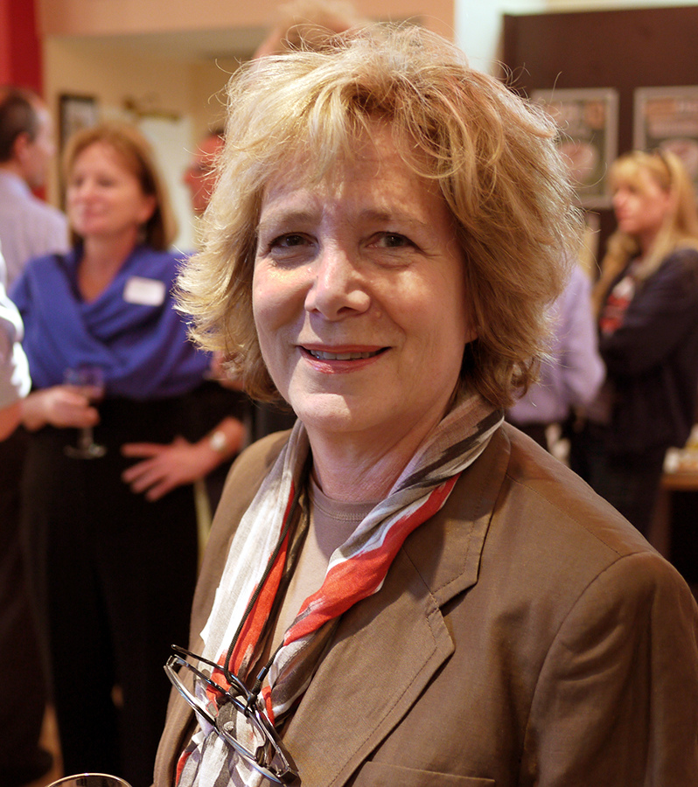
Knowledge Unlatched
“Free access to scholarly content for every reader across the world”
Notes:
Frances Pinter, Bloomsbury Academic & Knowledge Unlatched, photo by David Percy
http://bit.ly/2rQdAvI
http://www.knowledgeunlatched.org/
The Knowledge Unlatched model depends on many libraries from around the world sharing the payment of a single Title Fee to a publisher, in return for a book being made available on a Creative Commons licence via OAPEN and HathiTrust as a fully downloadable PDF.
The Title Fee represents the basic cost of publishing a book. Because the Title Fee is a fixed amount, as more libraries participate in Knowledge Unlatched, the per-library cost of ‘unlatching’ each title declines.
Access to the Title Fee allows publishers to feel confident that they will not make a loss on a title if it is made Open Access.
Publishers are willing to provide libraries with discounts and make books available on Open Access licences if they can be assured that their core costs will be covered.
Once it has reached scale, this model is expected to be financially self-sustaining: the costs of operating Knowledge Unlatched will be covered by a very small percentage of each Title Fee.
KU Select 2017 Collection
343 books available: 151 front list (Nov 2017-April 2018) and 192 backlist (2006-2016)
21 journals available (formerly closed and Open Access titles)
60 well-respected scholarly publishers participating on 5 continents including university presses, commercial publishers and Open Access publishers
Curated by the KU Title Selection Committee consisting of 40 librarians in 12 countries
17 subject areas in the Humanities and Social Sciences
Creative Commons licences - hosted by OAPEN and HathiTrust, also preserved by CLOCKSS and Portico.
http://support.knowledgeunlatched.org/ku-select-faq

Slide 10
BOOC
Notes:
https://ucldigitalpress.co.uk/booc-v1.1/BOOC/
Book as Open Online Content
Geoffrey Crossick’s report on Monographs and Open Access (HEFCE, 2015), he talks about the more ambitious ways open access allows authors and reviewers to interact. He talks about an ‘open-ended “living” document’, which is where BOOC takes its inspiration from. BOOC is a community ‘book’: a space where different approaches, different sorts of research, and different perspectives can be presented, read, and analysed together.

Slide 11
What does this mean for librarians?
Notes:
Moving away from traditional distribution channels so OA can be accommodated, e.g. Dawsons and Ebrary impose digital rights management on OA books.
Preservation and reliability – what if an OA provider ceases to exist? There are concerns about the long-term technical reliability of platforms
Change in processes of handling commercial e-books v. OA books – collection development, training and discoverability
In terms of metadata, will book and chapter level DOIs be needed? Will we need MARC records for each?
Hybrid OA monographs containing in- and out-of-copyright materials (OA and non OA material)
Is there a reference point for help with technical issues with OA books as with commercial e-book providers?
All institutional libraries will provide similar resources – it will be the quality of access and support provided that will stand out; not the collections.
Administering book processing charges will impact on staff resources and pressures on library budgets (if gold model followed)
Although a relatively new phenomenon, OA publishing for monographs already has significant support from some authors. The 2014 OAPEN-UK survey of over 2,000 researchers found that nearly 50% were ‘positive’ or ‘very positive’ about OA for monographs, with that proportion rising to 71% for PhD candidates. In addition, the DOAB now includes over 3,000 open access books from over 100 publishers (Collins et al, 2015).

Slide 12
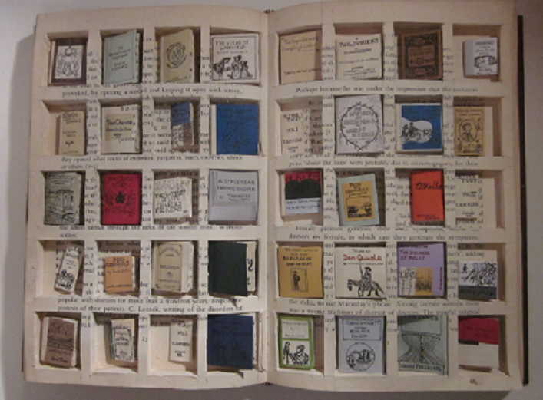
Metaphor for the Kindle
Notes:
http://rachelwalshillustration.tumblr.com/post/4183399323/final-outcome-for-interweb-project-metaphor-for
http://www.maria-fischer.com/project-5.html

Slide 13
Bibliography
Bass, R. and Edwards, K. (2013) Open Access Monographs in the Humanities and Social Sciences Conference 1-2 July 2013. Unpublished.
Collins, E., Milloy, C, Stone, C. (2015) Guide to Open Access Monograph Publishing for Arts, Humanities and Social Science Researchers : Helping Researchers to Understand the Opportunities and Challenges of Publishing a Scholarly Monograph in Open Access. Edited by James Baker, Martin Eve and Ernesto Priego. Manchester: JISC.
Collins, E., Milloy, C. (2016) OAPEN-UK Final Report: A Five-Year Study into Open Access Monograph Publishing in the Humanities and Social Sciences. Bristol: JISC.
Crossick, G. (2015) Monographs and Open Access: A Report to HEFCE. London: HEFCE.
Cond, A. (2016) ‘The University Press’ in Lyons, R. E., Rayner, S.J. (eds.) The Academic Book of the Future, Basingstoke: Palgrave Macmillan

Slide 14
Image credits
Choong, C. (2011) Book pile. Available at: http://bit.ly/2qwKBZZ (Accessed 30th May 2017)
Elliott, S. (2012) Wellcome Trust London. Available at http://bit.ly/2qx2XKl (Accessed 30th May 2017)
Le Guilloux, L. (2012) Menomena. Available at: http://bit.ly/2qXJV3u (Accessed 30th May 2017)
OpenSource.com (2011) Brigham Young University faculty survey seeks to advance open education through academic libraries. Available at: http://bit.ly/2rA4Z0J (Accessed 30th May 2017)
Patterson, A. (2011) Money. Available at: http://bit.ly/2rf1ppA (Accessed 30th May 2017)
Percy, D. (2012) Frances Pinter, Bloomsbury Academic & Knowledge Unlatched. Available at: http://bit.ly/2rQdAvI Accessed 20th May 2017
Pimthida (2012) idea. Available at: http://bit.ly/2qwPna5 (Accessed 30th May 2017)
Tasman, J. (2017) Question Finger 6. Available at: http://bit.ly/2sgUETD (Accessed 30th May 2017)
tyle_r (2010) This type is pretty cool. Available at: http://bit.ly/2rQld5m (Accessed 30th May 2017)
Walsh, R. (2011) Metaphor for the Kindle. Available at: http://bit.ly/2rA4MKH (Accessed 30th May 2017)

