Slide 1
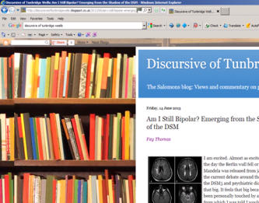




Getting Stuck In
Programmes as Provokers of Professional and Public Debate
Anne Cooke
Salomons Centre for Applied Psychology
Canterbury Christ Church University
GTiCP Conference 2013 , Windermere

Slide 2
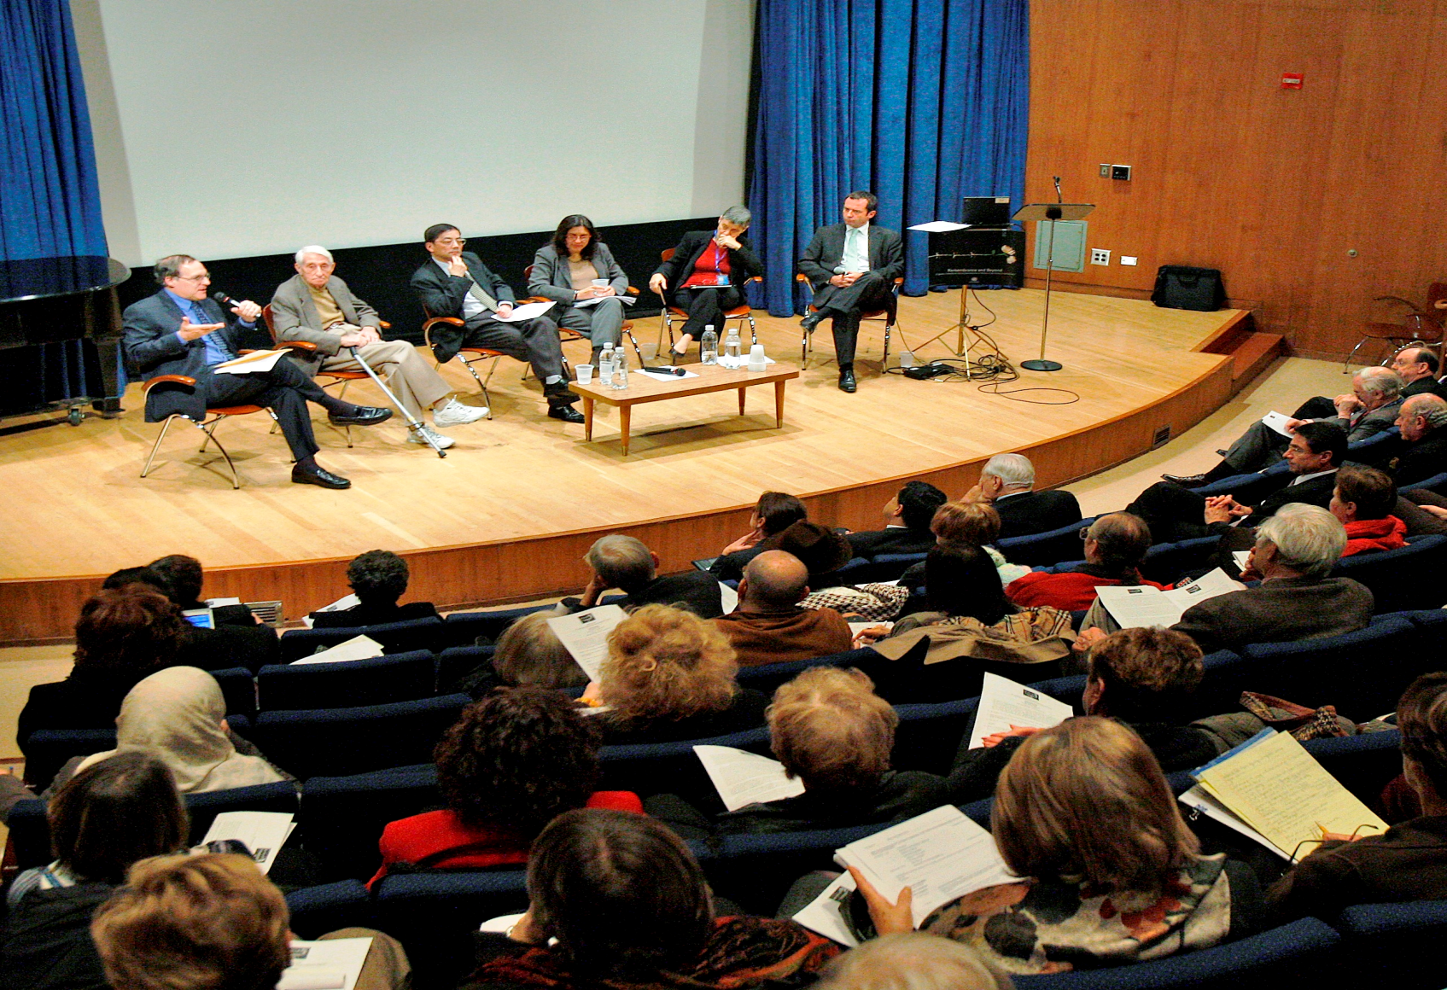
Provoking Debate within the Profession

Slide 3
British clinical psychology past, present and future
David Pilgrim PhD
Professor of Health & Social Policy, University of Liverpool

Slide 4
What are clinical psychologists for?
Revisiting our core values
Lucy Johnstone
Consultant Clinical Psychologist
LucyJohnstone16@blueyonder.co.uk
@clinpsychLucy
Blog at www.madinamerica.com

Slide 5

What next for the profession after IAPT?
Anne Cooke
Paul Gilbert
John McGowan
Dave Harper
Derek Mowbray

Slide 6


Slide 7
2020
What will clinical psychologists be doing?
Notes:
Anyway, I’ll shut up now and hand over to my august colleagues. I just wanted to end with a few questions that we hope to get you thinking about today. Firstly, three weeks today it will be 2010 now. So think ahead to 2020. What will clinical psychologists be spending their time doing in ten years time? Broadly the same as today? Will we largely be doing direct therapy like our colleagues in the USA for example?

Slide 8
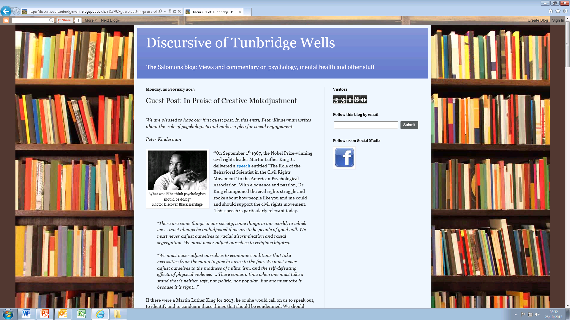

Slide 9
Public Information and Debate
Lack of clear information about mental health based on scholarship

Slide 10
Public Information and Debate
Information provided by parties with vested interests

Slide 11

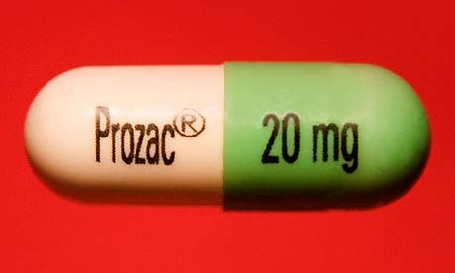
‘Depression is an illness with probable biological causes’
Prozac.com

Slide 12

Mental Health is a Contested Area
Policymakers, journalists and service users rarely have direct access to the debates

Slide 13
We are in a unique position
We have our feet in academia and also in a respected profession
We are in a unique position provide public information, and to provoke and influence vital debate
Do we have a moral duty to share the results of scholarship?

Slide 14

As a programme team and an academic department we have been experimenting with different ways of providing public information and opening up debate….
Notes:
? Need higher resolution pic

Slide 15
...such as a blog, a Twitter feed, contributing to DCP public information materials, and pub talks
Notes:
? Need higher resolution pic

Slide 16
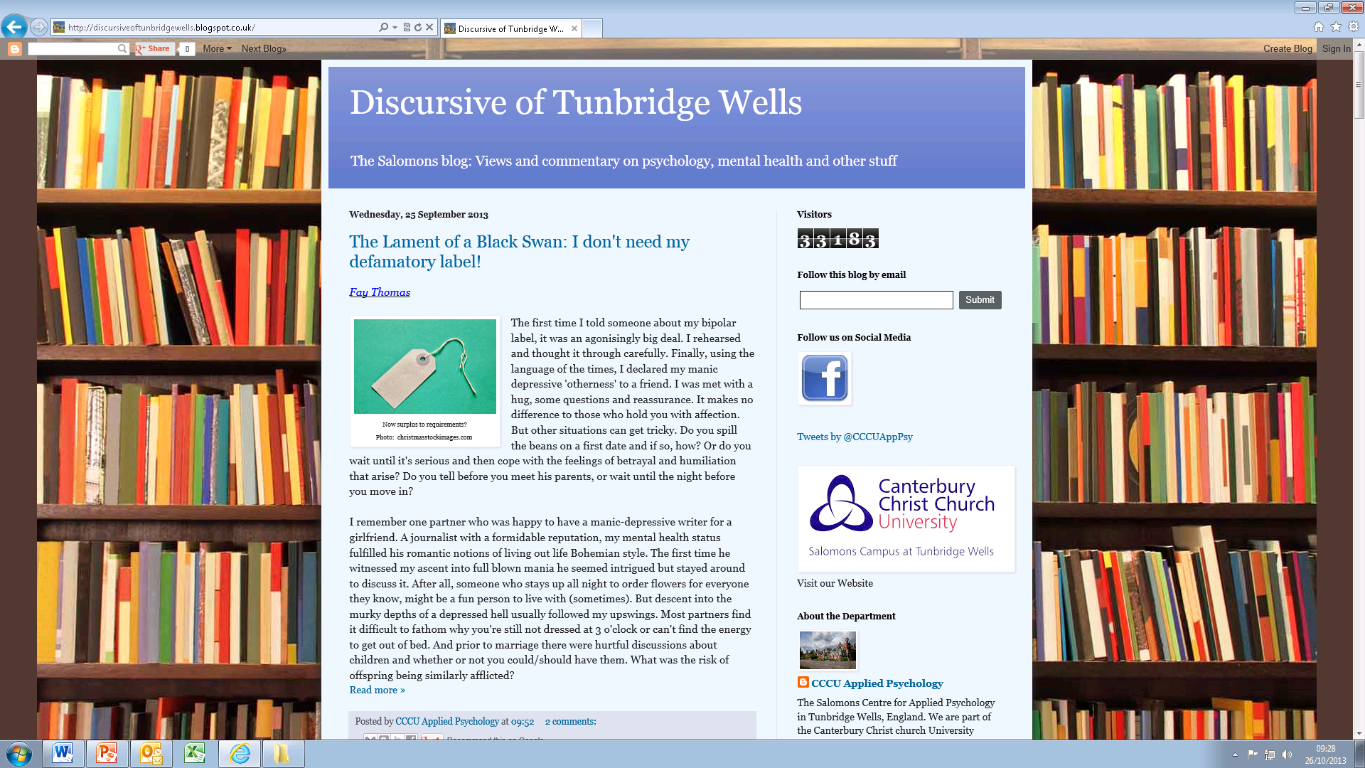

Slide 17
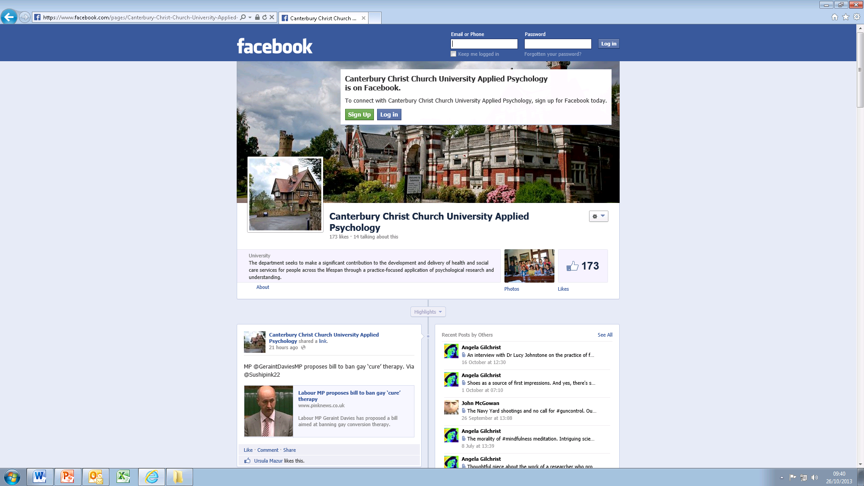

Slide 18
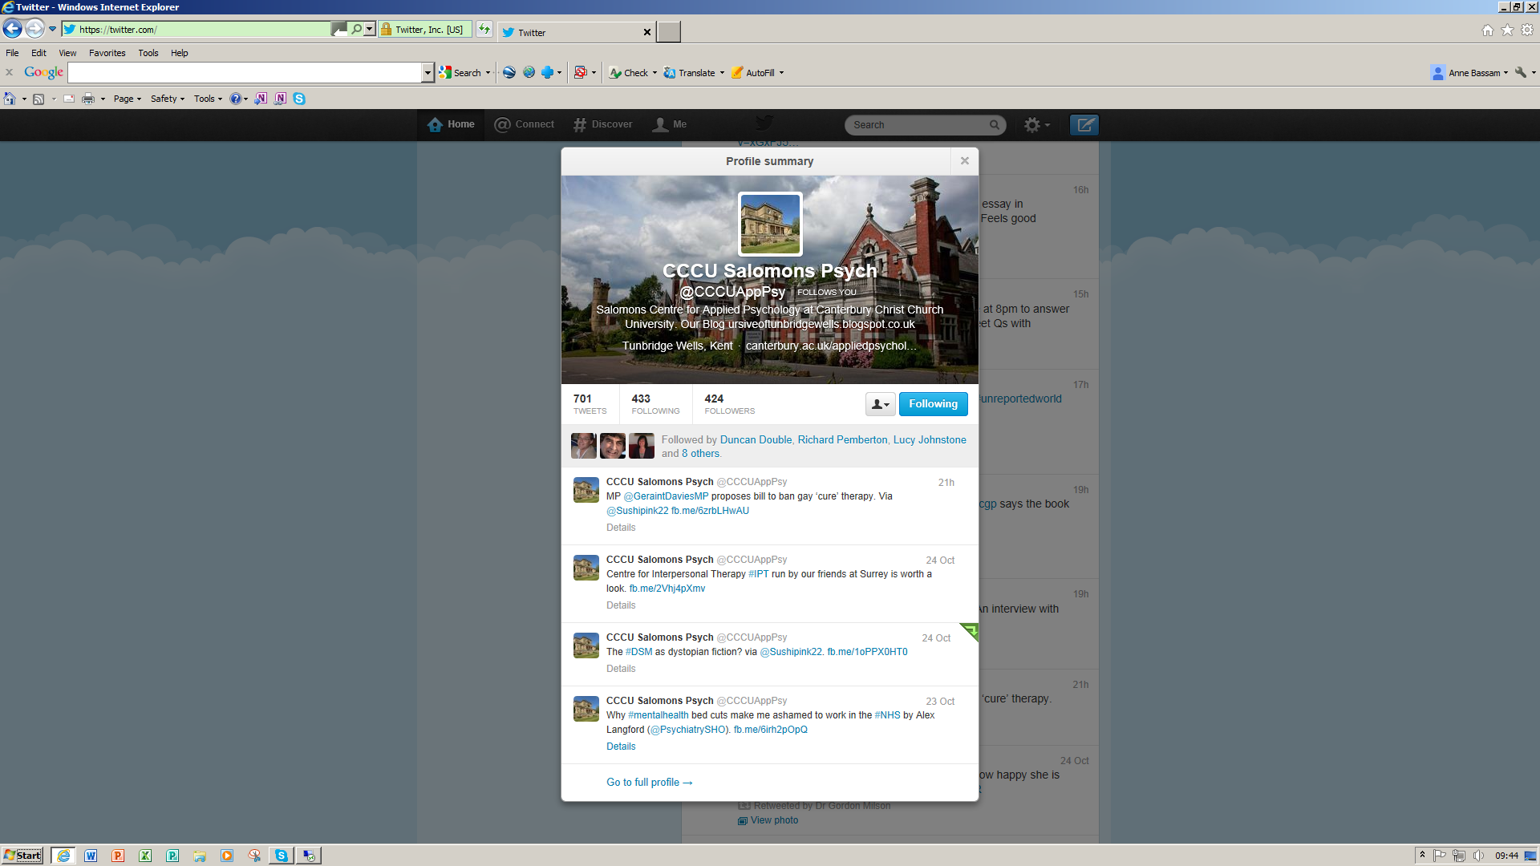

Slide 19
We focus on:
  • Clinical/diagnostic syndromes e.g. depression
  • Identified clinical problems e.g. suicidality
  • Policy issues relating to care in the NHS
  • Ideological debates affecting clinical care.
Notes:
Stuff we care about that is publically relevant but not always accessible. Lot might make people switch off or generate silly headlines

Slide 20

An Example: DSM 5

Slide 21
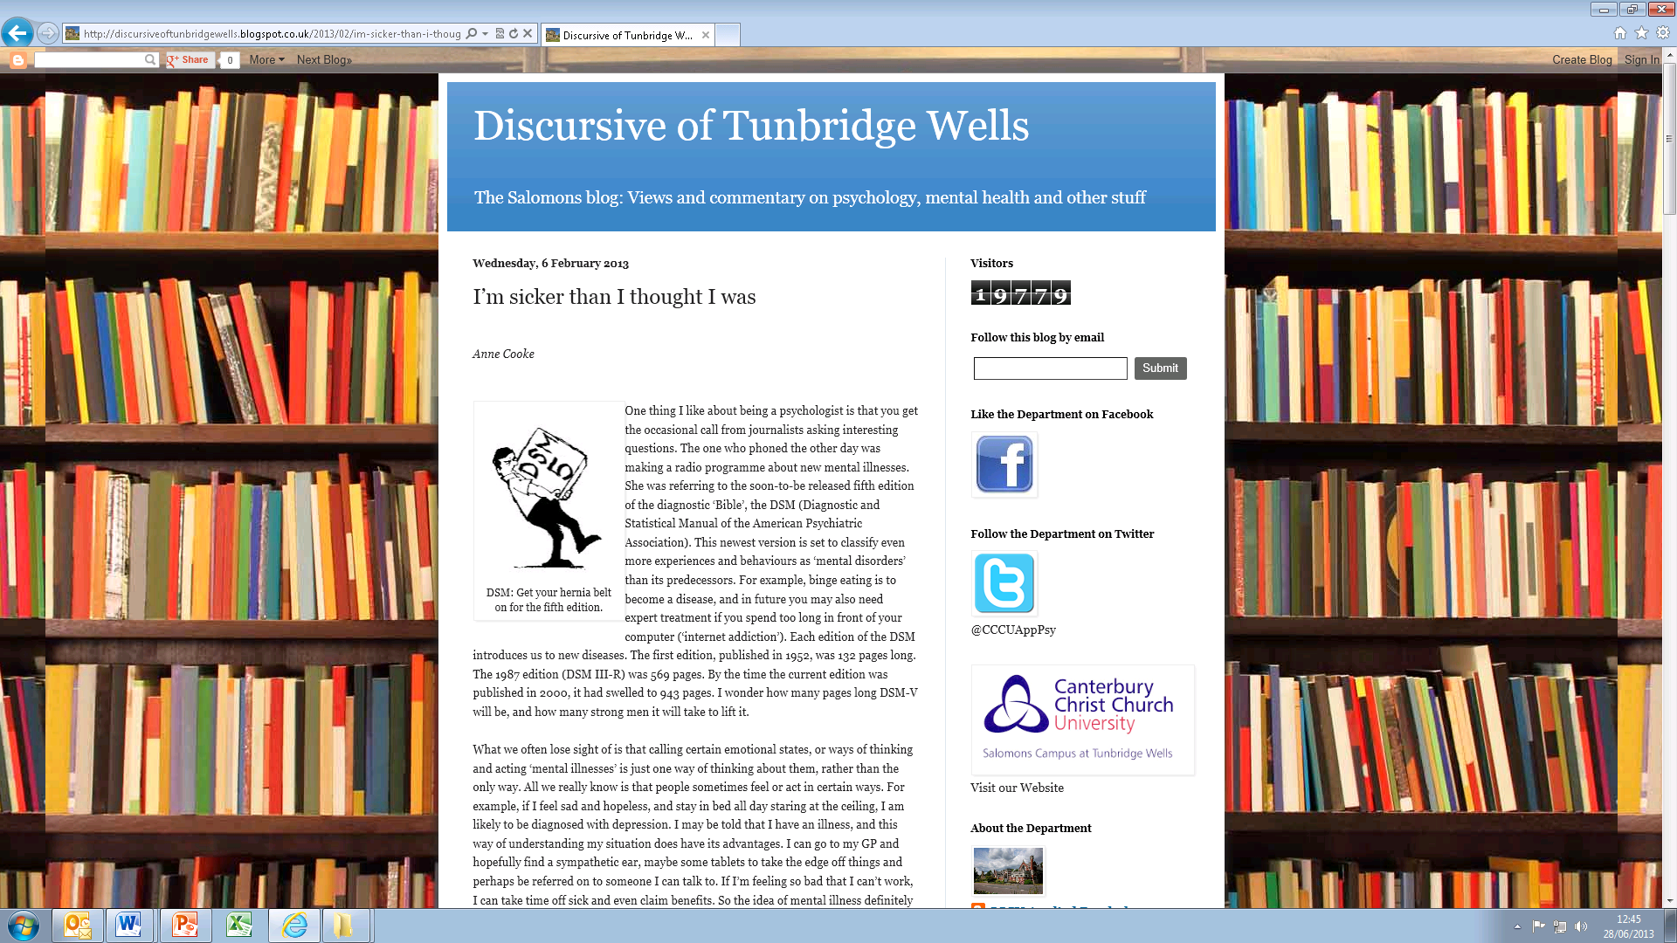

Slide 22
Challenges
Accessibility of the issues
Clarity of communication
Notes:
Diagnosis – social constructiion of meaning – esoteric, asks us to communicate in a different way. Time consuming going back and forward – skills of public engagement stuff we are interested in but link to academic work, increase hits

Slide 23



Slide 24
Understanding Depression
A report by the
British Psychological Society
Division of Clinical Psychology
Notes:
? Any images/’look’ yet? Or make one up

Slide 25
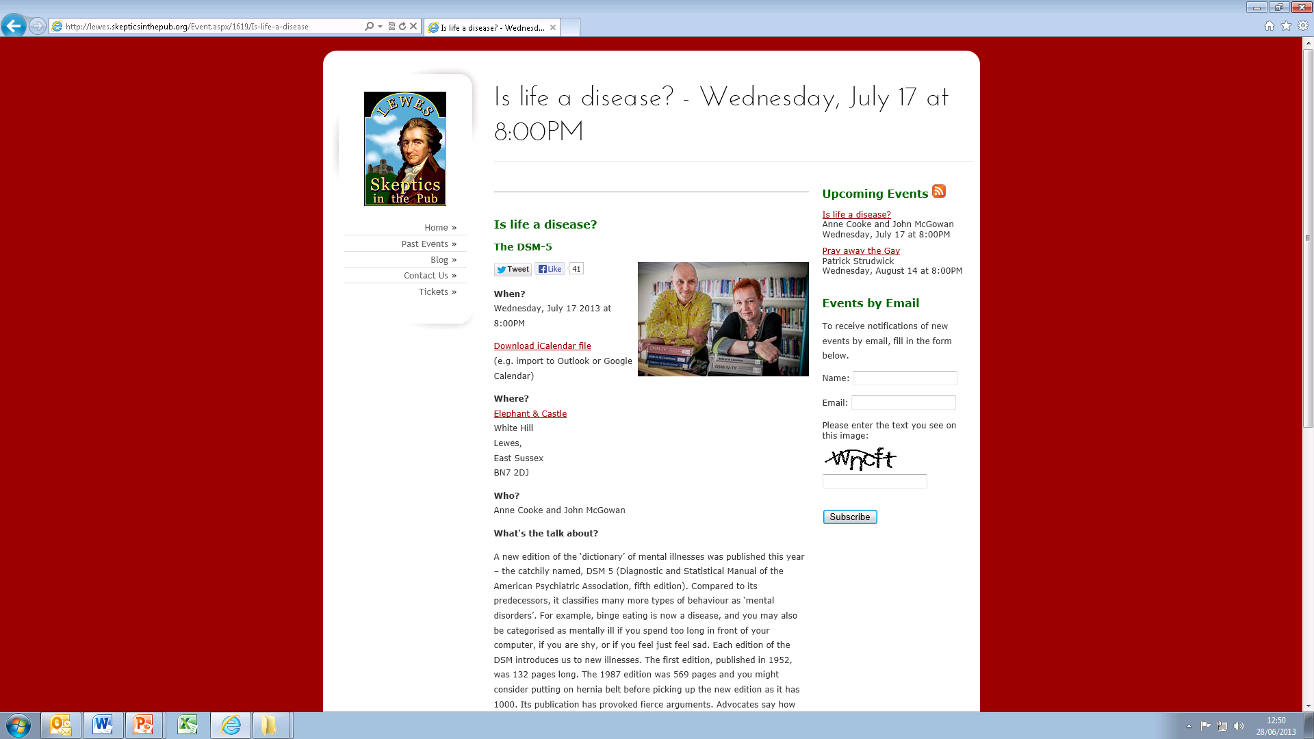

Slide 26
anne.cooke@canterbury.ac.uk www.discursiveoftunbridgewells.blogspot.co.uk
http://www.facebook.com/pages/Canterbury-Christ-Church-University-Applied-Psychology/264266386939444?fref=ts
https://twitter.com/CCCUAppPsy

