Slide 1
Problem Based Learning (PBL) in Cybersecurity
Project GEN1222
Alastair Irons, Harjinder Lallie, Paula Thomas, Paul Stephens

Slide 2
Background Presentation
Share the findings of the HEA project
Rationale for using PBL
Changes to student learning
Pragmatics
Ongoing research to gather views from stakeholders (students, educationalists, practitioners employers) on the effective use of PBL
Still time to get involved
Final workshops
Using / testing /evaluating PBL materials
Provide feedback to inform model
Due to be completed Sept 1st 2017

Slide 3
Objectives of Project
To provide shared PBL materials for HEI cyber security community
Develop and share resources to be used in PBL
To contribute to the current cybersecurity curriculum debate by developing and disseminating guidance on effective pedagogy
To evaluate PBL as a method in teaching and learning in cybersecurity
To explore opportunities for future collaboration
To provide a forum for discussion and debate in teaching and learning issues and opportunities in cybersecurity

Slide 4
Using PBL in Cybersecurity
We appreciate that the transition from conventional teacher centred education to problem-based learning can be tricky
A true understanding of PBL will only come with time and by students and academics engaging in the process
Our use of PBL is designed to improve the efficiency of cybersecurity education and to help students develop the wide range of skills needed to be a cybersecurity professional
Including team work, making judgments and developing as life long learners

Slide 5
Rationale for Using PBL in Cybersecurity
Reduce ‘information overload’ and stop students from learning huge amounts of unnecessary theoretical detail
Address perceived weakness in traditional ‘didactic’ teaching methods
Improve students’ control over their learning by providing more opportunity to be self directed, to locate what they need to know and give them possession of their learning
Improve students’ interpersonal skills

Slide 6
Why important professionally ?
Make undergraduate education a platform for life long learning
Cybersecurity is a field where professionals will need to continually build on and update their knowledge in accordance with ongoing developments in technology
Cybersecurity professionals must be able to
make judgments when faced with uncertainty
have the confidence to react quickly to situations
be able to work both as part of a team and independently.

Slide 7
Alternate Approach
Project has decided to use approach to embed PBL in existing contextualised modules
Alternate approach discussed at workshops started with generic PBL module and tried to fit cybersecurity into it

Slide 8
Materials
Case studies for PBL in cybersecurity
Scenarios for PBL cybersecurity
Teaching guide in using PBL in cybersecurity
To use materials
To develop own materials
To create learning environments
Student learning guide to PBL as a learning tool
VX Walkthroughs
Accessible through website

Slide 9
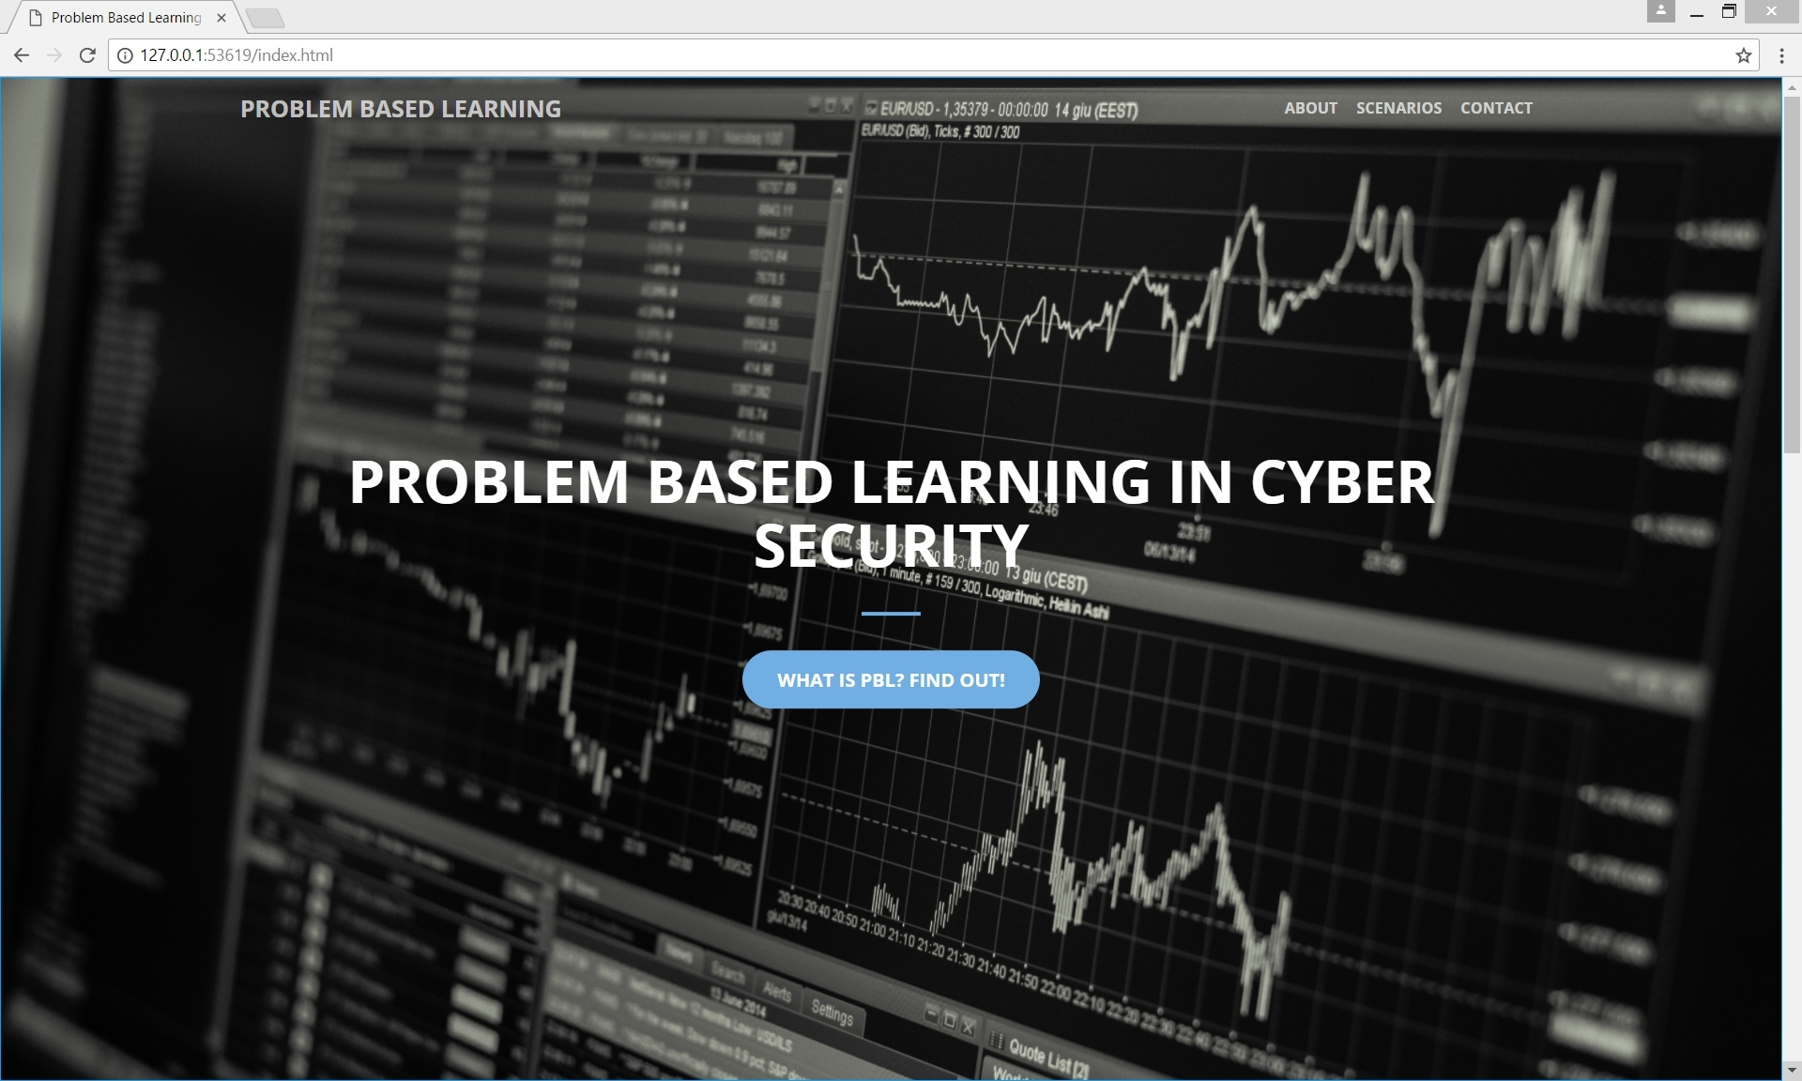

Slide 11
Collection of Data
Trying to measure effectiveness of PBL
Summative performance
Student engagement
Formative / summative
Student confidence
Smiley face – this is common across 4 partners
Collecting data at different levels from level 4 to 7
Range of PBL interventions
Single session (component of module)
Week long activity (component of module)
Longer period (3 weeks-ish) (component of module)
Semester (module)
Complete level / year
Whole programme

Slide 12
Initial Feedback from Students
Warwick
Use of standard module feedback and indication that scenario based PBL exercise was supportive of exercise
Gloucester
See graph
Sunderland
See graph
Canterbury
Longitudinal data collection in progress

Slide 13
Component Review - Gloucester

Slide 14
Confidence Measure pre and post PBL
Problem
Solving
Skills
Develop
Groupwork
Independent
Learning
Make
Judge
Knowledge
Application
PBL
Overall
N = 30

Slide 15
Summary
Project took time to get started so now looking at finish later in 2017
Initial findings are that PBL helps students learn in a different way
Initial findings suggest that PBL facilitates deeper learning
Takes time to get students used to approach
PBL tools appear to be “common sense” but actually quite difficult for students

