Slide 1
PhD in Professional Practice: Psychological Perspectives
3rd International Conference on Developments in Doctoral Education & Training
3-4 April 2017
Stratford-Upon-Avon
Dr Alex Hassett
Principal Lecturer and Senior Consultant
Salomons Centre for Applied Psychology

Slide 2
Overview of the Presentation
Background to the development of the PhD in Professional Practice
Where it sits in the degrees framework
PhD – Structure
Learning Plan
Portfolio
Learning Sets - Researcher Development
Supervision
Rationale for doing it this way
PhD or a Professional Doctorate
Examples of Student Portfolios
Challenges

Slide 3
Background to the development of the programme
Salomons Centre for Applied Psychology
Knowledge Exchange Activity
Practitioners
Developing research skills

Slide 4
What is it?
The PhD in Professional Practice is designed to enable participants to develop an individualised programme in an area of professional practice that is of interest to them.
PhD made up of a portfolio of work around a particular thematic focus.
The different elements of the programme are linked as investigations of different facets of a single topic or area.

Slide 5
What is it?
Within this coherent focus, the elements of the programme will each lead to a contribution to the advancement of knowledge and practice within their area of interest.
It is built to integrate with ongoing work. Allowing the practitioner to continue their practice whilst gaining their PhD, as opposed to having to take time out
Applicants include, but are not limited to, those working in the NHS, private and independent health and social care sector and higher education staff, managers and educators

Slide 6
This programme is defined by:
An individualised approach:
The programme is adapted to the needs of professionally qualified candidates by concentrating on study, development and research within a defined area of specialisation.

Slide 7
This programme is defined by:
Offers intensive and varied support and development:
The programme provides a wide range of teaching, support and development opportunities.
Each candidate will have a supervisory panel to support them through the course (both face to face and via Skype or teleconference).
In addition there is face to face teaching, learning sets, plus peer support through the learning sets and ongoing peer support (online and face to face).

Slide 8
This programme is defined by:
A focus on the application of psychological perspectives to the practice area:
What is distinctive about this process is that the understanding will be focused on taking a psychological perspective to understanding one’s chosen area and exploring how psychological principles can be understood and applied in these settings.
It is however not about making people psychologists; it is about the application of a psychological perspective

Slide 9
This programme is defined by:
Emphasis on research and write up for publication:
The focus is on developing research skills
The components of the PhD portfolio are all geared towards getting the candidates work published and disseminated.

Slide 10
Research degree by thesis
The Graduate School
Responsible for all research degrees by thesis
The PhD comes under this framework – subject in the PhD framework
5 years + 6 months for viva part-time – however early submission is possible
MPhil / PhD
Research Degrees by Thesis students are required to follow a programme of advanced study under guidance of a supervisory panel and supported by a programme of researcher development

Slide 11
Structure: Learning Plan
The candidate applies with a draft outline for their learning plan – offering a broad thematic area of study and how the various elements of the portfolio will fit
The individual learning plan is collaboratively redesigned by the candidate and supervisory panel to advance the candidate’s academic and research development.
In collaboration with their supervisor, areas in which the candidate wishes to advance their knowledge will be identified and they will be assisted to search for appropriate literature and a reading plan developed.

Slide 12
The Learning Plan and the Portfolio of Pieces of Work
Critical Review of Literature (10,000 words)
Small Scale Research Project (10,000 words)
Applied Research Project (20,000 words)
Report of Professional Practice (10,000 words)
Reflective Account (intro and final chapter) (10,000 words)

Slide 13
The PhD Portfolio
These five elements make up the final PhD dissertation.
There is some flexibility with the word count for each element of the portfolio.
This is agreed in the learning plan with the lead supervisor.
The overall word count for the portfolio should be in the region of 50 to 70,000 words.

Slide 14
Critical Review of Literature
The critical review of the literature is meant to provide a comprehensive and structured review of the literature that (1) addresses one or more research questions that can be answered by a literature review and (2) provides, as a result of the review, broad-based questions for future empirical research.

Slide 15
Small Scale Research Project
The completion of one small scale research project – taking a variety of forms
This can be designed to enhance professional practice associated with the organisation or delivery of services in the area of their specialism.
It can also be used as a pilot study for, or integrated with, the larger Applied Research Project
Candidates submit a project proposal

Slide 16
Applied Research Project
A more substantial, theoretically driven investigative research project must be undertaken.
This piece of research needs to be designed to be an original contribution to the advancement of knowledge in an area related to the thematic focus of the learning plan as a whole.
Candidates are required to submit a detailed proposal for their Research Dissertation and will be required to gain ethics approval for their research.

Slide 17
Report of Professional Practice
Case study or a more reflective piece on an area of practice within the thematic area
Integrate existing knowledge with practice
Theoretical and practice links
Change and develop practice
Understanding best practice
Applying the evidence to practice
Applying an understanding of process in their practice

Slide 18
Reflective Account
This piece of work serves to integrate the various elements of the PhD portfolio. It is divided into two sections.
The first an introductory chapter sets the scene for the reader in terms of the four other pieces of work that make up the portfolio. It also offers a rationale for the research.
The second is a final chapter that integrates the learning from the four elements of the PhD portfolio, reflects on the limitations of the PhD portfolio, draws conclusions and offers implications for practice and research.

Slide 19
Development and Support
The programme has been specifically designed so that practitioners may integrate the completion of the programme with their working lives, and both the work place and the individual will benefit from the outcomes.
Learning Sets
Group support sessions
Supervision

Slide 20
Researcher Development
The Graduate School offers a dedicated Researcher Development Programme (RDP).
The Learning Sets attended by students contributes to this researcher development.
Students can also access research methodology teaching on the Doctorate of Clinical Psychology Programme.

Slide 21
Learning Sets
Two study weeks (of 5 days each) a year. These will be made up of meetings of a small group of candidates working together as a Learning Set facilitated by the Programme Director or a member of the Salomons Centre for Applied Psychology staff.
These Learning Sets include a series of workshops/lectures on research methodology and input on advanced research skills.
During these periods the cohort will have time for group and individual learning.
Learning sets may continue where candidates request this; facilitated by the candidates, but supported by the programme. These may be run through the virtual learning environment.

Slide 22
Element of the Portfolio | Learning Set | Competencies | Submission for Review date
Critical Review of Literature (10,000 words) | LS1 March 2016 Input on The research process Using on-line data bases Research frameworks and appraising research Evaluating evidence | Literature searching techniques, Evaluating evidence Reviewing and synthesising evidence Writing a literature review | Nov 2016
Small Scale Research Project (Service Improvement Project) (10,000 words) | LS1 March 2016 Input on The research process Service Evaluation and Implementation Research frameworks and appraising research LS2 Nov 2016 Present proposed Small Scale Research Project | An advanced understanding of professional and service issues in the area of the candidate’s practice; An advanced understanding of evidence-based practice in this area An advanced understanding of approaches to service development and evaluation and associated methodologies Project management skills, including planning, implementation and dissemination | March 2017
Applied Research Project Proposal (2,000 words) | LS2 Nov 2016 Input on Proposal writing | Advanced research literature searching techniques Evaluating and critiquing research designs, methodologies and findings A rich knowledge of the existing research in relation to the area of enquiry. A comprehensive understanding of research design and methodologies A rich and practiced understanding of the research methodology applied in the project Writing for publication and dissemination of research findings Research project management including proposal writing, costing, ethical approval, and organisational access | March 2017 present proposal to the groups and review panel
Applied Research Project Ethics Approval (2,000 words) | LS2 Nov 2016 Input on Ethics Committees – proposals and forms |  | March 2017
Applied Research Project Report (20,000 words) | LS2 Nov 2016, LS3 March 2017 and LS4 Nov 2017 Input on Research Methods: more in-depth input on quantitative and qualitative methods Dissertation Design Specific input as requested |  | Nov 2018/19

Slide 23
Learning Sets
Element of the Portfolio: Critical Review of Literature (10,000 words)
Input on
The research process
Research frameworks and appraising research
Using on-line data bases
Literature searching techniques,
Evaluating evidence
Reviewing and synthesising evidence
Writing a literature review

Slide 24
Supervision
Each candidate has a supervisory panel for the duration of their registration.
A learning plan of the intended programme of study will be agreed with the candidate's lead supervisor at the start of the Programme.
This plan will be reviewed throughout the Programme and adjusted as necessary.
The candidate will also have a second supervisor and a Supervisory Panel Chair.

Slide 25
Supervisor experience
First supervisor – Have experience of supervising PhD to completion, and be research active i.e. published in peer review journals
Second supervisor – research active
Chair – Professor or Reader and have experience of supervising PhD, to completion, as first supervisor
Supervision contracts with the Lead and Second Supervisors are drawn up in the first three months of the programme clearly outlining responsibilities and expectations of the supervisors and student.

Slide 26
Review meetings
Happen yearly
They cannot be held without the 1st supervisor and the Chair
The 1st supervisor should help the student prepare for the Review
The two supervisors and the Chair must each provide an independent and substantially informative paragraph
The final report must be compiled by the 1st supervisor and sent to the student and the Graduate School
A Review meeting to consider upgrade must be held at least six months before the end of MPhil registration
Possible examiners should be discussed with the student during a review meeting, and have been agreed in principle by the Final Review.

Slide 27
Rationale for doing it this way
Practitioners – access to a process for developing their research skill and their theoretical and evidence based expertise
Developmental Approach – 5 elements to the portfolio
Making the teaching accessible
Offering ongoing review and feedback as well as supervision
Produces high-quality research with a strong focus on application and real world implication.

Slide 28
Distinctions with a ‘traditional’ PhD route
Don’t submit a proposal rather a learning plan
Proposals for elements of portfolio are developed in first year
Developmental approach
Researcher development includes learning sets

Slide 29
PhD or a Professional Doctorate?
The debate

Slide 30
Liverpool University
Professional doctorates | PhDs
Designed for students who wish to advance their professional practice and further their career | Suitable for students who want to pursue a career in academia
Aims to develop researching professionals | Intended to develop academic researchers
Holder has the title ‘doctor’ | Holder has the title ‘doctor’
https://www.online.liverpool.ac.uk/programmes/doctorates/resource/whats-the-difference-between-a-professional-doctorate-and-a-phd

Slide 31
Capella University
 | PhD | PROFESSIONAL DOCTORATE
DEGREE FOCUS | Contribute new knowledge aimed at solving real-world problems. | Apply existing knowledge aimed at solving real-world problems.
INDEPENDENT RESEARCH PROJECT | Five-chapter dissertation. | Five-chapter applied dissertation or paper, product, or portfolio.
CAREER INTENTION* | More interest in consulting and/or conducting research. | More interest in practicing directly in the profession.
http://www.capella.edu/blogs/cublog/phd-vs-doctorate-differences/

Slide 32
Northcentral University
WHY (PhD) | HOW (Professional Doctorate)
Motivation Behind the Research To contribute new knowledge and theory | Motivation Behind the Research Practical application of existing knowledge and theory
Future Plans Continued research and analysis of new theories and solutions | Future Plans Continued work in the field, applying knowledge gained to make improvements
https://www.ncu.edu/blog/how-to-decide-between-a-phd-and-professional-doctorate

Slide 33
Lancaster University
 | PhD *A research degree* | Doctorate of Business Administration *A practice-oriented degree* | Doctorate of Management *A practice-oriented research degree*
Degree aims | To contribute to the body of academic literature and theory in your discipline | To contribute to your profession, community, and practice in the relevant area of focus | To contribute both to the academic discipline and the practice within your organisation
Research focus/project | Research is focused on key questions within the academic discipline | A combination of coursework and research, which is limited in scope and is practitioner focused | Research contributes to the discipline and is focused on problems relevant to practice
Research process | A supervisor guides you to become an expert in research practice | A supervisor guides you to produce research appropriate to the needs of your practice | You and your supervisor co-create research as part of a research-practitioner community
Career outcomes | To become a professional research practitioner (often as an academic) | To become a more professional practitioner | To become a research-oriented practitioner who can bridge theory and practice
http://www.lancaster.ac.uk/lums/owt/research/phd/doctorate-of-management/doc-vs-phd/

Slide 34
PhD or a Professional Doctorate?
The main difference between a PhD and a professional doctorate lies in their orientation – one has an academic focus, the other a professional one.
A professional doctorate degree, such as a Doctor of Business Administration or an Doctor of Education, is designed for professionals who wish to deepen and advance their professional practice and career.
A PhD, however, is suitable for students who want to explore theory, push back the frontiers of knowledge, and pursue a career in academia.
From: https://www.online.liverpool.ac.uk/programmes/doctorates/resource/whats-the-difference-between-a-professional-doctorate-and-a-phd#oiT1XKYLjrZPCjWF.99

Slide 35
Review of Professional Doctorates (Gillian McCay, 2010)
Professional Doctorate leading to Professional Registration
Professional Doctorate
PhD
http://citeseerx.ist.psu.edu/viewdoc/download;jsessionid=1CE47C4183090D04088740B4E46C4E2C?doi=10.1.1.695.6804&rep=rep1&type=pdf

Slide 36
Is this clear distinction necessary?
Argument for a research degree that focuses on one’s practice.
Depth around one specific theme.
It is about depth and research skills within a professional context.
Focus on research skills and the process of being a researcher rather than developing their area of practice.

Slide 37
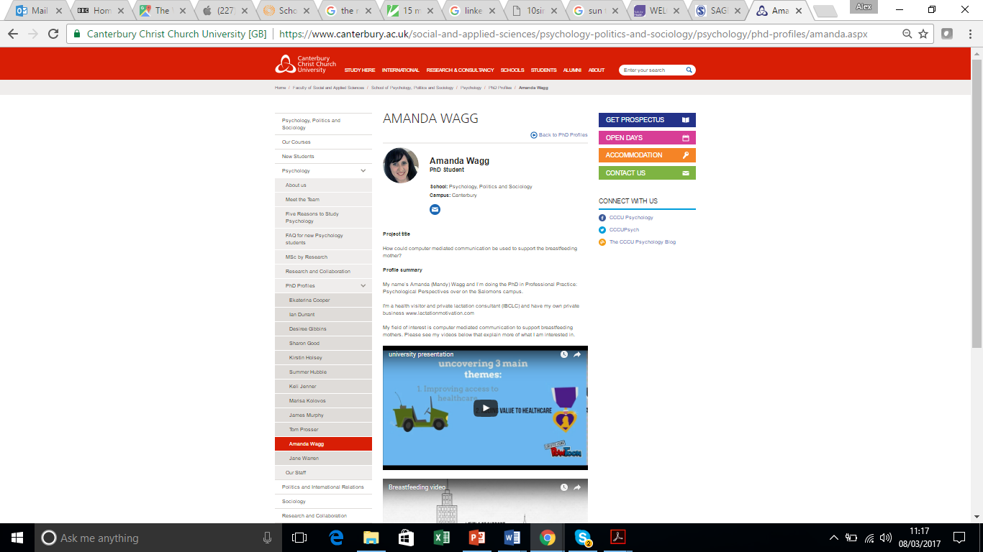
Examples of Student Portfolios
Dan
Chloe
Mandy

Slide 38
Dan – Cognitive Behavioural Therapist
Factors Affecting Outcomes in Cognitive Behavioural Therapy (CBT)
Looking at it from the perspectives of:
client factors (non clinical),
training factors and
personal practice and development (self practice and self reflection model).

Slide 39
Factors Affecting Outcomes in CBT
Clients
Practice
Training
Validating a measure developed by McLellan et al. (2016) on assessing suitability for CBT
Characteristics of non-clinical client factors affecting treatment outcomes
Literature Review
Applied Research project
Small Scale Research project
Report on Professional Practice
Analysis of training with psychiatrists around understanding how to access suitability for CBT treatment
Reflective Practice Bennett-Levy (2006) will reflect on own practice

Slide 40
Chloe – academic (and a nurse)
Psychological mechanisms to cope with the realities of healthcare associated anthropogenic global warming: an exploratory sequential study of nurses within the United Kingdom

Slide 41
Literature Review
What we know:
There are physical barriers preventing nurses from being sustainable…eg. time / resources / sick patients.
There are also perceptual / psychological barriers.
Cognitive dissonance is prevalent – whereby nurses know something is bad but for some reason feel unable to act / disempowered.
International literature from nursing / healthcare and general population suggests that individuals and cultures use a series of psychological mechanisms to cope with cognitive dissonance.
What we don’t know:
Exactly which psychological mechanisms nurses employ to deal with the realities of healthcare associated AGW..

Slide 42
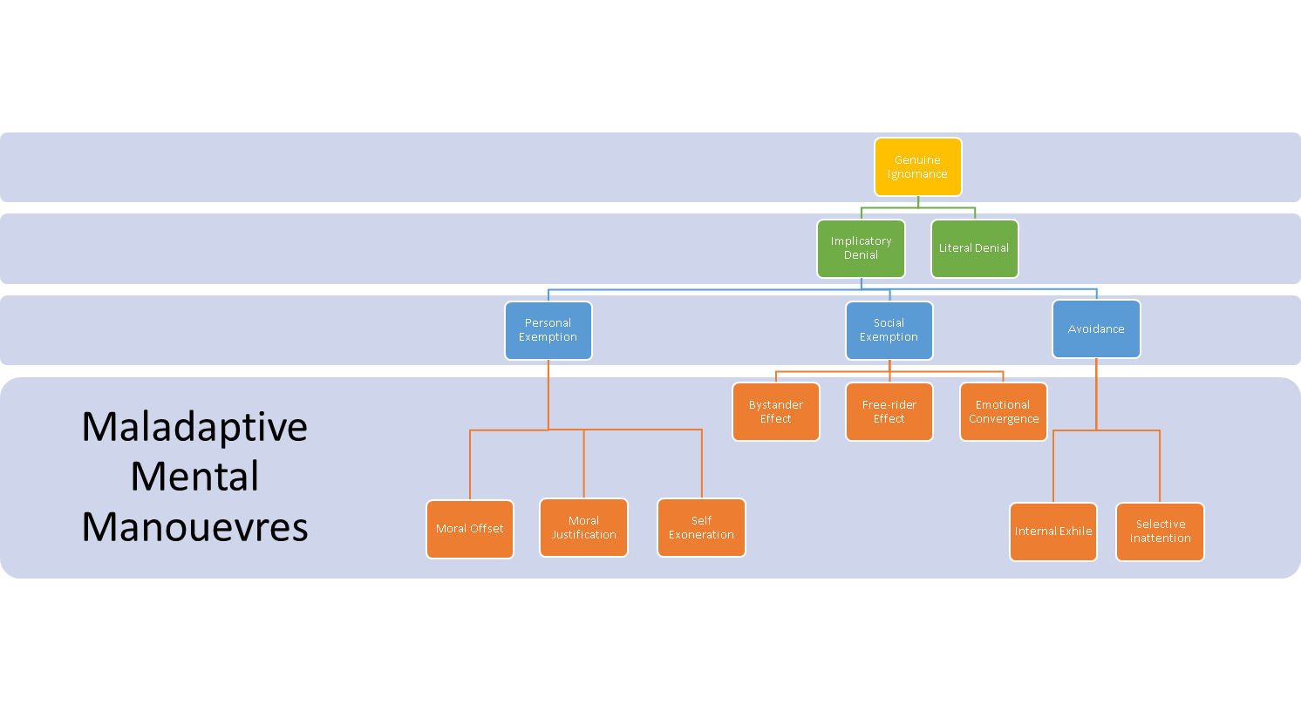

Slide 43
Exploratory Sequential Design
Creswell & Clark (2011)
INDUCTIVE
Qualitative
Exploratory
Constructivist
Tool is created
Post-positivist
Generalisations
Connect phase 1 and 2
Follow-Up
Emergent theory
Informs next stage
Large scale
Interpretation
Quantitative
Rich data
DEDUCTIVE
ITERATIVE PROCESS

Slide 44
Research Questions
Which psychological mechanisms do nurses employ towards the impact that healthcare is having on anthropogenic global warming?
To what extent do nurses exhibit: genuine ignorance; literal denial; implicatory denial; personal exemption or avoidance towards the impact of healthcare on anthropogenic global warming (AGW)?
Are nurses aware of the impact of healthcare consumerism on people and the environment?
To what extent do languid metaphors camouflage the realities of healthcare associated AGW and thus perpetuate psychological mechanisms?
To what extent do nurses externalise responsibility and use social exemption as a reason for inaction?
Are nurses aware of potential personal gains that could result from collective action?

Slide 45
Mandy – Health Visitor and academic
Exploration of the role of online support for breastfeeding mothers
Literature review: How could computer mediated communication be used to support the breastfeeding mother?
Small scale research project: Content analysis to describe and document use of online social support groups for breastfeeding mothers
Applied Research Project: Q-sort to develop the theory around and explore the supportiveness of online breastfeeding support.

Slide 46
Challenges
Lack of research design and methodology skills
Taking a critical perspective on one’s practice (passion)
Challenges of data collection in practice settings – complexity
Work study life balance
Changes in workplace – Public sector (NHS, education and social care)
Funding
On-line support

Slide 47
Alex Hassett
alex.hassett@canterbury.ac.uk

