Slide 1


Slide 2
Support needs of families with disabled children
Eve Hutton, Reader in Children & Young People’s Health & Wellbeing.

Slide 3
Aims
Empirical findings interviews with parents/carers
Context
Personalisation /personal health care budgets
Continuity of care
Implications for practice
Discussion

Slide 4
Incidence
Limited data
40,000 children with complex physical health needs in England ( CQC 2014).
725,000 0-16 year olds ONS General Lifestyle Survey.
500,000 moderate disability, 225,000 with more severe disabilities ( BHTA 2014).
7,045 children in Kent with Statements/EHC plans (Kent.gov.uk 2015)

Slide 5
Heterogeneous group
Cerebral palsy, muscular dystrophy, acquired brain, spinal injuries following trauma.
Associated disabilities – epilepsy, learning & communication & behaviour problems

Slide 6
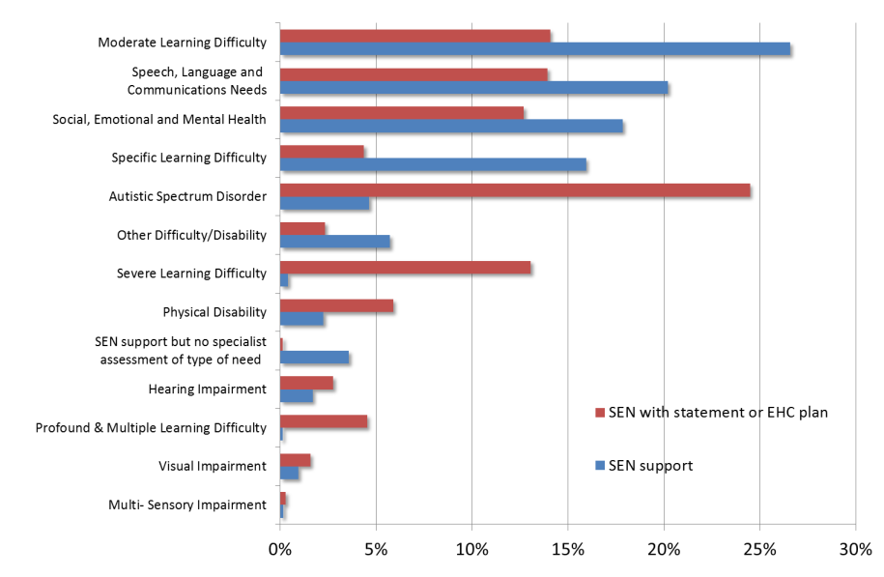
Special educational needs in England 2015

Slide 7
POET survey 2016

Slide 8
Costs
Health Costs to the NHS, including medical costs and spending on specialist equipment estimated at £1.9 billion
(CEBR 2014)

Slide 9
Poorer outcomes across a range of indicators
Difficult transition to adult services
Limited employment opportunities
Financial hardship -family breakdown
Psychological and physical consequences
Environmental barriers
‘Counting the costs’ contact a family 2014

Slide 11
Challenges for parents & carers
Navigate a complex landscape of care - access and eligibility criteria.
Health, education and social care
Wheelchair services
Local authority – housing adaptations
Community and specialist health input from London hospitals

Slide 12
Internal Project Grant
Funded by EKHUFT internal grant scheme
Aims
  To examine potential ‘transition points’ requiring a change in the nature or intensity of support provided.
  To explore parents and carer experience of therapy – responsiveness, personal care.
  Views on personal health budgets.
  To explore feasibility of a larger research project

Slide 13
Methods
Qualitative interviews with families (parents and carers) about their experiences of care
Analysed thematically, to identify salient themes

Slide 14
Recruitment
Inclusion criteria - Child with a physical disability (<18) who access 2 or more therapies.
Contact with therapists & voluntary organisation in East Kent to recruit families with complex physical needs
21 expressed interest, 15 accepted invitation, 9 attended.
Range of disabilities
Notes:
.

Slide 15
Themes
Parent and carer experiences of services - direct experience of therapy services
Education
Communication between therapists and parents and within services
The role of parents and carers in their child’s therapy
The system of provision, including equipment.
Experiences and views of personalised care and personal health budgets

Slide 16
Experience of therapy
Reassurance
Responsive
Forward planning
Communication
Personal attributes
Dismissive
‘Told off’
Not responsive
Poor communication
Lack empathy

Slide 17
Parent carer experience
“ Her attitude is, if you are feeling stressed about it and you think its not right, let’s let me see( name of child) just even if its only a reassurance for you ..”
“ And they are always talking about to you about what their thoughts are and what they think he needs and what he’s doing well. Very encouraging all the time and I think all of that together takes away any kind of stress there may be ..”

Slide 18
Parent carer experience
“ I don’t feel they take my opinion on board. I feel like they have an outlook on something and they’re gonna do it their way regardless.”
“..I had to be doing all this…and she came in and she told me that I had to do all these things in a day and I’m like… I just burst into tears when she went because I thought I cant cope with this ….”

Slide 19
Equipment provision
‘Broken’ system
Delay – waiting times unacceptable
Incorrect provision – when it arrives child has outgrown or just ‘wrong’
Gaps – grey areas and ‘red tape’
Poor communication between services
Parents valued planning ahead ( school, wheelchairs)

Slide 20
Equipment
“I’ve got two paediatric chairs here ..we’ve got one that she’s currently using and then a second one that we’re waiting for the equipment to come. The equipment hasn’t yet come so we can’t use the chair. But... we can’t get rid of the one that she’s currently using because we can’t use the new one”
‘ Yeah I think just anything kind of takes a little while for it to actually whirl round in their system and kind of come back because they have to look through the system where it’s already been used …. So I think they have to look on that for at least six to eight weeks and then they can request it new and then obviously from new it can take six to eight weeks again. So the bath took, I don’t know a matter of sixteen weeks or something”

Slide 21
Personal health care budgets
Hypothetical - little awareness or experience.
Not aware of ‘entitlement’
Seen as ‘enhancing’ rather than ‘replacing’ NHS care
Uncertainties and risks of PHCB compared with certainty and reliability of current provision.

Slide 22
Personalised budgets
“I’d rather just carry on with what we’re doing. If it... if it... If basically the cost of the services I’m getting on the NHS would come in at less than the pot of cash that I would be given then that in some ways is quite useful because it would allow in part for me to pay for some of the private services that I’m already buying”
“You would hope then because you have more control that you would get those bits quicker. I would want to keep what I have but just hopefully like when it comes to equipment then it could be faster”

Slide 23
Support needs of parents/carers
Personalised services and continuity of care - policy analysis

Slide 24
Children & Families Act 2014
Education, health care and social care services working together
One overall assessment ( education, and their health and social care needs 0-25).
Give children and young people and their parents more choice/ say about the help they get.

Slide 25
Gift and Citizenship models of service delivery
Shift to Citizenship: From Gift to Entitlement © Simon Duffy 2009

Slide 26
‘Making it Personal’ ( Department of Education ) 2014

Slide 27
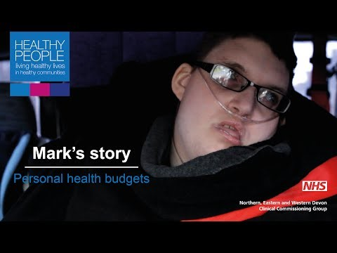
Notes:
Example of a personal health care budget - https://youtu.be/U86XuI23RfQ

Slide 28
POET survey 2016

Slide 29
Personalisation
Cost efficient, flexible services that meet individual needs?
Shift the balance of power towards service users ?
Roll back the welfare state?
Undermine public services ?
Save money ?
Budget driven or Outcome focused?

Slide 30
Continuity of care
‘The concept—and reality—of continuity of care crosses disciplinary and organisational boundaries……’
Continuity of care: a multidisciplinary review ( Haggerty et al 2003)

Slide 31
Three types of continuity
Informational continuity—The use of information to make current care appropriate for each individual
Management continuity—A consistent and coherent approach to the management of a health condition that is responsive to a patient’s changing needs
Relational continuity—An ongoing therapeutic relationship between a patient and one or more providers

Slide 32
Discussion
Challenges, service delivery – implications for practice, further research ….

Slide 33
Implications for therapy practice
A trusted relationship with a therapist who knows their child and family circumstances.
Continuity of care provided by therapists over the long term.
Reassurance and regular feedback about their child’s therapy in terms that recognize the child’s strengths as well as limitations.
Flexibility in how therapy is provided
Planning for the longer term needs of the child especially in relation to equipment needs and at key transition points such as entering school.
An advocate helping parent & carer navigate the wider care system to ensure that the best choices are made for their child (wheelchair, adaptations to the home, education, and possibly personal budgets).
Notes:
So implications

Slide 34
Areas amenable to change
Opportunity to (re)create a relational model of care for the small number of children on caseloads with complex and long term needs
Individual therapist are enabled to work in partnership with families on a longer-term basis - taking on a flexible and adaptable care approach focused on the evolving needs of the child and the family.
Personalised care model, consultation with parents to ensure that most appropriate elements are included from the perspective of parents.
Consultation with parents may also highlight therapies not currently available to the NHS, but which parents deem ‘beneficial’ for their child.
Parents could also be consulted on areas of care which, in their experience, may not be suitable for inclusion in a PHCB.

Slide 35
Challenges
Right ideas at the wrong time ?
Resource Allocation System ( RAS )
Managing risk
NHS services vulnerable to growing private sector in therapy provision ?

Slide 36
“The solution, lies in learning the ‘right lessons’ from the implementation of personalization so far, moving from consumerist notions of individual control and a preoccupation with PBs, to refocusing on truly personalized support plans built from accurate assessment of needs, sufficiency of resource and flexibility of provision”….
Slasberg and Beresford (2015)

Slide 37
References
Dodd, J., Saggers, S. & Wildy, H., 2009. Wk 6 Constructing the “ideal” family for family‐centred practice: challenges for delivery. Disability & Society, 24(2), p.173-186. Available at: http://www.tandfonline.com/doi/abs/10.1080/09687590802652447.
Forder, J. et al., 2012. Evaluation of the personal health budget pilot programme. Available at: https://www.phbe.org.uk/\nhttp://www.personalhealthbudgets.dh.gov.uk/_library/Resources/Personalhealthbudgets/2012/PHBE_personal_health_budgets_final_report_Nov_2012.pdf.
Haggerty, J. L., Reid, R. J., Freeman, G. K., Starfield, B., Adair, C. E., & McHendry, R. (2003). Continuity of care: A multidisciplinary review. British Medical Journal, 327, 1219-1221. doi:10.1136/bmj.327.7425.1219
Kruijsen-Terpstra, A.J.A. et al., 2016. Parentsʼ experiences and needs regarding physical and occupational therapy for their young children with cerebral palsy. Research in Developmental Disabilities, 53-54, p.314-322.
Raina, P. et al., 2005. The health and well-being of caregivers of children with cerebral palsy. Pediatrics, 115(6), p.e626-36. Available at: http://www.ncbi.nlm.nih.gov/pubmed/15930188.
Waldboth, V. et al., 2016. Living a normal life in an extraordinary way: A systematic review investigating experiences of families of young peopleʼs transition into adulthood when affected by a genetic and chronic childhood condition. International Journal of Nursing Studies, 62, p.44-59.
Welch, V. et al., 2012. Using direct payments to fund short breaks for families with a disabled child. Child: Care, Health and Development, 38(6), p.900-909.

Slide 38
References
Care Quality Commission 2014. From the pond into the sea. Children’s transitions to adult health services, (June), p.1-12. Available at:http://www.cqc.org.uk/content/transition-arrangements-young-people-complex-health-needs-children’ s-adult-services
.Care Quality Commission 2012 Health Care for disabled children and young people.
British Healthcare Trades Association 2014 . Economic benefits of better provision of equipment for disabled and terminally ill children. (BHCTA).

