Slide 1
WANNSEE CONFERENCE 20 JANUARY 1942
A PROCESS OF INHUMANITY
Dr. martin watts cccu

Slide 2
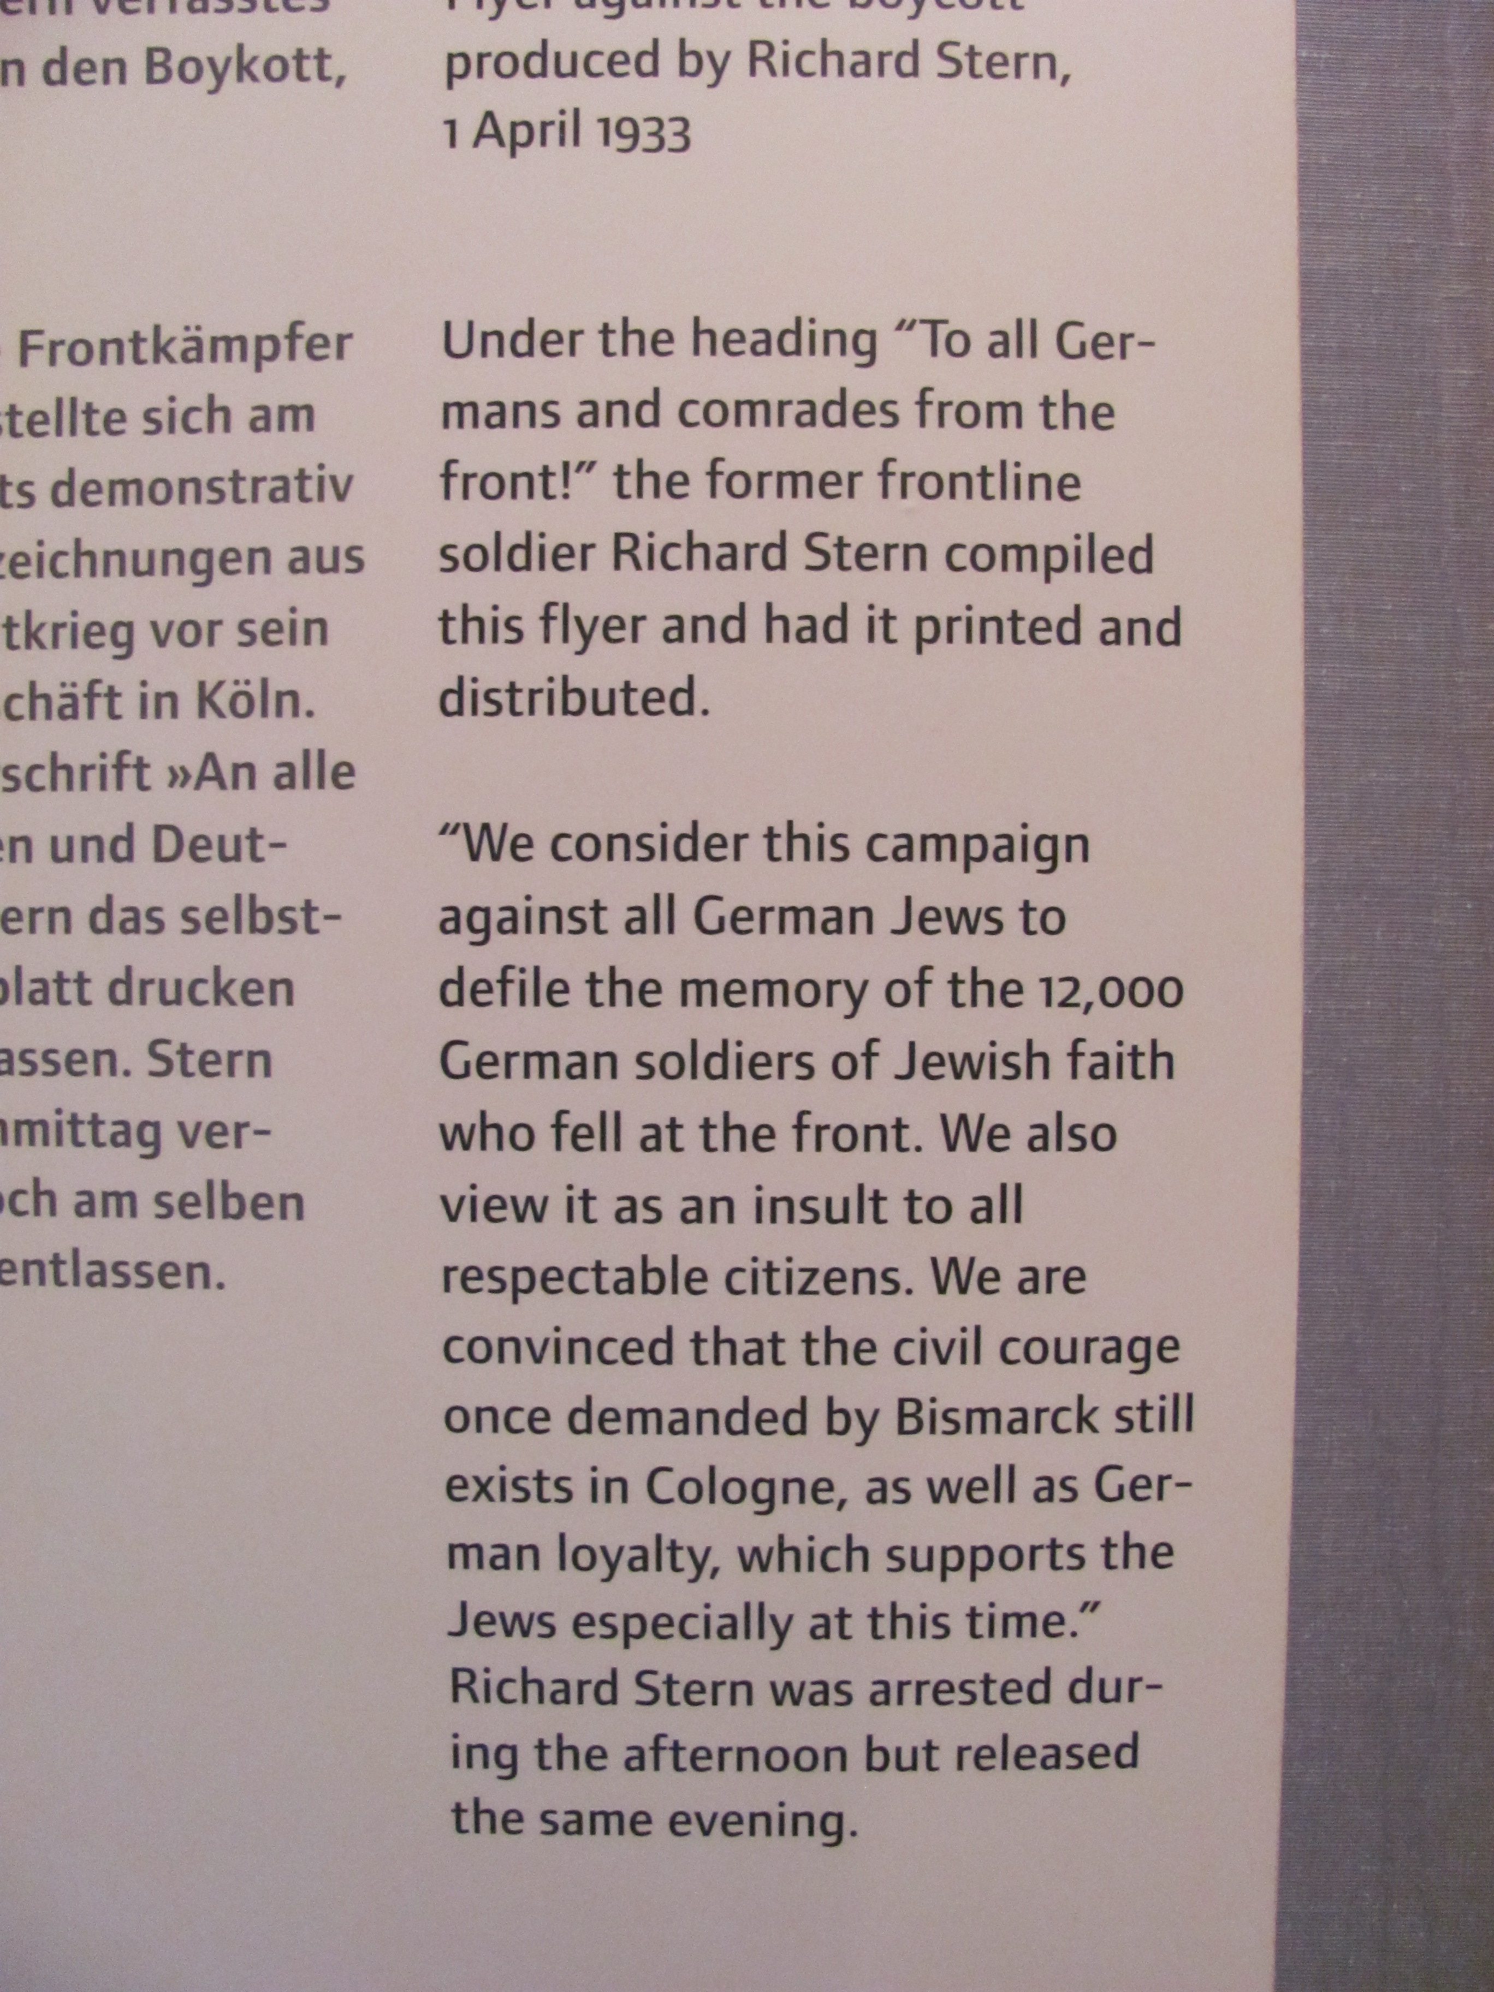
DEFIANCE
The question of the Jewish veterans 1933-
The first Female Rabbi
January 1936

Slide 3
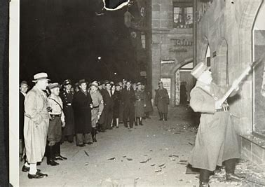
kRistallnacht November 9-10 1938
Defining moment of Nazi anti-Semitism following discrimination laws
Unease in several places led to less publicity

Slide 4
DEPORTATION ‘EMIGRATION’

Slide 5
DEPRAVITY

Slide 6
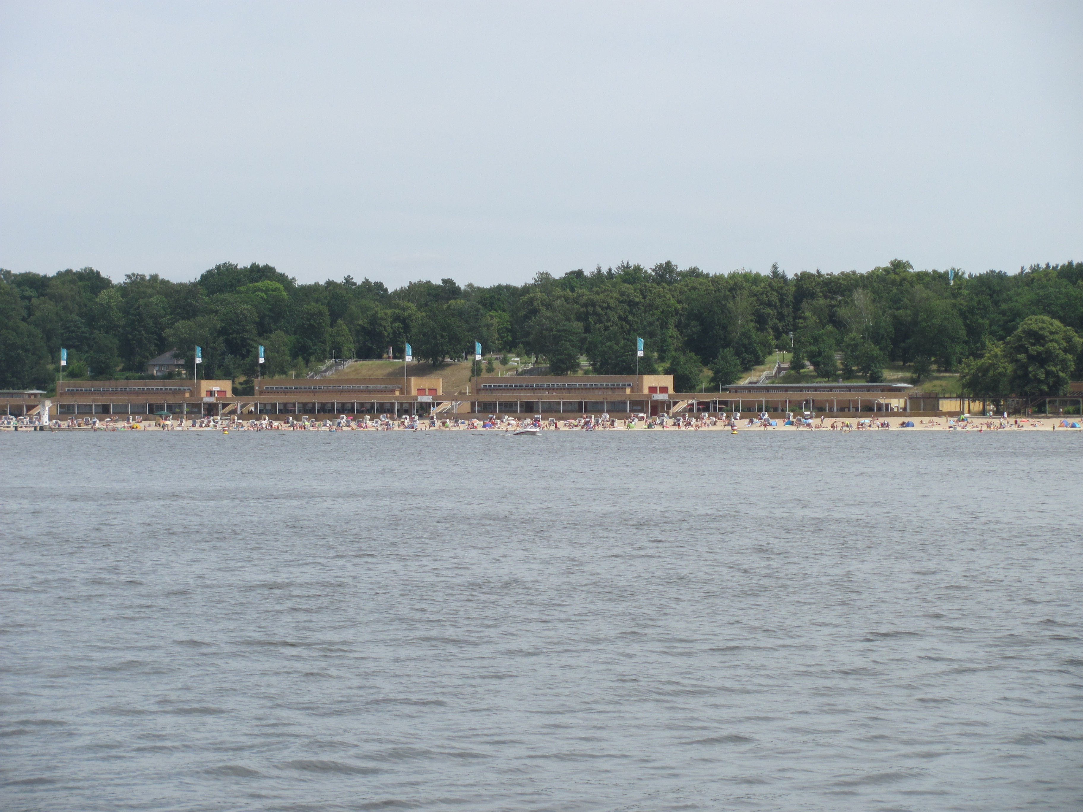
WANNSEE
A lakeside business conference centre until purchased by Himmler for the SS in the late 1930’s.
The lake built as a public resort by the Nazi Govt for the recreation of the people of Berlin

Slide 7
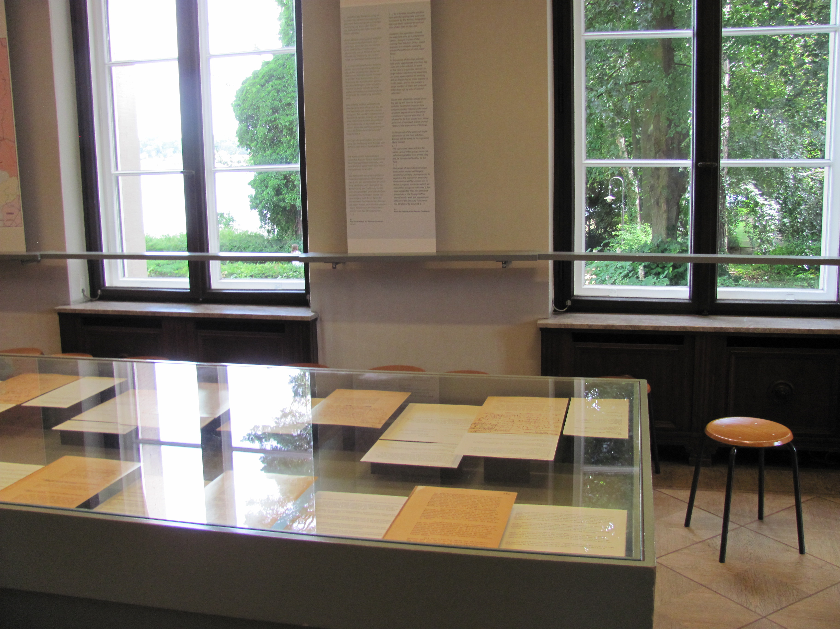
WANNSEE
Today the Conference Room is at the centre of a museum displaying the conference papers in original and translated formats.

Slide 8
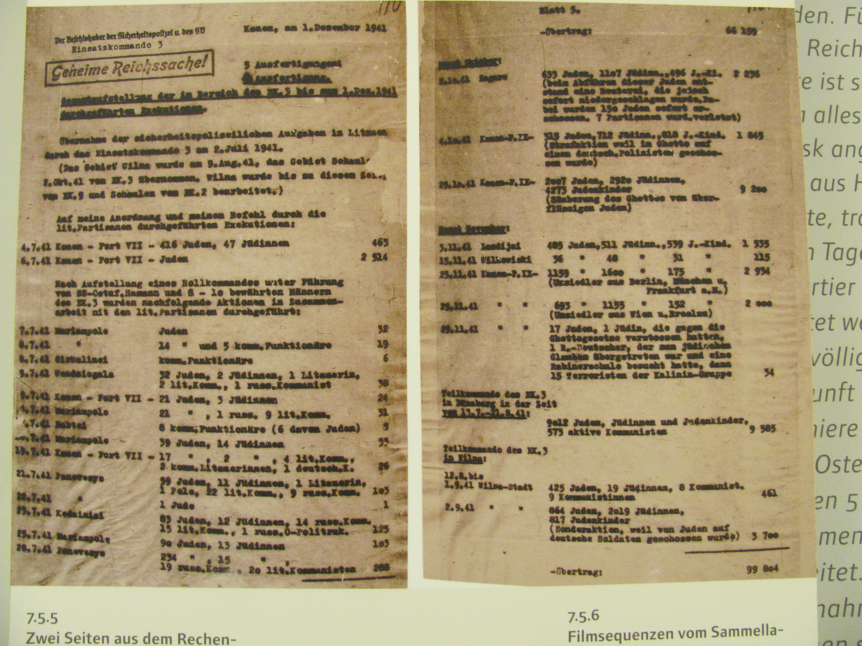
BEFORE WANNSEE
AND AFTER BARBAROSSA

Slide 9
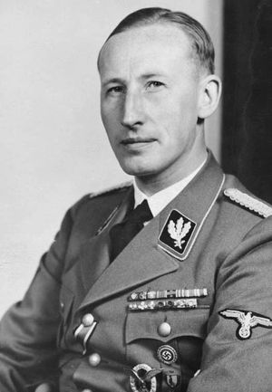
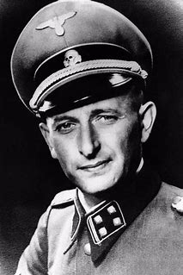
Reinhard Heydrich ss leader and gestapo chief
Charged by Reichsmarshall Herman Goering at the end of July 1941 to devise a comprehensive plan for the ‘final solution’. Convened and led Wannsee Conference assisted by the minute taker …
Adolf Eichmann, Chief of Jewish Affairs in the Reich Central Security Office.

Slide 10
delegates
15 officials representing the different and overlapping branches of government in Germany and the Occupied Territories
8 professionals with PhD qualifications science, engineering and transport

Slide 11
data

Slide 12
Protocols & EuphEMISM

Slide 13
Numbers & logistics

Slide 14
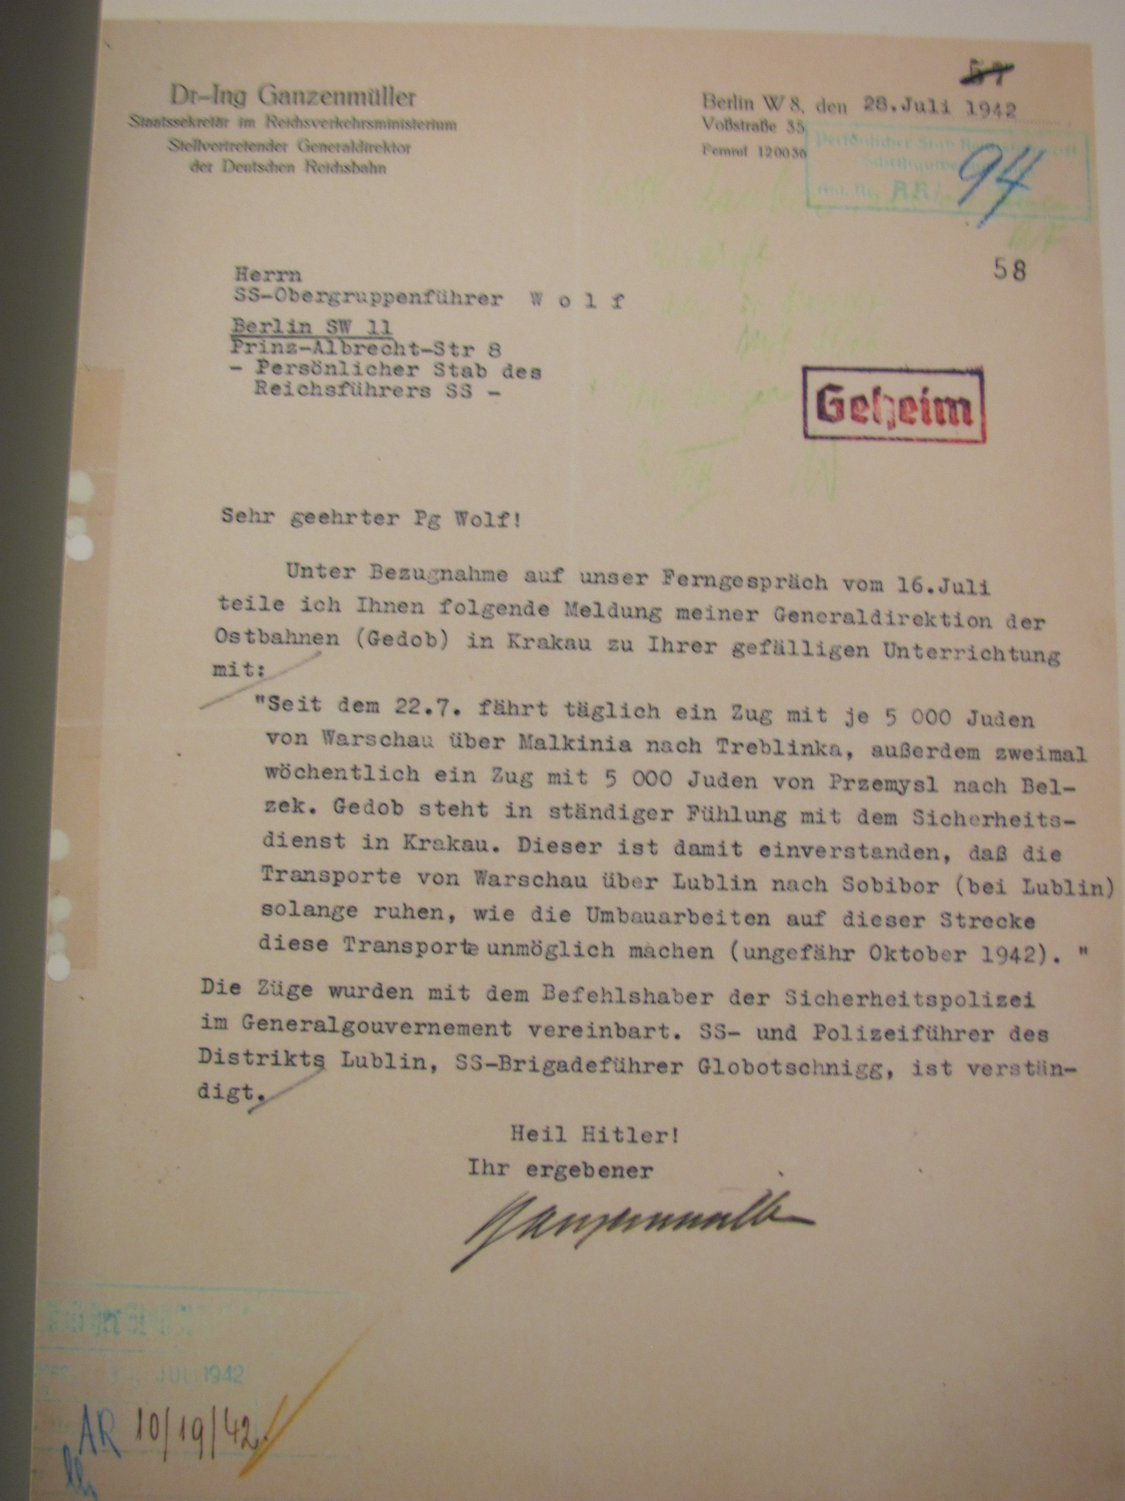
ORIGINAL

Slide 15
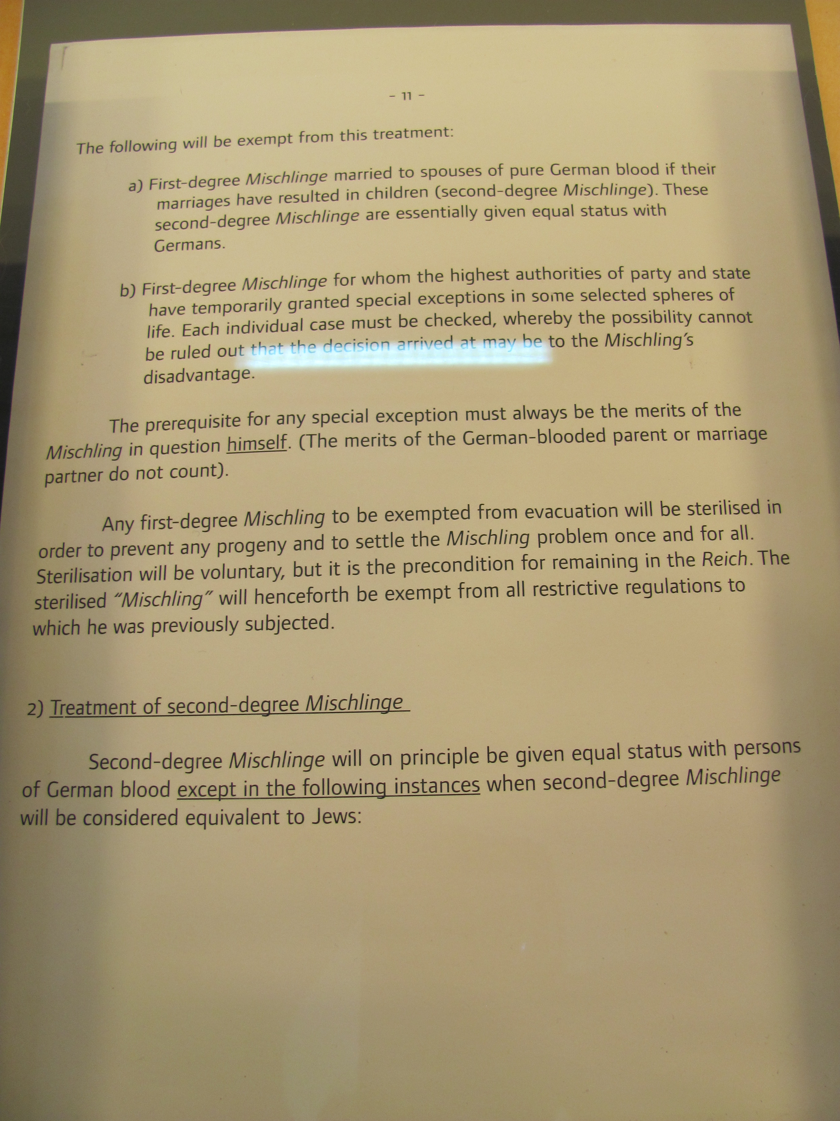
MISCHLINGE

Slide 16
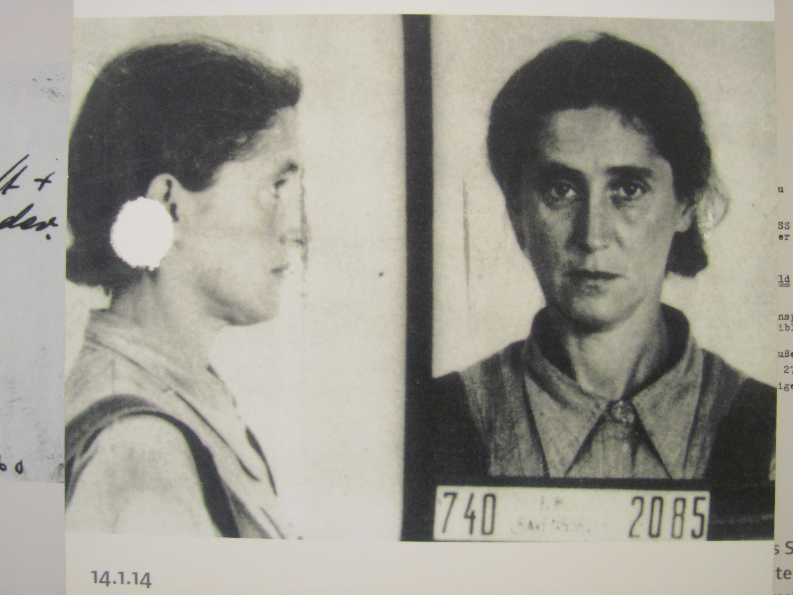
MISCHLINGE & RACISM

Slide 17
MISCHLINGE & RACISM

Slide 18
DEBATE & HISTORIOGRAPHY
Intentional or Structural?
Blueprint or Conceit?
Bureaucracy & Euphemism
Hitler’s overlapping administration – effect on the conduct of war and genocide
Complicity – Browning’s Ordinary Men and Evans Trilogy
Wherein lies the proof? From Lebensraum to Holocaust

