Slide 1
Rethinking module evaluation: defining, measuring and promoting engagement with teaching excellence by enabling the unfettered student voice
Dr Susan Kenyon
Presented at HEIR 2019, Wolverhampton, UK. 11-13 September 2019.

Slide 2
Overview
Employing MINDSPACE for Institutional behaviour change.
Module evaluations:
Method;
Results.

Slide 3
Part 1. Institutional change.

Slide 4
All aboard the ‘Student Voice Express’!
Module evaluation policy
Mood
Time

Slide 5
Module evaluation policy
Mood
Time

Slide 6
Messenger
Incentives
Norms
Defaults
Salience
Priming
Affect
Commitments
Ego
Dolan, P. et al. 2020. MINDSPACE: influencing behaviour through public policy. Available online via:
https://www.instituteforgovernment.org.uk/sites/default/files/publications/MINDSPACE.pdf, viewed 11/09/2019.
Mood
‘M I N D S P A C E’
Time

Slide 7
Part 2. Research findings.

Slide 8
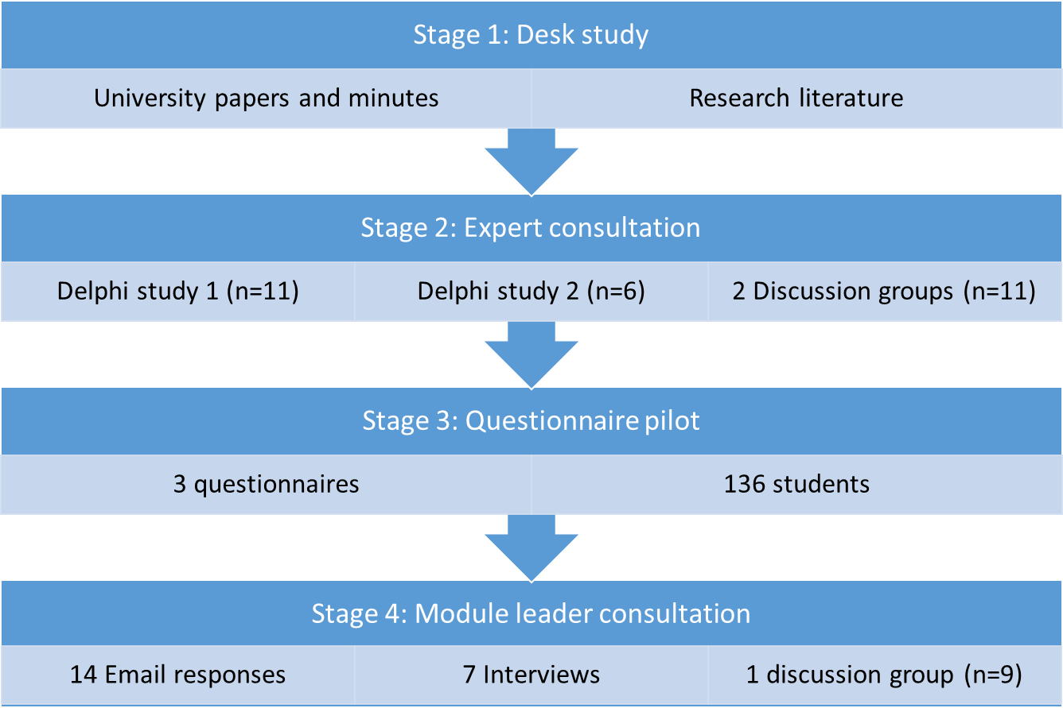
Method

Slide 9
Key findings (1): Different actors, different visions
 | Senior leaders of Learning and Teaching | Module Leaders | Students
Purpose of MEQs. | Monitoring. | Enhancement. | Relationships.
What improvement looks like | Metrics improve. | Learning better meets the needs of the cohort giving the evaluation. | Understanding; partnership.
How to drive improvement | Metrics indicate need for improvement. | Gather feedforward, not feedback. | Opportunity to discuss the learning experience: what worked; what did not; what would work better; and why.
Data needs | Quantitative: effectiveness, satisfaction and change in the same. | Qualitative data. | Unstructured.
Vision for MEQs | ‘Tell me that something needs to change’. | ‘Tell me what needs to change’. | ‘Work with me to change’.

Slide 10
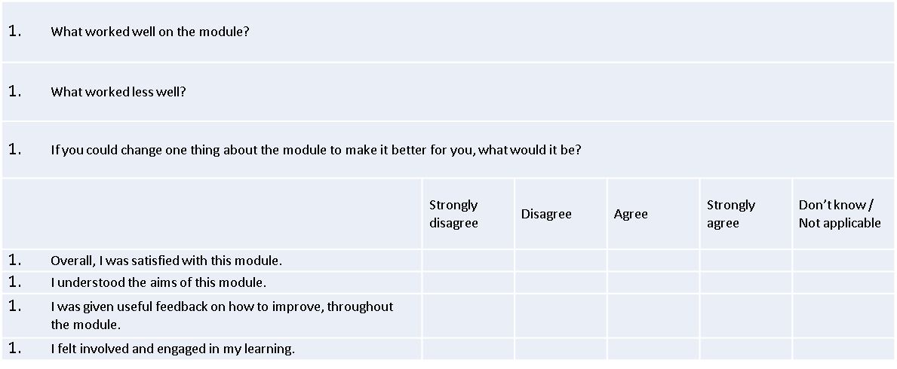

Slide 11
Key findings (2): very early indications
Effective for monitoring, enhancement and relationships.
Increase in trust.
Partnerships: student-staffs; staff-management.
New information with real opportunity for impact.
Increase in response rates.
Improvement (enhancement and relationships) must be prioritised over accountability (managerialism and quality assurance).

Slide 12
Next steps
Stage 5 ongoing: technical pilot.
Merging data, to enhance the inclusive curriculum.
Assigning Programmes/Modules.
Stage 6: testing at Institutional level.
Beyond the self-selecting sample of staff and students.

Slide 13
Dr Susan Kenyon
Susan.Kenyon@Canterbury.ac.uk

