Slide 1
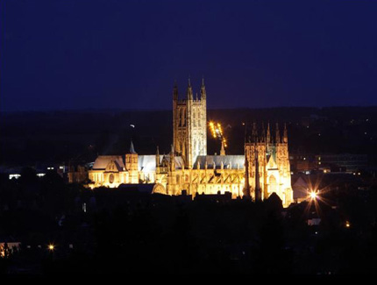
Is spirituality evident as part of the caring activity of nurses within an intensive care unit?
Ann Price
Canterbury Christ Church University
15-17th May 2012
British Association for the Study of Spirituality
This material is copyrighted to the author

Slide 2
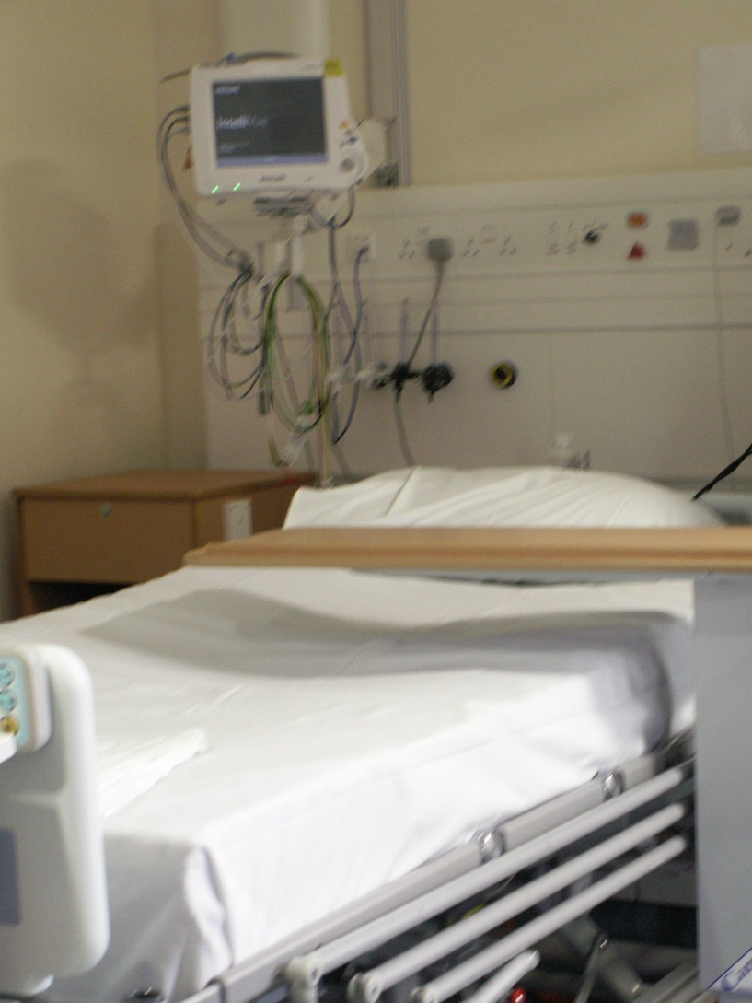
Context
Intensive care units:
  Highly technical
  Life saving interventions
  Multi-disciplinary team
  Stressful time for patients and families
  Many patients can not communicate verbally
  Many are sedated to aid treatment

Slide 3
Background to study
Ethnography (Fetterman 1989) looking at caring practice within the technological intensive care setting using:
  Participant Observations
  Semi-structured interviews
  Document review
Ethnography focuses on the culture of a group/ situation

Slide 4
Highlighted
Focus on getting people physically better
Involving people to enable this to happen
Refining care/technical aspects to include psychological recovery
Commitment to the individual through engagement
Harmonising these elements to achieve best outcome for individual
However, I noticed that there was virtually no reference to spiritual needs either during the observations or in the interviews.

Slide 5
Caring and Spirituality in ICU
Caring
Spirituality
Holistic (Finfgeld-Connett 2007)
Moral, emotional, cognitive elements (Kyle 1995)
Societal, political and cultural influences (Smith-Campbell 1999)
Involves interaction and action
Complex term
Holistic incorporating body, mind and spirit (Ellis & Narayanasay 2009)
Generic, biological and religious behaviours (Swinton 2010)
Cultural influences
Complex term

Slide 6
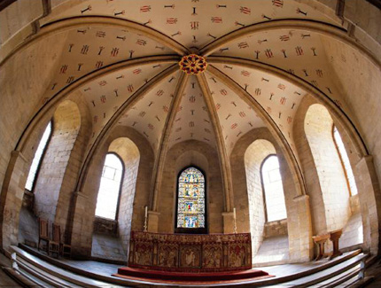
Considering ….
Body and mind evident but not spirit
I wondered whether spirituality was displayed but in a less formalised way.
I wanted to see if I had missed the spiritual elements

Slide 7
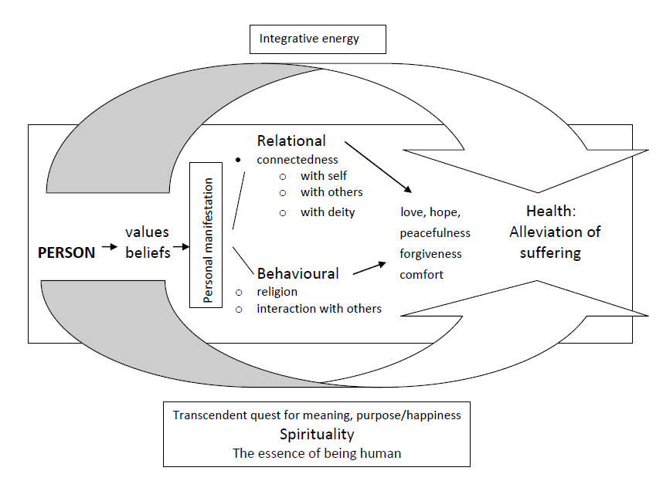
Model of Spirituality – Miner-Williams (2006) p. 817
Notes:
Thus I decided to utlise a model of spirituality to see if elements were within the data but had been missed, Chose Miner Williams as related to health care practice.

Slide 8
Exploring
Sample
Analysis
Used the nurses interview transcripts
13 participants
Semi-structured interviews had explored what caring practice meant
Meant researcher not making value judgements on what was seen in observations
Content analysis
Using Miner-Williams model as a basis to examine if the issues were evident within the data

Slide 9
Table of Findings
Model | Relational: Connectedness |  |  |  | Behavioural |  |  | Concepts |  |  |  |  | Transcedent |  |  | Health |  | Person
Participants |  | With self | With others | With deity | religion | interaction | $ With nurses | love | hope | peaceful | Forgive ness | comfort | meaning | purpose | Happi ness | *Allev suffering | $ Holistic | values
2 |  |  |  |  |  | 1 | 2 |  |  |  |  |  |  |  |  |  | 2
4 |  |  | 1 |  |  | 1 | 2 |  |  |  |  | 1 |  |  |  | 1
5 |  |  | 2 |  |  | 1 | 1 |  | 1 |  |  | 3 | 1 |  |  |  | 2 | 1
7 |  |  |  |  |  | 2 | 2 |  | 1 |  |  | 1 |  |  | 1 | 1
8 |  |  |  |  |  | 2 | 1 |  |  |  |  | 1 |  |  |  |  | 1
9 |  |  | 1 |  |  | 2 | 1 | 1 |  |  |  | 1 | 1 | 2 |  |  | 1 | 1
10 |  |  | 1 |  |  | 2 | 1 |  | 1 |  |  | 1 |  |  | 1
11 |  |  |  |  |  | 1 | 2 |  |  |  |  | 1 |  |  |  | 1 | 2 | 2
12 |  |  |  |  |  | 1 | 1 |  |  |  |  | 1 |  |  |  | 1 |  | 1
13 |  | 1 | 1 |  | 1 | 3 | 1 |  | 1 |  |  | 1 |  | 1 |  | 1 | 1
14 |  | 1 | 2 |  | 3 | 3 | 1 | 1 | 3 | 2 |  | 3 | 2 | 3 | 1 | 2 | 2 | 1
15 |  | 1 |  |  |  | 2 | 1 |  |  |  |  | 2 |  | 1 | 1 |  |  | 2
19 |  |  | 1 |  |  | 1 | 1 | 1 |  |  |  | 2 |  | 1 |  |  |  | 1
TOTAL |  | 3 | 9 | 0 | 4 | 22 | 17 | 3 | 7 | 2 | 0 | 18 | 4 | 8 | 4 | 7 | 11 | 9
*Alleviation of suffering
$ added by researcher

Slide 10
Findings
Relational connectedness
Behavioural
Importance of ‘knowing’ the patient evident
This related to individualised care and psychosocial issues
Connectedness not mentioned
Overlapped with behaviour as Miner-Williams suggests
Interaction evident and particularly with nursing staff
However more about communication for a purpose/psychological rather than affecting the spiritual
Only 2 participants mentioned religious activity

Slide 11
Findings continued
Concepts
Transcendence
All mentioned ‘comfort’
‘Support’ frequently used for physical and psychological aspects
Miner Williams talks about touching the spirit and these may be the way ICU nurses achieve this
Hope related to family
Respect and devotion rather than love
Scantly referred too
More about the meaning and will to live
Possibly because patients can not express this
Meaning may be important area to develop awareness about for individuals
Notes:
These issues may be more problematic in ICU as many patients can not talk due to treatment. Physical comfort is important as they can not do many activities of daily living (such as washing ) for themselves.
Respect and devotion may be easier in UK cultural context.

Slide 12

Findings continued
Health
Person
Reducing physical and psychological distress
Overlapped with comfort
Holism mentioned by many participants
The values expressed reflected the professional values of the nurses
Privacy, respect, dignity
This may be because they were in work mode and not considering the personal values

Slide 13
Discussion
Miner-Williams model not easy to apply to this practice setting
Although psychological and physical aspects of care clearly evident the spiritual was not.
However, this could be cultural within UK or within intensive care practice
Need to think about patients finding meaning from suffering

Slide 14
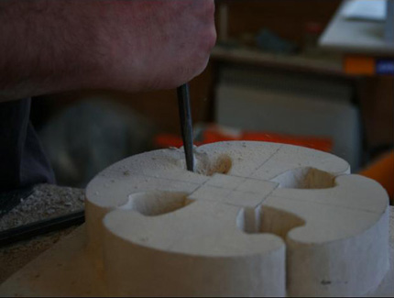
Limitations
The original questions not explicit enough to unveil about spiritual issues.
Female nurses may have different views to patients about the relevance/importance
Further research

Slide 15

“Caring is an Umbrella term….Caring is the whole thing”
As participant 11 stated
But critical care nurses need to develop the spiritual aspects within caring so that it really is the ‘whole thing’

Slide 16
Any Questions?

Slide 17
References
Ellis, H.K. & Narayanasamy, A. (2009) An investigation into the role of spirituality in nursing. British Journal of Nursing 18(14) pp 886-9
Fetterman, D.M. (1989) Ethnography: Step by Step. Applied Social Research Methods Series. Volume 17. London: Sage Publications
Finfgeld-Connett, D. (2007) Concept comparison of caring and social support. International Journal of Nursing Terminologies and Classifications 18(2): 58-68
Kyle, T.V. (1995) The concept of caring: a review of the literature. Journal of Advanced Nursing 21: 506-514
Smith-Campbell, B. (1999) A case study on expanding the concept of caring from individuals to communities. Public Health Nursing 16 (6): 405-411
Swinton, J. (2010) The meanings of spirituality: a multi-perspective approach to ‘the spiritual’ In: McSherry, W. & Ross, L. (Eds) Spiritual Assessment in Healthcare Practice. Cumbria: M&K Publishing. PP 17-35

