Slide 1
Exploring provision and impact of physical activity advice and guidance offered to women undergoing fertility treatment
Stacey Draper
Supervisors: Dr Marlize De Vivo & Dr Hayley Mills
stacey.draper@canterbury.ac.uk
Canterbury Christ Church University

Slide 2
Background and Rationale
Research demonstrates mixed findings but suggests physical activity can significantly affect fertility treatment outcomes.
inactive
extremely active
negative effect
frequency
intensity
type
moderately active
positive effect
There are currently no physical activity guidelines for women undergoing fertility treatment.

Slide 3
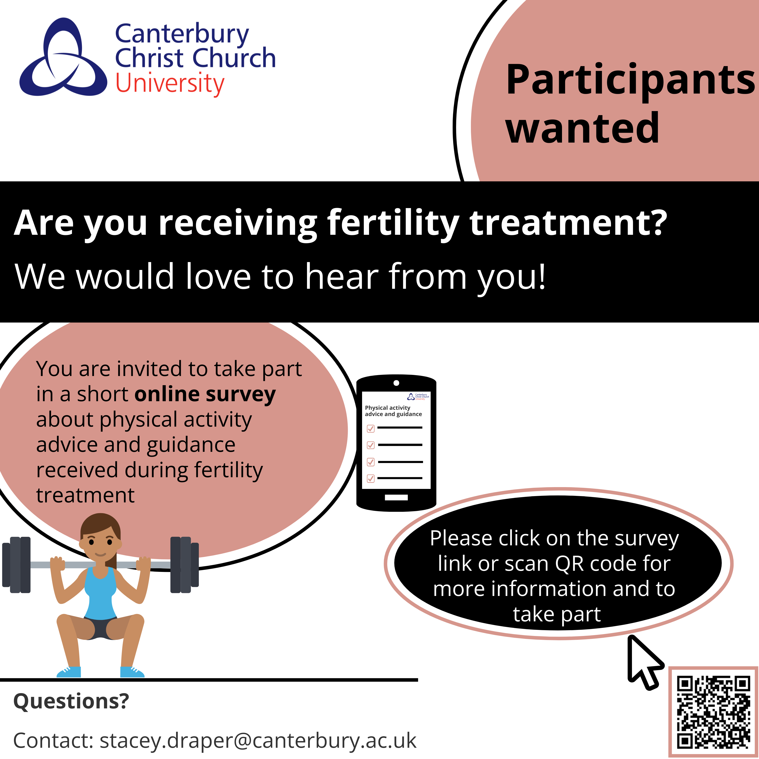
Method
HCP
Qualitative
(interviews)
Women
Quantitative
(survey)
(n=256)
Quantitative
(survey)
Qualitative
(interviews)
(n=11)

Slide 4
Results
Do women receive physical activity advice and guidance from their healthcare professional?
I did question a few times about going to the gym. Like once I’d gone in and had injections and things on the day at the clinic then I’d say well I’m planning on going to the gym later, can I do that? Their advice was “oh if you’re concerned just don’t risk it”.
(Aurora)
of women received physical activity advice and guidance. However...
I do remember at one of the earlier appointments asking the healthcare provider if I could still do things like go running but he cut me off and said “why would you want to go running if you’re trying to get pregnant?”
(Feyre)
of those women had to initiate the conversation themselves.
you might, you might go oh it’s a silly question to ask about exercise, right?
(Maya)

Slide 5
Results
women who received advice and guidance from their HCP decreased their activity levels significantly more than those who did not (p=0.01)
As soon as I start taking injections, I’ve tended not to do any strenuous exercise. So, I won’t run, I won’t do any swimming, I won’t do any like weights or anything, I’ll just do, I’ll just walk.
(Raven)
Their advice was to take it easy, walking is fine, gentle stretching and when I was in treatment not to do anything that involved twisting.
(Esme)
If you’re telling me not to exercise, I take that as I just need to sit on the sofa for two weeks.
(Riley)

Slide 6
Results
Has your physical activity levels changed since starting treatment?
"Risk and Reward"
79%
If I feel like I’m gonna impact something I’m not gonna risk it because I mean the risk and reward, it’s just not, you can’t even compare it.
(Riley)
Even when I wanted to run or jog my worry was well that could happen and I’d been told how dangerous that was from a torsion perspective and then I guess after transfer you’re then so scared of anything that might lead to another miscarriage.
17%
(Esme)
4%
Ok, now I’m in it I have to, I have to. It can be, it felt quite frustrating but then also, right well the greater good if it gets me to the end point that I want then in a way I was like suck it up.
I do less
I do more
No change
(Esme)

Slide 7
Results
‘Helping people navigate that uncertainty’ – Support for Guidelines
I really think it would be useful to have some more specific information about this because I definitely found that it was lacking, and you do, you know, you do second guess yourself, right?
of women believe there is enough information available to inform decisions around physical activity during fertility treatment
8%
(Maya)
of women believe it would be beneficial to have physical activity guidelines to refer to
100%

Slide 8
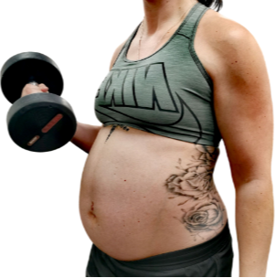
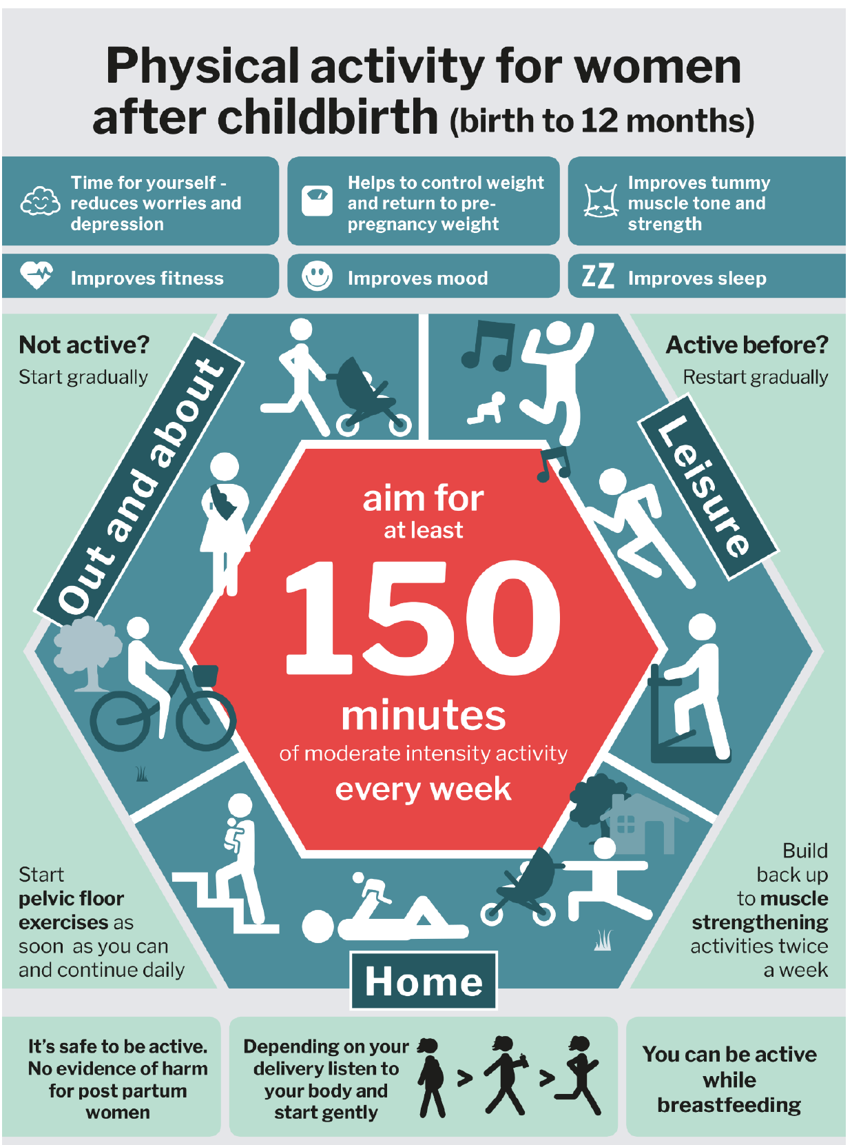
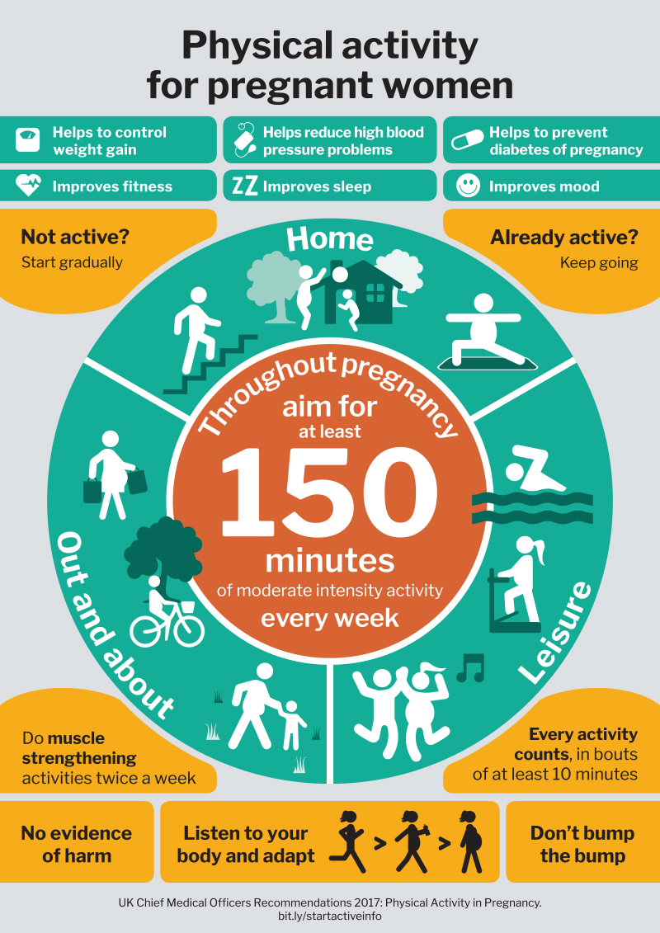
Reflections once pregnant
It’s not just about cardio it’s now, also about strength. Whereas before, during treatment I was always really scared to do anything strength focussed. Now that I’m pregnant and potentially with twins I think right I need to be really strong.
(Matilda)
I just find it interesting getting all this information now that I’m pregnant and having these guidelines telling me to do these things and feeling like oh how can I suddenly do all this now there’s a baby inside me but when there wasn’t anything I was told I couldn’t do it?
(Feyre)

Slide 9
Thank you for listening!
stacey.draper@canterbury.ac.uk

