Slide 1
ADVANCE in HIGHER EDUCATION Assessment and Feedback Symposium 5 November 2024
What feedback do students want?
Dr Gemma van Vuuren Cassar
Email: Gemma.van-vuuren-cassar@canterbury.ac.uk
LinkedIn: Gemma van Vuuren-Cassar

Slide 2
OVERVIEW
Summative Assessments: written and audio feedback in higher education
Communicating assessment feedback: students’ emotions and self esteem
Staff Perspectives - survey and focus group (2021)
Conclusions and recommendations
Student focus group (2024)
Students’ Perspectives – surveys (2021 and 2024)

Slide 3
SUMMATIVE ASSESSMENT FEEDBACK “The quality and depth of marking and assessments is an issue of real importance to students” (Advance HE and HEPI, 2024, pg. 63)
Written Feedback
Audio feedback
Students value (Brown, 2015) and expect high quality information without considering their own role in the process (Winstone and Carless, 2019).
While students were broadly positive about audio feedback, they indicated a strong preference for written feedback due to visually being able see their strengths and areas to improve on their work (Morris and Chikwa, 2016; Sarcona et al, 2020).
Summative feedback type did not impact on students’ grades in the subsequent assignment (Morris and Chikwa, 2016).
A ‘voice comment’ made the assessment feedback more personalised (Carruthers et al, 2015; Sarcona et al, 2020).
Audio feedback is highly acceptable to students but is underused (Cann, 2014).
Students found difficulty to match the teachers’ comments on the audio recordings with their written document causing emotional reactions (Carless and Boud, 2018) stress and anxiety following feedback (Lynam and Cachia, 2018).

Slide 4
COMMUNICATING ASSESSMENT FEEDBACK
Students’ Emotions
Self Esteem
The feedback literacy model stressed that students need the capability to working with emotions productively, since negative emotions can interfere with students’ use of feedback information (Carless and Boud, 2018).
Students experienced positive emotions when the assessment feedback recognised their efforts, while stress and anxiety as a result of receiving feedback impeded engagement with assessments (Lynam and Cachia, 2018).
Lecturers need to increase their awareness of intercultural differences of international and domestic students – critical assessment feedback - Bad job? Improve.. (Rovagnati and Pitt, 2021)
Feedback emphasising students’ strengths, weaknesses and shortcomings communicated through a computer did not minimise possible harmful effects on students’ self-esteem, nor did it result in the prompt adoption, processing, or feedback-seeking by students (Bulut et al, 2019).
Critical comments from lecturers reduced the self-esteem and perceived self-efficacy of students, resulting in negative emotional reactions (Rowe, 2017)
More research is needed in understanding how to help students manage the potential negative effects of emotional backwash in feedback situations (Pitt and Quinlan, 2022).

Slide 5
WHY AUDIO FEEDBACK?
Audio feedback was trailed across one Academic School for Semesters 1& 2 of the academic year 20-21 since teaching was online and students were not on campus. A ‘voice comment’ made the assessment feedback more personalised (Carruthers et al, 2015). Audio feedback used for the last 3 years.
Generating voice comments and less written comments in text potentially saved time and made explanations tailored for the student’s work. Students would like to have both audio and written assessment modalities as they appreciated the personal nature of hearing the instructors’ voice (Sarcona et al, 2020).
Students received feedback via Turnitin: assessment rubrics, a grade, audio feedback, and in the ‘text comment’ instruction of how to access audio feedback.
Staff used the integrated ‘voice comment’ functionality in Turnitin (3 minutes) - audio-feedback. Staff provided with training for the voice recording; templates of texts of instructions to paste; and a script to use for the recording.
Notes:
S

Slide 6
STUDENTS’ PERSPECTIVES
2021: Supply type questions; Likert scales and open-ended responses on
What is most important to students?
Accessibility, engagement and quality of audio feedback
Perspectives on audio and written feedback
Student views on feedback
formative and summative assessment
focus and general feedback
2024: added questions about self-esteem and anxiety
JISC Surveys
JISC Online Survey Bournemouth University (2006-2022)

Slide 7
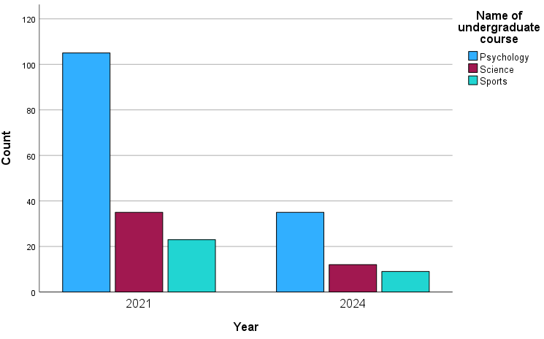
STUDENTS Year of study Courses Levels

Slide 8
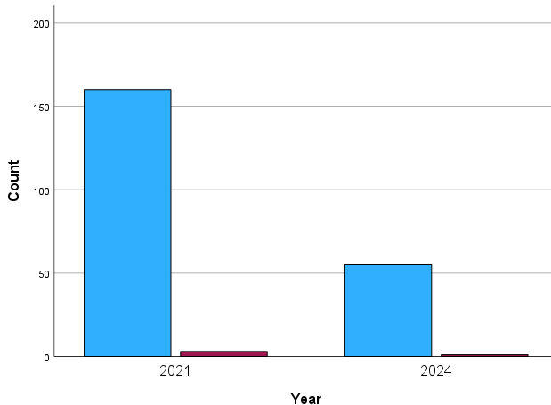
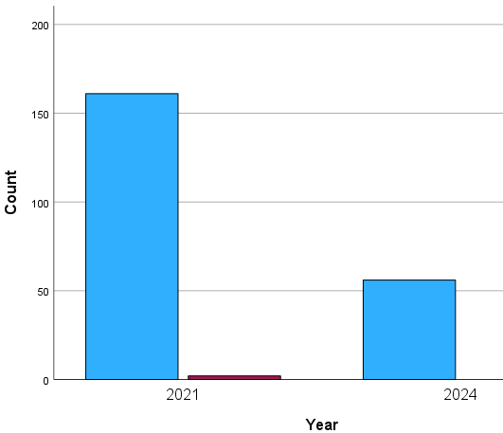
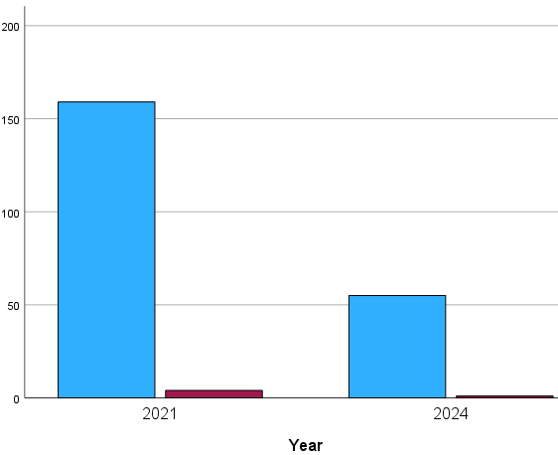
FEEDBACK ON SUMMATIVE ASSESSMENT: What is important to students ….
Easy to Access & year
DETAIL & YEAR
Timely- 15 WORKING DAYS & YEAR

Slide 9
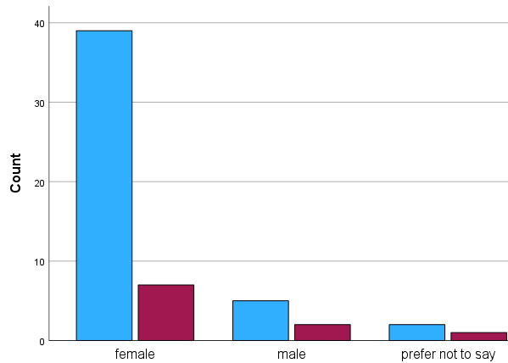
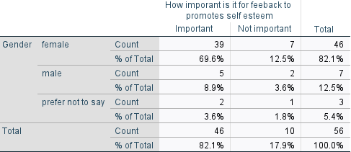
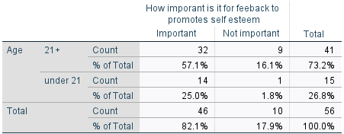
FEEDBACK ON SUMMATIVE ASSESSMENT: What is important to students ….
Personalised & YEAR
Self-Esteem & Age
Self-Esteem & Gender

Slide 10
STUDENTS AND SUMMATIVE ASSESSMENT FEEDBACK (preliminary data analysis) *2024 students only
Statements (5 Strongly Agree – 1 Strongly Disagree) | N | Mean | SD
I listened to each recorded piece of audio-feedback all the way through. | 219 | 4.25 | 1.262
It was easy to find and play the recorded audio-feedback. | 219 | 4.10 | 1.222
*I wish I could download the transcript of the recorded audio feedback from Turnitin | 56 | 3.95 | 1.78
I could hear and understand what the marker(s) were saying clearly. | 219 | 3.85 | 1.320
The sound quality of the recorded audio-feedback was very good. | 219 | 3.74 | 1.314
I listened to each recorded piece of audio-feedback several times. | 219 | 3.68 | 1.351
The recorded audio-feedback made clear the weaknesses of my work. | 219 | 3.60 | 1.283
*I am more anxious about the grade that I receive and less on what is said in the recorded audio or written feedback | 56 | 3.54 | 1.709
The recorded audio-feedback made clear the aspects of my work I need to pay attention to in my future assessments. | 219 | 3.52 | 1.345

Slide 11
STUDENTS AND SUMMATIVE ASSESSMENT FEEDBACK (preliminary data analysis) *2024 students only
Statements (5 Strongly agree – 1 Strongly Disagree) | N | Mean | SD
*The feedback (3mins) was long enough | 56 | 3.37 | 1.727
The marker(s) providing my recorded audio-feedback sounded interested. | 219 | 3.34 | 1.389
The recorded audio-feedback is more personalized than written feedback | 219 | 3.11 | 1.348
I took notes when listening to my recorded audio-feedback. | 219 | 3.01 | 1.453
*I get anxious before I listen to the feedback | 56 | 3.00 | 1.935
I am more likely to contact my lecturer to discuss recorded audio-feedback than written feedback. | 219 | 2.93 | 1.215
I am more likely to act on recorded audio-feedback than on written feedback. | 219 | 2.79 | 1.286
I am more likely to review recorded audio-feedback than written feedback when I'm working on my next assessment. | 219 | 2.78 | 1.338
Recorded audio-feedback goes into more detail than written feedback. | 219 | 2.85 | 1.436
It depends on the assessment type which type of feedback I prefer (recorded audio-feedback or written feedback). | 219 | 2.79 | 1.224
It causes me less anxiety listening to recorded audio-feedback than reading written feedback | 219 | 2.50 | 1.272

Slide 12
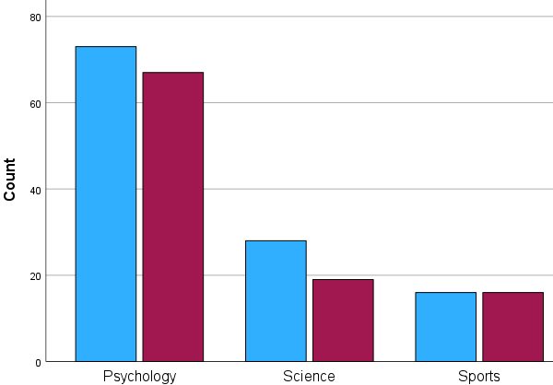
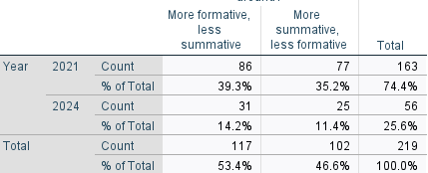
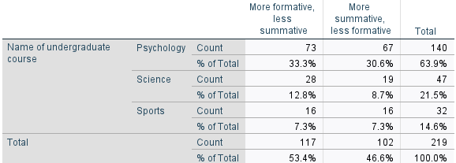
WOULD YOU RATHER HAVE FEEDBACK THAT IS…

Slide 13
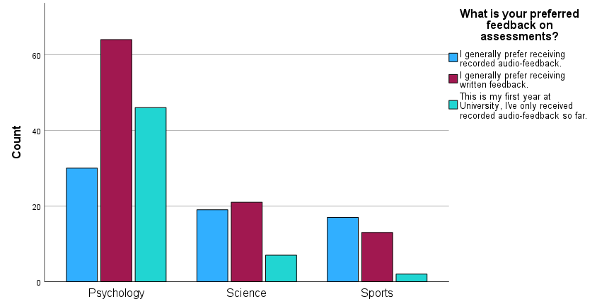
PREFERRED FEEDBACK by course X² (4, N=219 )= 20.76 , p=<.001*
There is a slight preference for written feedback by psychology students (N=64) - this is statistically significant*

Slide 14
STUDENT FOCUS GROUP (2024) Experience of assessments and feedback
Exams
Grade and Audio feedback release day
“the word exam puts fear into students regardless of what platform and what sort of shape it takes place.
For me, it's a fear of failing, a fear of not doing well, so I was always anxious …
I prefer online exams- a relaxed approach being 24 hours online rather than, say, hour exam in person.” P1
“personally, I was incredibly anxious, but I was also furious .. I have auditory sensory issues - I have been fighting with a disability team to get a cover slip, saying my feedback has to be given written”P1
“I can tell by the feedback if someone actually has taken the time to probably read it, understand it, and actually being a little bit inspired and, you know, have learnt something from it, some feedback that I've received has been quite generic”.P2

Slide 15
STAFF EXPERIENCE (2021) Audio Feedback
Staff- JISC Survey
Staff -Focus Group on Audio Feedback
46 Participants (30%)
Open-ended questions
Using the audio feedback template
Time to complete audio feedback
Recording the audio feedback
6 opt in participants
Semi structured questions on
Use of template
The process and technical matters
Time to complete audio feedback
Perceptions of audio feedback and written feedback

Slide 16
AUDIO FEEDBACK
Structure of and Using Template
Time - Technical Issues
Works well for essay type assignments but not for exercises and research reports
Not as detailed as written feedback … with annotations in text.
Level of detail was reduced … generic and not specific to their work
Harder to use for low achieving students…; higher level modules … and dissertations
Audio feedback is not always the most appropriate format. To force all staff to use audio feedback removes any professional autonomy. Staff to choose audio / written feedback…. it would be nice to have flexibility.
3 minutes not enough to do the full Strengths-Weaknesses-Key Points going forward
Process quicker than written feedback
Easier to type and copy written feedback.. templates can be pasted, and text can be edited
Write feedback for students with hearing impairment
Recorded and cancelling a few times / forgot to “Save” recording
Moderation takes longer

Slide 17
CONCLUSIONS AND RECOMMENDATIONS
Students want
detailed, timely and personalised assessment feedback
concise feedback that emphasises areas for improvement
formative and summative feedback
psychology students prefer written summative feedback
Students
engaged with audio feedback recordings
would like a transcript of the recording
feel that it is important for assessments to promote self-esteem, especially for female and older (21+) students.
experienced some anxiety and stress before seeing the grade whether feedback was audio or written.
not likely to contact a tutor because they heard the tutor, and the feedback was voice recorded
Further investigations on
“how” and “when” formative feedback will benefit students for different types of assessments.

Slide 18
REFERENCE LIST
Advance HE and Higher Education Policy Institute (HEPI) (2024) Student Academic Experience Survey 2024. Available at: https://advance-he.ac.uk/knowledge-hub/student-academic-experience-survey-2024. (Accessed: 20/6/20204)
Brown, S. (2015) Learning, Teaching and Assessments in higher education: global perspectives. London: Palgrave-McMillan.
Bulut, O., Cutumisu, M., Aquilina, A.M., and Singh, D. (2019) ‘Effects of digital score reporting and feedback on students’ learning in higher education’, Frontiers in Education, 4 (65), 1-16.
Cann, A. (2014) Engaging Students with Audio Feedback, Bioscience Education, 22:1, 31-41.
Carless, D., and Boud, D. (2018) ‘The development of student feedback literacy: Enabling uptake of feedback’, Assessment and Evaluation in Higher Education, 43 (8) ,1315-1325.
Carruthers, C., McCarron, B., Bolan, P., Devine, A., McMahon-Beattie, U., and Burns, A. (2015). “‘I like the Sound of That’ – An Evaluation of Providing Audio Feedback via the Virtual Learning Environment for Summative Assessment.” Assessment & Evaluation in Higher Education 1 (3): 353–370.
Lynam, S., and Cachia, M., (2018) ‘Students’ perceptions of the role of assessments at higher education’, Assessment and Evaluation in Higher Education, 43 (2): 223-234.
Morris, C., and Chikwa, G. (2016) Audio versus written feedback: exploring learners’ preference and the impact of feedback format on students’ academic performance. Active Learning in Higher Education, 17 (2), 125-137.
Pitt, E., Quinlan, K. M. (2022) Impacts of higher education assessment and feedback policy and practice on students: A review of the literature 2016-2021. Advance HE.
Rovagnati, V., and Pitt, E. (2021) ‘Exploring intercultural dialogic interactions between individuals with diverse feedback literacies’, Assessment and Evaluation in Higher Education, 47 (7), 1057-1070.
Rowe, A. D. (2017) ‘Feelings about feedback: The role of emotions in assessment for learning’, in Carless, D, Bridges, S, Chan, C K and Glofcheski, R (eds) Scaling Up Assessment for Learning in Higher Education. Singapore: Springer, pp 159-172. Available at: doi.org/10.1007/978-981-10-3045- 1_11
Sarcona, A., Dirhan, D., Davidson, P. (2020) An overview of audio and written feedback from student’s and instructors’ perspective. Educational Media International, 57 (1), 47-60.
Van Vuuren-Cassar, G. and Harvey, C. (2022) Undergraduate students’ perspective of summative and audio feedback. International Network of Assessment in Higher Education Conference, Manchester, UK. (22nd June 2022)
Winstone, N.E., and Carless, D. (2019) Designing effective feedback process in higher education: A learning-focused approach. London: Routledge.

