Slide 2
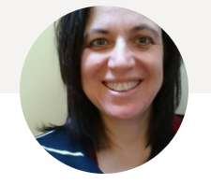
Female Entrepreneurship: Challenges and Opportunities
Dr Aga Gordon
Senior Lecturer in Entrepreneurship and Innovation
Christ Church Business School, CCCU
acgtranslation.com
Polish Educational Club in Kent CIC
www.polisheducationalclub.com
Women in Business Conference and Women Entrepreneurs Forum, 19th March 2024

Slide 3
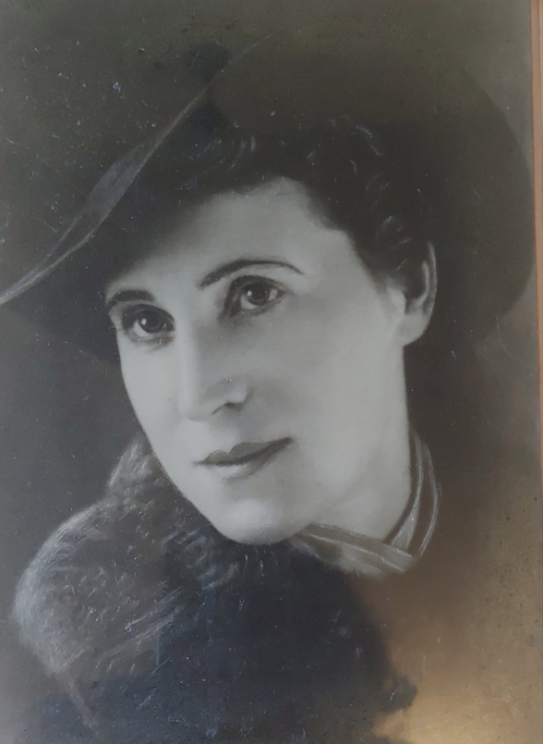
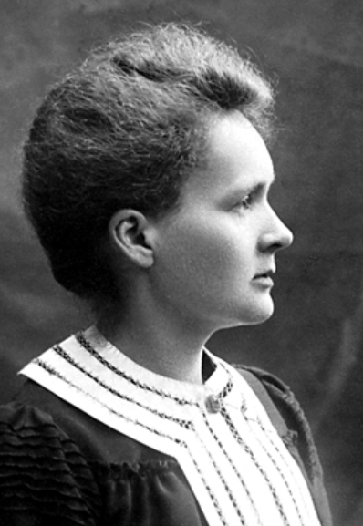
My role models – International Women’s Day
Notes:
Work hard you can achieve anything
Female role models- my gran – encouragement, courage, believe in good values,
Maria Sklodowska Curie (minority, woman ; achieved a lot when education was not offered for women; first woman to achieve Nobel prize yet did not get professorial chair after Pierre died.

Slide 5
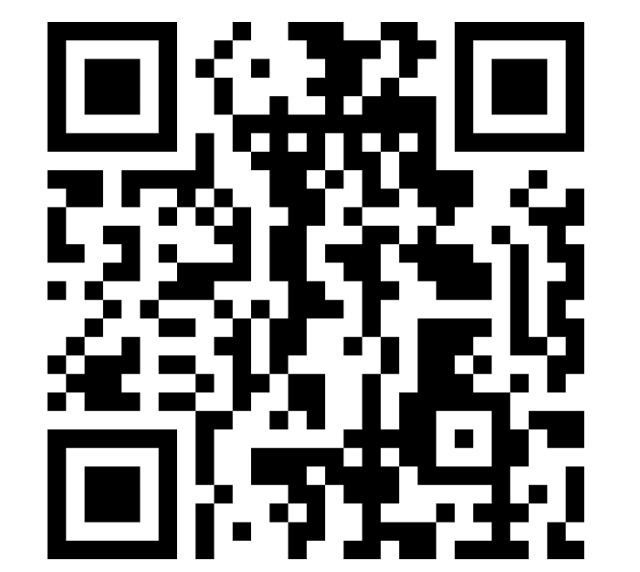
What challenges have you faced as an entrepreneur?
MENTI CODE: 3204 3366
www.menti.com
Notes:
ICEBREAKER
Picture of a desert tropical island
You are allowed to pick 5 items as a team, you have to agree the selection and explain to the rest of the group your

Slide 6
Challenges and how to overcome them
Female challenges - Juggling multiple projects (family, work)
BAME/minority challenges - Cultural/procedural/educational
Stereotypes – female/male – can do attitude, collaborate, help others, show your knowledge by sharing expertise, skill swap
Lack of social capital in the UK – building networks
Enterpreneurial challenges - financial, know your competitors, markets, value proposition
Great role models both female and male
There is no such a thing like ‘impossible’ – make impossible possible
Notes:
ICEBREAKER
Picture of a desert tropical island
You are allowed to pick 5 items as a team, you have to agree the selection and explain to the rest of the group your

Slide 7
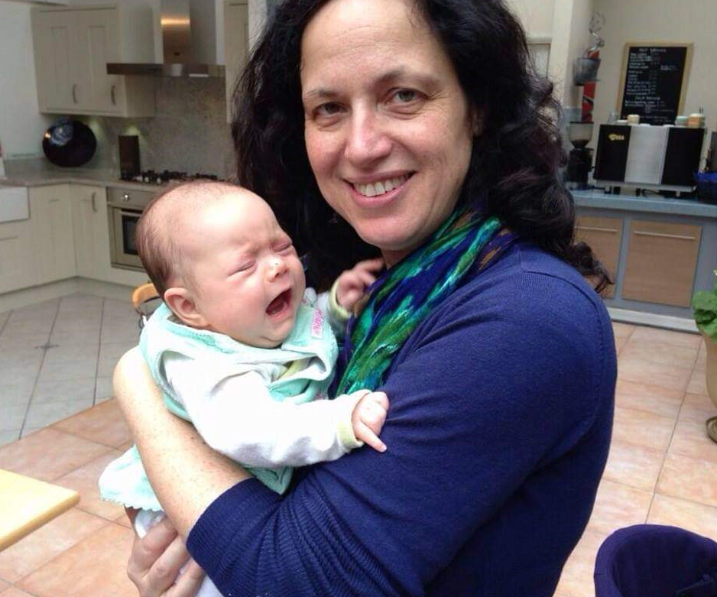
Challenges and how to overcome them
PhD – first baby
MBA – second baby
Entrepreneurship – third baby
When change hits, assess your options and see what
you can offer!
Kent Business Tweetup networking event, photo: Jules Serkin

Slide 8
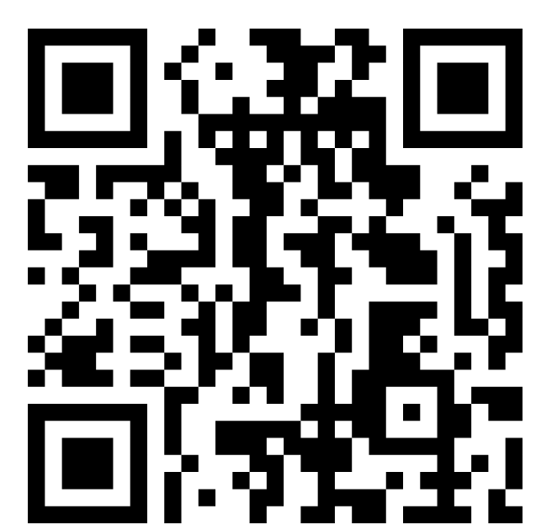
Entrepreneurial traits
What traits do we need to be successful?
MENTI CODE: 3204 3366
www.menti.com

Slide 9
Entrepreneurial traits
From my experience:
Creativity
Innovation
‘Big picture’ – pulling your skills and experiences together
Confidence
Can do attitude
Resilience
Learning from ‘failure’
Spotting opportunities
Flexibility and agility
From research:
Need for independence
High need for achievement
High internal locus for control
High creativity, innovation and opportunism
Acceptance of measured risk and uncertainty

Slide 10
My tips
Do what you love – passion is a key!
You can achieve anything if you work hard enough
Connect and collaborate with others
See challenges/failures as opportunities to change and grow
Ask for help – at home, professionally
Network
Share you expertise/help others
Educate yourself/learn – informally and formally
Overcome perfectionism
Surround ourself with those who can support and encourage you – men and women
Know your value and confidently present it (ask for money when selling your services!)
Take care of your mental health

Slide 11
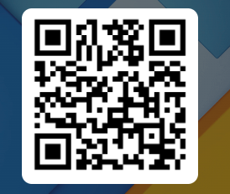
How can I help?
Fill in the form if you are interested in:
free workshops
networking opportunities
university level courses
KTPs – funded innovative projects between academia and industry
I am also happy to talk to anyone after the session

Slide 12
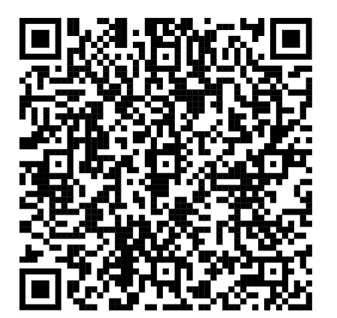
Upcoming workshop – in person, CCCU
Creative Strategies for Implementing Digital Tools
You will apply creative problem-solving techniques to create a strategy/plan for implementing digital tools/AI into your business.
Date: 21/03/2024
🕐1:00 PM GMT - 3:00 PM GMT 📍 Verena Holmes Building, VH 1.14b, N Holmes Rd, Canterbury, Kent, CT11QU Sign up here ➡https://lnkd.in/gVQHmxxv

Slide 13
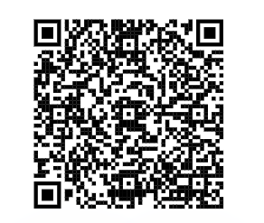
Upcoming Help to Grow Management Course
Are you a senior business leader/owner/founder of a small or medium sized enterprise (>5 employees,< 250)?
Are you looking for an opportunity to develop a growth action plan for the business?
Register here for a place on our next course starting 24 April for 12 sessions on topics such as strategy and innovation, digital implementation, building a brand and winning new markets - 90% funded by central government.
On completion you will join the alumni network with thousands of other business leader peers here in Kent and across the UK.
If you want to have a chat regarding the course prior to registration, please email via htgmanagement@canterbury.ac.uk

Slide 14
QUESTIONS?
aga.gordon@canterbury.ac.uk

