Slide 2
Unpacking Employablity
BA Media and Communications, experiences and examples of embedding employability
James Corbin – Deputy Manager Employability and Careers and Dr. Joanne Woodman – Programme Director Media and Communications
Notes:
JW
Basically the journey myself and the team went through – with James in order to revalidate the Media and Communications programme – so offers an overview of How we began thinking about the student transition into HE and Out into the world of work

Slide 3
Transforming Media and Cultural Studies from traditional theory based degree to a modern degree with a focus on theory and professional content
How did Employability fit? (Why we did it)
How we did it? (Process)
What is employability?
Benefits/Challenges
What next?
Notes:
James
This is what we are going to cover…

Slide 4
Why We did it?
Flat student numbers/drop in applications
Student Requests for Practical Work (evaluations surveys)
Advice from externals and schools to increase professional content
Poor Destination Figures (only 15% in graduate employment)
Issues around retention (10-15% - student expectation)
Strategic Plan (2011-15) supported by Faculty and Department Plans (HOD experience and sharing modules/efficiencies)
Due for revalidation
Notes:
JW
Will say more around how –Background was that as a result of the above we had begun to bring in some more professional modules – which improved student satisfaction – brought in an advertising module and Andrew King Piloted getting students to work to live briefs – brought in a public relations module so students carried out a PR campaign – from this realised students needed help with web design and digital skills – last year brought in some digital skills in year 1 – on a module that had mainly been about semiotics and textual analysis got students to design DVD covers and discuss/theorise how they had created meanings and on a men’s magazines module moved from completely theory based to bringing in practical elements – the module had been about the representations and construction of masculinity underpinned by gender theory – brought in practical and creative skills.

Slide 5
Assessment Masculinity and Men’s Magazines Module
Notes:
JW – example might look like a piece of fun and indeed students enjoyed it and found it very engaging as opposed to the traditional essay but students – applied gender and economic theory particularly theories of hegemonic masculinity and consumer culture in order to analyse magazine covers – so first piece of assessment asks them to show understanding of a variety of theories and apply them in a textual analysis - then were taught to use industry standard software – adobe creative master suite in order to do page layouts to construct there own cover. The final part of the assessment they had to write an analysis of their covers applying theories to discuss how masculinity and feminity are constructed in relation to each other, in relation to consumerism and in relation to social status – so for example examing how different ideals of femininity are set up in cheaper top shelf mags like nuts and zoo whereas they are more sophiticated and less brah in mags such as GQ. Creating an awareness of gender issues and of economic and commerciallinks as well as industry skills.

Slide 6
Strategic Plan as framework
Ambition 7 development of the Academic Portfolio: to develop a distinctive curriculum offer with a strong focus on developing student employability and preparing students for employment, lifelong learning and citizenship in the modern, global world. Among the graduate attributes to be developed are: an ethical approach to professional life, research and enquiry skills, academic skills including critical thinking, communication skills and reflective capacities as learners / practitioners (Strategic Plan 2011-15, 2011: 19).
Notes:
JW

Slide 7
How We Did It?
Engagement with Employability and Careers Service–
a) Scholarship and Resources relating to Employability –

Slide 8
What is Employability?
QAA Student Employability Profiles
Higher Education Academy http://www.heacademy.ac.uk/ourwork/teachingandlearning/employability/employability
Notes:
JCo

Slide 9
QAA EMPLOYABILITY PROFILES Cognitive Skills identify, and solve problems, handle diverse data, draw conclusions. | Generic Competencies High level and transferable key skills: the ability to work in a team, communicate, persuade | Personal Capabilities ability and desire to learn for oneself and improve, | Technical Ability - having the knowledge and experience of working with relevant modern technology. | Business/ Organisation Awareness appreciation of business operation, organisational culture, policies and processes through (preferably relevant) work experience. | Practical and Professional Elements Critical evaluation of professional practice, participate in and review quality control processes and risk management
Notes:
Jco
Need to translate this into the curriculum

Slide 10
A widely accepted definition of employability is
a set of achievements, - skills, understandings and personal attributes – that make graduates more likely to gain employment and be successful in their chosen occupations, which benefits themselves, the workforce, the community and the economy HEA, 2012, PDF).
Notes:
JCo

Slide 11
What is Employabilty?
it is not enough to provide students with opportunities for work placements and with skills training …it is also necessary to develop their language of employment-enhancing skills. R. Barrow, C. Behr, S. Deacy, F. McHardy and K. Tempest, ‘Embedding Employability into a Classics Curriculum: A Case Study of the Classical Civilisation Bachelor of Arts Programme at Roehampton University’, in: Arts and Humanities in Higher Education 9.1, 2010.
Notes:
JW

Slide 12
Employability
It is about learning and the emphasis is less on ‘employ’ and more on ‘ability’. In essence, the emphasis is on developing critical, reflective abilities, with a view to empowering and enhancing the learner.
(Harvey 2003)
Notes:
JW

Slide 13
What did we think about?
a) Practicalities of Embedding Employability
b) Help and support with work placements/experience/guest lectures/resources
Engagement with LTEU and QSO

Slide 14
Engagement with TELT
…the perceived benefits may be focused on engaging students through enhanced learning opportunities thus enabling them to work towards a range of higher level skills which contribute to their employability. (TELT Strategy Consultation document -2012-15)
Notes:
JW – Media and Communications lends itself particularly well to bringing in technology enhanced learning as these skills are related to the kinds of skills students will need to use in the work place

Slide 15
How we started
Industry panel – ADVICE AND OPPORTUNITIES
Work related learning/Introduction to professional communications
Threads of employability in different modules
Notes:
, JCo panel
MODULES RAISING AWARENESS OF HOW TO COMMUNICATE IN THE WORK PLACE AND HOW TO COMMUNICATE EMPLOYABILITY SKILLS – ALL UNDERPINNED BY MEDIA OR COMMUNICATIONS THEORY,
the module introduces students to issues associated with commencing Higher Education – how to communicate ie verbally and in writing also on the importance of employability within the Media and Communications curriculum and on student engagement with Employability and Careers Services. Sessions cover communication skills specific to media and communications and to a professional media career. Students learn how communication takes place to develop essential skills in multi-platform communications – from communicating with lecturers and peers to presenting to different professional audiences and target markets. Students introduced to basic communications theory include transmission and reception, non-verbal communications, dealing with noise, asymmetric and symmetric models, one to one and the dynamics of group communications. This knowledge is applied in practical projects and so they analyse their work in relation to theory. A LOG OF RESOURCES – WEBSITES, USEFUL INFORMATION, REFERENCES OR THEORIES THAT WILL HELP STUDENTS IN THEIR CONTINUING DEVELOPMENT (STUDENTS MUST ENTER THE DATE OF THE ENTRY AND HOW AND WHY IT IS USEFUL) (5%) (PASS/FAIL)
A STUDY WORK PLAN – WHICH ESSAYS ARE DUE WHEN AND HOW WILL YOU TIMETABLE WORKING ON THEM? (5%) (PASS/FAIL)
A CV (5%) (PASS/FAIL)
A GROUP POWERPOINT PRESENTATION OF A BUSINESS IDEA INCLUDING A MEDIA PLAN SHOWING HOW IT WILL ACHIEVE AIMS AND OBJECTIVES (15%)
A SHORT CREATIVE INDIVIDUAL PIECE LINKED TO THE POWERPOINT (15%) (Any student who does not contribute an individual piece to the powerpoint will get zero for both the powerpoint and for the individual piece)
AN ONLINE PROFILE (20%)
A 1500 WORD ACADEMIC DISCUSSION OF AND REFLECTION ON THE COMMUNICATIONS PRODUCED AND THE LEARNING PROCESS INCLUDING CONSIDERATION OF WHAT THEORIES AND IDEAS WERE APPLIED AND A DISCUSSION OF THEIR APPLICATION AND USEFULNESS
Work related learning module – similar to one that ken focx will talk about buit basica;lly stuidents are prepared for a work placement with support from emplyabilty and carrers and can do a case study if they don’t get a placement.

Slide 16
Contemporary Media Debates | Introduction to Professional Communications | Research Skills | Making Media Meanings and Messages | Media Consumption | Digital Media Practice
Media and Creative Industries and Policies | Media and Society | Writing for Media Communi-cations | Advertising in Context | Celebrity, News and the Media | Popular Genres | Creative Media and Communi-cations Practice | Public Relations, the Media and Sustaina-bility | Social Media
Media Business: Management and Entrepreneur-ship | Individual Research Project or Extended Individual Research Project | Work Related Learning | Advertising Practices | Journalism Issues and Practices | Media and Ethics | Multi-media Practice | Public Relations: Campaign Planning and Evaluation | Networked World
Notes:
JW Jco OUTLINE OF STRUCTURE HOW WE EMBEDDED DIFFERENT ELEMENTS -YELLOW PROFESSIONAL CONTENT , BLUE ANALYSIS OF MEDIA CONTENT AND CREATION OF MEDIA CONTENT RESEARCH, PROFESSIONAL CONTENT, RESEARCH METHODS AND THEORIES OF LEARNING AND TEACHING

Slide 17
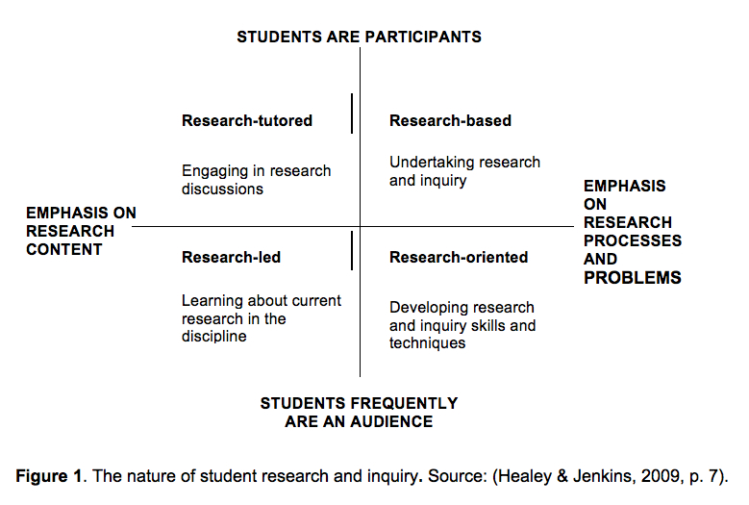
Students Learning in research Mode
Research skills
Notes:
JW Writing and discussing papers or essays – engaging with theory and scholarship – research –led researching subject and teach subject content
Research based – curriculum is based in undertaking enquiry based learning and problem solving – research orientated – curriculum emphasises the construction of knowledge in the subject

Slide 18
What Support do E&CS offer?
Sounding board
Staff time
Best practice sharing
Experienced staff
Flexibility
Employer engagement
Workplace advice
Notes:
Jco
Sounding Board – advice on new modules, revalidation, revitalising existing content
Staff time – through our SLA agreement
Best practice sharing – through contacts at other institutions and across the University
Experienced staff – all of the team have different backgrounds and experiences and relevant staff are brought in at the right time because of our project based style of working
Flexibility – we will work with what we are given. There are ideals, but we will use what time and resources are available.
Employer engagement – Industry Advisory Panels, guest lectures, industry insight days, work placements, work shaddowing

Slide 19
Challenges/Advantages-
rebranding/repackaging applications rose – firm offers fairly stable - hope to meet targets
Networking/Collaboration
staff development/student development
temp shop
Time and uncertainty
Notes:
Industry, other departments – sustainability and development other enterprises – believe it will lead to and develop more partnerships – go to HAMBROOK SLIDE
Debut JW

Slide 20
Notes:
Awareness raising Campaign about A social enterprise, Kent enterprise trust – students had to create a campaign and discuss ethical and theoretical issues underpinning their work and reflect on the process raised student awareness about conservation projects and about how social enterprises operate - offered students an internship and work experience – they felt they got some good ideas from students on how to promote themselves

Slide 21
Does Employability mean compromise?
Potential tension between the academic training in a BA in any Humanities subject and the demands of preparing students for jobs.
Year 3 PR module – External comments Both pieces of assessment demonstrated a thorough engagement with the aims of the module, blending theory and practice extremely successfully. Clearly a module that has engaged students – excellent breadth and depth of research supported by the module leader.
Notes:
JW Jco That is why we needed to try to integrate employability without compromising on content and rigour of academic studies.
We introduced learning opportunities and forms of assessment that satisfied academic standards, were intellectually stimulating and at the same time contributed to skills development relevant for work situations.

Slide 22
Moving forward what next?
CONFERENCE ATTENDANCE
SHARING GOOD PRACTICE
VISITING/NETWORKING WITH OTHER INSTITUTIONS
MAINTAINING A MEDIA EMPLOYERS DATABASE
EMPLOYABILITY STRATEGY AND PROCESSES
Notes:
JW and JCo

