Slide 1
Curriculum Design
Rich Little| Senior Lecturer Physical Education

Slide 2
Curriculum
DESIGN
or
CRAFT ?

Slide 3
Scope
Questions
What is the rationale behind the activities that we offer in the curriculum?
How do we design the curriculum?
How do we know it is the best offer?
Can we do it better?
Can we do it differently?

Slide 4
The Perfect World?
‘If physical education was primarily concerned with the initiation of well-behaved, capable, and motivated students into established physical activities and sports such as exercising, basketball, and tennis, then the objectives approach provides some of the advice a curriculum worker might need.’
(Kirk, 1993, p250)

Slide 5
Dilemmas
…for many years physical education has been criticized for being too traditionally game oriented, focusing more on the development of elite performers and taught in a very teacher-led, didactic style that does not engage all children.
…teachers have been more concerned with the ‘product’ of physical education than the 'process’ or modes of delivery.
… teachers often preach about a ‘fitness for life’ philosophy, yet a ‘fitness for sports performance’ approach is often adopted as they look to develop the most able players for sports teams rather than foster lifestyle habits for all children. (Howells et al , 2017)

Slide 6
Time in PE – Overall Aims
Primary Pupil
Year 1 to year 6 = 6 years of PE lessons
Secondary Student
Years 7 – 11
or 7 – 13 = 5 or 7 years of PE lessons
Total =11 – 13 years of PE lessons
What does your PE policy say?
What can they do?
What is the impact?
Is it worth it?
How do you know?

Slide 7
Theoretical Principles:
Curriculum planning should consider
the interrelationship of aims, objectives and subject matter
Interrelationships between subject-centred and student-centred education
performance objectives and specific student behavioural outcomes
objectives can be covered by three domains," the cognitive, affective, and psychomotor (Kirk, 1993)

Slide 8
Strategic Approach
https://www.youtube.com/watch?v=YVEo6XnuwvE

Slide 9
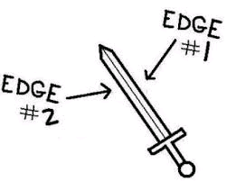
Solutions and Challenges
Subject knowledge
External Providers
Primary PE and Sport Premium
School ethos
Facilities

Slide 10
Curriculum Planning
Three questions driving curriculum design, development and implementation
WHAT are you trying to achieve?
HOW do you organise learning to achieve your aims? BLOCKS!
HOW well are you achieving your aims?

Slide 11
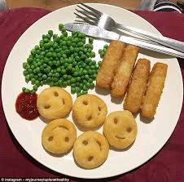
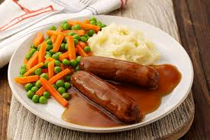
Rationale – What is Yours?

Slide 12
What we probably do
National Curriculum
Activities / Sports
PE Lessons
Pupils
AfPE outcomes

Slide 13
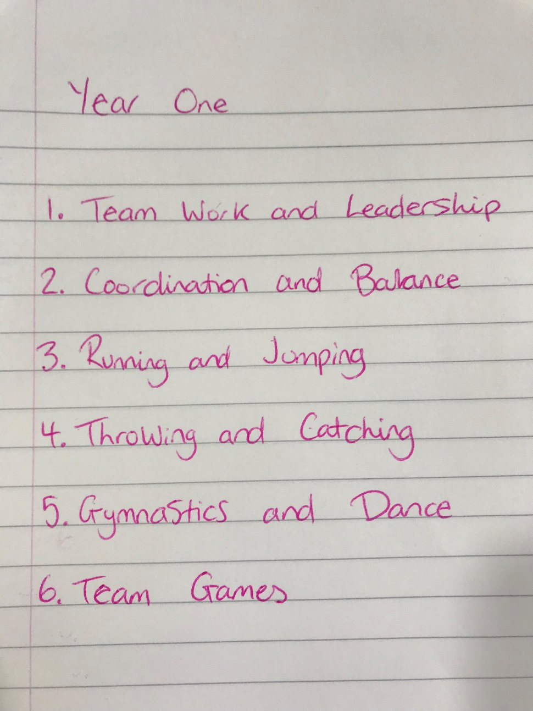
Doing it differently KS 1 – 1 minute

Slide 14
Real Example KS 1
 | Key Stage 1 Curriculum Map for Physical Education
 | Term 1 (1) | Term 1 (2) | Term 2 (3) | Term 2 (4) | Term 3 (5) | Term 3 (6)
 | 7 Weeks | 7 Weeks | 6 Weeks | 6 Weeks | 6 Weeks | 7Weeks
Year 1 | Send and return | Attack, defend and shoot | Dance | Gymnastics | Run, jump and throw | Hit Catch and run
Year 2 | Send and return | Attack, defend and shoot | Dance | Gymnastics | Run, jump and throw | Hit Catch and run

Slide 15
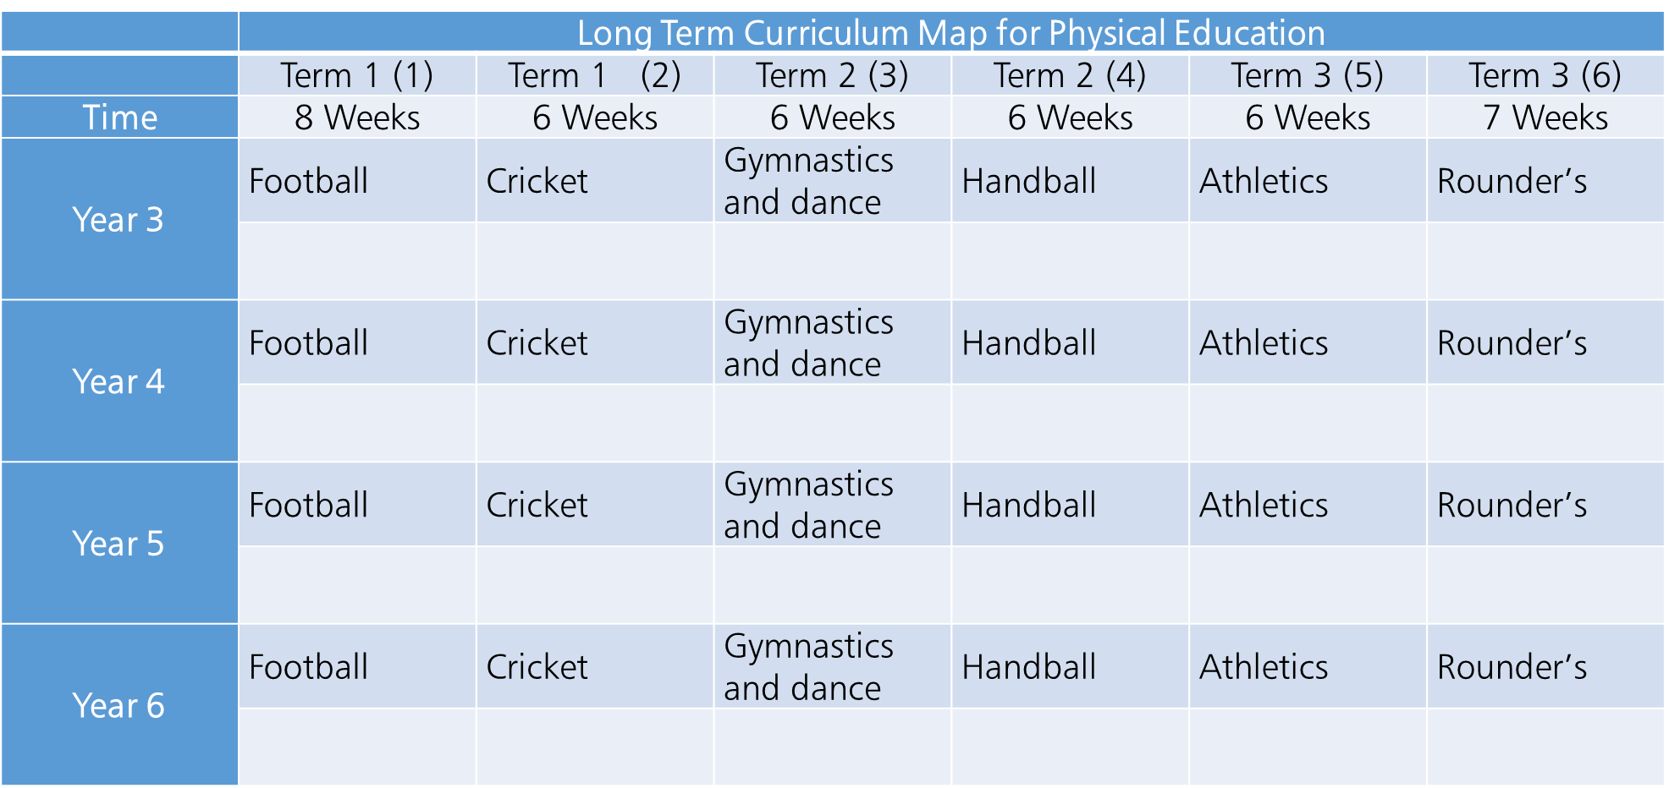
KS 2 – The Same School

Slide 16
Key stage 2
Pupils should continue to apply and develop a broader range of skills, learning how to use them in different ways and to link them to make actions and sequences of movement. They should enjoy communicating, collaborating and competing with each other. They should develop an understanding of how to improve in different physical activities and sports and learn how to evaluate and recognise their own success. (DfE, 2013)

Slide 17
KS 2 - Pupils should be taught to:
use running, jumping, throwing and catching in isolation and in combination
play competitive games, modified where appropriate [for example, badminton, basketball, cricket, football, hockey, netball, rounders and tennis], and apply basic principles suitable for attacking and defending
develop flexibility, strength, technique, control and balance [for example, through athletics and gymnastics]
perform dances using a range of movement patterns
take part in outdoor and adventurous activity challenges both individually and within a team
compare their performances with previous ones and demonstrate improvement to achieve their personal best. (DfE, 2013)

Slide 18
A Pause for Thought: Physical Education provides a wonderful opportunity to develop the whole child.
What skills do you want to introduce and develop with your pupils ?
How have you identified these skills?
Are they all physical skills or have you considered social, cognitive and emotional skills as well?

Slide 19
Physical Education provides us with the opportunity to develop a wide set of skills which are not just physical
Confident (cognitive) Cooperative (social) Linking skills (practical) Apply (practical and cognitive) Evaluate (practical and cognitive) Competent (cognitive, social and practical) Perform a range of skills (cognitive, social and practical) Fairness (social and cognitive) Develop understanding (cognitive) Collaborate (social) Know how to improve (cognitive) Competitive (practical)
Term 1 Focus Perform a range of skills (cognitive, social and practical) Linking skills (practical)
Term 2 Focus Apply (practical and cognitive) Develop understanding (cognitive) Evaluate (practical and cognitive)
Term 3 Focus Cooperative (social) Competitive (practical) Collaborate (social)

Slide 20
Doing it differently
Explicitly teach the sport
Or
Use the sporting activity as a medium for learning and development of the whole child
Or
Have generic themes
Or
Maybe a combination of the above!

Slide 21
Doing it differently - Options
Activities areas are based upon the needs of each class or year group
Allocate an activity area rather than a sport, i.e. net / wall games
Teachers given the flexibility to choose / modify the activity that meets pupils needs

Slide 22
Transferable Skills – Isolation and Combination
Travelling Skills | Sending Skills | Receiving Skills
With ball Without the ball Look up / forwards. Change of pace. | Throwing Kicking Striking Preparation, Action, Recovery. Transfer of weight. Tracking an object. | Catching, Controlling, Positioning to hit. Keep eye on object. Move into line. Withdraw/cushion.

Slide 24
What we could do
AfPE / School Outcomes
Pupils
Activities / Sports
HIGH QUALITY
PE Lessons
National Curriculum

Slide 25
Skills observed You decide these as the class teacher | Gloria | Benjamin | Evie | Richard | Alistair | Lewis | Freddie | Harvey | Katie | Laura | Sanjay | Joanne | Susan | Samuel | Chris | Jonny | Anna | Ami
1.Send and receive a ball with their hands or feet
2.Send and receive a ball with equipment
3.Perform a range of movement patterns and sequences
4.Children can tell you how to improve
5.Children can work in pairs or groups cooperatively
6.Children understand respect and fairness when they compete

Slide 26
Work in Progress
Term | Topic/Focus | Domains of Learning
 |  | Psychomotor | Social | Cognitive | Affective
1 | Skill Application | Linking FMS appropriately and effectively to achieve success in a variety of tasks
2 | Team Work | Applying necessary skills required to achieve success | Communicate effectively within a diverse environment in order to achieve success
3 | Problem Solving | Applying necessary skills required to achieve success | Continued work on effective communication in a diverse environment | Utilise social learning from teamwork in order to solve problems
4 | Creation and Exploration | Exploring different techniques and skills that produce an aesthetically pleasing performance | Evaluation of performance in order to peer assess | Creating routines by linking skills together
5 | Leadership |  | Develop confidence to lead/coach/teach a group of their peers |  | Understanding feelings and emotions of both the participant and the leader
6 | Competition Outcomes | Competing in competitions of modified games and competitions | Work as teams to achieve success within a competition |  | Understanding the feelings associated with winning and losing.

Slide 27
Planning
Considerations for your department / team:
Develop a curriculum that is going to meet the needs of the learners in your school. There is no one model that fits all.
What will they need in the future? Skills for work:
Problem solving
Leadership
Questioning
Analysing
How are you preparing them for the next Key Stage and beyond
What cross curricular links do you have?

Slide 28
Does the PE curriculum only take place in PE?
Children answering a numeracy question, forming the number 17 using their bodies
(Howells et al, 2017)

Slide 29
A Buffet!

Slide 30
Summary: Physical Education is multi-dimensional
We should create a physical education environment where all children feel physically and emotionally safe.
Recognizing and celebrating the skills of the leader, organizer, umpire, scorer, etc. are just as valuable as physical talent and performance, there should be something for everyone.
Learning through this range of skills (along with the physical) provides the child with a broader experience and understanding of themselves through the medium of physical education.
This may then provide the child incentive to continue to participate in sports beyond school, into adult years. This supports the concept of the physically literate child ( Whitehead 2010 ). We must encourage participation and success to promote lifelong physical activity.

Slide 31
rich.little@canterbury.ac.uk
Contact Details

Slide 32
References
Department for Education (DfE) (2013), The National Curriculum in England. Key stages 1 and 2 framework document. London Crown. (Accessed on 5th Jan 2019)
Howells, K., Carney, A., Castle, N. and Little, R. (2017). Mastering primary physical education. Bloomsbury
Kirk, D. (1993) Curriculum work in physical education: Beyond the objectives approach? Journal of Teaching in Physical Education, 12(3), 244-265
Lawrence, J. (2012). Teaching primary physical education. SAGE.
McMorris, T. (2004) Acquisition and Performance of Sports Skills. Chichester: John Wiley and Sons Ltd.
OFSTED (2013). Beyond 2012 – outstanding physical education for all. Physical education in schools 2008–12. Available at: https://www.ofsted.gov.uk/resources/120367 (Accessed on 5th Jan 2019)

