Slide 1

Best Practice Forum
Reducing the Risk of Trauma and Re-Traumatisation
10.30 to 13.00 – 17th October 2014
Committee Room 3, House of Lords. Westminster

Slide 2

The Solihull Approach: Understanding Your Pupil’s Behaviour
A pilot study in Four Primary Schools
Dr Alex Hassett
Principal Lecturer and Senior Consultant
Salomons Centre for Applied Psychology

Slide 3
Overview of the Talk
The Understanding Your Pupil’s Behaviour Solihull Whole School Approach
Brief overview of what makes it different
The Research
  Quantitative and Qualitative Results
Personal Reflections

Slide 4
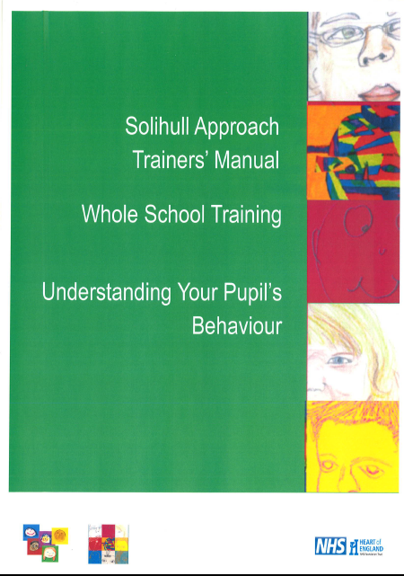
The Solihull Approach: Understanding Your Pupil’s Behaviour
Based on the original Solihull Approach Framework

Slide 5
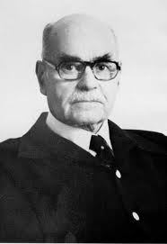
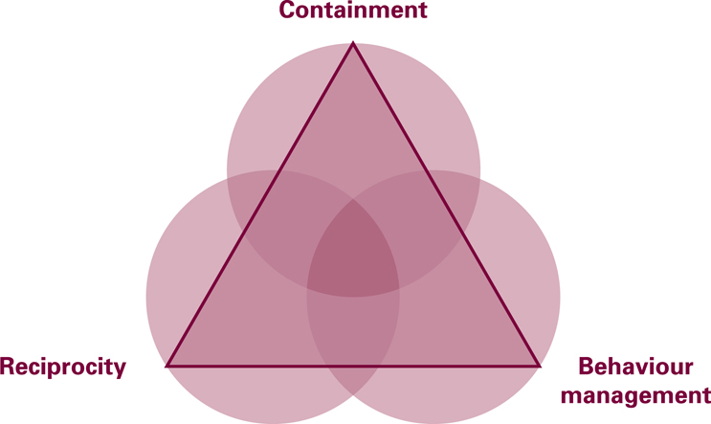
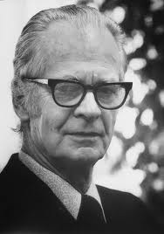
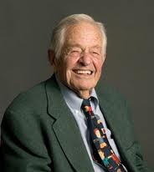
The Solihull Approach -
supporting relationships to improve outcomes
Psychoanalytic theory (Bion)
Child Development research (Brazelton)
Behaviourism (Skinner)
Notes:
Solihull Approach: solihullapproach@solihull-ct.nhs.uk Solihull Approach Antenatal 2 day Foundation Training
Solihull Approach Antenatal 2 day Foundation Training
5

Slide 6
Trauma
No only useful for educators in understanding the behaviour of all the children in the classroom and thinking about how they manage their behaviour
Also enables teachers and support staff to understand the behaviour of children who have been neglected and experienced trauma

Slide 7
Secondary Trauma
The role of containment at the individual, classroom and school level has an impact on educators’ ability to understand and manage some of the powerful emotional and behavioural communication of children who have been traumatised
Emphasises why support for educators is key

Slide 8
Aims of the Solihull Approach Training
Provide the framework of the Solihull Approach model for understanding your pupil’s behaviour to support pupils to learn
Understand how relationships affect behaviour
Understand the importance of relationships for brain development
Provide a ‘framework for thinking’ when learning about behavioural techniques
Notes:
8

Slide 9
Aims of the Solihull Approach Training
Enable practitioners to apply their knowledge of behavioural techniques more effectively through understanding their pupils’ behaviour
This training does not aim to teach behaviour management techniques. There are many other trainings and resources available for this. This training aims to put behaviour management techniques into a framework that will increase their effectiveness

Slide 10
Why the Solihull Approach maybe useful
Helps with professional responsibilities and stress
Provides a framework to help 'contain' role as a professional worker
Containment from colleagues may be especially helpful when working with particularly challenging or difficult situations
Provides a shared language
Helps decision making
Supports the safeguarding process – capacity to think and calm communication
10

Slide 11
Brains develop in the context of a relationship

Slide 12
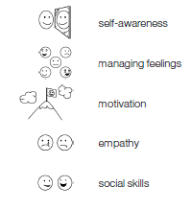
Solihull Approach links to SEAL
Solihull Approach Model and training supports SEAL, explains why it is so important and sets it in a theoretical context
Containment and reciprocity:
- supports staff in recognising needs of individual pupils and enabling them to reach their potential
    promotes emotional health and wellbeing
Solihull Approach supports the 5 broad social and emotional aspects of learning
    Self awareness
    Managing feelings
    Motivation
    Empathy
    Social skills
12

Slide 13
What’s different
Makes the links to pupils’ behaviour more explicit as well as to behaviour management
Makes the links between containment and reciprocity and learning more explicit
Thinking not only about the relationship/interaction between child and educator but also within the broader school context

Slide 14
What’s different
Emphasises the relationships between educator and pupils and the relational context of effective behaviour management

Slide 15
The Solihull Approach
THEORETICAL MODEL

Slide 16
Containment for Learning
Thinking about the impact of emotions on our capacity to concentrate, think and learn.

Slide 17
Activity – Containment in Schools
Think for a minute about a child in your classroom or school where the child needs to calm down to learn
Share some of the ways you help the child calm down in order to restore their capacity to think and learn

Slide 18
Containment in Schools
Effective teaching and learning take place in a containing environment
Teachers need to feel contained enough to teach and pupils contained enough to learn

Slide 19
Containment and the brain
Parallel process

Slide 20
Containment and Learning
‘Students who are anxious, angry or depressed don’t learn; people who are in these states do not take in information efficiently or deal with it well.... when emotions overwhelm their concentration, what is being swamped is the mental capacity cognitive scientists call ‘working memory’ the ability to hold in mind all information relevant to the task at hand.’ (p.8)
Goleman, D. Emotional Intelligence (1995) Excellence and Enjoyment: social and emotional aspects of learning. Guidance. New York: Bantam Books
20

Slide 21
The Solihull Approach
THEORETICAL MODEL

Slide 22
Reciprocity In The School
Rhythm of building up and calming down
Link to containment – are children in the best state for thinking, is their arousal system lower, are they calmer and ready to learn?
Reciprocity in lessoning planning – building up to an activity or piece of learning and then winding down

Slide 23
Activity:
Reciprocity In The Playground
How does your school help children decelerate from the excitement of the playground to transitioning into the classroom?

Slide 24
Reciprocity
Look away
Chase and Dodge
Rupture and Repair
Good enough parenting

Slide 25
The Solihull Approach
THEORETICAL MODEL

Slide 26
How is brain development relevant to behaviour management?
Activity:
Think about one way in which knowing about brain development might help behaviour management?
Regulation of behaviour, emotion and impulses

Slide 27
How can you use containment and reciprocity to inform behaviour management?
How might containment help behaviour management?
How might reciprocity help behaviour management?

Slide 28
Managing your pupils’ behaviour
Being sensitive to individual children’s needs will help the child learn to regulate their feelings enough so that they can take in and process information
Understanding your pupils behaviour will help you in managing their behaviour in class
Professionals have a range of behaviour management strategies and toolkits available to them
28

Slide 29
What do we mean by
Behaviour for Learning?
the containment of children’s emotions/anxieties so that the child can concentrate and think
reciprocity between the teacher and child so that the child is regulated enough to take in and process information
optimal brain development so that the child has neural pathways to both self regulate and to learn
29

Slide 30
The Research
A pilot study in Four Primary Schools

Slide 31


Background to the study
Part of a consultancy and training and development programme based run by the Salomons Centre for Applied Psychology in Kent in collaboration with Solihull Approach
Funded by the Local Authority and Primary Care Trusts

Slide 32
The research
What impact does the Solihull Approach Understanding Your Pupil’s Behaviour on teacher levels of stress, anxiety, mood, sense of teacher efficacy, self-esteem at 6 months after the training

Slide 33

Challenges Around Measuring Outcomes for Preventative Interventions
What do we measure?
How do we know it was due to the training?
Challenge around measuring outcomes on children from training delivered to practitioners
Long-term studies needed

Slide 34
Rationale for Measuring Teacher Outcomes
Hypothesis
It is argued that by understanding and using the approach teachers will feel more contained themselves and will be in a better position to be attuned to their pupils’, the parents’ and colleagues’ behaviour
In doing this they will be less stressed and feel more able to do their jobs

Slide 35
Methodology
The studies focus in on a group of teachers from 2 primary schools in Kent. One the experimental group received the training the other the control (this group received the training after the research if they are interested).
In order to assess the impact of the training a pre-test follow-up at 6 months design was be used.
Interviews were conducted with teachers from the school receiving the training

Slide 36
Measures
Professional Quality of Life Scale (PROQOL) (Stamm, 2009). The ProQol comprises three discrete scales that measure:
  Compassion satisfaction – the pleasure that one derives from being an effective caregiver
  Burnout – feelings of hopelessness, difficulties in dealing with work or carrying out the work effectively
  Compassion fatigue – psychopathological symptoms associated with secondary exposure to stressful events.

Slide 37
Measures
The Robson Self Concept Questionnaire (Robson, 1989) self-report scale measuring self-esteem.
Teacher Efficacy Scale - Guskey, T. R., & Passaro, P. D. (1994) looks at teacher efficacy in terms of internal and external orientations.

Slide 38
Measures
The Generalized Anxiety Disorder Assessment Version 7 (GAD 7; Spitzer, Kroenke, Williams, et al; 2006) measures levels of anxiety.
The Patient Health Questionnaire (PHQ-9, Kroenke, Spitzer, Williams; 2001) measures mood i.e. feelings of depression.

Slide 39
The delivery
School 1:
3 twilight session
26 staff including teachers, support staff and administrators
School 2:
Full INSET day and a twilight session
30 staff including teachers, support staff and administrators

Slide 40
Extended Due to Interest
2 other schools offered to participate based on the response from the 2 initial schools

Slide 41
The delivery
School 3:
Full INSET day and a twilight session
12 staff including teachers, support staff and administrators
However support staff (4) did not come to the twilight session
School 4:
Full INSET day and a twilight session
54 staff

Slide 42
Support session
All schools were offered 6 follow up support sessions
Only School 1 took up the six sessions.

Slide 43
Quantitative Results

Slide 44
Findings
School A – Six month after receiving the training showed a statistically significant:
  increase in satisfaction with their helping role
  decrease in feeling burnt out/stressed
  increase in self-esteem
  increase in teacher efficacy scores
School B – which received no training only showed an improvement in teacher efficacy over the period.

Slide 45
Qualitative Data Collection
4 staff were interviewed from School 1 nine months after the training
A further 3 one year after the training
A semi-structured interview asking about their views on the training, whether there had been any impact, what they felt had facilitated and hindered the process
A thematic analysis of the interviews was undertaken

Slide 46
Qualitative Results

Slide 47
Teachers’ Views on the Training
Overall teachers found the following useful:
Offered a framework that underpinned all aspects of the work they do
Focus on the relationships not only with pupils but teachers and support staff and parents as well
Focus on well-being and its link with learning

Slide 48
Teachers’ Views on the Training
All the interviewees felt that the overarching framework had provided the theory and ‘scientific’ back-up for what they were doing.
For example:
Children who had experienced trauma, fidgeting made sense not as naughtiness but as an attempt to self-regulate
Having time to share your struggles with colleagues now made sense in terms of containment

Slide 49
Teacher Views on the Impact
Staff reported that it had impacted on their interactions with
The children,
The parents and
Other staff members

Slide 50
Impact on Interactions with Children
Offered a different perspective on behaviour
Taking a developmental perspective
Taking the child's perspective
Understanding where certain behaviours may be coming from
Understanding the theory behind why children may behave the way they do

Slide 51
Changed perspective on behaviour
Examples:
“Firstly I didn’t realise how big behaviour was, which is quite strange I’ve been teaching now for a million years anyway … I’ve been looking for like a quick fix for a particular child and then I realised that it needed to be bigger than that”

Slide 52
Changed perspective on behaviour
“It’s changed my views of behaviour. So sometimes when I see, what I would ascribe to not doing as they were told, you know, fidgeting, or so-and-so’s definitely got ADHD, now I’m looking more perhaps, thinking why are they behaving this way, what’s the behaviour showing me apart from the surface impression. So I’m perhaps more lenient? I don’t know, I try to be more understanding perhaps”.

Slide 53
Taking the child's perceptive
Rupture and repair = falling out and building bridges
“the whole dance of when you’re falling out and building bridges, that, those were the two bits that really I think about and could use. And I can sort of see it in children now when they’re trying to, like if I’ve been cross with them for doing something I can see now that they’re trying to, when they come up and say ‘Oh can I just show you this Miss X’ and I know it’s because they’re trying to build bridges again and now that I’m more aware of it and of why I sort of tend to maybe give them more time with that or make sure that I’ve actually responded rather than thinking that oo hang on I’ve just got to do this, I try and make a point of saying ‘yeah, you know, that’s great, well done I’m really pleased’ so that they know that everything’s fine whereas I didn’t really know to think about that before I just thought ‘oh how lovely’”.

Slide 54
Chase and Dodge
Examples:
Chase and dodge – realising that making children look at you when you’re talking to them is not always useful – particularly if they are already stressed (or if you’re stressed out)

Slide 55
Using containment with behaviour management
There’s somebody in my class who joined quite recently, quite challenging behaviour. And as well as very firm boundaries I have used the reflecting back to him how he is feeling and erm, yeah it’s worked.
In terms of what you’ve noticed about the response to that?
When I say it’s worked, it’s enabled him to calm down and be more reflective himself to work out a bit more in other words to think he’s actually said ‘it’s helped me to think twice’ so I think that’s got to be rather good.
Yeah it’s also really good that HE could say it’s helped me think twice’
Yes, I know he doesn’t always think twice but at least he realises that you can think twice, you know. He’s a very intelligent child, but erm he needs to take charge of his emotions rather than just let them run riot

Slide 56
Impact on themselves
Feeling less stressed
Own well-being
Confidence in their ability
Several teacher mentioned that having a different perspective and support from other staff has made them feel more relaxed

Slide 57
Containing Teachers Anxieties Lead to them Being More Reciprocal
Talking about her difficulties managing a young boys behaviour as she knew he had been abused and felt that as she was not a mental health specialist she may do something that would be damaging to him and so found it hard to respond to him a teacher said:

Slide 58
Containing Teachers Anxieties Lead to them Being More Reciprocal
“I sort of could use that with him and that made me again more relaxed with him so that I could sort of, erm because I was worried I was doing the wrong thing … having someone’s input in that way helps me think that I’m not going to do him damage by acting the wrong way. Because particularly because he’s got certain needs, so generally I don’t worry about that so much but when there’s certain children that you know certain things have happened in the past, it’s definitely more of a worry that you’re going to do more damage so having someone to then talk about things you just get the reassurance that actually it’s ok and you know you can adapt things and everything. So in that way, I’ve definitely used that as well.”

Slide 59
Impact on Interactions with Parents
Containing parents feelings
Understanding their perspective

Slide 60
Impact on Interactions with Other Staff Members
All the staff reported that staff relationships / interactions had changed:
More sharing and openness
A willingness to show vulnerability
Not reacting so fast to things
People being more amenable to discussions with other staff
Felt the SA offered a structured way to think about their interactions

Slide 61
Led to changes in support structures
Morning briefings
Planning, Preparation and Assessment time
Phase Group Time
Staff Meeting Time
Focus Group
All focused on joint working and sharing information about pupils particularly those with challenging behaviour

Slide 62
Limitations
Sample size
Matching of schools
Could not exclude other factors
However still showing promising signs

Slide 63
Tentative Conclusions
Both the quantitative and qualitative data suggest that the Solihull Approach Understanding Your Pupils’ Behaviour has had a positive impact on teachers
The quantitative data suggests there has been an impact on teachers interactions with their pupils, the parents and colleagues and it has led to wider school changes.

Slide 64
Data from the other schools
School B: increase in compassion satisfaction on ProQol
School C: no significant difference
School D: no significant difference
Suggests that the support sessions are a key to embedding the ideas from the framework. However this needs further research.

Slide 65
Challenges
Not all staff taking up the approach
Time and funding
Support sessions take up and how they are structured
Parents not having the same information

Slide 66
Facilitators
Trained as a whole staff – importance of including support staff and admin
Working across the years
Support in place

Slide 67
Learning from the experience
Not being a teacher
Using whole school, classroom and individual examples
Size of the group
Twilight versus INSET day and twilight
Composition of the group matters
Resource packs

Slide 68
Some teacher’s views that were challenging
Not having time – how much time spent on not planning around disruptive behaviour
You are making excuses for poor behaviour / poor parenting
It is not possible to use the approach when dealing with the range of needs in a class
It’s not fair, we need to treat all children equally
Children getting one up on you

Slide 69
alex.hassett@canterbury.ac.uk

