Slide 1
OSIRT: A Tool for Law Enforcement Research and Investigation
Joseph Williams and Paul Stephens
joseph.williams@canterbury.ac.uk
paul.stephens@canterbury.ac.uk

Slide 2
Introduction
What is open source research
Particularly the social media aspect
What law enforcement officials (LEOs) use to conduct open source research
The software tool created to aid LEOs

Slide 3
What is Open Source Research?
Obtaining publically available information to use as intelligence or evidence
Unrestricted
Available via subscription
Overt
Not to be confused with ‘open source’ in the software sense
Notes:
Not “open source” in the traditional software sense

Slide 4
Not New
The idea of gathering open source evidence is nothing new
‘Linear Media’
Printed publications
TV
Radio
Landline telephones

Slide 5
Missed Opportunities
In August 2011, London and other parts of the UK were plagued with riots
Law enforcement criticised for their deficiencies in capturing evidence on social media
‘With some notable individual exceptions, the power of this kind of media […] is not well understood and less well managed.’
Her Majesty’s Chief Inspector of Constabulary (Cited in Hobbs et al, 2014)

Slide 6
Methodology for Open Source Research
Bucknor v R [2010]EWCA Crim 1152
Any material taken from the Internet must have full provenance
I.e., The ability to record the history of data and its place of origin.
ACPO – Good Practice Guide for Computer-Based Electronic Evidence
Particularly principle 3, the need for an audit trail
Notes:
Bucknor v R:
ACPO Guidelines: This was intended for traditional ‘dead box’ computer forensics. Given the nature of the way the Internet stores its data, these guidelines do look dated. Principle 3 (the audit trail) is the principle closely followed by OSIRT.

Slide 7
What the police use
A real mishmash of software
From free browser add-ons to expensive suites
The tools they use are great, but are shoehorned into the role
Notes:
The utter misery of using a spreadsheet to log every single website you visit.
Hashing every single file you download.
Officers and civilian staff are required to conduct open source research on the Internet. Pretty much every officer will conduct ‘open source research’. From PSD, anti-terrorism units to vetting.

Slide 8
What the police need
College of Policing requested a bespoke tool to relieve some of the tedium
One that ‘just does it’
Logs
Captures (dynamic and static)
Hashes
Reporting
Notes:
Officers and civilian staff are required to conduct open source research on the Internet

Slide 9
OSIRT – Open Source Internet Research Toolkit
“A browser on steroids” – Paul Stephens

Slide 10
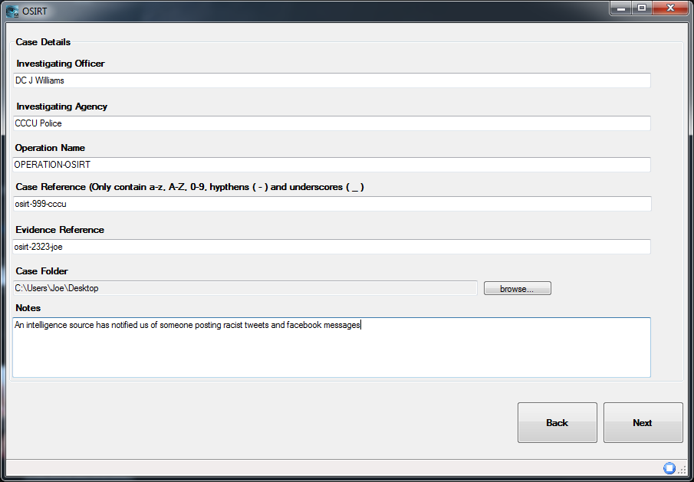
Case Creation

Slide 11
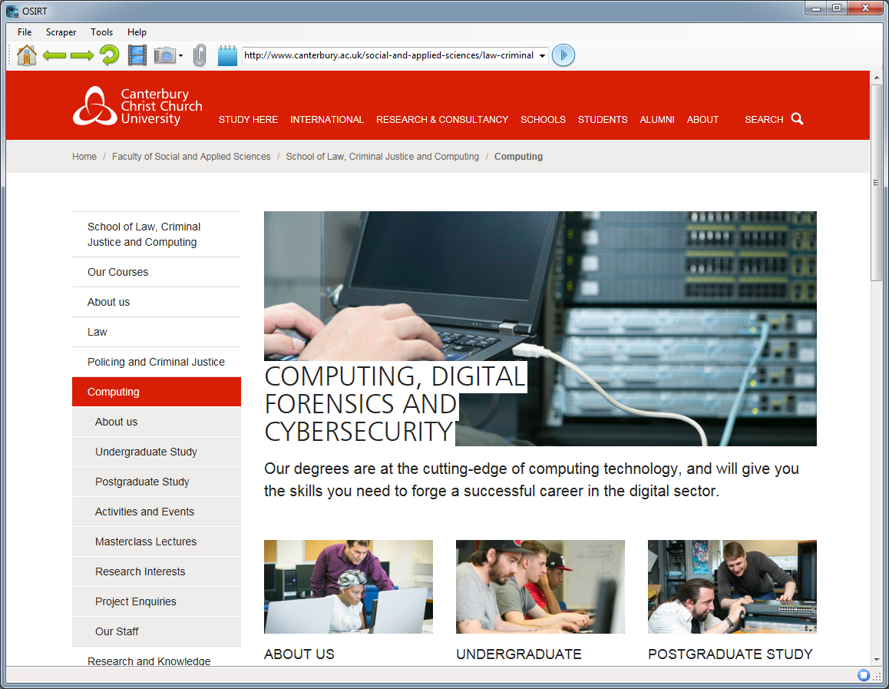
Browsing

Slide 12
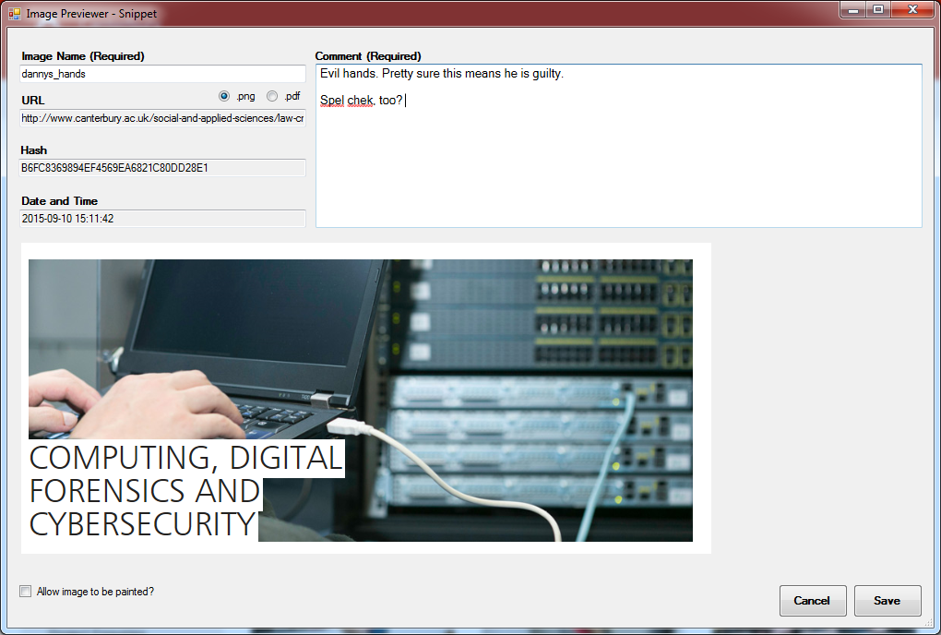
Static Screen Captures

Slide 13
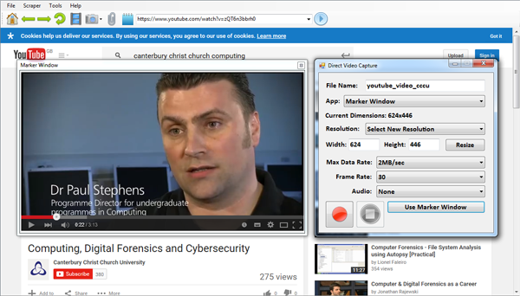
Dynamic Screen Captures
Video capture library by Matthew Fisher

Slide 14
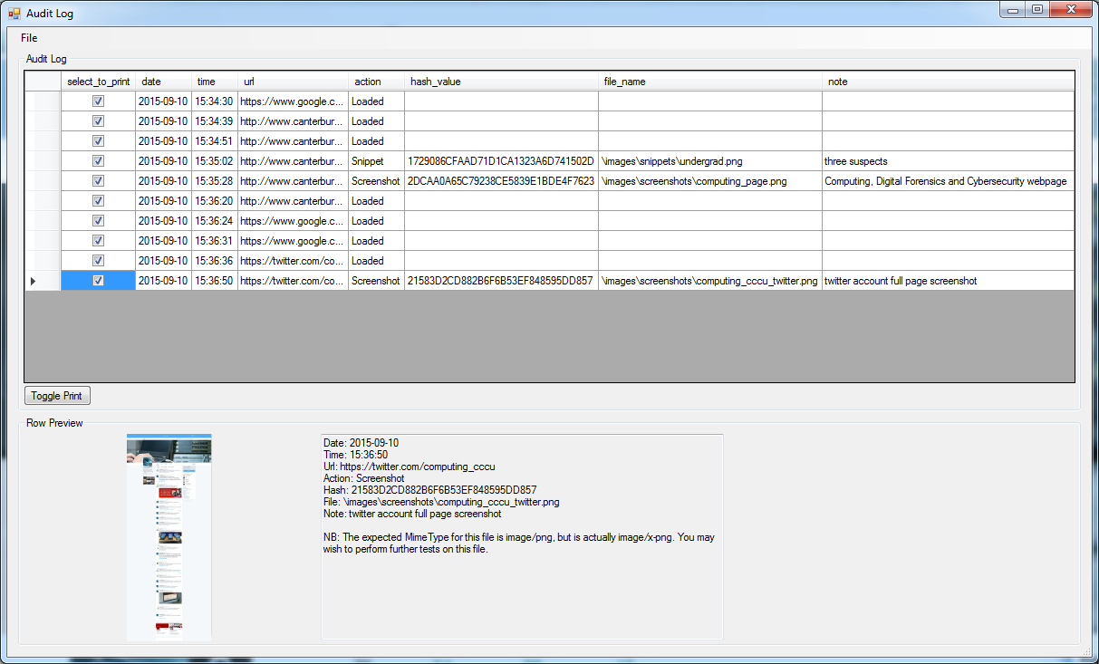
Audit Log

Slide 15
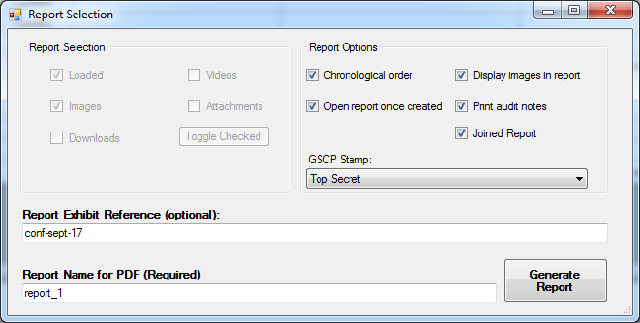
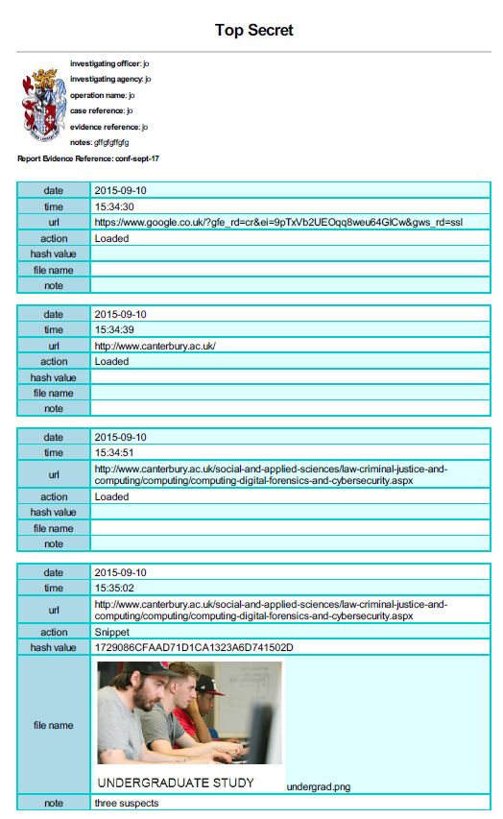
Report Generation
Notes:
Hishibi et al (2011) asked participants about reporting and documentation. With ACPO principle 3 stating the need of an audit trail, this is an important step. 75.4% of respondents “bookmarked some important points in the program itself” with 51.8% and 48.2% using a pen and paper or Microsoft Word respectively. Interestingly, twelve participants explicitly stated they would prefer having better reporting tools available to them. Participants were shown a mock-up of a reporting tool that automatically logged the investigator’s actions; 55% of respondents stated “that this tool would be useful” while a further 20% felt the tool would be useful, just not to them.

Slide 16
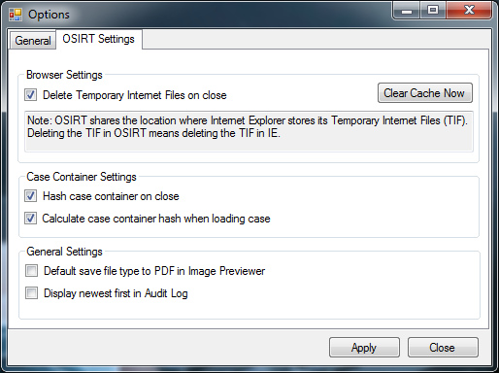
Options

Slide 17
Automation
Automatically logging saves time
“It’s at least halved, probably more actually, how long it takes me to conduct [open source] research” – DC from Staffordshire Police
More automation means
Time saved
Human error reduction

Slide 18
Already in Use
Used by LEO country wide (that we are aware of)
Dorset
Staffordshire
Leicestershire
Durham
Thames Valley
City of London
Met
Yorkshire
North Wales
Royal Air Force Police (Specialist drugs squad)
NCA

Slide 19
Validation
In conjunction with College of Policing, we’re looking to validate OSIRT
ISO 17025
General requirements for the competence of testing and calibration laboratories

Slide 20
The Dream
Go to Twitter and get all the Tweets with this hashtag
Go to YouTube and download all the videos on this channel
Go to this person’s Facebook page and take a screenshot of their entire wall and his friends’ walls
However, we start delving into covert and the boundaries of “open source” are skewed
Notes:
Social media is now significantly relevant to security and public safety. Facebook, for example, has been used to coordinate contract killings, boast about serious animal abuse, conduct cyber-stalking, plan sexual assaults, breach court orders and cause distress through anti-social ‘trolling’.

Slide 21
Laws
RIPA
Open source, unlikely to require a RIPA authorisation
Data Protection Act
Building a profile on a person or group must be necessary and proportionate
The Human Rights Act (Article 8)
Right to Respect for Private and Family Life
Notes:
Building a profile on a person or group must be necessary and proportionate , to ensure that any resultant interference with a person’s Article 8 right to respect for their private and family life is lawful

Slide 22
Terms and Conditions
YouTube forbid the downloading of videos
Facebook forbid fake/impersonation accounts

Slide 23
Research Areas
Validation of software used by LEO
Usability of software used by LEO
Privacy vs Security trade off of open source research
Legal and ethical
Terms and Conditions of social/media websites
OSINT and SOCMINT
Creation of guidelines for Internet evidence gathering

Slide 24
Feedback/criticism/ideas always welcome
http://osirtbrowser.com
E-mail: joseph.williams@canterbury.ac.uk

