Slide 1
‘AI Cops, Robo-detectives and Techno-solutionism: Imagining an Ethical Framework for Sustainable and Responsible Science and Technology in Policing and Crime Control’ Possibility Studies Network Conference 8th July 2024 University of Cambridge – Homerton College Faculty of Education
Paper Session 2
Dr David Lydon
School of Law, Policing and Social Sciences
Canterbury Christ Church University

Slide 2
Context and Introduction
We are seeing the ‘scientification’ of policing as the main solution to deal with crime and criminality in the 21st century– what I refer to as ‘Sci-Tech’.
But the ethical framework applied, appears outdated and myopic.
AIM - To signpost a revised framework for sustainable and responsible decision-making about Sci-Tech innovations in policing, highlighting the possibility of doing things differently.
Specifically, regarding environmental and technology ethics.
A disclaimer!

Slide 3
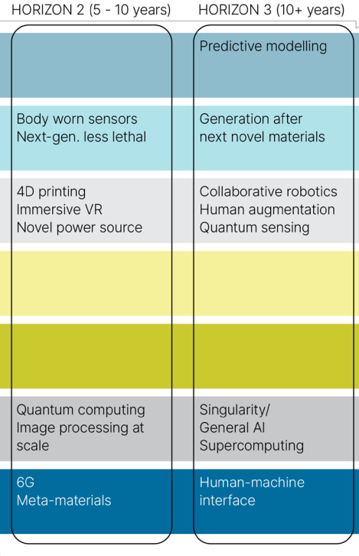
‘To deliver the most science and technology-led police service in the world’
Source: NPCC Science and Technology Strategy 2023

Slide 4
Ethical dimensions – who decides?
Typically, premised on the legal, ‘rules-based and utilitarian approach as to what is considered proportionate, lawful and necessary to deal with the ‘threat’ of crime to a host audience (the public).
BUT – considerations of the global impacts are not part of the ethical decision-making process. What are the global consequences of developing, procuring and using the ‘sci-tech’ locally?
Just because we can do something – should we?

Slide 5
Additional ethical considerations
Issues to consider in ‘Sci-Tech’ innovations, from raw materials to e-waste disposal.
Examples: sourcing, manufacturing processes - global impacts on people and places, e-waste, disposal and life cycles of technology.
The current ethical framework doesn’t deal with these ‘awkward’ questions.

Slide 6
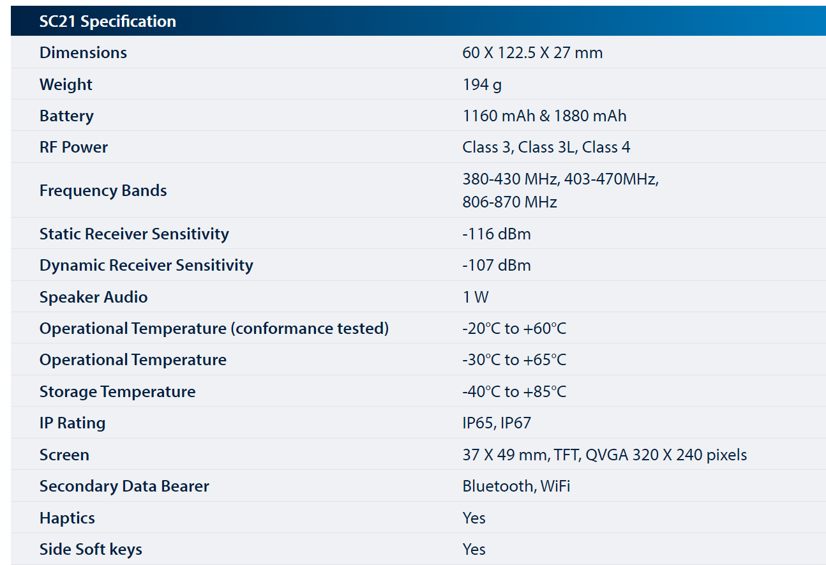
Consider simple examples…

Slide 7
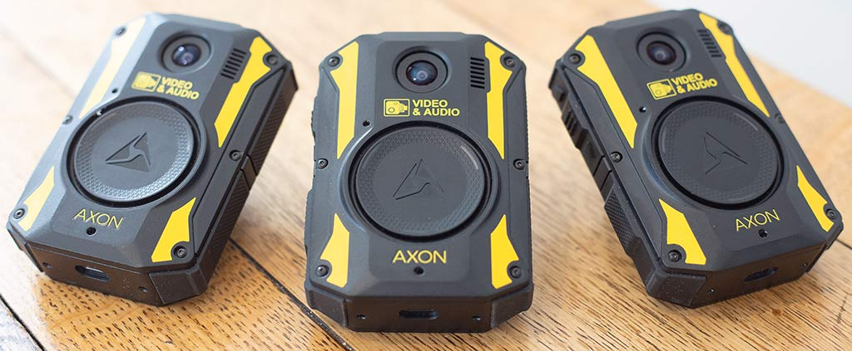
Body-worn video cameras

Slide 8
These are small examples…
The supply chain for lithium and other critical minerals is immense and complex.
It engages geopolitical, environmental, and economic concerns that currently lie outside the direct control of the Police and their partners.
But does this mean that they should not take them into consideration in an ethical decision-making process about which technologies to pursue and at what cost?

Slide 9
Environmental and technology ethics require us to do so…
Environmental ethics - the moral relationship between humans and the natural environment, including issues surrounding societal attitudes, actions, and policies to protect and sustain biodiversity and ecological systems.
Technology ethics applies ethical thinking to the practical concerns of technology. New technologies give greater power to act, engaging choice architecture we didn't have before: we have to learn to be voluntarily constrained by our judgments and aware of the bias/ideology we ‘build’ in.

Slide 10
Concluding remarks
British policing claims to be democratic, consensual and ethical.
Increasingly, global threats and impacts require local responses – see climate change.
This works in reverse – local decisions engage global implications
Yet, policing cannot continue to do so without adopting a new ethical framework.

Slide 11
Bibliography
College of Policing, (2020). Taking the long view: Policing into 2040. Available at Policing in England and Wales: Future Operating Environment 2040 (paas-s3-broker-prod-lon-6453d964-1d1a-432a-9260-5e0ba7d2fc51.s3.eu-west-2.amazonaws.com) Crawford, K. (2021). Atlas of AI. Yale: Yale University Press. Loader, I., Bradford, B., Jauregui, B. and Steinberg, J. (2016). ‘Global Policing Studies’. In B. Bradford, B. Jauregui, I. Loader and J. Steinberg, (Eds.), The Sage Handbook of Global Policing. London: Sage. Lydon, D. et al. (2024). 'This is Not a Drill': Police and Partnership Preparedness for Consequences of the Climate Crisis. International Journal of Police Science and Management. Available at: https://doi.org/10.1177/14613557241248295 Lydon, D. (2024). 'Rise of the machines': technology, technocracy and the future of community policing. Policing Insight. Available at: ‘Rise of the machines’: Technology, technocracy and the future of community policing - Policing Insight
Ministry of Defence, (2022). Global Strategic Trends - The Future Starts Today (publishing.service.gov.uk)
Nyholm, S. (2023). Technology Ethics. New Jersey: Wiley.

