Slide 1
Challenging the Penal Present: Developing and Representing a Critical History of the Prison
Dr Maryse tennant and professor shane blackman, canterbury Christ church university
Digital panopticon end of project conference
15th September 2017
Maryse.tennant@canterbury.ac.uk
Twitter: @marysetennant #canterburyprison
Shane.blackman@canterbury.ac.uk
Notes:
I’m Maryse Tennant and I’m a Senior Lecturer in Criminology at Canterbury Christ Church University. Today I’m going to be talking about some research I’m currently involved in along with my colleague Professor Shane Blackman. But first I want to begin with a story.
In September 2013 I was appointed as a lecturer at Canterbury Christ Church University. On my first day whilst walking to my new office I noticed that the campus was directly adjacent to what looked like a Victorian prison. As both a critical criminologist and a crime historian this sparked my interest but I quickly discovered that it had closed in March that year. At the time I was disappointed to see there had been public visits shortly after its closure and I had missed them. However, by February 2014 there was a rumour that the University might buy the prison and when my partner came to take me out for a Valentine’s meal I spent the whole evening talking excitedly about my plans for research if this were to happen. Over three years later I’m now involved in developing a bid to be submitted to the Heritage Lottery Fund to provide the capital to establish a heritage centre focusing on the prison’s history. Whilst this is in its very early stages, making plans extremely provisional and the eventual outcome uncertain, this is more than I ever imagined would happen on that slightly unromantic Valentine’s Day. Unfortunately for my partner this has meant that many more meals have been taken over by excited talk about prison history!
Today I want to very briefly outline the current situation in relation the to former Canterbury prison before going on to consider how plans for the heritage centre have been informed by the emerging academic critique of representations and interpretation at prison heritage sites. Finally I will give some indications of how our current research hopes to try and produce material that will enable more critical interpretations to be developed that encourage the public to reflect on and question the use of the prison both in the past and the present.

Slide 2
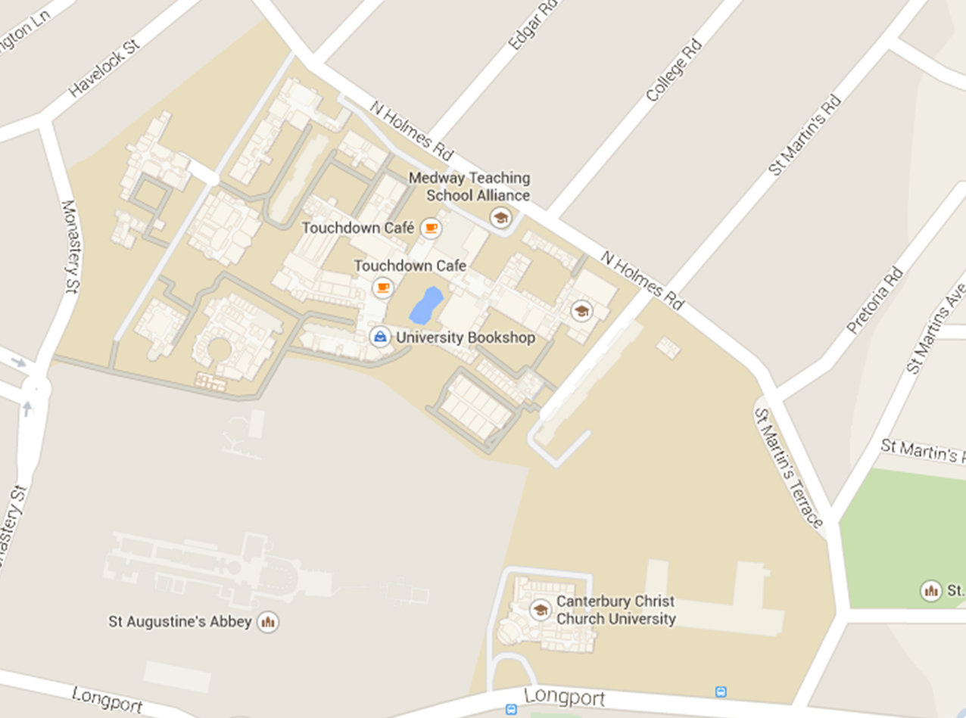
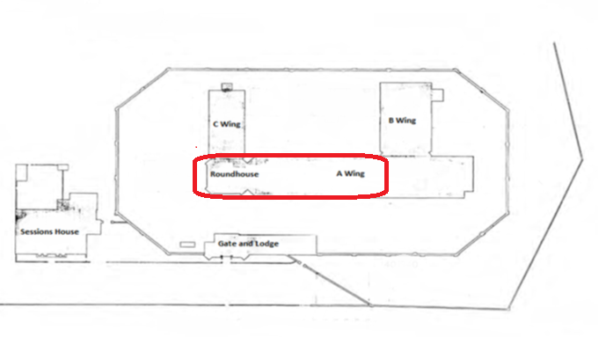
Plan of the Grade II Listed prison buildings with the proposed heritage centre circled
https://www.canterbury.ac.uk/about-us/master-planning-review/master-planning-review.aspx
Notes:
Just to give you a little context. This is the campus of Canterbury Christ Church University with the prison adjacent to it. Much of the former prison site consists of twentieth century buildings which are not considered of historical significance and so much of the large space at the back of the prison can be knocked down and rebuilt. The buildings that are marked on google maps are the actually cellular blocks of the prison, all of which are grade II listed. CLICK If we look a bit closer at this part we can see that there is a octagon which was the governor’s house when the original prison was built in 1808. The three other cell blocks are not original but were constructed between the 1840s and the 1890s. A block is the oldest of these. The proposed heritage centre with be located in the octagon and the first stretch of A Wing – marked in red on the plan. These buildings are three stories high and so there is considerable space which will be available to present the history of the prison. Planning permission for this has already been obtained and for anyone who is particularly interested there is a video on the University website outlining the redevelopment plans for the entire site. Link on slide.

Slide 3
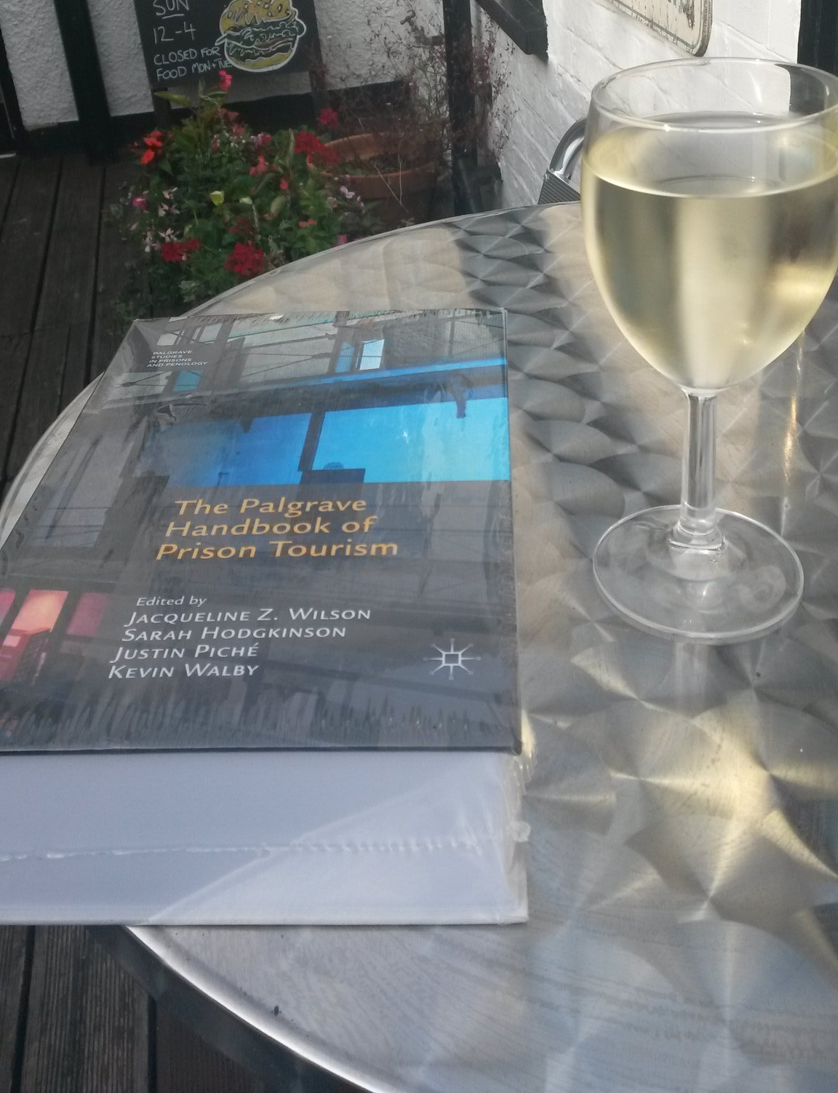
Growing academic interest in the subject of prison tourism as reflected in the publication of the first large-scale text on the topic (Wilson et al., 2017)
Highlights the need to explicate and refine interpretations of prison heritage (see Garton-Smith, n.d; Wilson, 2008; Walby and Pichet, 2011; Gould, 2014; Welch, 2015)
Barton and brown (2015: 237) in particular have called for “more ethical, multi-perspective and politically diverse interpretation within prison musuems”
Notes:
Now for the wider context. There is growing academic interest in the subject of prison tourism, evident in the recent publication of the first large-scale text on the topic edited by Jaqueline Wilson and others (Wilson et al., 2017). One key area in these developing discussions relates to the way that prison museums interpret the history of punishment for a popular audience and a number of limitations have been identified in relation to this. Several scholars have highlighted the need to explicate and refine these in order to produce more nuanced and critical accounts (see Garton-Smith, n.d; Wilson, 2008; Brook, 2009; Walby and Pichet, 2011; Gould, 2014; Barton and Brown, 2015; Welch, 2015) with Barton and Brown (2015) calling for a more ethical, multi-perspective and politically aware presentation of prison history at heritage sites.
The University’s commitment to developing a heritage centre places it in a position where it will have to oversee the development of interpretations of the site’s history for a public audience. I consider the University has a particular responsibility to reflect the concerns from this literature in its plans for the heritage centre. In part this relates to the role of Universities generally in producing social knowledge which can act as an evidence-based critique of past and contemporary social practices. This is increased by Christ Church’s own institutional commitment to a just and sustainable society and belief in the capacity of higher education and knowledge exchange to enrich communities. I have been working with those responsible for developing the heritage centre to try and ensure we focus on the production of nuanced and complex interpretations and make these publically accessible. But recently there has been agreement to frame the planned HLF bid around these ideas.

Slide 4
Prison musuems and penal proressivism
Dark tourist sites have the capacity ‘to introduce anxiety and doubt about the project of modernity” (lennon and Foley, 2010: 11) and act as spaces in which ‘morality is generated, maintained, challenged or confirmed’ (Stone, 2009: 70)
As such they are ‘an ideal space from which to promote discussion’ of contemporary penal policy although there is a widespread failure to promote strong dialogism in prison museums about prisons (Garton-smith, n.d.: 11)
This is especially troubling in an era of penal expansionism when ‘it is very important to raise the visibility of exactly who is imprisoned and problematize the appropriateness of their confinement’ (Scott and codd, 2010: 5)
Notes:
As a critical criminologist who sees the prison itself as a social problem this is particularly important for me. Prison museums have been identified by Garton-Smith as an ideal space through which to promote discussion of contemporary issues relating to imprisonment. But they rarely do this is practice. As a form of dark tourism, they have the capacity ‘to introduce anxiety and doubt about the project of modernity’ and so critique simplistic and problematic notions of social progress (see Lenon and Foley, 2010: 11; Strange and Kempa, 2003). They have also been identified by Stone (2009) as important communicative moral spaces in a post-secular society. Often the focus for Dark Tourism’s critique of modernity is the limits and unintended consequences of technological advancement. Whilst the modern prison does not reflect technology in its strictest sense, the pursuit by nineteenth century prison reformers of the creation of ‘technologies of institutions’ to provide a solution to the social problems of crime and idleness, was a key feature in the evolution of modern crime control techniques (McGowen, 1995: 82-4). The continued reliance on prisons for more than two hundred years, despite the fairly quick failure of the new institutions to achieve such solutions (McGowen, 1995: 90), clearly raises uncertainty about the continued and growing use of imprisonment in contemporary society (Garland, 2001). Indeed we are witnessing a period of penal expansionism in which it is increasingly important “to raise the visibility of exactly who is imprisoned and problematize the appropriateness of their confinement” (Scott and Codd, 2010: 5).
Few sites representing penal history, however, engage with the disquieting nature of the faith which continues to be placed in an institutional form that has consistently failed to achieve the aims anticipated for it, and which carries with it an enduring sense of being in ‘crisis’ (Fitzgerald and Sim, 1982; Sim, 1994; Mathieson, 2000; Sim, 2009). Never more so then recently when this sense of crisis has been a strong theme in discussions of prisons. Such a presentation contributes ‘to the silent acceptance of mass incarceration’ within many modern Western societies (Gould, 2014: 268). Instead prison museums tend to rely on a chronological distancing which portrays a ‘less civilized and more deterrent past’ in contrast to a ‘supposed more enlightened but less questioned present’ (Barton and Brown, 2015: 251). This facilitates a rhetoric of penal progressivism which implicitly relies on the false notion of the prison as neutral and apolitical.

Slide 5
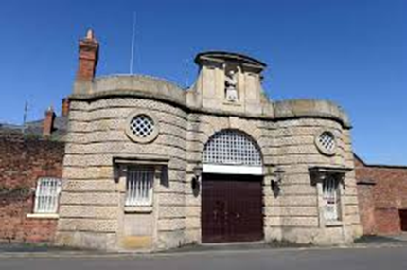
Dark fun factories (Stone, 2010)
Shrewsbury Prison and Jailhouse Tours - http://www.jailhousetours.com/
“LOCKDOWN is the UK’s first ever prison based Zombie chase event, set in the context of prison riot with prisoners ‘acting like wild animals’
PRISON ESCAPE: ‘Think you have what it takes to escape an actual prison? Now you can find out.
A DAY IN THE LIFE OF A PRISONER: Implies that it gives an indication of ‘what it’s really like’ to be in prison
Notes:
At its worst this involves a crude sensationalism which renders places of punishment ‘dark fun factories’ (Stone, 2010), trivializing the inherent suffering associated with imprisonment and sweeping over the unequal nature with which this is distributed within society. A good recent example of this is at Shrewsbury Prison which was closed at the same time as Canterbury. Jailhouse Tours now run a series of events at the site which raise an number of concerns in the way that they reinforce troubling and inaccurate assumptions about prisoners. You can see three of the events on the slide. All information is taken from the website – I haven’t actually been to any events. The “Lockdown” event – the UK’s first ever zombie prison chase event, presents an interpretation of prison riots which reinforces narratives of animalistic, uncontrollable brutality rather than focusing on the institutional injustices and poor conditions which have been shown time and again to contribute to outbreaks of disorder. The drama of seeing “if you have what it takes” to escape an actual prison excludes any awareness of the desperation and longing involved in motivating prisoners to attempt to break free from their confinement, experiences which are powerfully indicated by the plight of William Mummery, who hanged himself in Canterbury Prison in 1809 upon realising that his efforts to tunnel out of his cell had been unsuccessful (Kentish Weekly Post, 26 May 1809). Even the Day in the Life of a Prisoner offers a brief and artificially constructed environment whilst implying that this enables an understanding of the lived experience of a prisoner. This ignores some of the key features that research has associated with the pains of imprisonment such as the management of time whilst incarcerated and the difficulties negotiating an often hostile and unsafe environment (Sykes, 1958).

Slide 6
Educative interpretations
Dark dungeons (combine education and entertainment)
At the Clink Prison Museum you have the choice between:
“a fun visit to torture each other and learn of the truly horrible history or a visit filled with educational fun and learning”
Dark exhibitions (Educative but still sanitised)
At Beaumaris gaol Museum:
“place of harsh punishment, of sadness and sometimes despair”
“grim reality of Victorian justice” …
After reform prisoners “had to be treated humanely while in gaol”
Notes:
Shrewsbury is at the more extreme end of sensationalist representations and this probably reflects the fact it seems to be solely concerned with providing money for the development company that own the site as they wait to be able to begin building work. Many prison heritage sites offer a more factual and balanced interpretation. They are not without their problems though. Take, for example, the Clink Prison museum, which can be considered a dark dungeon in Stone’s (2010) classification of dark tourist sites as it combines education and entertainment. At the Clink they actually make this dual function explicit by offering tourists a choice between an entertaining visit focusing on horrors or an educational trip more concerned with learning. Whilst I can see that this is a way of squaring the circle of wanting to present authentic heritage in an educative way whilst also needing to attract visitors in a commercially competitive world, the implications are troubling. I feel uncomfortable about the conjunction of fun and torture in a world where torture remains a widespread global problem. Additionally the use of the word ‘truly’ before the horrible history embellishes that side of interpretation with an authenticity which it actually lacks.
Beaumaris Gaol offers a particularly good interpretation of prison heritage with a predominantly educative focus which avoids many of the limitations apparent at other sites. There is even an awareness of some of the less talked about elements of imprisonment such as the sexual exploitation of women, prisoner suicide and the impact of prison on mental health and so it is only partially sanitised.
The continuous nature of imprisonment in modern society is not reflected at all though. The present is acknowledged on very odd occasions, for example there is a reference to continued controversy around the issue of capital punishment, but there is little sense that prisoners from Anglesey continued to be confined elsewhere, as they continue to be today, even after the closure of the gaol. Indeed the site was still used for confinement in its role as a police station until 1952. The interpretation offered does little to connect these two forms of incarceration, however, or the similarities between the types of groups on the receiving end of police and penal power. Silence on the continuation of imprisonment reduces the capacity for interpretations to raise questions about these issues in a contemporary setting. I’ll consider just a few examples of some of the effects of these interpretations from notes taken from a field work trip in April this year. In the first quotation the conjunction of harsh punishment with sadness and despair establishes a connection between the two, subtly implying that imprisonment without this harshness would not induce such feelings. Many visitors may assume contemporary imprisonment has lost much of its severity and, therefore, there is less sadness and despair. A quick look the figures for suicide and self harm in contemporary prisons would not support such an idea. And phrases such as the ‘grim reality of Victorian justice’ reinforce this by emphasising the harshness of the past whilst ignoring important areas of continuity in the experience of prisoners over time. Ideas such as ‘humane treatment’ are also presented in a factual manner, as if these concepts are unproblematic and uncontested, rather then complex notions open to interpretation. Similarly individual offenders are presented in terms of their crime and punishment with no other detail about their wider life histories. It is clearly more difficult for sites such as Beaumaris, which closed as a prison in 1878, to engage with present practices of punishment, but even at sites which have been recently used for punishment Wilson (2008 ) has identified a tendency for the perspectives of former prison staff to dominate interpretations, leaving the voices of prisoners (and often also victims) on the periphery.

Slide 7
Trying to forge a new way(1)
Methodologically:
Archival research at national and local archives as well as family history research to trace the life stories of prisoners
ethnographic interviews with prison staff, prisoners and other members of the community with stories to tell about the prison
Notes:
I have to be honest that I don’t have all the answers to how we develop representations that move beyond some of these limitations. I have lots of ideas for things we could do in the heritage centre but given the provisional nature of the bid I won’t go into too much detail about these at this time. But I will talk briefly about the research we are currently undertaking which we hope will provide a good body of knowledge to inform more critical interpretations of the prison’s history should we secure funding. Methodologically there are two central approaches within the research. The first is archival and draws on a wide range of records at national and local archives alongside family history research with resources such as Ancestry, Find My Past, and, of course, the Digital Panopticon website. The second strand involves conducting ethnographic interviews with prisoners, prison staff and other members of the community to produce an oral history archives of stories about the prison and the people within it. This will also generate evidence which can be used in conjunction with the archival research to help explore issues of continuity and make links between the different periods of Canterbury’s operational history.

Slide 8
Trying to forge a new way (2)
Interpretation focus:
An institutional history which focuses on both change and continuity overtime and includes awareness of the ways in which the tensions between the different aims of imprisonment have impacted on the institution
A community history which incorporates multiple perspectives and challenges the notion of a strict and impassable divide between ‘inside’ and ‘outside’
Life histories of prisoners and their families to contextualise offending behaviour, highlight the multiple identities of prisoners and give insight into the wider effects of imprisonment. The concepts of personal troubles and public issues, taken from C Wright-mills (1959) will be used to ensure that these stories are able to make connections between the past and the present.
Notes:
The aims of this are to produce knowledge that can inform an interpretation focusing on three main areas to be presented through exhibits in the heritage centre, a website to accompany this, and through publications . One aspect is the history of the institution but the presentation and interpretation of this will focus on issues of continuity and change overtime. In particular tensions between the conflicting aims which are expected of the prison and the ways in which this impacted on the institution at different periods in its history will be a key element interpretive element. It is also hoped to draw out a focus on the relationship between the community and the prison by incorporating multiple perspectives in order to move beyond the idea of the prison as simply a closed institution shut off from wider society. Finally interpretations will present life histories of prisoners and their families. A biographical narrative approach is taken to try and move away from representations of prisoners solely as offenders. Instead these will aim to contextualise their offending behaviour and the multiple identities they possessed over their life course. The family are included to try and provide awareness of the ways in which the harms of the prison spread outside its walls. It is hoped that presenting these narratives as stories of personal troubles and then connecting these with wider public issues, concepts taken from the work of C Wright Mills, will provide a way of exploring connections between the past and the present as well as highlighting the way that crime and punishment are situated within wider relations of power and inequality.

Slide 9
references
Barton, A. and Brown, A. (2015) ‘Show me the Prison! The Development of Prison Tourism in the UK’, Crime, Media, Culture, 11(3). 237-258
Fitzgerald, M. and Sim, J. (1982) British Prisons, Blackwell: Oxford
Garland, D. (ed.) (2001) Mass Imprisonment: Social Causes and Consequences, SAGE: London
Garton-Smith, J. (2000) ‘The prison wall: Interpretations problems for prison musuems’, Open museum journal 2, 1-13
Gould. M. R. (2014) ‘Return to Alcatraz: Dark Tourism and the Representation of Prison History’, in Death Tourism: Disaster Sites as Recreational Landscape, University of Chicago Press, Chicago, IL
Lennon, J. and Foley, M. (2010) Dark Tourism: The Attraction of Death and Disaster, Cengage Learning: Andover
Mathieson, T. (2000) Prison on Trial, Waterside Press: Winchester
McGowen, R. (1995) ‘The Well-Ordered Prison: England, 1780-1865’ in Morris, N. and Rothman, R. J. (eds) The Oxford History of the Prison: The Practice of Punishment in Western Society, Oxford University Press: Oxford, pp. 71-99
Scott, d. and Codd, H. (2010) Controversial issues in prisons, Open University Press: maidenhead

Slide 10
Sim, J. (1994) ‘The abolitionist approach: The British perspective’ in Y. Jewkes and H. Johnston (eds) (2006) Prison Readings: A Critical Introduction to Prisons and Imprisonment, Routledge: London, pp. 98-104
Sim, J. (2009) Punishment and Prisons: Power and the Carceral State, SAGE: London
Stone, P. R. (2009) ‘Dark tourism: Morality and new moral spaces’ in R. Sharpley and P. R. Stone (eds) The darker side of travel: The theory and practice of dark tourism, Channel view publications: bristol
Stone, P. R. (2010) Death, Dying and Dark Tourism in Contemporary Society: A Theoretical and Empirical Analysis, available at: http://clok.uclan.ac.uk/1870/1/StonePPhD_thesis_final.pdf
Strange, C. and Kempa, M. (2003) ‘Shades of Dark Tourism: Alcatraz and Robben Island’, Annals of Tourism Research, 30(2), 386-405
Sykes, G. (1958) The Society of captives: A study of a maximum security prison, Princeton University Press: Princeton, US
Walby, K. and Piché, J. (2011) ‘The Polysemy of Punishment Memorialisation: Dark Tourism and Ontario’s Penal History Museums’, Punishment and Society, 13(4), 451-472
Welch, M. (2015) Escape to Prison: Penal Tourism and the Pull of Punishment, University of California Press: Oakland, CA
Wilson, J. Z. (2008) Prison: Cultural Memory and Dark Tourism, Peter Lang: London
Wilson, J. Z., Hodgkinson, S., Piché, J. and Walby, K. (eds) The Palgrave Handbook of Prison Tourism, Palgrave: London
Wright-mills, c. (1959) The Sociological imagination, oxford university press: oxford

