Slide 1
2nd International Conference
on
Science, Engineering and Advanced Technology
(ICSEAT 2024)
”How do we engineer inclusive education technology”
Professor Anne Nortcliffe | Canterbury Christ Church University | Anne.Nortcliffe@canterbury.ac.uk
Notes:
How do we engineer inclusive technology education?

Slide 2
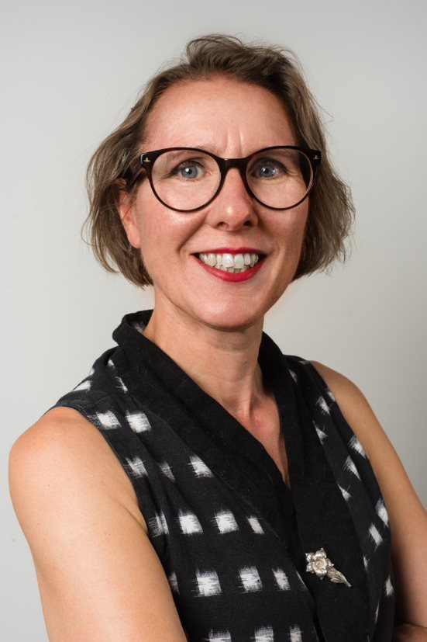
Welcome
Introduction to my technology education research history to enhance student learning
Introduction to my EDI research history to create a New EDI HE School of Engineering Technology and Design
Introduction Lessons to be Learnt from EDI for Education Technology

Slide 3
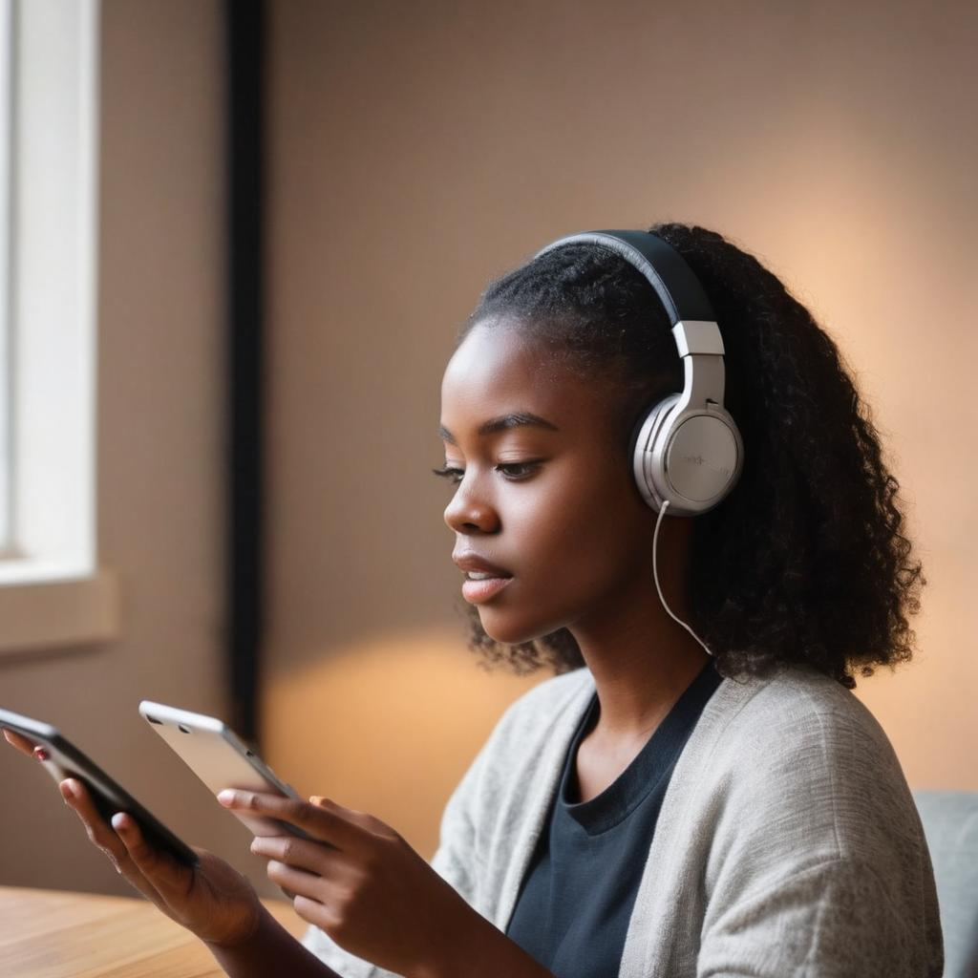
Education Technology Researcher – Audio
Researched and developed Good Practice Audio Lecture Notes
Radio style audio chunks 6-8 mins
Meaningful file names
Aid to scaffold student learning (Nortcliffe & Middleton, 2008)
Captures more than verbalisation (Fidler et al, 2006)
Supports neuro-diverse (Nortcliffe & Middleton, 2006)
Researched and developed Good Practice Audio Feedback – Audio Feedback Toolkit
Brief and engaging - 3-6 mins (Middleton & Nortcliffe, 2009)
Record Student Name, Assessment & meaningful file name (Middleton & Nortcliffe, 2010)
Blended feedback circular dialogue – Mini Tutorials (Nortcliffe & Middleton, 2011a)
“Inside head of academic” – live and unedited, (iBid)
Multi-dimensional- dynamic language, tone, pace, (iBid)
Call to action - what done well and areas for improvement (iBid)
Feedback to Feedforward, (iBid)
Long tail effect, life beyond assessment, (Nortcliffe & Middleton, 2011b)
Timely and personal feedback (Nortcliffe & Middleton, 2010a)
Student
Academic
Traditional Communication
Image Generated by Gencraft by Anne Nortcliffe prompt
Academic
Student
The potential of audio recordings through multi-layers of learning through listening, self-reflection, sharing audio, peer conversations, tutor conversations, re-listening of audio.

Slide 4
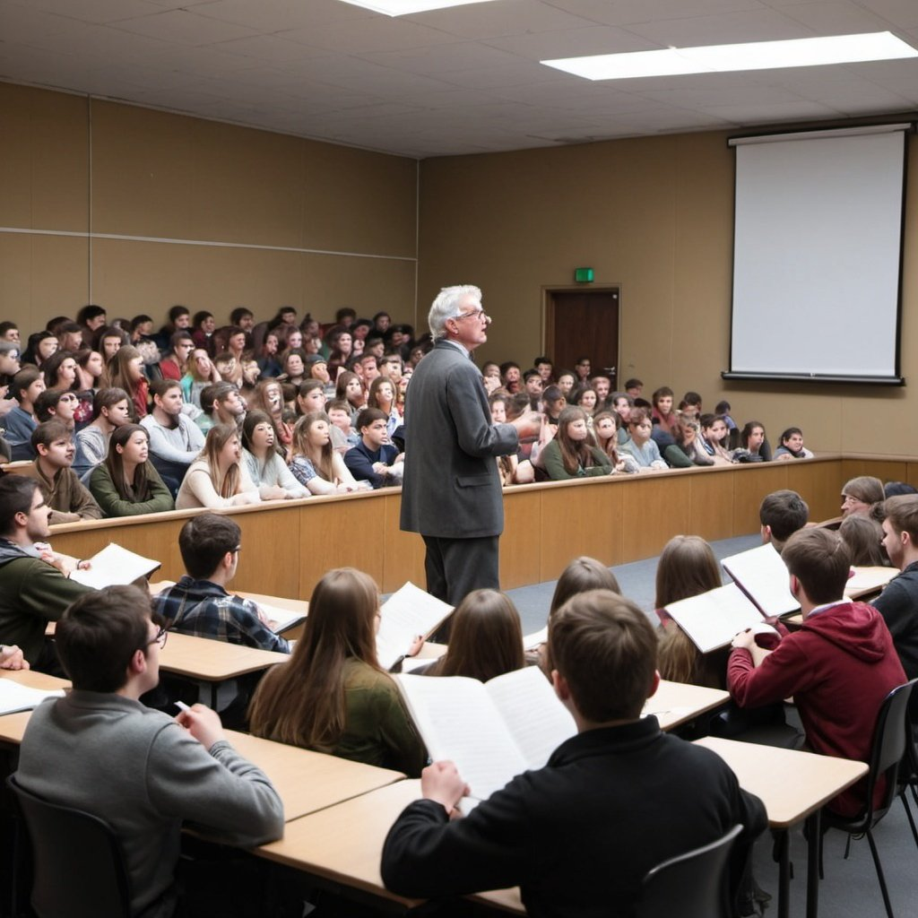
Education Technology Researcher – Student Audio Notes
Researched and developed Good Practice Student Audio Notes
Rethinking Traditional academic model transmission and passive student receptor
Students innovative audio note taking theirs and others voices (Rossiter et al, 2009a)
Captures ephemeral learning conversations (Rossiter et al, 2010)
Captures informal/semi-formal/formal learning opportunities (Nortcliffe et al, 2009)
Promotes multi-dimensional learning dialogues, (Nortcliffe et al, 2013)
Promotes student development of CPD (Nortcliffe and Middleton, 2010b)
Re-listening promotes reflective learning (Nortcliffe and Middleton, 2010c)
Enhances project supervision, (Nortcliffe, 2011)
Supports ALL students, in particular disabled (Nortcliffe et al, 2009)
Tool that aids student learning, (Rossiter et al, 2009b)
Image Generated by OpenAI by Anne Nortcliffe prompt
Academics/Peers
Student
Layers of learning of student audio notes: student recording conversations, listening, reflecting, sharing, discussing (peers/tutor), recording, relistening to audio

Slide 5
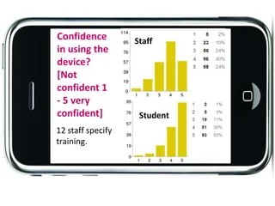
Education Technology Researcher – Smart Technology
Researched and identified student’s adoption smart technology
Technology students’ innovate smart technology for learning, (Nortcliffe & Middleton, 2013)
Students embrace BYOD (Woodcock, et al 2012a)
Supports formal and informal learning engagement, (Nortcliffe & Middleton, 2013)
Smart technology should be at heart of every institution digital strategy, (Woodcock et al, 2012b; Ţălu, Ş., 2020)
Digital poverty is a reality for some students (Nortcliffe, 2021)
Ubiquitous use digital and learner efficacy (Nortcliffe & Middleton, 2013)
Digital literacy v digital natives v digital nomads v digital curious – (Nortcliffe, 2015)
But, COVID separated digital divide (Holmes and Burgess, 2022) and GDPR
Researched and identified good academic smart technology practice
Academic digital literacy v digital natives v digital nomads v digital curious –(Nortcliffe, 2015)
Personal devices work use, (Nortcliffe, 2015),
GDPR and Personal Data (Raghunath et al, 2018)
Institutional IT support (iBid)
Roaming WiFi and institutional integration apps (iBid)
Staff development (iBid)
Support formal, semi-formal and informal, (Nortcliffe, 2015)
Work smarter (iBid)
Woodcock et al, 2012c

Slide 6
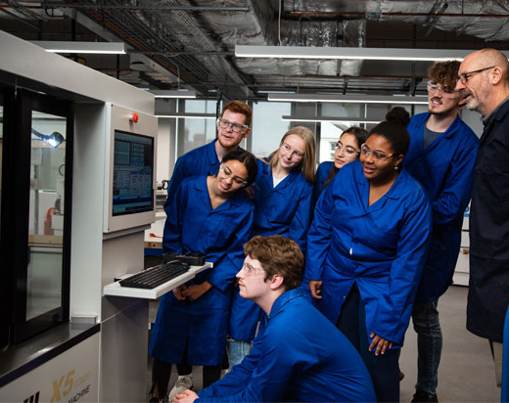
Education Researcher – EDI
Expand the talent pool (Nortcliffe et al, 2019)
Meaningful STEAM outreach activities (Lawson et al, 2024)
Student marketing (Nortcliffe, 2022)
Higher Education Facilities and Resources
Staff and Student Mirror Image (van Mens-Verhulst et al , 2015; Oputa et al, 2021)
Inclusive Estates Facilities and equipment (Latulipe et al, 2018)
Inclusive PPE (Peters, 2017)
Industrial engagement and inclusive learning opportunities (Fortin, et al, 2019)
Adoption Industry sourced CDIO projects (Manna et al, 2023)
Employer Inclusive Engagement (Blicblau, 2016)
Inclusive Higher Education Curriculum (Nortcliffe, 2022)
Decolonise the curriculum (Fomunyam, 2017)
Inclusive engineering curriculum (Mills et al 2008; Perez, 2019)
Inclusive learning and teaching facilitation (Beddoes et al, 2018)
Canterbury Christ Church University Engineering students and Head of Technical operations in the engineering workshop

Slide 7
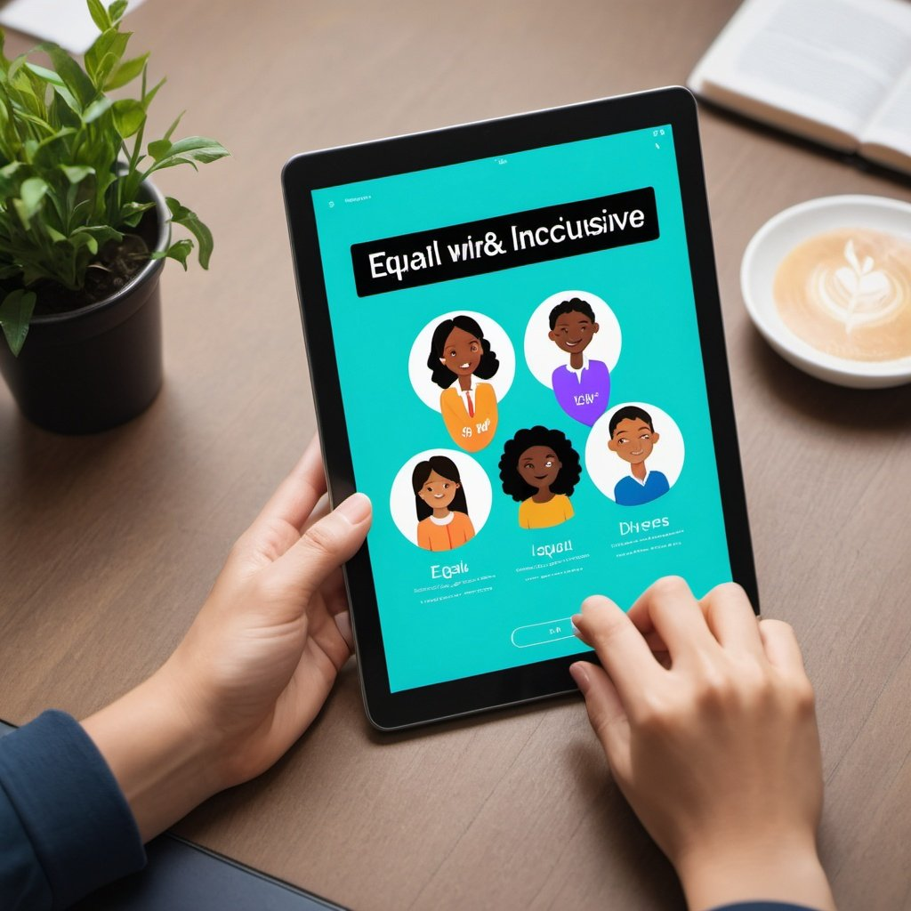
Education Technology Researcher – Inclusive Education Technology
Lessons learnt from creating inclusive higher education facility
Images support sense of belonging
Text is neuro-diverse
Less is more
Don’t make you think – intuitive – invest staff/student development
Compatible with disability software
Speech to text
Audio to text captions
Language matters
Gender neutral or feminine language
Decolonised
Cultural aware – gamification v collaboration culture
Not platform dependent
Less power and WiFi hungry
Image Generated by OpenArtAI by Anne Nortcliffe prompt

Slide 8
References
Here's the organised reference list:
Beddoes, K., Panther, G., Cutler, S., & Kappers, W. M. (2018). Training and Resources for Gender Inclusive Teamwork. , [on-line at]. https://doi.org/10.15394/2018.1791
Blicblau, A.S., Nelson, T.L. and Dini, K., 2016. The Role of Work Placement in Engineering Students' Academic Performance. Asia-Pacific Journal of Cooperative Education, 17(1), pp.31-43
FIDLER, A., MIDDLETON, Andrew, & NORTCLIFFE, Anne. (2006). Providing added value to lecture materials to an iPod generation. In International Consortium for Educational Development Conference, Sheffield, June 2006. Retrieved from: [on-line at:] https://shura.shu.ac.uk/id/eprint/14439
Fomunyam, K. G. (2017). Decolonising the engineering curriculum in a South African University of Technology. International Journal of Applied Engineering Research, 12(17), 6797-6805.
Fortin, C., NORTCLIFFE, A., & Serreau, Y. (2019). Developing good practices for industrial engagement in co-creation of CDIO curriculum. In The 15th international CDIO conference.
Holmes, H., & Burgess, G. (2022). Digital exclusion and poverty in the UK: How structural inequality shapes experiences of getting online. Digital Geography and Society, 3, 100041.
Latulipe, C., MacNeil, S. and Thompson, B., 2018, October. Evolving a data structures class toward inclusive success. In 2018 IEEE Frontiers in Education Conference (FIE) (pp. 1-9). IEEE.
Lawson, F. I., Colley, S., & Billingsley, B. (2024). Approaching STEAM via inquiry-based responses to big questions. Motivation and Engagement in Various Learning Environments: Interdisciplinary Perspectives, 29.
Manna, S., Joyce, N., & NORTCLIFFE, A. (2023). Integration of graduate employability skills through industry outsourced CDIO project. In 19th International CDIO Conference (pp. 425-435). NTNU SEED.
Middleton, A., & NORTCLIFFE, A. (2009). Understanding effective models of audio feedback. In: ROY, Rajarshi (Ed.), Engineering education: perspectives, issues and concerns. Shipra Publications.
Middleton, A., & NORTCLIFFE, A. (2010). Audio feedback design: principles and emerging practice. International Journal of Continuing Engineering Education and Life Long Learning, 20(2), 208-223.
Mills, J. E., Ayre, M. E., & Gill, J. (2008). Perceptions and understanding of gender inclusive curriculum in engineering education (Doctoral dissertation, SEFI).
NORTCLIFFE, A. (2015). HE BYOD—ready or not?. In: MIDDLETON, Andrew (Ed.), Smart learning: teaching and learning with smartphones and tablets in post compulsory education (pp. 147-157). Sheffield, Media-Enhanced Learning Special Interest Group and Sheffield Hallam University.
NORTCLIFFE, A., & Middleton, A. (2013). The innovative use of personal smart devices by students to support their learning. In Increasing student engagement and retention using mobile applications: Smartphones, Skype and texting technologies (pp. 175-208). Emerald Group Publishing Limited.
NORTCLIFFE, A., & Middleton, A. (2011a). Smartphone feedback: Using an iPhone to improve the distribution of audio feedback. International Journal of Electrical Engineering Education, 48(3), 280-293.
NORTCLIFFE, A., & Middleton, A. (2011b). Employability Feedback for Engineering Students. In: International Conference on Engineering Education, Belfast, Northern Ireland, 21-26 August 2011 [on-line at:] https://shura.shu.ac.uk/id/eprint/14538
NORTCLIFFE, A. (2011). About using iPhones/iTouches for project supervision. In: Middleton, Andrew (Ed.), Media-enhanced feedback: case studies and methods. ASSET and MELSIG, 17-20.
NORTCLIFFE, A., & Middleton, A. (2010a). Effective assignment feedback through timely and personal digital audio engagement. In Technology-supported environments for personalized learning: Methods and case studies (pp. 409-428). IGI Global.
NORTCLIFFE, A., & Middleton, A. (2010b). Student Audio Notes Project: lessons from autonomous use of MP3 recorders by students to enhance their learning. In: Moore, Ivan, Elving-Hwang, Jo, Garnett, Kenisha, & Corker, Chris (Eds.), CPLA Case Studies. Centre for Promoting Learner Autonomy, Sheffield Hallam University, 151-164.
NORTCLIFFE, A., & Middleton, A. (2010c). In: Corker, Chris (Ed.), Enquiry, Autonomy and Graduateness: achieving an outstanding student learning experience: CPLA Conference Proceedings. Centre for Promoting Learner Autonomy, Sheffield Hallam University, 89-99.
NORTCLIFFE, A., Rossiter, J. A., Griffin, A., & Middleton, A. (2009). Students using digital audio interventions to enhance their learning experience. Paper presented at The Higher Education Academy Annual Conference 2009 "The Future of the Student Learning Experience", 30 June - 2 July 2009, Manchester, UK.
NORTCLIFFE, A., & Middleton, A. (2006). Audio lecture notes: supplementary lecture materials with added value. NADO News The Official newsletter of the National Association of Disability Officers Ltd, Summer 2006.
NORTCLIFFE, A. (2022). How are do you create an inclusive engineering graduate pipeline? Precision, June (24), 8-11.
NORTCLIFFE, A. (2021). Digital reality in supporting students' learning, the challenges and opportunities. Education Technology Insights.
NORTCLIFFE, A., Barley, R., & Andrews, J. (2018). Are we (engineering education) missing engineering student potential? UK&IE Research Network Symposium, Portsmouth University, Portsmouth, 1-2nd November 2018.
Oputa, O., & Cross, I. (2021). Be SMART: A BAME staff-student partnership to enhance graduate employability. The Journal of Educational Innovation, Partnership and Change, 7(1).
Perez, C. C. (2019). Invisible women: Exposing data bias in a world designed for men. Random House.
Reorganized reference:
Peters, J. (2017). A bold step forward in women’s PPE. The Woman Engineer, 19(16), Autumn 2017, pp. 3.
Rossiter, J. A., NORTCLIFFE, A., & Middleton, A. (2009). A workshop on using audio devices to improve student learning. In: STEM Pedagogy Research Methods 2009 Symposium, Loughborough, UK, June 2009.
Rossiter, J. A., NORTCLIFFE, A., Griffin, A., & Middleton, A. (2009). Using student generated audio to enhance learning, Engineering Education: Journal of the Higher Education Academy Engineering Subject Centre, 4(2), 52-61.
Rossiter, J. A., NORTCLIFFE, A., & Middleton, A. (2010). Using audio to support student learning. In: EE2010: Inspiring the next generation of engineers, Aston University, Birmingham, 6-8 July 2010.
Ţălu, Ş. (2020, May). New perspectives in the implementation of smart-technologies in higher education. In 2nd international scientific and practical conference “modern management trends and the digital economy: From regional development to global economic growth”(MTDE 2020) (pp. 253-257).
Here are the reorganized references:
1. van Mens-Verhulst, J., Woertman, L., & Radtke, L. (2015). Faculty women as models for women students: how context matters. Studies in Higher Education, 40(7), 1164-1178.
2. Woodcock, B., Armstrong, M., Nortcliffe, A., & Middleton, A. (2012a). Smart-device Potential for Student Learning. In: CSEDU 2012: International Conference on Computer Supported Education, Porto, Portugal, 16-18 April 2012 (pp. 410-415).
3. Woodcock, B., Armstrong, M., Nortcliffe, A., & Middleton, A. (2012b). Smart-device Potential for Student Learning. In: CSEDU 2012: International Conference on Computer Supported Education, Porto, Portugal, 16-18 April 2012 (pp. 410-415).
4. Woodcock, B., Armstrong, M., Nortcliffe, A., & Middleton, A. (2012c). Smart-device potential for student learning. Mobile Monday Manchester: Mobile Education Event, Manchester, UK, 12th.
Image Generated by OpenArtAI by Anne Nortcliffe prompt

Slide 9
THANK YOU

