Slide 1
Finley Lawson, Research Fellow LASAR: Canterbury Christ Church University

Slide 2
Opportunities and Possibilities Raised by Teaching Science and Religion in the Digital Age
The Epistemic Insight Initiative: Bridging Discipline Boundaries

Slide 3
Opportunities and Possibilities
Scholarly thinking has moved beyond conflict models of the relationship
Increase of AI, robotics & technology in everyday life brings Big Questions to the fore
Technology in the classroom provides new opportunities to develop students epistemic insight and challenge their misperceptions
Ofsted’s requirement for considered curriculum & RE Commission report provide challenge and opportunity to explore the place of RE in the wider curriculum.
Notes:
R: Reluctant to say 1 after Mark’s talk yesterday – but perhaps it is safe to safe the conversation has moved beyond a simplistic model of conflict
B: AI, robotics etc make us ask questions about ethics, personhood and challenge the idea that science can sit in isolation – driverless =good example
O: we’ll look at some of these later – provides opportunities to help students catch themselves being inconsistent and analyse worldview/ metpajhysics stance
G: (apologies for those of you teaching here,

Slide 4
What is Epistemic Insight?
Knowledge about knowledge – particularly methods and norms of though within disciplines and interaction between disciplines (intellectual virtue –teachable & assessable)
Moving beyond topic work through recognising the distinctiveness of and interaction between the disciplines (pedagogical approach)

Slide 5
Framing the “Problem”
School compartmentalisation/ subject fragmentation
Emphasising boundaries without explaining links/ powers & limitations
Digital “collapse” of boundaries
“knowledge” or evidence is removed from context in the way search results are presented
Notes:
epistemic insight lies at the heart of developing and supporting students’ to make sense of the world around by enabling them to recognise the pedagogical engineering that goes in to their learning and supporting them to bridge the subject or module boundaries that are an inherent part of the compartmentalised curriculum.
Whilst pedagogical engineering and compartmentalisation have been long standing issues in education, in equipping students’ to deal with the digital age it has become increasingly important to actively work to build their understanding of school/university as a multidisciplinary arena because the challenges and issues they will be addressing in their working lives will not be able to be tackled by one discipline in isolation.
EI is about equipping students to be able to address the boundaries – why are they there? What information can or should cross those boundaries and how does crossing the boundary change what that information/knowledge/vocabulary looks like? Equipping students to be critical of those boundaries – have they been engineered? Are there limitations etc.

Slide 6
The Epistemic Insight initiative aims to create an education system which more effectively:
Stimulates students' intellectual curiosity in Big Questions and ensures they have access to the idea that science and religion are not necessarily incompatible; positively influences students’ attitudes to their subjects and to asking questions which bridge subject boundaries.
Stimulates students’ scientific curiosity and develops their appreciation and understanding of the power and limitations of science in multidisciplinary contexts; widens the pipeline from school to science and science related careers.
Stimulates teachers’ pedagogic curiosity, develops their understanding of the factors which affect students’ developing epistemic insight in schools; enriches science and RE teachers’ expertise and confidence so that they feel equipped to teach about science and religion.

Slide 7
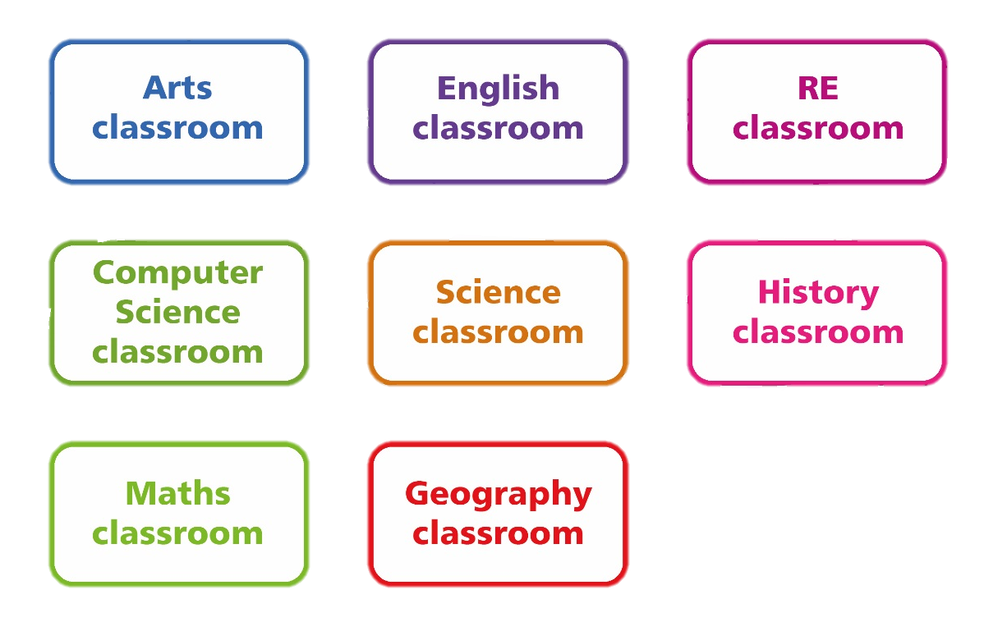
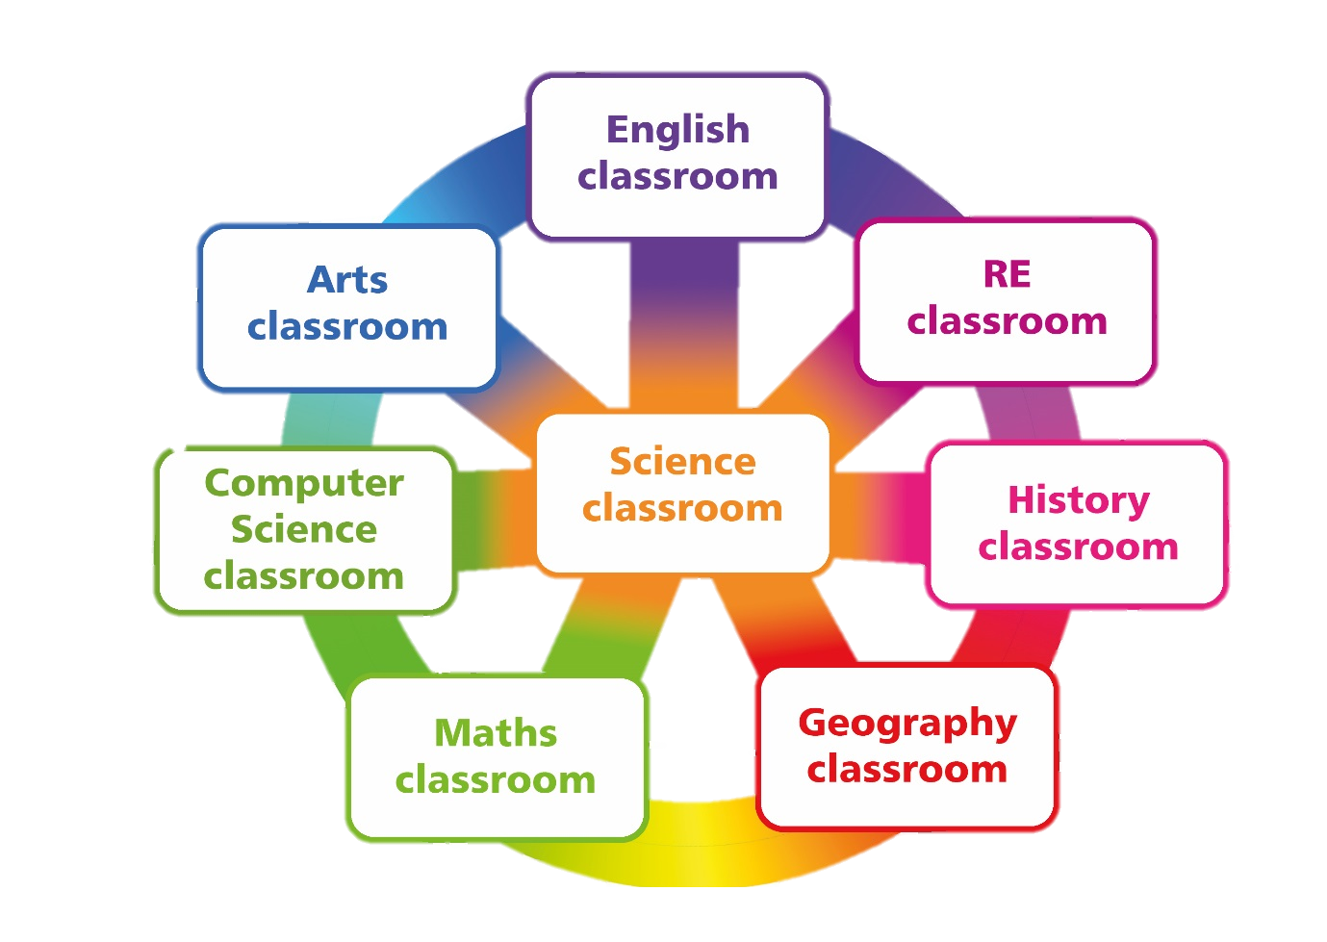
Challenge of Entrenched Subject Compartmentalisation
Epistemology is taught in a fragmented way, making it difficult to appreciate how different ways of knowing interact
Pressure on covering subject content in science means conceptual understanding is often developed through recipe investigations & lack of time for explorations of methodological questions.

Slide 8
Framework for Developing Students’ Epistemic Insight
Develop students’ interest in Big Questions and understanding of the relationships between science and religion.
Develop students’ understanding of cross-discipline relationships and the power and limitations of science.
Develop students’ understanding of different ways of knowing and how they interact.
Raising Awareness of Subject Compartmentalisation
Exploration of Big Questions in Multidisciplinary Arenas
Understanding Science and Religion are Not Necessarily Incompatible
Notes:
A way to understand where the current system struggles to develop student’s EI is to look at the science curriuc in England & wales:
In KS1 (age 5-7) : asking simple questions and recognising that they can be answered in different ways
In LKS2 (age 7-9): asking relevant questions and using different types of scientific enquiries to answer them
In UKS2 (age 9-11): asking their own questions about scientific phenomena
In KS3 (age 11-13/14): become aware of some of the big ideas underpinning scientific knowledge and understanding.
In KS4 (age 13/14-16): develop understanding of the nature, processes and methods of science through different types of science enquiries that help them to answer scientific questions about the world around them

Slide 9
Opportunities for Bridging Science and Religion in the Classroom

Slide 10
What is the concern?
Scientism: the belief that there are not real limits to the competence of science and science alone will eventually solve all, or almost all, of our real problems (Stenmark,1997).
Reductionism: without transparency/criticality and the potential “loss” trivialise rational part of human thinking and cognitions.
Other disciplines are of very little help or no have no value at all
Science is not in conflict with religion, but scientism is necessarily in conflict with religion.
Notes:
We’ve heard a lot about scientism yesterday and also pointing towards reductionism/materialism
We are not advocating that students all have to discard scientism or that they have to see sci & rel as compatible but their scientism needs to be critical and they need to see sci & rel are not necessarily incompatible.

Slide 11
Frank Jackson’s Mary’s Room Experiment

Slide 12
Helping Students Search for “Truth”?
Which experience provided Mary with “truth” about colour?
Do they provide different kinds of truth?
What roles do objectivity and subjectivity play in your answers?

Slide 13
Science, Reality & Experience
The ultimate aim of the modern movement in biology is in fact to explain all biology in terms of physics and chemistry” (Francis Crick)
Capturing the full authenticity of actual human experience, lived in the world
(John Polkinghorne)
Notes:
Uncritical scientism can lead students to expecting crick, but as we’ve discussed during this conference sci reaches in to much broader areas and it can e argues a purely reductionism approach looses some of what it is to be human in the way it is explained in schools.

Slide 14
Bringing VR to Nagel’s Question
Notes:
What is it like to be a bat?

Slide 15
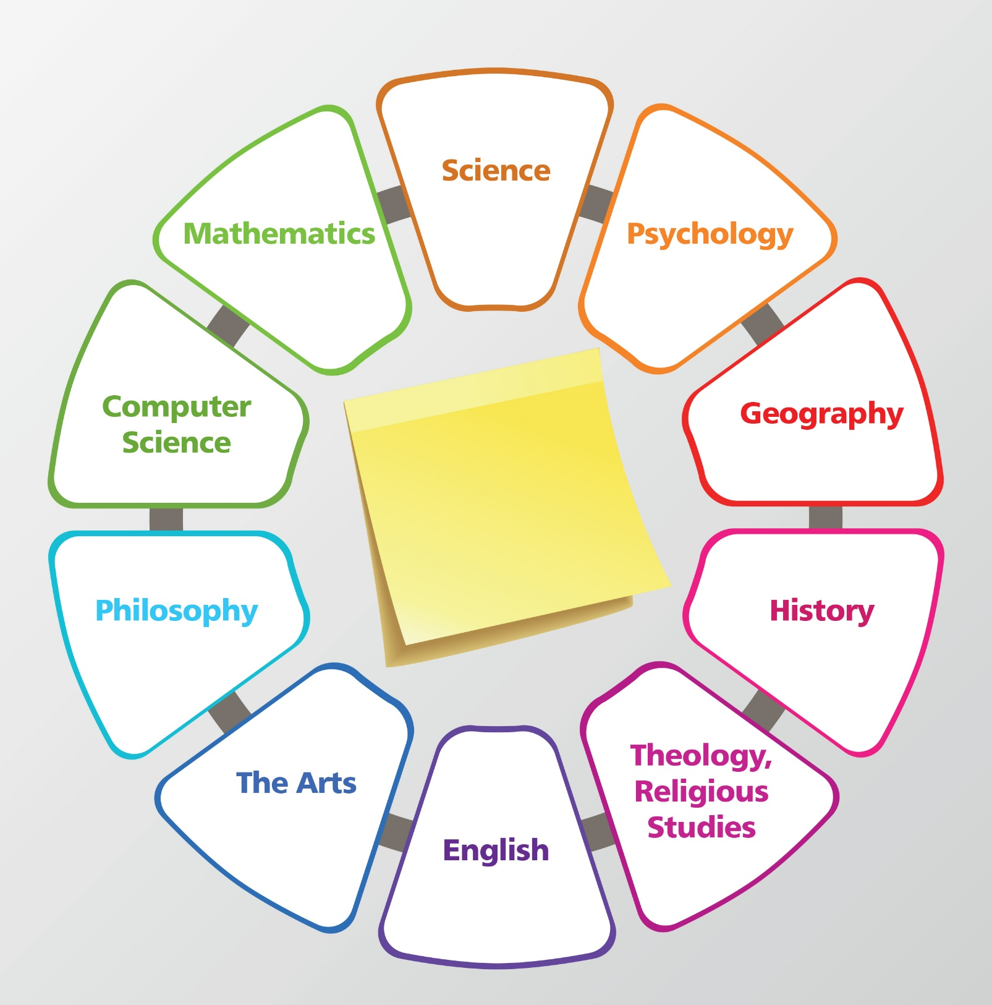
Helping Students Navigate Different Ways of Knowing
Notes:
Looking at how we pose the questions can change which discipline we go to for answers…
Question 1:
Is it alive?
What is life?
Question 2 :
Consider what disciplines would support – eg

Slide 16
Re-Engaging with Science via Philosophical Big Questions
Inspiring Minds brings students to science through questions of human identity, nature of reality & technology
Questions we may expect to explore in the RE classroom but can and do cross over into science
Co-planning & development of a ‘considered curriculum’ can enable students to navigate discipline boundaries and make links across subjects
In ISL this has helped students appreciate relevance & re-engage w/ subjects

Slide 17
Co-Planning & Co-Teaching
Creating a joined up curriculum – over to you!
Notes:
No single subject alone can answer the universe’s big questions, particularly those that bear on the human search for meaning, purpose, and truth
Multidisc questions & big questions that touch on the understanding the universe and humanity’s place within it

Slide 18
Epistemic Insight Initiaitive
Research, outreach and curriculum innovation to address a gap in the way that schools currently develop students’ capacities to ask and explore different types of questions, including Big Questions.
Seeking a research-based solution to the following question:
How can the education system in England open its classrooms to Big Questions, systematically counter uncritical scientism and equip young people with the epistemic insight (EI) they need to access a range of ways to think about how science and religion relate, including positive views of the relationship.

Slide 19
The Initiative is funded by:

Slide 20
Year Level | Relationships between science and religion | The nature of science in real world contexts and multidisciplinary arenas | Ways of knowing and how they interact
Primary Learning Outcomes | Science and religion are mostly concerned with different types of questions, including different types of why question. | Science begins with observations of the natural world and constructing ways to explain our observations. | Science has some similarities and some differences with other ways of knowing that we learn about in school.
Lower secondary Learning Outcomes | Some people say that science and religion are compatible and some people say they are not. | Some questions are more amenable to science than others. | Different disciplines have different preferred questions, methods and norms of thought.
Upper secondary Learning Outcomes | Science and religion are not necessarily incompatible. | Scientism is not a necessary presupposition of science. | Some questions are more metaphysically sensitive than others.

