Slide 1
The Comquol Study: - A pilot trial looking at a structured communication intervention in secure mental health settings: Outcomes and Challenges

Slide 2
The research was funded by the National Institute for Health Research (NIHR) under its Research for Patient Benefit (RfPB) Programme
(Grant Reference Number
PB-PG-0609-19107)
The views expressed are those of the authors and not necessarily those of the NHS, the NIHR or the Department of Health

Slide 3
Research Team
Professor Douglas MacInnes, Canterbury Christ Church University
Dr Catherine Kinane, Kent and Medway Partnership Trust
Dr Janet Parrott, Oxleas NHS Foundation Trust
Professor Tom Craig, Institute of Psychiatry, Kings College, London
Professor Sandra Eldridge, Queen Mary University, London
Mr George Harrison, Oxleas NHS Foundation Trust
Dr Ian Marsh, Canterbury Christ Church University
Miss Jacqueline Mansfield, Canterbury Christ Church University
Professor Stefan Priebe, Queen Mary University, London

Slide 4
Learning Objective
To understand the practicalities in undertaking a pilot trial in forensic settings
To be aware of using a computer aided structured communication approach to help collaborative decision making
To examine the findings for the ComQuol study

Slide 5
ComQuol Overview
A pilot trial of a structured communication approach in medium secure settings (Priebe et al, 2002)
Intervention comprised of six 1:1 sessions facilitated by primary nurses
The intervention consisted of two elements:
A computer-mediated approach (DIALOG+) and
Non-directive counselling based on SFT
It employed a user centred approach promoting service users active participation in the intervention

Slide 6
Aims and Objectives
To examine the proposed methodology and establish the feasibility of the research design for a full scale trial
To determine the variability of the outcomes of interest
To estimate the cost of the proposed intervention
Refine the intervention following the outcome of the study based upon the experiences of the participants

Slide 7
Method
Design
36-Month pragmatic cluster randomised pilot trial
Six medium secure units
Data Collection
For all quantitative data
Three time points
Baseline
Six Months
Twelve Months

Slide 8
Preparation and Support
Each nurse was individually trained to use the DIALOG+ software
Nurses received a three-day training in Solution Focused Brief Therapy
Monthly meetings were held between researcher-nurse

Slide 9
Activity
If you were the PI of your unit, how would you consider the following:
How would you recruit participants (nurses and in-patients) into a study?
Tackling randomisation
Training; How could a three-day training program be organised for nurses within a medium secure setting?
How would you maintain the fidelity of the intervention?
How do you ensure the outcomes being recorded are valid and not influenced by the researcher/clinical team?
How would you maintain participant confidentiality?
Any other practical issues to consider?

Slide 10
Outcomes
Primary outcome:
Quality of Life (MANSA, Priebe et al, 1999)
Secondary outcomes
Disturbance (disturbance monitoring form)
Therapeutic Relationships (HAS, Priebe & Gruyters, 1993)
Ward Climate (EssenCES, Schlast et al, 2008)
User Satisfaction (FSS, MacInnes et al, 2010)
Recovery (QPR, Neil et al, 2009)
Nurse Stress (MBI, Maslach et al, 1996)
Health economic data (self developed form)

Slide 11
DIALOG +
A computer-mediated intervention developed to rate a patient’s level of satisfaction and needs for care on 8 life domains and 3 treatment aspects within the routine 1:1 session with their primary nurse
Provided a structure and patient-centred meeting focused on change

Slide 12
Rated on a 1 (totally dissatisfied) to 7 (totally satisfied) Likert scale across these domains
Patient’s view on their situation and needs are the central point of discussion; their views are explicit
Mental health | Physical health
Accommodation | Job situation
Leisure activities | Friendships
Medication | Personal safety
Relationship with family & friends | Practical help Consultations

Slide 14
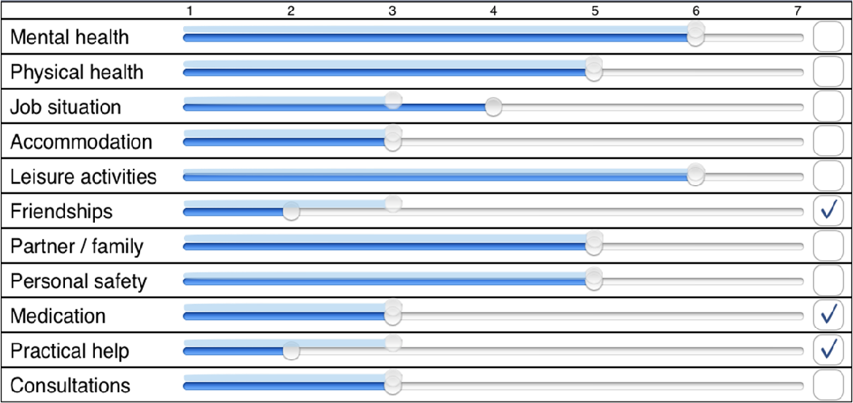

Slide 15
Activity
Practice undertaking an initial assessment using the DIALOG+ software
Work in pairs or a small group (2-4)
Rate all the domains (ensure to answer the question “Do you need additional help?”
Select one of the domains, and enter a couple ‘Next Steps’

Slide 16
Training
Three day training programme offered to all nurses in the intervention group – ensure DIALOG+ approach was consistently administered.
Each nurse was individually trained to use the software
Solution Focused Brief Therapy training delivered by an experienced solution-focused therapist
Each nurse also received a practical handbook explaining how to conduct the solution focused approach
After first training day, nurses encouraged to complete their 1st session before the Day2 of training
Nurses brought their notes and thoughts from the initial sessions to the 2nd and 3rd training days for review by the SFBT trainer.

Slide 17
Ensuring Consistancy
Fidelity of the intervention assessed through a number of procedures
Nurse facilitating session recorded the main topic(s) on a record sheet
Up to two sessions, out of the six session, were audio recorded.
The record sheets and recordings were reviewed
Monthly meetings held between the Research Assistant and each nurse to examine the intervention

Slide 18
Solution Focused Brief Therapy
Counselling approach
Structured conversational approach that promotes movement towards positive change in individuals, families, and other systems
Characterised by a focus on the future, more specifically, exploring what will be different when things are better

Slide 19
Solution Focus vs. Problem Focus
Solution Focus is very different to a problem focus
When you are problem focused you start with a problem (you engage in problem-solving)
You try to find out as much as possible about the problem and its component parts
You try to find out ‘what’s wrong’ and fix it
Most medical and psychological approaches are problem focused.

Slide 20
Humans are very good at problem-solving – the problem-solving process is very effective and we are taught it from an early age.
Although some people might argue that solution focus is actually ‘creative problem-solving’ in order to utilise it effectively it is helpful to see it as a different type of strategy from what we normally think about as ‘problem-solving’. Solution focus is more similar to puzzle-solving strategies.

Slide 21
Solution Focus Focuses On:
What difference a person wants to see in their life – their ‘preferred future’.
What is working or going well right now
Finding out strengths and resources in the person and their wider context
Working out what small steps will bring about changes towards that desired difference

Slide 22
Activity
Working with Complaints
Sometimes when people are meeting with you they feel the need to complain
The listener generally wants to either avoid getting involved or to get stuck in to solving the problem
Instead SFT sees everything as an opportunity to learn about something that can help to build a solution

Slide 23
Activity – Moan Moan Moan
People in pairs – A & B A = moaner B = listener
Instruction for A: You have to moan to B about something that really annoys you. You have to keep moaning for 3 minutes, don’t stop, just keep going
Instruction for B: You have to listen to A without saying anything. You may only nod your head. As you are listening to A think about what qualities and strengths A has simply from listening to them moaning.
Ask yourself, what sort of person would complain about this thing?
For example, if someone is moaning about there never being enough tills open at the supermarket, the person has probably got good organisational skills
At the end of the 3 minutes B formulates some compliments for A based on what they have heard and delivers these to A.

Slide 24
Nurses’ Experiences
Overall experience positive
Arranging Sessions
Working with Intervention
Software (DIALOG+)
Solution Focused Therapy
Helpfulness of sessions

Slide 25
Focus Group Themes
Service User Involvement
Nature & benefits
Relationship between quality of life and perceptions of:
Fairness
Safety
Order
Humanity
Trust
‘We have to see them 24/7; we have to see them every day. We have to work with them and sometimes we are polite to them and they are not polite to us. Sometimes’.

Slide 26
Quality of Life Scores
Domain Mean (range 1-7) (SD) | Baseline | 6-Months | 12-Months
Control (N = 52) | 4.2 (0.2) | 4.3 (0.1) | 4.3 (0.3)
Intervention (N = 53) | 4.4 (0.3) | 4.5 (0.4) | 4.7 (0.2)

Slide 27
Treatment Effect Quality of Life Scores
 | Treatment Effect (intervention – control) and Confidence Interval
 | 6-Month | 12-Month
 | 0.2 (-0.4 to 0.8) | 0.4 (-0.3 to 1.1)
ICC (CI) | 0.04 (0.00 to 0.17) | 0.05 (0.00 to 0.18)

Slide 28
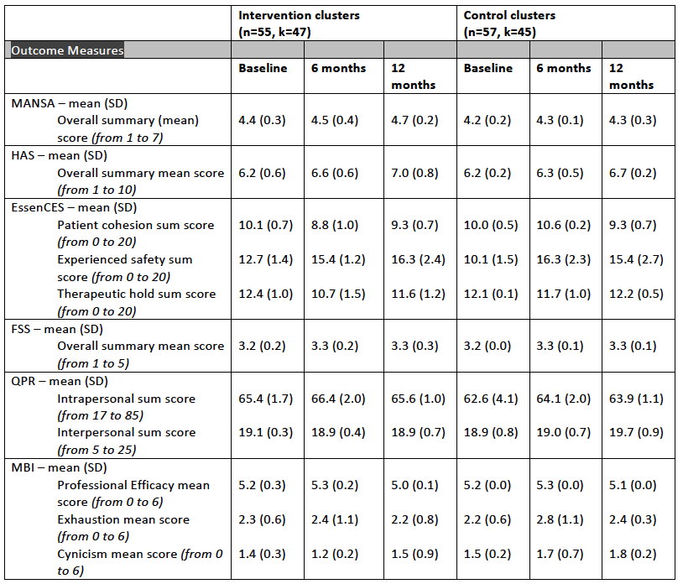

Slide 29
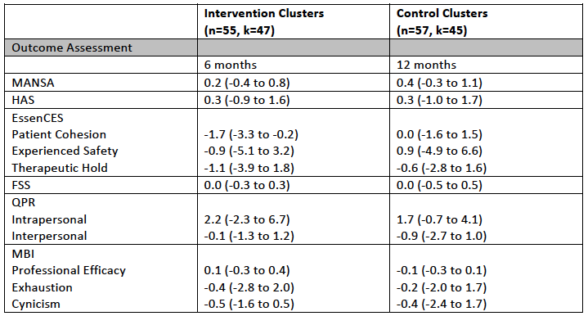

Slide 30
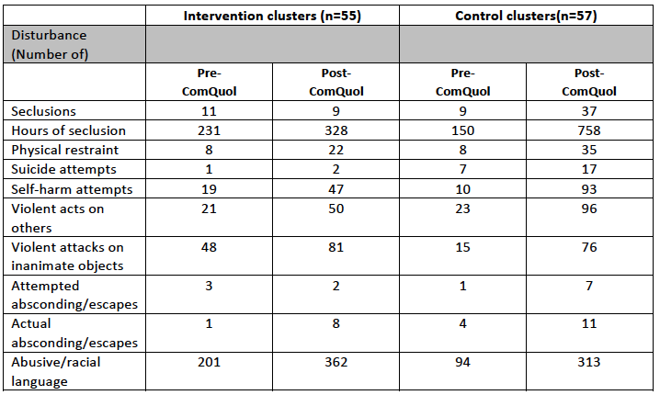

Slide 31
Resource use and costs | Intervention group | Control group
Total cost of intervention | £30,413 | £0
Cost of intervention per user including nurse training | £529 - 576 | £0
Av no of days in the facility over 12 months, mean (SD) | 341 (56) | 338 (37)
Av cost of stay in the facility (bed-day cost) over 12 months | £166,064 | £164,506
Total cost of incidents | £23,697 - £38,354 | £51,222 - £92,340
Cost of incidents per user | £456 - £738 | £985 - £1,776
Av treatment cost (intervention + stay + incidents) | £167,049 - £167,378 | £165,491 - 166,282

Slide 32
Conclusions
Establish the feasibility of the trial design as the basis for determining the viability of a large full-scale trial
The trial design appears viable.
The procedures seem to function well.
The response rates were good with low service user withdrawal rates.
Determine the variability of the outcomes of interest
The variability of the outcomes of interest was all within normal limits.
The estimated treatment effect of the primary outcome is within the range where it could be considered significant.
A full trial would be justified to estimate the effect with greater certainty.

Slide 33
Conclusions
Estimate the costs of the intervention
Incidents are costly, as associated with significant use of NHS resources and police.
Real cost of incidents may be even higher when analysed using patient-level data.
Refine the intervention following the outcome of the study based upon the experiences of the participants
Responses suggest general satisfaction with the approach.
Number of nurses lost to follow up questions including nursing outcomes.
The reasons for higher dropout rates for women and whether to offer ongoing support.
Examining the incident costs for longer may give a better indication of on-going costs.

Slide 34
Thank You!
If anyone would like further information, please contact
douglas.macinnes@canterbury.ac.uk

