Slide 2
TCT Innovation Taxonomy & OFIP Supporting science fiction prototyping by making the case for an Open Foresight Innovation Paradigm

Slide 3
Introduction
This presentation focuses on the findings reported in the paper, “TCT Innovation Taxonomy and Open Foresight Innovation Paradigm”.
The main contributions are:
TCT Innovation Taxonomy
Open Foresight Innovation Paradigm (OFIP)
Diegetic Innovation Templating in VR (DITVR)

Slide 4
TCT Innovation Taxonomy
An approach for research into innovation theories.

Slide 5
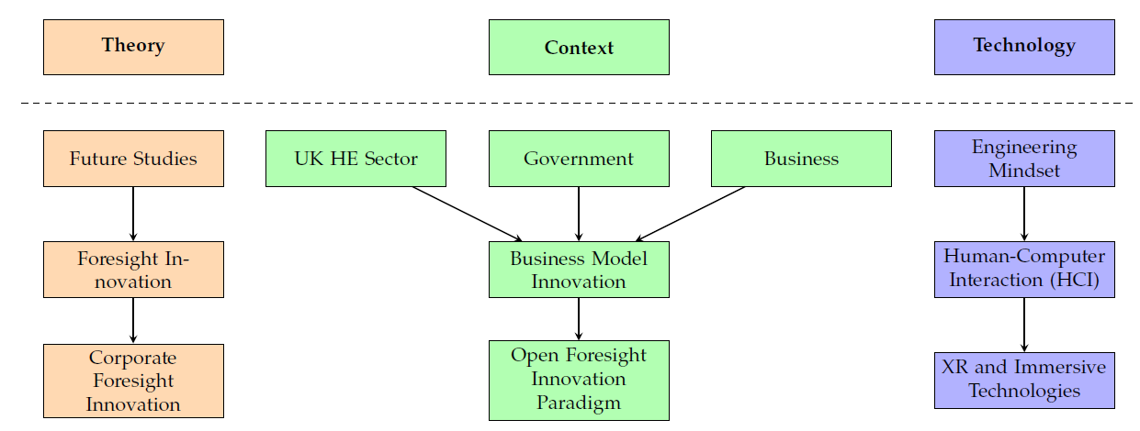
TCT Innovation Taxonomy
The Immersive

Slide 6
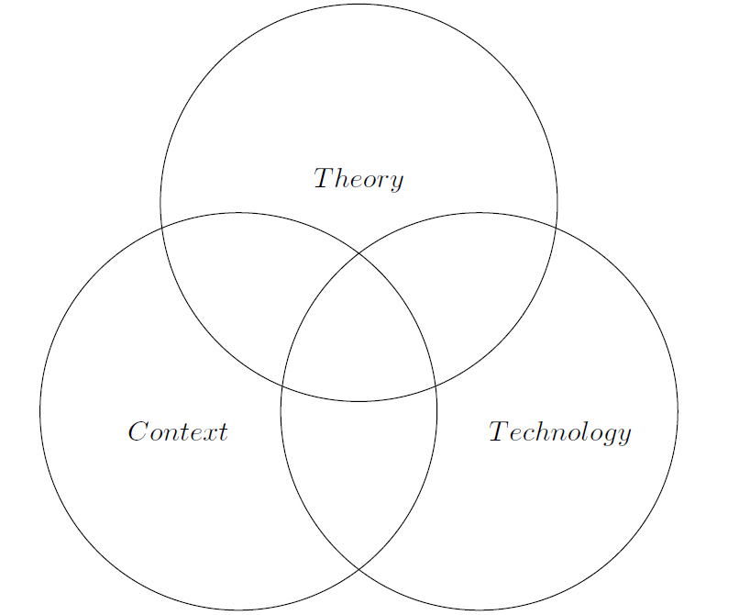
Defining the Research Domain
The taxonomy provides a recommended approach for supporting research in the field of ‘innovation’.
Socio-Technical Theory
People develop technology, that when used form a symbiotic relationship (Trist and Bamforth, 1951; Eason, 2015; Emery, 1980; Kassam et al, 2024)
Originally encompassed technology and society.
Decomposed further into technology, sociotechnology and the sociotechnical system (Weingartner, Bunge and Dorn, 1990)
Attempting to apply concepts from outside of Socio-Technical Theory to this type of system identified the need for an additional lens.
Applying this model to business led to the ‘society’ being rephrased to ‘context’ to better represent the location where this model would be applied.
This resulted in the acronym ‘TCT’.

Slide 7
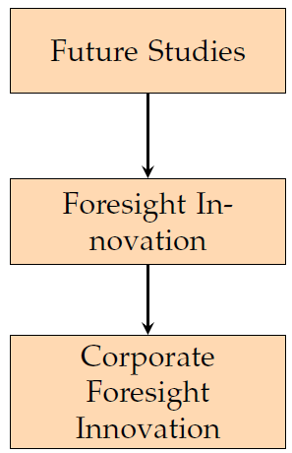
Theory
This taxonomy proposes that published literature and foundational concepts should be viewed independently from Context and Technology.
Future Studies is interested in studying the range of different possible futures.
This can be decomposed as:
Astrology,
Prophecy,
Forecasting (Sardar, 2010).
Forecasting has been built upon to support the research area of Foresight Innovation which relies on the use of facts and quantifiable information.
The application of foresight innovation in business eventually became known as a specialist area of research called ‘Corporate Foresight Innovation’.

Slide 8
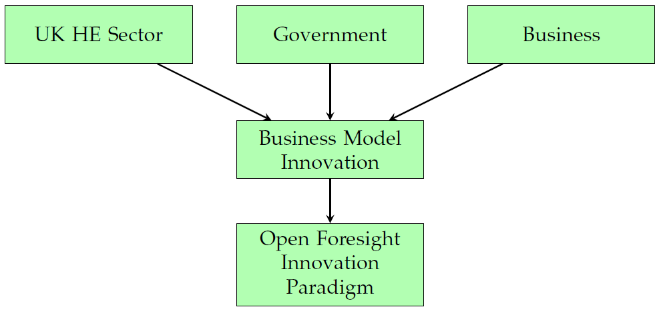
Context
The context is defined in this taxonomy as the combination of actors where academic research, governmental policy and business operations combine.
These three areas represent the operating environment where organisations are formed and create value, resulting in innovative business models.
It has been proven that an open approach to innovation provide the ideal foundations for business innovation to thrive (Chesbrough, 2003).
Foresight is required before innovation can occur as there is the need for an antecedent, resulting in the need for a new Open Foresight Innovation Paradigm.

Slide 9
Open Foresight Innovation Paradigm (OFIP)
Foresight (Wiener, Gattringer and Strelh, 2020) aligns with the same principles of Open Innovation (Chesbrough, 2003), namely:
Fosters out-of-the-box thinking
Supports breaking away from path dependency
Increases the potential of innovations
Helps generate new insights.
In addition, four core precepts must be embedded in the culture of all partners:
Collaboration with external entities,
Incorporation of external ideas,
Internal and external paths to market,
Openness to change.
Hypothesis: (OF + OI) =< OFIP

Slide 10
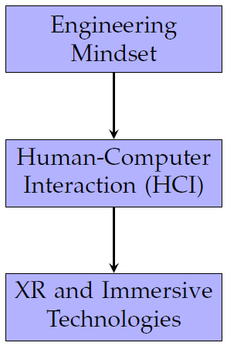
Technology
Technologies enhance natural capabilities of human-kind. Innovation today is mainly focused on either digital technologies, or with the support of digital tools.
An engineering mindset provides a recognised framework for identifying solutions for problems faced by wider society.
HCI is focused on how humans use computers and provides a mechanism enabling the engineering mindset to be applied to digital technologies. This is well established, (e.g. ISO 9231, 2019, Ergonomics of human-system interaction – Part 210: Human-centred design for interactive systems).
The need for increasingly natural ways to interact with digital systems resulted in increasingly sophisticated abstraction layers. XR and Immersive Technologies are at the forefront of removing such barriers.

Slide 11
Reading the Taxonomy
The taxonomy can be viewed horizontally as well as vertically.
Row 1: Context is broad, requiring a whole-field approach via Future Studies. Given the complexities an engineering mindset is required.
Row 2: Businesses innovate their practices through BMI, benefiting from the use of innovation theories. Mapping of this is made more efficient by using digital tools. Non-technical users require that digital tools use HCI principles.
Row 3: Innovation cannot take place without foresight. An open approach is necessary to maximise opportunities, using CFI and I4.0, XR and Immersive Technologies
No. | Theory | Context | Technology
1 | Future Studies | UK HE Sector, Government and Business | Engineering Mindset
2 | Foresight Innovation | Business Model Innovation | Human-Computer Interaction (HCI)
3 | Corporate Foresight Innovation | Open Foresight Innovation Paradigm (OFIP) | XR and Immersive Technologies

Slide 12
TCT Innovation Taxonomy
The Immersive

Slide 13
Using the Taxonomy
Four stages have been proposed when using the TCT Innovation Taxonomy in academic research, as follows:
First Stage (Domain of Research): is to define the domain of research by identifying the Theory, Context and Technology (TCT) being investigated.
Second Stage (Field of Research): is to use the taxonomy to inform a structured literature review from the various perspectives as tabulated above.
Third stage (Specialist Area Within Field): is focused on applying the taxonomy to a specialist area of interest where Theory, Context and Technology have been validated (I.E. where the circles in the Venn diagram converge).
Fourth stage (Theoretical Framework): is the culmination of knowledge where the separate specialist area(s) combine to form a new theoretical framework that can be used to answer the original question.

Slide 14
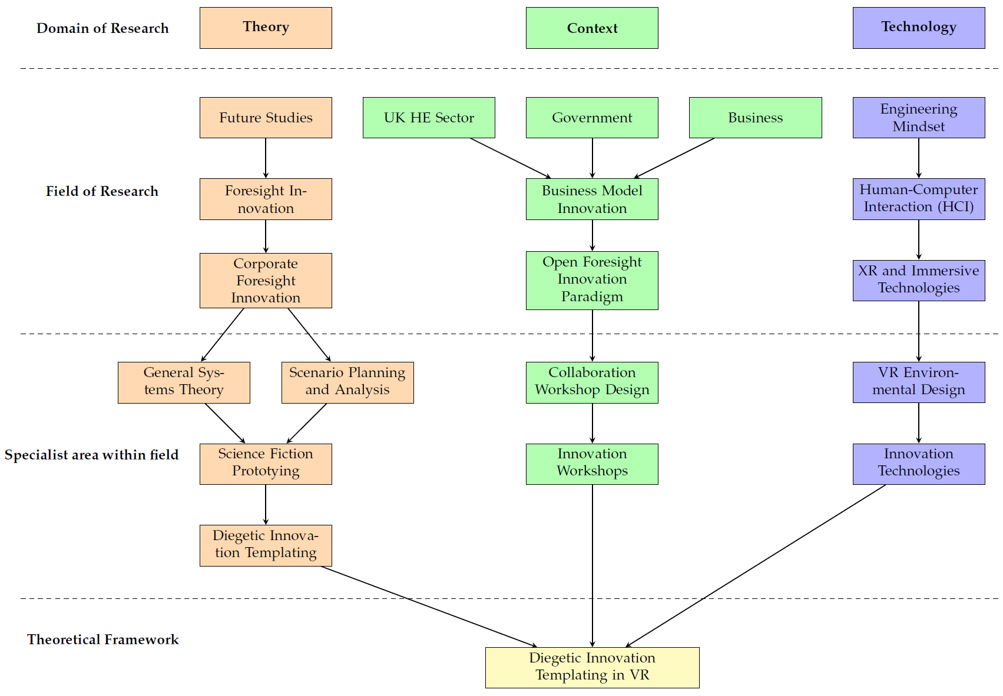

Slide 15
Applied Example
Diegetic Innovation Templating in VR (DITVR)

Slide 16
Stage 1: Domain of Research
The TCT Innovation Taxonomy was applied using the following lenses:
Theory: Diegetic Innovation Templating
Context: UK University to Business Collaboration
Technology: Virtual Reality

Slide 17
Stage 2: Field of Research
DIT is an innovation theory with strong ties to Corporate Foresight Innovation.
DIT was originally observed in the Chinese fashion industry (Zheng and Callaghan, 2018)
Applying the theory to other contexts is currently being researched.
Leveraging U2B collaboration has not yet been fully explored
The use of digital technologies to remove barriers should be used wherever possible
XR and Immersive Technologies became natural fit.

Slide 18
Stage 3: Specialist Area Within Field
DIT is a sub-type of Science Fiction Prototyping (SFP), focused on generating specific innovations as ideation templates.
Creation of ideation templates digitally requires a high level of openness, interactivity and collaboration.
Innovation workshops provide a space for such activities and can take place in VR.
VR enables the recording of the workshop, end-to-end, and provides novel ways of forming ideation templates

Slide 19
Stage 4: Theoretical Framework
Diegetic Innovation Templating in Virtual Reality (DITVR) was created to enable DIT to be applied to a business where it had not previously been observed.
DITVR refactors the observed process to be applied using a digital innovation workshop.
The original process used the measure, ‘Diegetic Gap’ to assess the viability of an innovation template.
This metric has been redesigned to be more applicable to a wider variety of businesses.

Slide 20
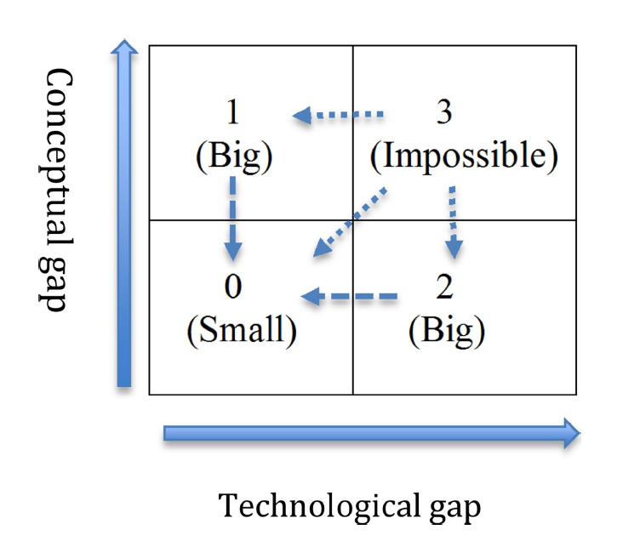
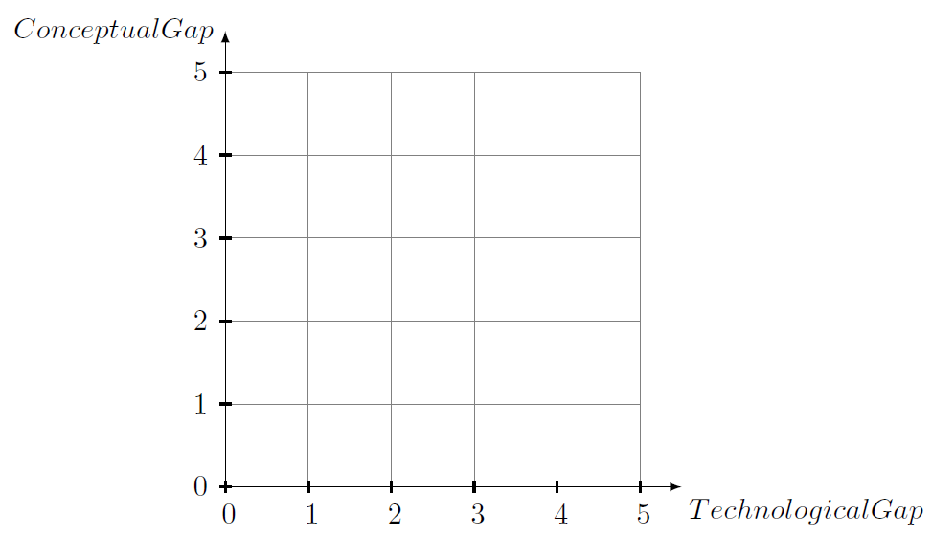
Stage 4: Theoretical Framework

Slide 21
Stage 4: Theoretical Framework
The Diegetic Gap in VR (DIGVR) measure is defined as a percentage, using the formula:
1 – ((X * Y) / 25)
The higher the percentage, the more likely that the conceptual and technological gaps can be overcome.
This calculation means that an idea may have a probability of 0 or 100.
1 – ((0 * 0) / 25) = 100%
In this scenario the template is likely not a true innovation.
1 – ((5 * 5) / 25) = 0%
In this scenario the template might not be possible due to current legislation

Slide 22
Outcomes
A new theoretical framework has been established, DITVR.
This is currently being researched and tested in real-world U2B collaborations.
There is likely to be changes to the DITVR process because of the ongoing research.
The outcome will be an innovation process supported by VR that embodies OFIP.

Slide 23
Summary

Slide 24
Discussion and Conclusion
TCT Innovation Taxonomy provides a novel way of understanding how to encourage innovation between universities and businesses.
Central to ‘Context’ is OFIP, a newly defined, and currently as-yet under researched phenomena identified during the creation of TCT and is central to its use.
A potential limitation of TCT is that it has been developed in the UK, leaning heavily on UK governmental policies that encourage U2B collaboration and innovation.
TCT was identified while developing the DITVR theoretical framework.
The Creative Science Foundation (CSF) define four different methodologies, of which DIT is one.
Recommendation 1: Research the application of TCT in non-UK contexts
Recommendation 2: Research the application of TCT to SFP, µSFP and Macro SFP

Slide 25
References
Adegbile, A., Sarpong, D. and Meissner, D., 2017. Strategic Foresight for Innovation Management: A Review and Research Agenda. International journal of innovation and technology management [Online], 14(04), August, p.1750019. Available from: https://doi.org/10.1142/S0219877017500195.
Bell, F., Fletcher, G., Greenhill, A., Griffiths, M. and McLean, R., 2013. Science fiction prototypes: Visionary technology narratives between futures. Futures [Online]. Exploring Future Business Visions Using Creative Fictional Prototypes, 50, 1 June, pp.5–14. Available from: https://doi.org/10.1016/j.futures.2013.04.004 [Accessed 5 November 2019].
Callaghan, V. and Kameas, A., 2009. Intelligent Environments 2009: Proceedings of the 5th International Conference on Intelligent Environments, Barcelona 2009. IOS Press. Google Books: VGqCZe4lHWUC.
Callaghan, V., 2016. An Online Immersive Reality Innovation-Lab [Online], 27 June. Available from: http://victor.callaghan.info/publications/2016_ILRN16(AnOnlineImmersive)FINALwithHeaders.pdf [Accessed 10 August 2019].
Chesbrough, H.W., 2003. Open innovation: the new imperative for creating and profiting from technology. Boston, Mass: Harvard Business School Press.
Chesbrough, H.W., Vanhaverbeke, W. and West, J., 2006. Open innovation : researching a new paradigm [Online]. Oxford: OUP Oxford. Available from: http://eds.b.ebscohost.com/eds/ebookviewer/ebook?sid=fbf15606-7c3b-40da-a0bb-028f01679361%40sessionmgr101&vid=0&format=EB [Accessed 13 July 2020].
Creative Science Foundation, 2020. Creative Science Foundation – CSf – A Partnership with You to Invent the Future [Online]. Available from: https://www.creative- science.org/ [Accessed 19 September 2020].
Dan-Suteu, S.-A. and Giorgi, G., 2019. Future Studies, Forecast and Foresight - Critical Considerations and Relevant Findings [Online]. 19 April. Available from: https://doi.org/10.12753/2066-026X-19-017.

Slide 26
References
Dator, J., 2019. What Futures Studies Is, and Is Not. In: Jim Dator: A Noticer in Time [Online]. Vol. 5. Cham: Springer International Publishing, pp.3–5. Available from: https://doi.org/10.1007/978-3-030-17387-6_1.
De Bruijn, H. and Herder, P.M., 2009. System and Actor Perspectives on Sociotechnical Systems. Ieee transactions on systems, man, and cybernetics - part a: systems and humans [Online], 39(5), September, pp.981–992. Available from: https : / / doi . org / 10 . 1109 / TSMCA . 2009 .2025452 [Accessed 30 June 2024].
De Wit-de Vries, E., Dolfsma, W.A., van der Windt, H.J. and Gerkema, M.P., 2019. Knowledge transfer in university–industry research partnerships: a review. The journal of technology transfer [Online], 44(4), 1 August, pp.1236–1255. Available from: https://doi.org/10.1007/s10961-018-9660-x [Accessed 30 June 2024].
Dix, A., 2007. Human-computer interaction. Third edition [Online]. Harlow: Prentice Hall. Available from: http : / / www . dawsonera . com / depp / reader / protected / external / AbstractView/S9781405890328 [Accessed 19 July 2021].
Eason, K., 2014. Afterword: The past, present and future of sociotechnical systems theory. Applied ergonomics [Online]. Advances in Socio-Technical Systems Understanding and Design: A Festschrift in Honour of K.D. Eason, 45 (2, Part A), 1 March, pp.213–220.Available from: https://doi.org/10.1016/j.apergo.2013.09.017 [Accessed 1 March 2024].
Emery, F., 1980. Designing Socio-Technical Systems for ’Greenfield’ Sites. Journal of occupational behaviour [Online], 1(1), pp.19–27. JSTOR: 3004061. Available from: https://www.jstor.org/stable/3004061 [Accessed 26 June 2024].
Goodall, R., Gill, G. and Gardiner, M., 2003. Learning the Habit of Innovation: Harnessing Technology for Strategic Planning Phase. Norwich: University of East Anglia, p.39.
Hollender, N., Hofmann, C., Deneke, M. and Schmitz, B., 2010. Integrating cognitive load theory and concepts of human–computer interaction. Computers in human behavior [Online]. Online Interactivity: Role of Technology in Behavior Change, 26(6), 1 November, pp.1278–1288. Available from: https://doi.org/10.1016/j.chb.2010.05.031 [Accessed 29 July 2021].

Slide 27
References
Inayatullah, S., 2007. Questioning the future: methods and tools for organization and societal transformation.Taipei, Taiwan: Tamkang University.
ISO 9241 [Online], 2019. 2nd ed. International Organization for Standardization. Available from: https://www.iso.org/obp/ui/#iso:std:iso:9241:-210:ed-2:v1:en [Accessed 22 July 2021].
Johnson, B.D., 2011. Science Fiction Prototyping: Designing the Future with Science Fiction. Synthesis lectures on computer science [Online], 3(1), 19 April, pp.1–190. Available from: https://doi.org/10.2200/S00336ED1V01Y201102CSL003.
Johnson, G., 2018. Fundamentals of strategy. Fourth edition. Harlow, England : New York: Pearson.
Kassem, B., Rossini, M., Frecassetti, S., Costa, F. and Portioli Staudacher, A., 2024. An implementation model for socio-technical digital tools. Journal of manufacturing technology management [Online], ahead-of-print (ahead-of-print), 1 January. Available from: https://doi.org/10.1108/JMTM-06-2023-0230 [Accessed 26 June 2024].
Mütterlein, J., 2018. The Three Pillars of Virtual Reality? Investigating the Roles of Immersion, Presence, and Interactivity [Online]. Hawaii International Conference on System Sciences.Available from: https://doi.org/10.24251/HICSS.2018.174 [Accessed 22 January2022].
Obrist, M., Velasco, C., Vi, C., Ranasinghe, N., Israr, A., Cheok, A., Spence, C. and Gopalakrishnakone,P., 2016. Sensing the future of HCI: touch, taste, and smell user interfaces. Interactions [Online], 23(5), 23 August, pp.40–49. Available from: https://doi.org/10.1145/2973568 [Accessed 21 July 2021].
Potstada, M. and Zybura, J., 2014. The role of context in science fiction prototyping: The digital industrial revolution. Technological forecasting and social change [Online], 84, 1 May, pp.101–114. Available from:https://doi.org/10.1016/j.techfore.2013.08.026 [Accessed 2 July 2024].
Ringland, G., 1998. Scenario planning: managing for the future [Online]. Chichester ; New York: Wiley. Available from: http://documents.irevues.inist.fr/handle/2042/30191.

Slide 28
References
Sardar, Z., 2010. The Namesake: Futures; futures studies; futurology; futuristic; foresight—What’s in a name? Futures [Online], 42(3), 1 April, pp.177–184. Available from: https://doi.org/10.1016/j.futures.2009.11.001.
Trist, E.L. and Bamforth, K.W., 1951. Some Social and Psychological Consequences of the Longwall Method of Coal-Getting: An Examination of the Psychological Situation and Defences of a Work Group in Relation to the Social Structure and Technological Content of the Work System. Human relations [Online], 4(1), 1 February, pp.3–38. Available from: https://doi.org/10.1177/001872675100400101 [Accessed 26 June 2024].
Wagemans, J., Elder, J.H., Kubovy, M., Palmer, S.E., Peterson, M.A., Singh, M. and von der Heydt, R., 2012. A Century of Gestalt Psychology in Visual Perception I. Perceptual Grouping and Figure-Ground Organization. Psychological bulletin [Online], 138(6), November, pp.1172–1217. pmid: 22845751. Available from: https://doi.org/10.1037/a0029333 [Accessed 22 July 2021].
Weingartner, P., Bunge, M. and Dorn, G.J.W., eds, 1990. Studies on Mario Bunge’s Treatise, Pozna´n studies in the philosophy of the sciences and the humanities, 18. Amsterdam: Rodopi.
Wiener, M., Gattringer, R. and Strehl, F., 2020. Collaborative open foresight - A new approach for inspiring discontinuous and sustainability-oriented innovations. Technological forecasting and social change [Online], 155, 1 June, p.119370. Available from: https://doi.org/10.1016/j.techfore.2018.07.008 [Accessed 6 October 2021].
Wilson, T., 2012. A review of business-university collaboration [Online]. London: Department for Business, Innovation and Skills, p.89. [Accessed 31 May 2020].
Wynn, M. and Jones, P., 2017. Knowledge Transfer Partnerships and the entrepreneurial university. Industry and higher education [Online], 31(4), 1 August, pp.267–278. Available from: https://doi.org/10.1177/0950422217705442 [Accessed 30 June 2024].

Slide 29
References
Zheng, P. and Callaghan, V., 2016. Diegetic Innovation Templating [Online].Available from: https://www.creative-science.org/wp-content/uploads/2015/05/2016_CS16DiegetingInnovationTemplatingwithHeaders.pdf [Accessed 10 August 2019].
Zheng, P. and Callaghan, V., 2018. How Chinese SMEs Innovate Using ‘Diegetic InnovationTemplating’ – The stimulating role of Sci-Fi and fantasy. Futures [Online], 95, 1 January, pp.98–117. Available from:https://doi.org/10.1016/j.futures.2017.10.005.

