Slide 1
A Case Study of How Research Co-Creation is Supporting the Development of “Epistemically Insightful” Curriculum Transformation in English Secondary Schools
Michelle Lawson: Head Teacher
Finley Lawson : Research Fellow

Slide 2
Starting point for the School:
Responding to Ofsted and OECD for students to be equipped in understanding knowledge formation within and across disciplines (prior to new Ofsted framework for curriculum intent)
Ensuring students develop as independent learners, and better equipped for the transition to Secondary School.
What ensures that students learn more and remember more?
Starting Point for the Researchers:
How can we support students to better navigate a compartmentalised curriculum (initially focused on links between science and wider humanities)?
Can interventions designed to create collaboration across departments support interdisciplinary learning opportunities?
What activities, language or tools facilitate interdisciplinary learning within the current curriculum and assessment frameworks in England?

Slide 3
Co-Creation Partnership Process
University Research Centre
Research evidences systematic challenges to students’ ability to navigate compartmentalised curriculum
Hypothesis testing approach – explicit teaching into gaps will lead to shifts in students’ knowledge and/or attitudes
URC Research Recruitment
Started recruitment process for schools to participate in in URC-led CPD then deliver interventions
Alongside DBIR model seeking case study schools
School Implementation
SLT “buy in”
Core team (10 teachers) receive URC-led CPD then co-design curriculum (implementation); Curriculum delivered by 7 SLT
School level student data shared back to school
Shared vision/ investment in tackling the research-identified challenge
School staff supported through partnership with URC to take the research questions further

Slide 4
Challenges & Opportunities for Research-Engaged Schools
Some Opportunities (Sharp et al. 2006) :
Raises standards through improved teaching
Contributes to SEF/ Ofsted /School improvement conversations
Develops opportunities for progressing personalised learning
Contributes to whole school staff retention
(Sanders et. al, 2006) Success requires:
The existence of ‘research-orientated’ colleagues within school
The support of external researchers who can offer a “guiding light”
Research involving schools (Nelson and Sharples, 2017):
Desk based “research” done by teachers (teachers as consumers)
“Academic research” conducted by ‘universities or professional research organisations’

Slide 5
Even where teachers and schools are able to have “research leads” they are ‘in uncharted waters without a compass. There is no blueprint for the work of the research lead and the coordination of research activities in schools is not necessarily straightforward’ (McAleavy, 2015)
Why Co-Create When Everyone is Busy?

Slide 6
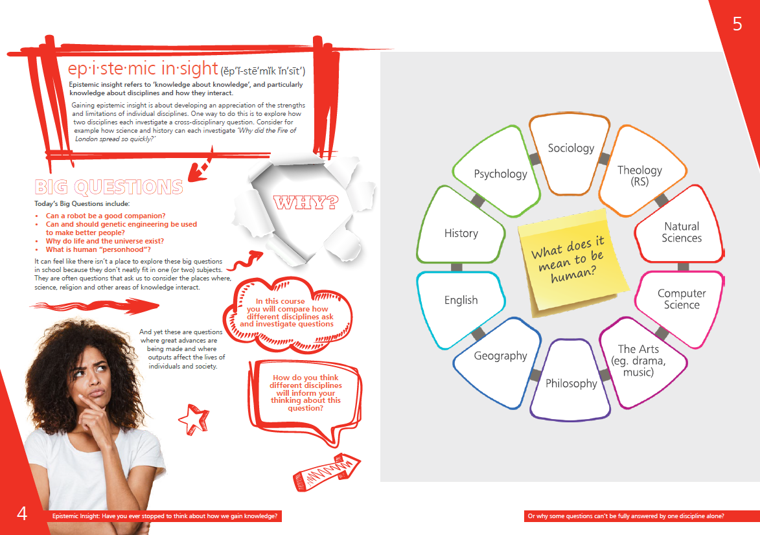
Developing a Curriculum

Slide 7
Iterative Curriculum Development

Slide 8
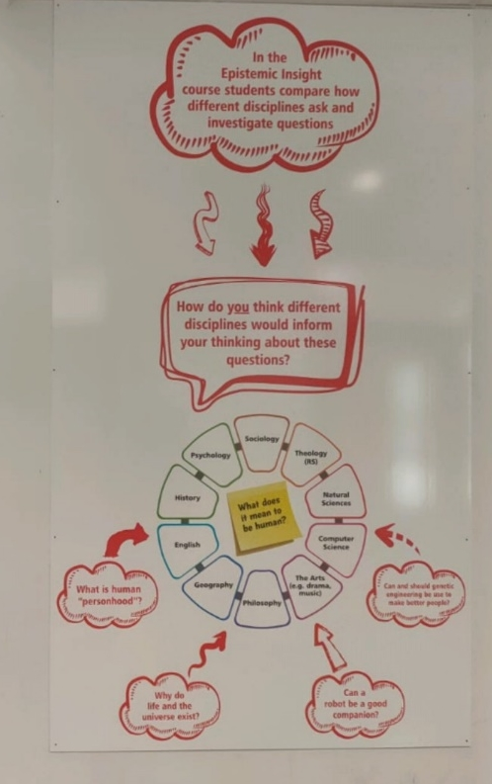
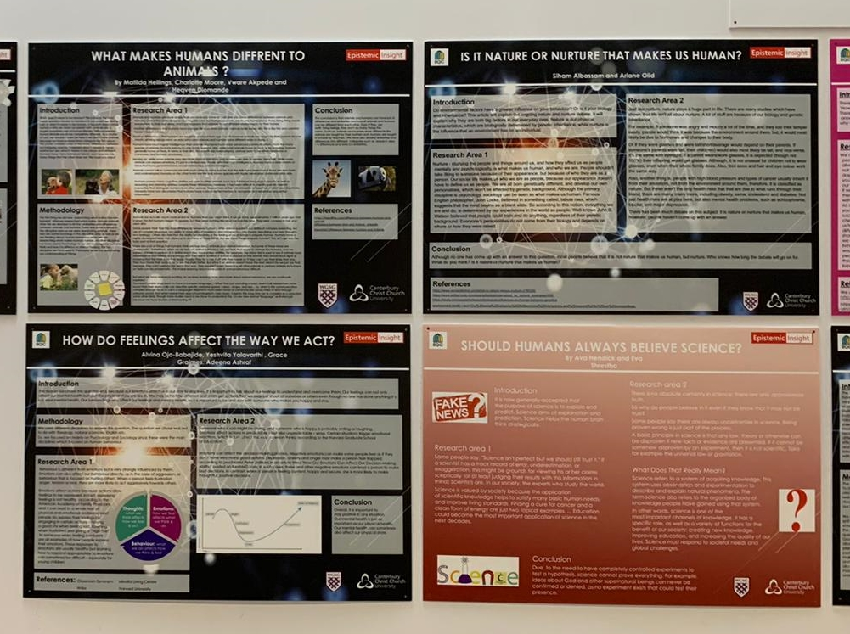
Sharing the Vision with the Students

Slide 9
Public Commitment to Curriculum Innovation

Slide 10
From 17 staff to a Whole school PLC- Professional Learning Community URC – University Research Centre
Developing a research-engaged school (in partnership)
Teacher agency increased through investigating the questions that matter to them.
Planning team can see impact/use of their work
More staff want to take part in research
All staff (including support staff) involve in PLC
SLT deliver research and methodology training with support of URC
PLC investigates a research question of their choice
Results published internally – working towards external publications

Slide 11
But What About the Original Project?
2nd year of delivery on the original project – still informing URC research (through implementation research, data evidence and staff suggestions)
Year 8 development project led by NEW planning team
Year 12 elective exploring the same curriculum for comparable data set (delivery by original planning team teacher)
Exploring independent Year 9 accredited qualification delivered by school scholarship lead
Reality?
Transformational learning and ethos in school (in 2 years)
Led by teachers with shared (enthusiastic) vision
New challenge – embedding the original vision and not scattering to the four corners!

Slide 12
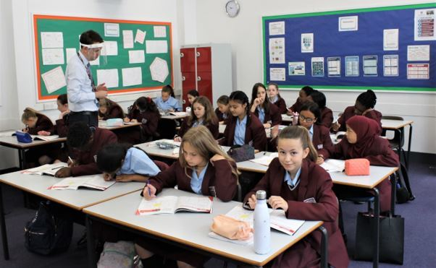
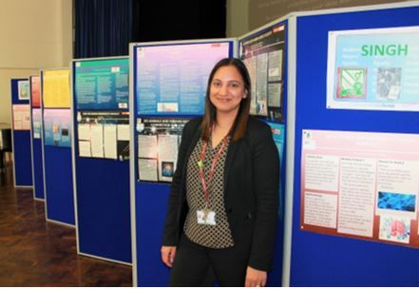
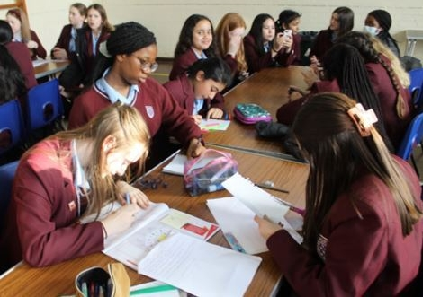
Interim Impact & Next Steps

Slide 13
Comments from staff surveys (20-21)
What has surprised you regarding student engagement?
“the level of thinking and complexity that young children can access”
Students are becoming more confident in seeking answers from a multi-disciplinary approach - they have been able to make connections between disciplines and understand contrasting viewpoints as a result of the EI work.
Colleagues have commented on students use of knowledge and application from other subjects and students themselves commented on how they are using an EI approach to their work.

Slide 14
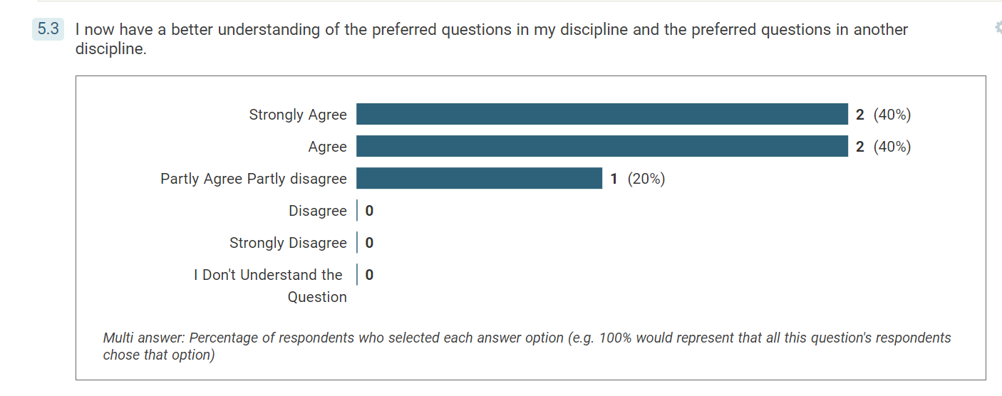
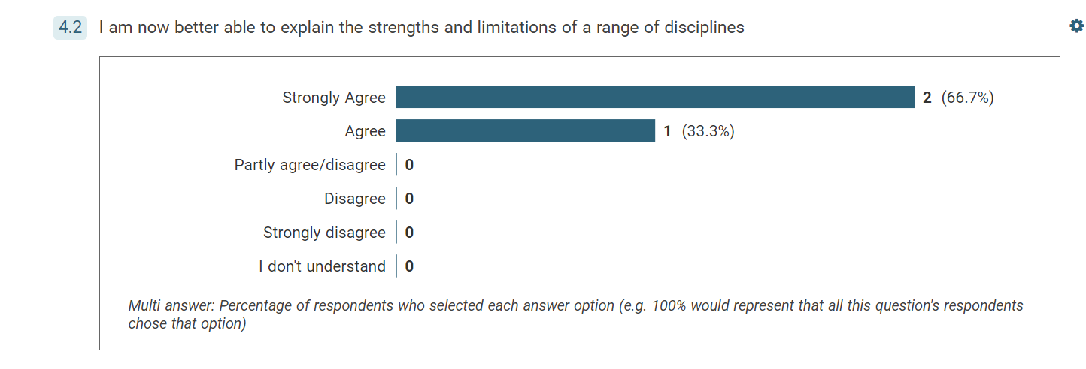
Increase in Staff Subject Knowledge
As a result of delivering sessions using the Epistemic Insight pedagogy (Oct 20)
As a result of delivering sessions using the Epistemic Insight pedagogy to what extent do you agree with the following (Jan 21)

Slide 15
Shift in Pedagogical practice
Has teaching using epistemic insight pedagogy changed your attitude to students wanting to examine “off topic” questions within your lessons? Apr 21 & Apr 22
Yes, I have changed my approach and used EI pedagogy in my teaching - allowing them to explore other viewpoints to a question outside of the subject area. An example, in Law we discussed the issues with sentencing and students brought in sociological knowledge regarding ethnicity and gender bias. […]. Although not completely off topic, it was outside of spec which then allowed for deeper analysis and evaluation in their work.
I have been much more comfortable relating topics to subjects outside History. Especially when relating to topics students don't study in the lower school such as psychology and sociology. I am also much better at signposting where these links are for students.
Yes, in particular when teaching the philosophy and ethics unit to year 8 - understanding the impact of EI pedagogy has allowed my teaching to be flexible in addressing other areas which are not in my lesson plan but provide another answer to the moral dilemmas being analysed. (Apr 22)

Slide 16
Shift in Pedagogical practice (2)
What impact has delivering the EI programme had on your approach to addressing questions from a multidisciplinary perspective within your "subject teaching" this academic year? Jan ‘22
As a result of your involvement in the Epistemic Insight Initiative has your experience of working with staff from other departments to deliver learning changed. Jan ‘22
Working collaboratively in planning the project has enabled me to develop my understanding of the norms of thoughts of other disciplines and how these are delivered and embedded within students’ learning and how other departments cross over in their approaches and opportunities for further discussion on permeable walls approach to planning.
It has supporting me to ensure that I plan for opportunities within my lessons to go beyond the specification and enable students to develop their analytical and evaluative skills further using a multi disciplinary approach

Slide 17
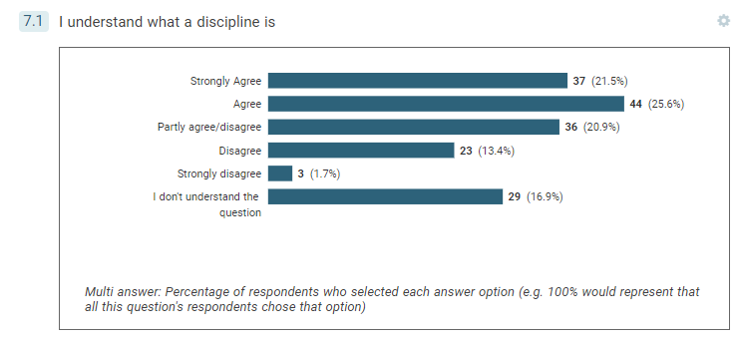
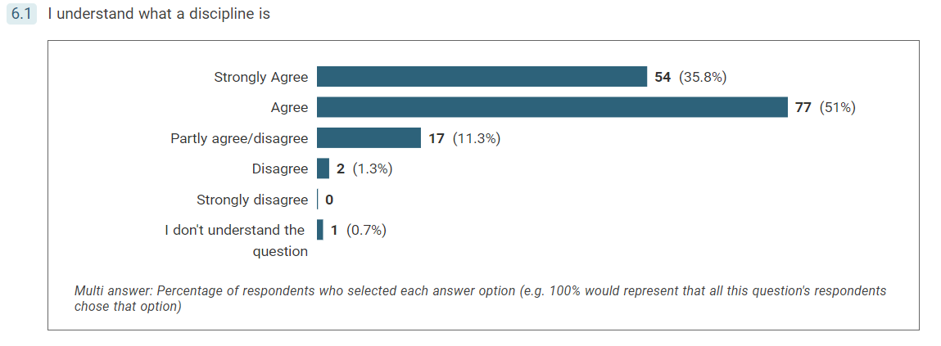
Change in Students’ Understanding of Disciplinary Knowledge
Start of Year 7
Easter of Year 7

Slide 18
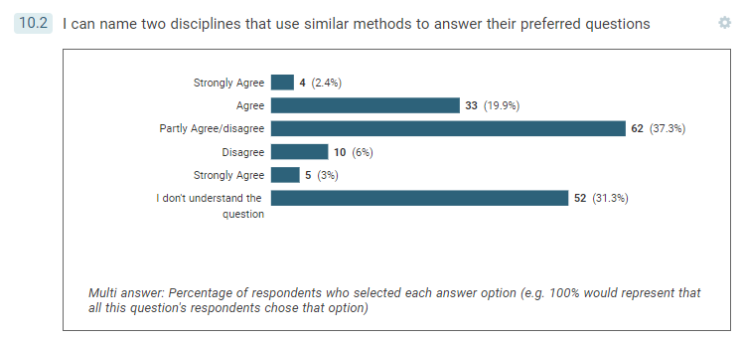
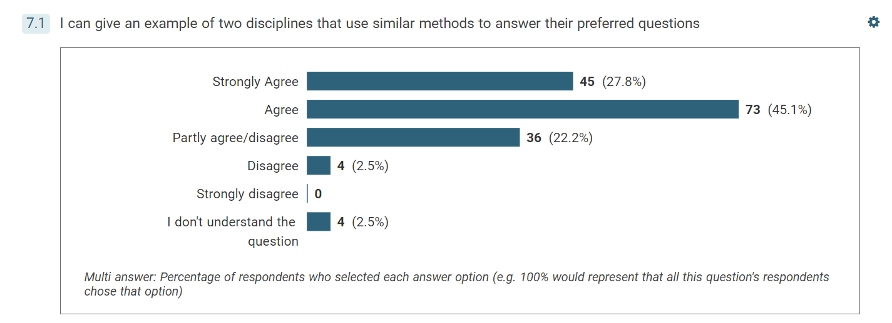
Change in Students’ Ability to Apply Their Understanding
Start of Year 7
February Half term of Year 7

Slide 19
Comments from student survey
Helps me view things in different perspectives and helps me have a larger viewpoint. it has been helpful for understanding questions with an open mind
what surprised me is that there are many answers and thought processes and that in most cases it's about how you think about something, if you're thinking scientifically you would get a completely different answer than if you're thinking another way.
What has a multidisciplinary approach added to their understanding of the Big Question?
What has surprised them about exploring through a multidisciplinary perspective?
I now know different ways to answer the question and can sort the answers with different disciplines. I can view the question through many different disciplines
I’m surprised that different disciplines can answer the same question and word the question in a completely different way.

Slide 20
Next Steps
As a School
Further evaluation of the findings from year 2 (following end of year surveys).
Continued development to understand what the progression of EI looks like within a school.
Develop processes for feeding the continued in-school research into the “academic” community and practice.
For the Research
Create a learning network between partnership schools, and between partnership schools and ITE provision.
Supporting partners to apply for practitioner-research funding (including teacher release) if wanted/appropriate.
Understanding what epistemically insightful experiences look like in a wider range of settings and (at first) across the diverse UK curricula.

Slide 21
Work funded by TWCF’s Big Questions in Classrooms Initiative

Slide 22
Selected References
Godfrey, D., Brown, C. (Eds.), 2019. An ecosystem for research-engaged schools: reforming education through research. Routledge, Taylor & Francis Group, London ; New York.
Hargreaves, E., Rolls, L. (Eds.), 2020. Reimaginig Professional Development in Schools, Unlocking research. Routledge, Abingdon, Oxon ; New York, NY.
McAleavy, T., 2015. Teaching as a research-engaged profession: problems and possibilities. Education Development Trust.
Nelson, J., Sharples, J.M., 2017. How research-engaged are you? Impact: Journal of the Chartered College of Teaching.
Sanders, D., Sharp, C., Eames, A., Tomlinson, K., 2006. Supporting research-engaged schools: a researcher’s role. NFER.
Sharp, C., Eames, A., Sanders, D., Kathryn, T., 2006. Leading a Research Engaged School. National College for School Leadership, Nottingham.
Any Questions?
Contact Details: Michelle Lawson – Mlawson@wgsg.co.uk
Website - https://www.gsgw.org.uk/

