Slide 1
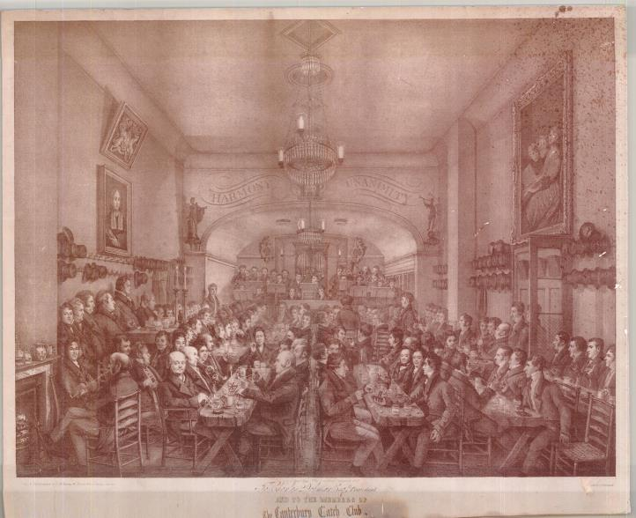
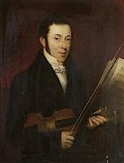
Unsung singers: the musicians of Canterbury 1770-1865
Notes:
Catch Club in full swing – by-now-familiar print. 1826
[Click] We have a key sketch – provenance uncertain
[Click] The musicians – apart from Goodban – are nameless.
But, 20 years later, we have a list! [Click]

Slide 2
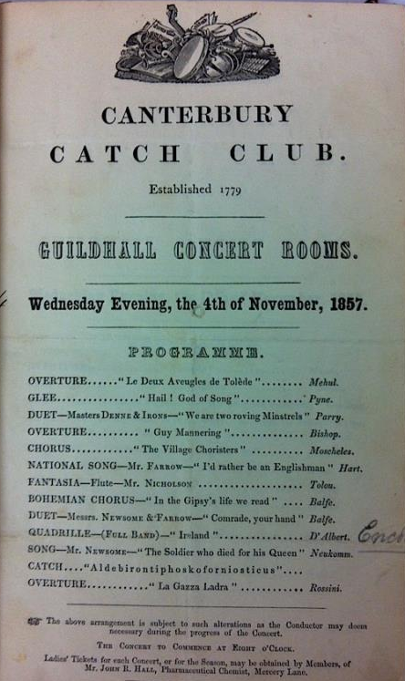
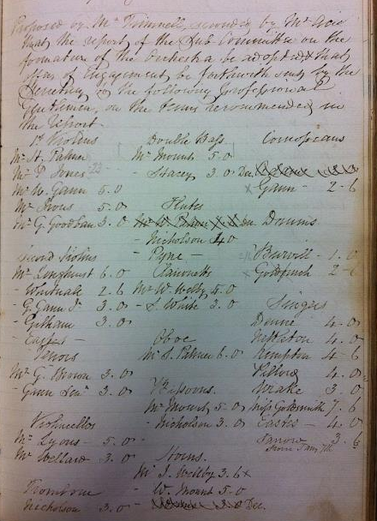
Notes:
Cost of an Orchestra 1843: £6.7s.6d – over £500 using RPI now (www.measuringworth.com/ukcompare/)
Names – some family connection?
Longhurst
…and this is the sort of programme they put on
BUT – who were these people?
ANSWER: Lay Clerks, and we know this how, exactly?

Slide 3
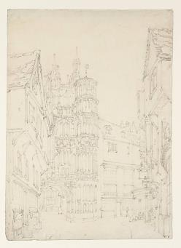
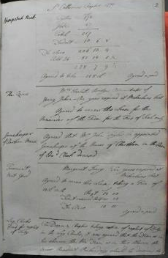
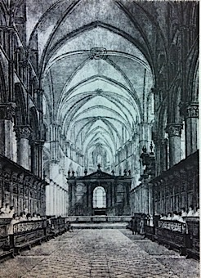
Notes:
Cathedral viewed down Mercery Lane, sketched by Turner
The Quire, c. 1800
Enter the Dean’s Books…
1770 neglect of duty: all admonished
What was this neglect?
Why did the D&C feel entitled to take this view?
Musician held in low esteem
Clearly artisan families, judging by the trades the choristers were apprenticed to…

Slide 4
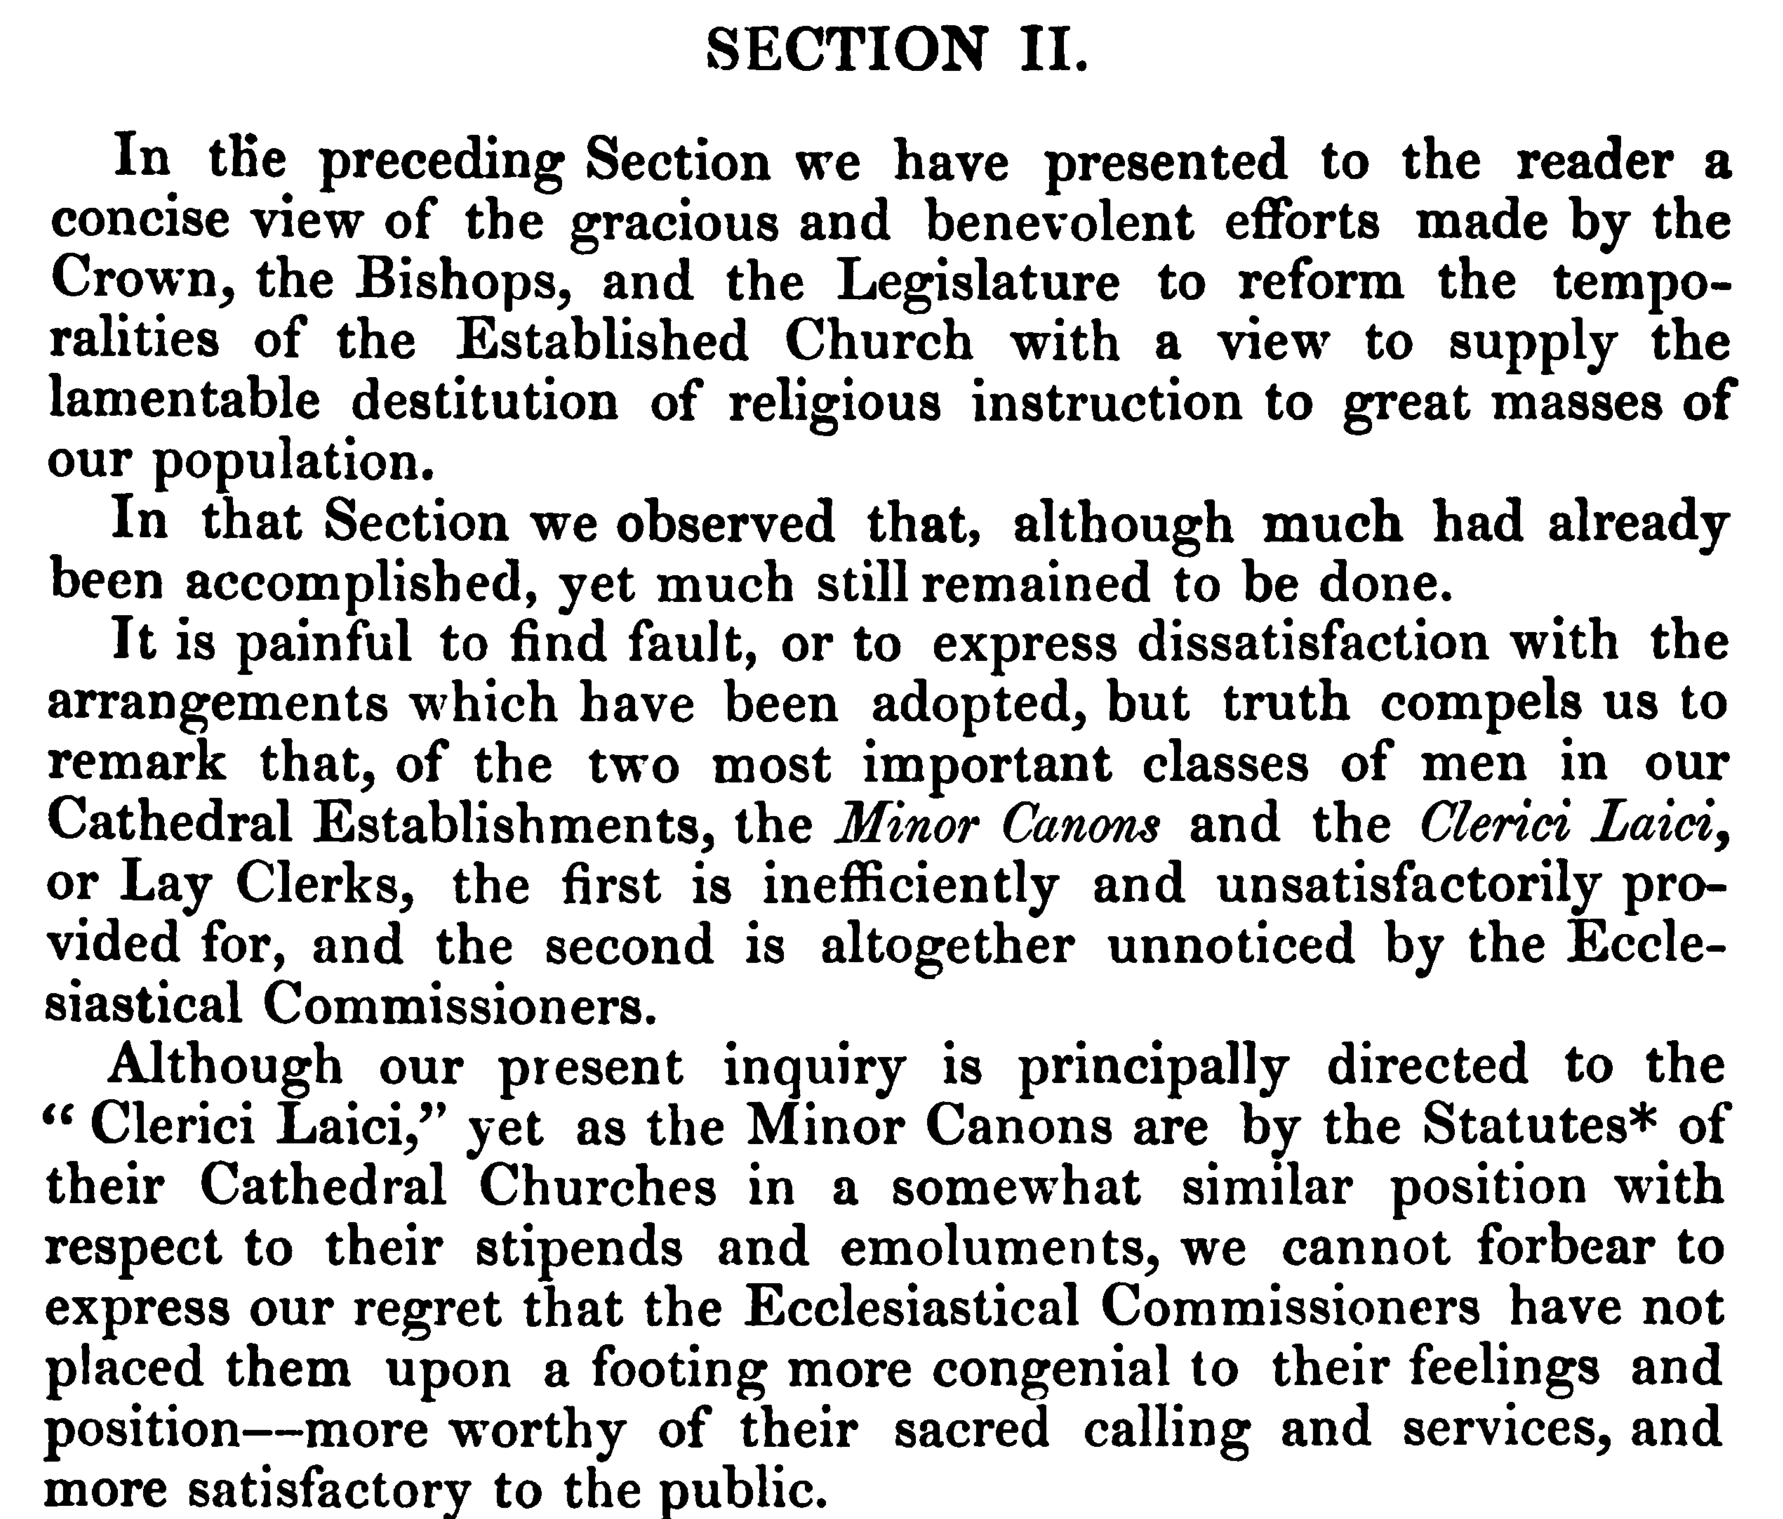
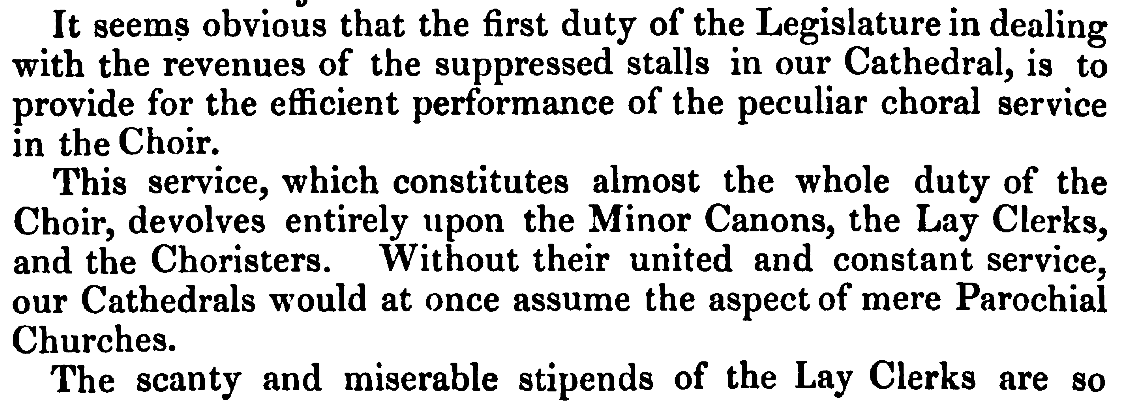
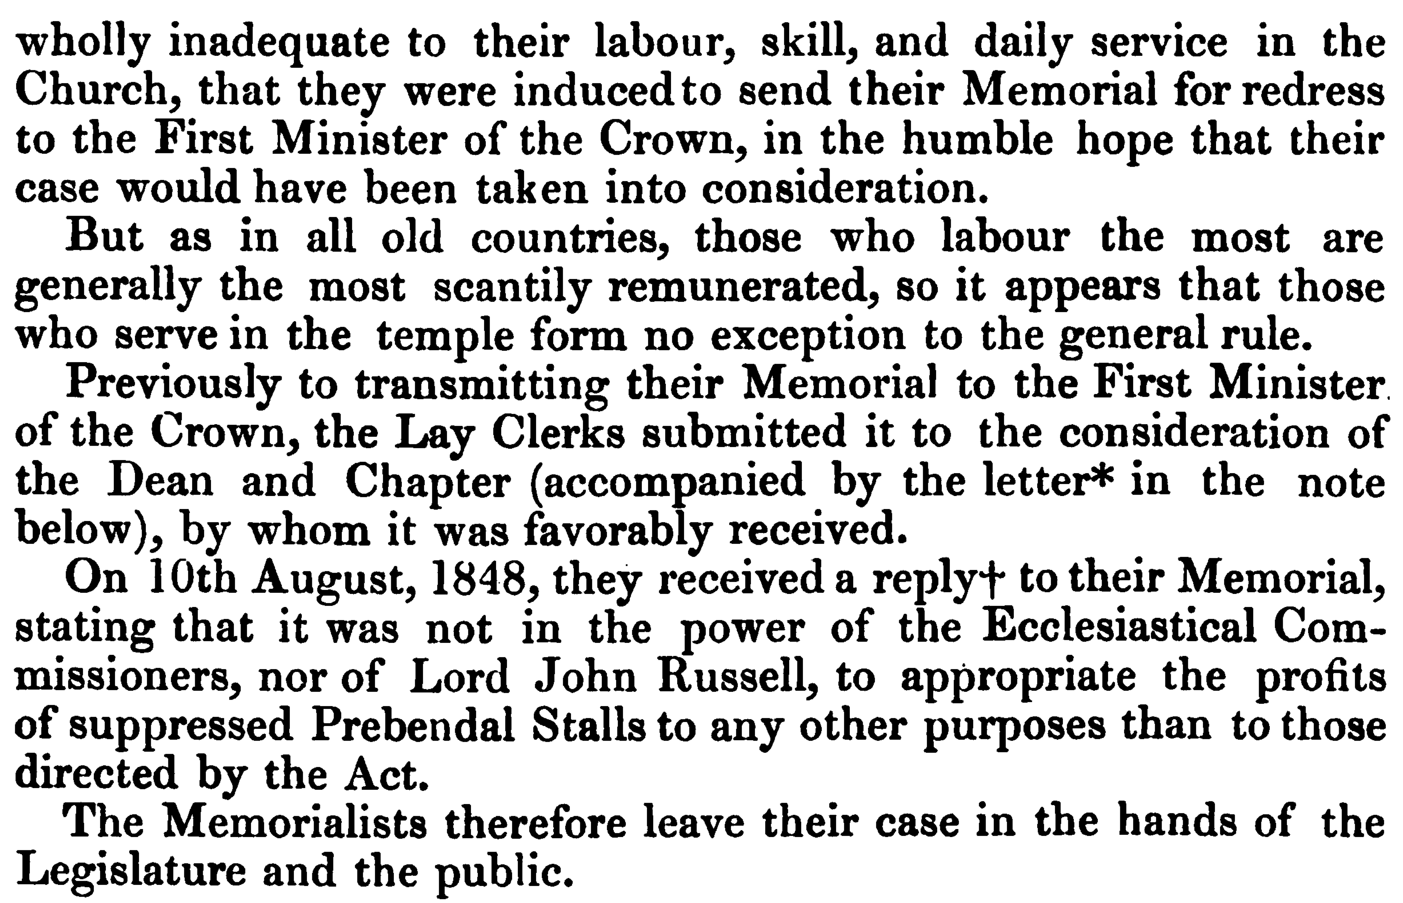
Notes:
1848

Slide 5
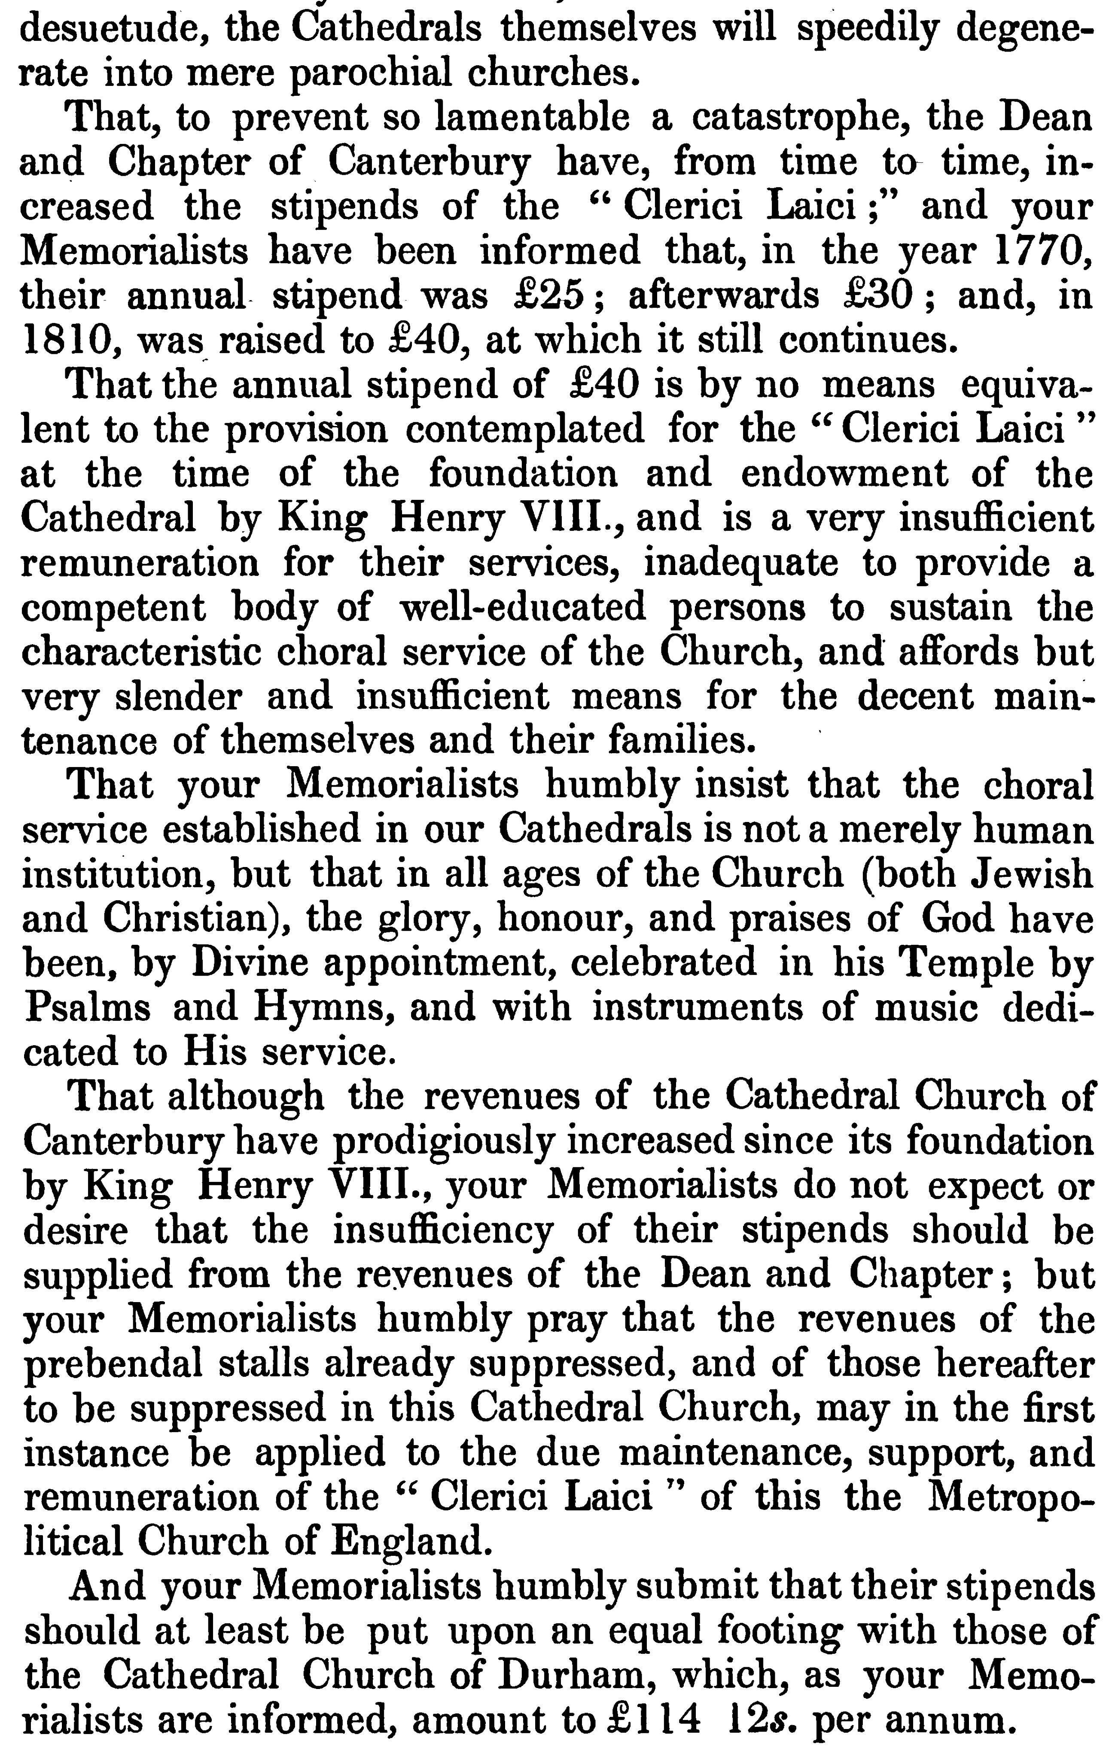
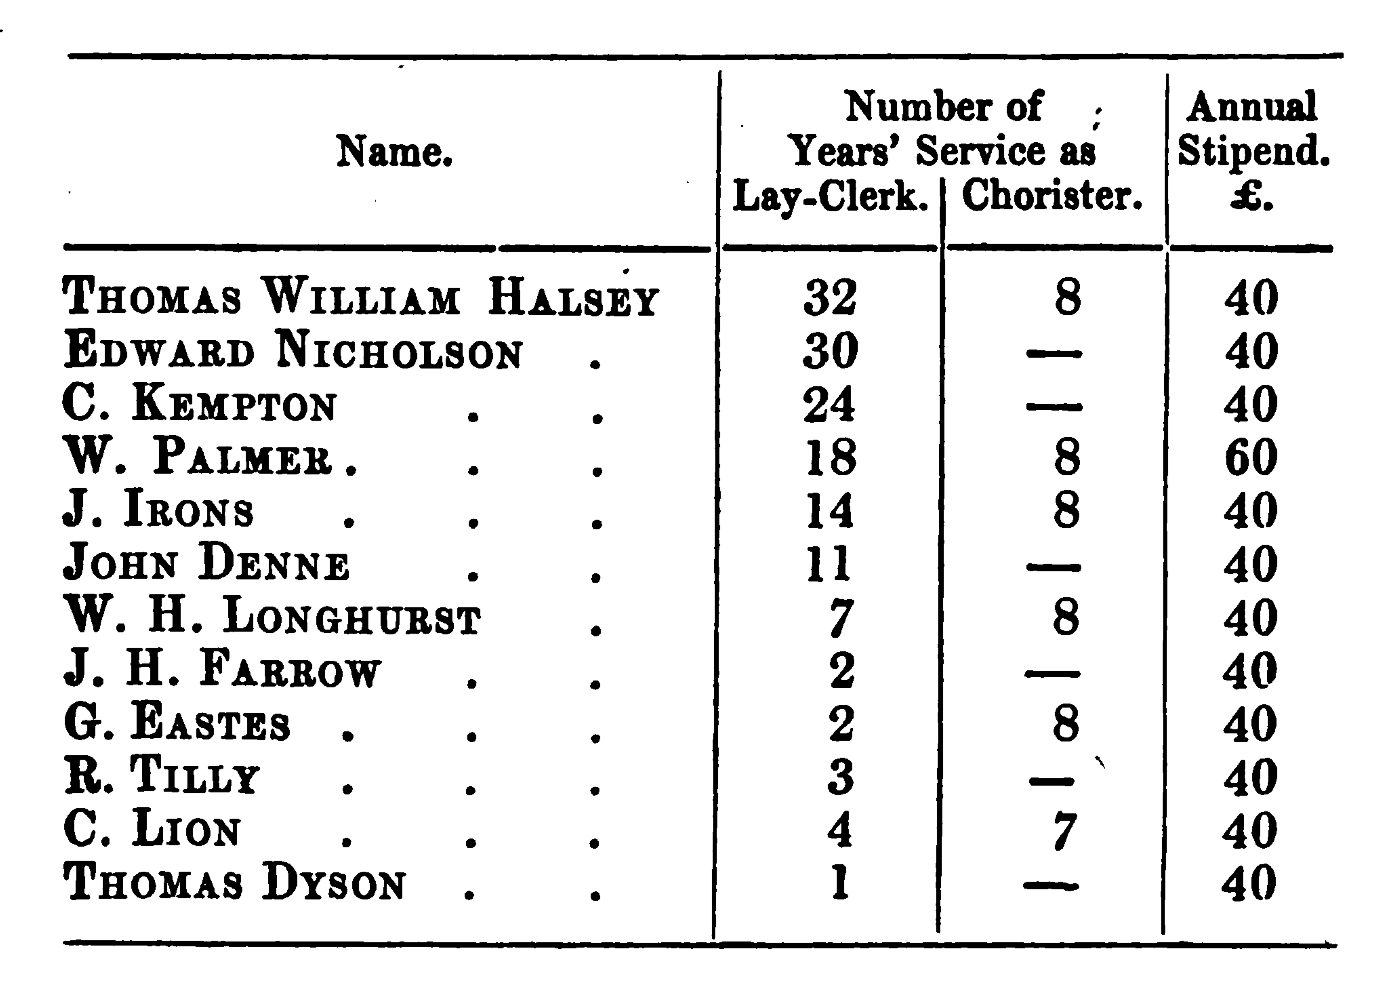

Slide 6
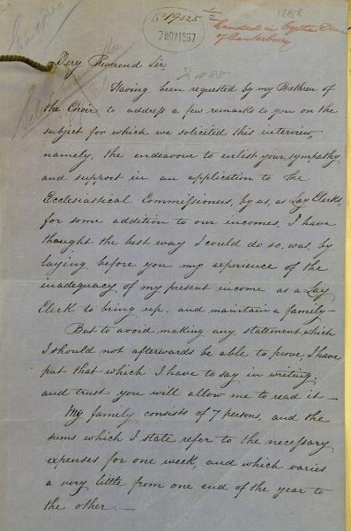
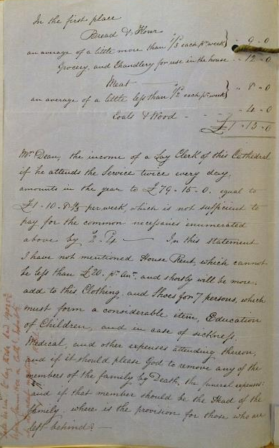
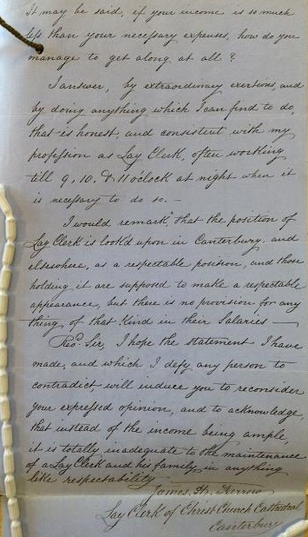

Slide 7
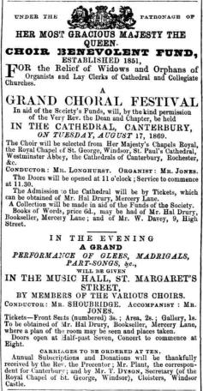
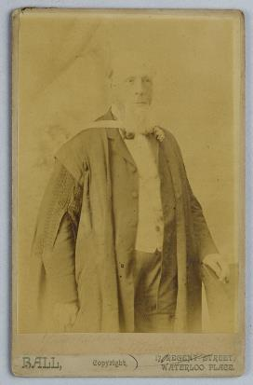
Kentish Gazette:
Aug 10th 1869

Slide 8
Any Questions?

