Slide 1
Collaborating to improve teaching and learning about sustainability within an international learning community
Partner Conference: Collaborating for Success
Contemporary Issues in Business Management
4th September 2023, Christ Church Business School, CCCU
Dr Agnieszka Gordon, Sherry Simpson,
Dr Finley Lawson, Dr Caroline Thomas
www.epistemicinsight.com LASAR@canterbury.ac.uk

Slide 2
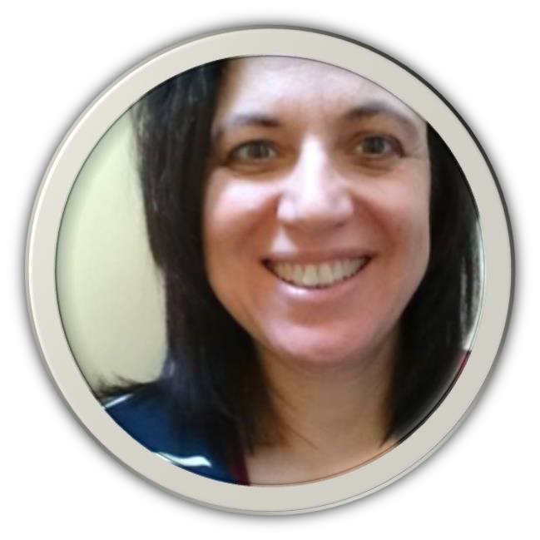
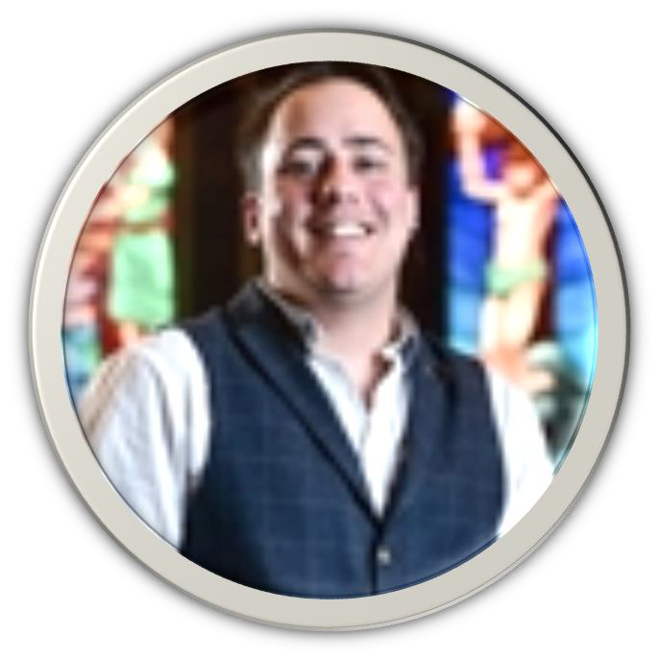
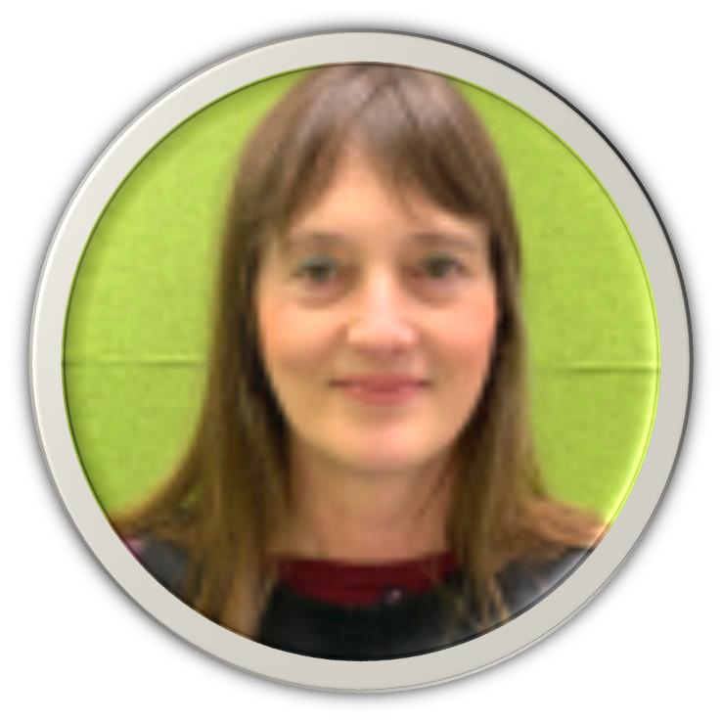
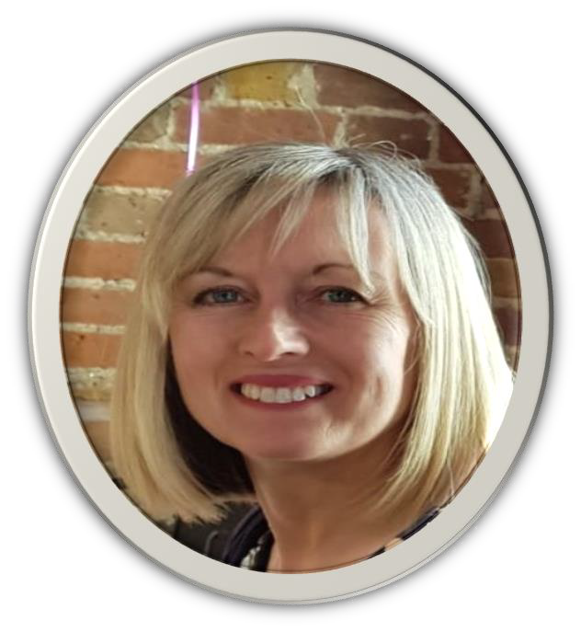
Project Research Team
Dr. Agnieszka Gordon
Senior Lecturer
CCCU Business School
Dr. Finley Lawson
Education Development Lead
CCCU
Sherry Simpson
LASAR Research Fellow
FAHE CCCU
Dr. Caroline Thomas
Senior Lecturer
Teacher Education, CCCU
www.epistemicinsight.com LASAR@canterbury.ac.uk
Notes:
Project PI: Professor Berry Billingsley
Professor of Science Education

Slide 3
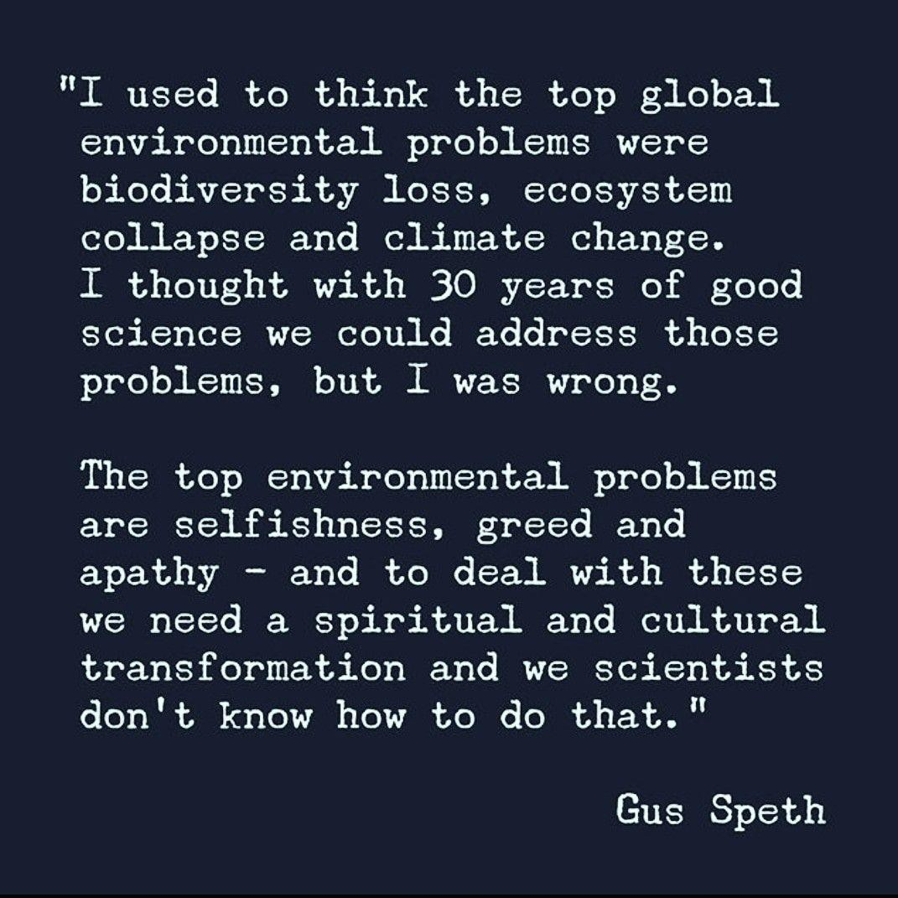
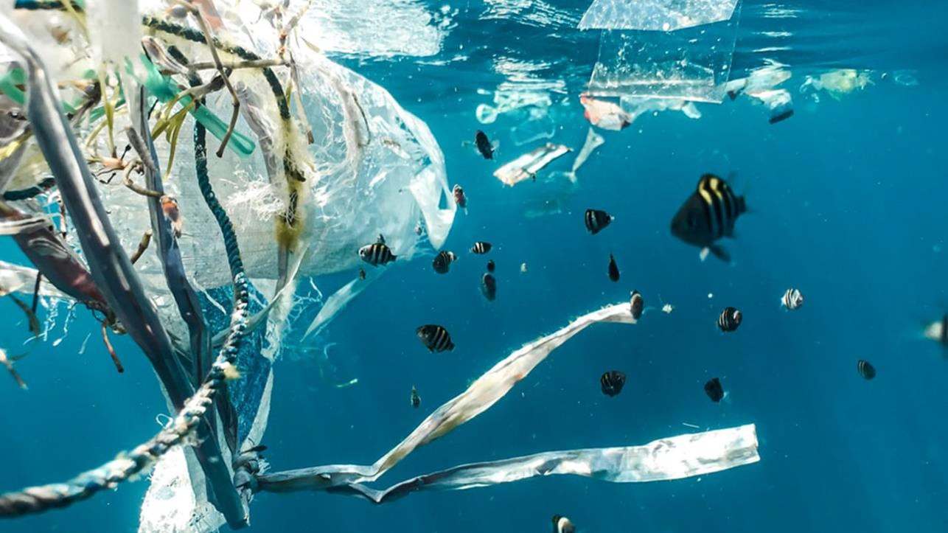
An interesting
perspective…
www.epistemicinsight.com LASAR@canterbury.ac.uk

Slide 4
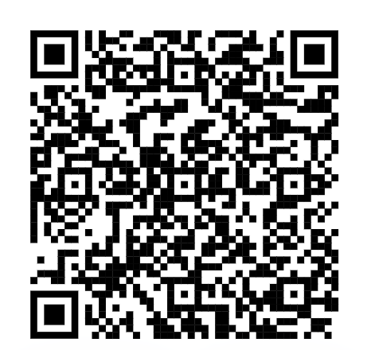
Project outline
Pilot study (10 months)
Research - Mixed methods
Develop a cross disciplinary, cross cultural learning community CCCU network/partners
ECTs
CCCU and City Schools network – Karachi, Pakistan
Facilitate 3 workshops which explore sustainability
Epistemic Insight (EI) tools and strategies
Co-create resources for teaching for about science and religion related to sustainability
Test resources in ECTs' schools
Evaluate and refine resources within learning community
Dissemination – e.g. Zenodo Open science platform
www.epistemicinsight.com LASAR@canterbury.ac.uk

Slide 5
Research aims
To evaluate the effectiveness of the learning community for developing ECTs’ understanding of, and confidence in exploring, science and religion in relation to issues of sustainability
To explore ECTs’ perceptions of the value of the learning community
To explore ECTs’ perceptions of the importance of recognizing diversity in religion and worldviews around these topics.
www.epistemicinsight.com LASAR@canterbury.ac.uk

Slide 6
Why explore sustainability in the context of science and religion?
Sustainability - often associated with STEM, but is a complex and multidisciplinary issue
Sustainability issues often link to theology in a sense of stewardship or guardianship - ‘looking after the earth’
who is responsible?
who are those responsible, responsible to?
why are they/we responsible?
The project sits in the science-religion discourse
Synergy and interaction between stewardship and STEM
TIES the sustainability conversation together
Enables a multidisciplinary response and closes knowledge gaps created when exploring issues through a single discipline - examples of issues can be related to e.g. population, economics, technology, environment
www.epistemicinsight.com LASAR@canterbury.ac.uk

Slide 7
Participants' Perceptions of…
Stewardship
Sustainability
To be sustainable is to meet the demands of the present without sacrificing the requirements of the future, and to do so in a way that maintains a healthy equilibrium among economic development, environmental protection, and social progress.
A responsible person, someone who looks after things for others, plans and manages as well.
Students were not much aware of the term stewardship… responsibility for something and take ownership to fulfil the responsibility and to manage the resources well to achieve the desired results.
They are eco aware and would say it is about recycling, not wasting resources. They worry about climate change. They may not yet understand their need to make personal sacrifices.
That stewardship is understood as taking care of or looking after the environment and living things around us
It is the process of making ends meet and developing a stable lifestyle to avoid a crisis
www.epistemicinsight.com LASAR@canterbury.ac.uk

Slide 8
Project implementation
Four online workshops Mar-Jun 23
Provided a rich source of collaboration.
Co-creation of resources.
Participants were drawn from experienced teachers, tutors and educators
Workshop participants shared their experiences of planning and delivery of sustainability related topic that included science and stewardship (religious/worldviews).
Workshop 1: Collaborative approach to developing engagement with science and religion
Workshop 2: Creating a lesson to engage with science and religious or worldviews when exploring sustainability
Workshop 3: Developing a sustainability lesson to incorporate science and religious perspectives and worldviews
Workshop 4: A sustainability lesson plan with science and religious perspectives and worldviews

Slide 9
Participation:
3 nations (England, Pakistan, Zambia, )
11 professionals engaged in workshops
52 participants interacted with surveys, workshop delivery and BB discussion
26 synchronous interactions/attendances across four workshops.
www.epistemicinsight.com LASAR@canterbury.ac.uk

Slide 10
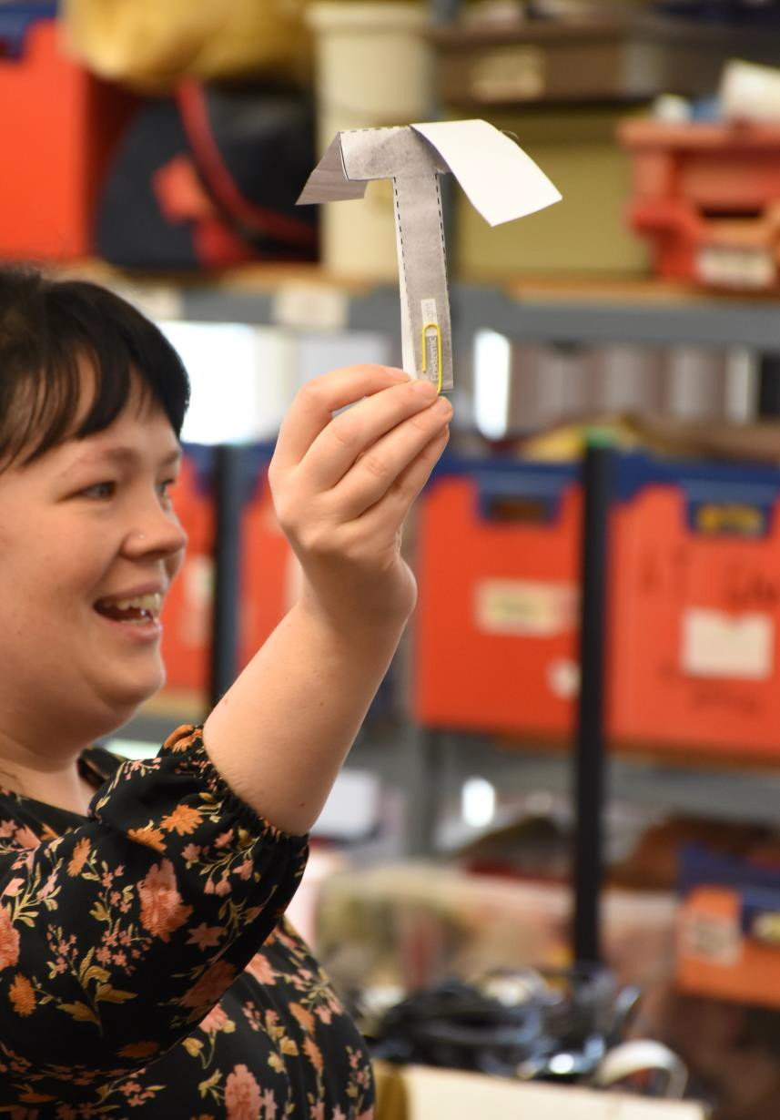
Feedback: introductory session
What do you hope to gain from the learning community?
Be a part of a learning community to be more aware and contribute to improving the problems of my country and the world at large.
A new insight into bridging science, religion, and humanity and how to bring them all into the classroom.
New ideas and methodologies and how can I execute and implement them in my classroom.
It would help me to strengthen my professional abilities further.
www.epistemicinsight.com LASAR@canterbury.ac.uk

Slide 11
Knowledge Exchange
Blackboard VLE- CCCU:
Facilitated discussions
Resource sharing and adaptation
Sharing ideas
Learning from others
Discussion 1: Using and adapting existing resources
Discussion 2: Creating a sustainability and stewardship lesson plan
Discussion 3: Experiences of teaching sustainability that includes science and RE/stewardship
Discussion 4: Feedback on your learning community experience.
www.epistemicinsight.com LASAR@canterbury.ac.uk

Slide 12
Feedback - sessions 1 & 2
What are teachers gaining from the learning community?
The debate around the relationship between S & R was striking and triggered a trail of questions in my mind...
Science and religion have a lot of overlap and are not contradictory – not always easy to get across
A good learning
opportunity…collaboration
and interaction is always healthy
Really thought-provoking and stimulating – identifying links that are not necessarily obvious
Speth’s quote was convincing…it made me agree that all scientific developments need a sense of ownership and
guardianship…
www.epistemicinsight.com LASAR@canterbury.ac.uk

Slide 13
Learning community challenges
What we thought were the Challenges…
What have been the Challenges…
Participants of the learning community have been very engaged; however, challenges were:
Recruitment to the project
Possible reasons for lack of engagement with project:
Workshop timing fit to school calendar
Staff workloads and capacity
International time differences
Different curriculum models
Systematic study of Islam (Karachi)
RE and worldviews (UK)
Awareness of the relationship between sustainability and stewardship
Identify what stewardship means
How stewardship and STEM interacts with sustainability
Addressing these relationship in a classroom
Teacher confidence
Space in curriculum
Increased engagement through…
Workshops
Recordings of workshops
Blackboard resources
Emailing resources & discussion links
Zenodo – free to download
FOK
www.epistemicinsight.com LASAR@canterbury.ac.uk
Notes:
4 BST or 5 hours ahead – Pakistan
1 or 2 GMT ahead - Zambia

Slide 14
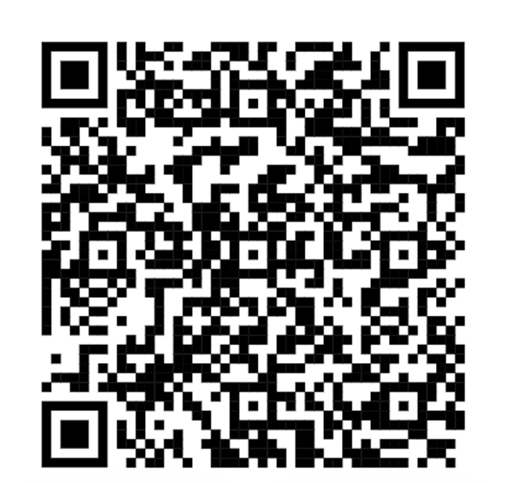
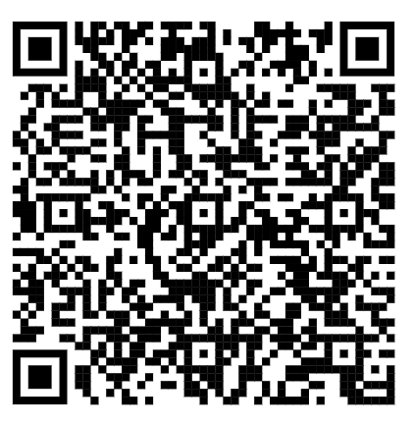
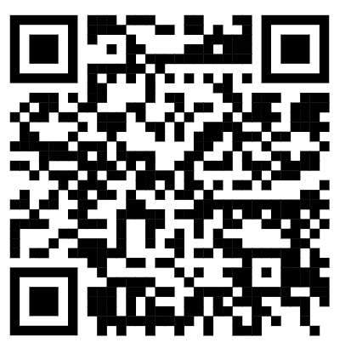
Output highlights
The learning community gained momentum as it matured; growing as new colleagues joined the community to share diverse experiences of teaching sustainability in different contexts and settings.
Dissemination of resources
zenodo.org
Views – 154
Downloads – 134
futureofknowledge.com
epistemicinsight.com
4 PowerPoints presentations – 1 per workshop
2 co-created lesson plans
How Green are electric Car’
Will Nuclear power save the planet?
Lesson plans with guidance (in development)
How sustainable are the agricultural practices in my country/area?
Where should we put a wind turbine?
How are animals adapting to our changing world?
Poster
Blogs
www.epistemicinsight.com LASAR@canterbury.ac.uk
Notes:
https://zenodo.org/communities/epistemic-insight/?page=1&size=20
https://futureofknowledge.com/sustainability-and-stewardship-in-education/,
https://www.epistemicinsight.com/

Slide 15
Outcome highlights
Improved confidence of understanding and application of multidisciplinary pedagogical approaches, particularly the relationship between science and religion
Co-created Lesson plans indicate greater understanding and improved confidence when addressing the relationship between science and religious/worldviews when teaching sustainability.
Attending to diversity in religious/worldviews around sustainability issues
Workshop discussion evidenced engagement with the importance of diversity in religious/worldviews around sustainability.
One participant noted the importance of an “in-depth and broad understanding of an issue from different perspectives”
Demonstrate an interest in the learning community model
Participation –discussions, workshops, collaborative lesson planning, feedback of teaching and planning sustainability sessions in different contexts.
Dissemination - wider teacher network
LASAR Newsletter - reach 400+ practitioners
Blogs
Zenodo – free downloadable resources
TEAN Conference
www.epistemicinsight.com LASAR@canterbury.ac.uk
Notes:
Q. how would a theologian/scholar of religion/ethics know they had a good answer – one participant pointed to “values in religious texts of how to take care of the planet”.

Slide 16
Evaluation and Feedback
What surprised you the most about the session?
“ Link of science with theology.”
Participants found sessions:
“very stimulating and thought provoking with clear objectives…”
The impact of the workshops (if any) on your understanding of the relationship between science and religion in the context of sustainability…
“Has given me more confidence to explore the relationship between stewardship and sustainability“
How the learning community supported understanding and confidence in planning and delivery of sustainability lessons which include science and religious/worldviews (stewardship)
“Increased knowledge level and awareness of opportunities…to incorporate issues of sustainability in the lessons.”
Project evaluation methods:
Jamboard (interactive whiteboard)
Menti.com
Padlet
Surveys
Interviews (TBC)
Next Steps…
www.epistemicinsight.com LASAR@canterbury.ac.uk
Notes:
“importance of teaching sustainability in the classroom.”
“Excellent, helpful dialogue…” “Forces me to think.” “A good learning opportunity”.
“Ideas and suggestions have been employed and investigated”
“More collaboration and interaction is always healthy”.

Slide 17
Invitation to collaborate
Invitation to collaborate
Although this project has focused on sustainability within the area of teacher/school education and predominantly from two lenses: science and religion, we are interested in future collaborative projects related to sustainability in a broader sense from multidisciplinary perspective.
Anyone interested is welcome to contact us:
aga.gordon@canterbury.ac.uk
sherralyn.simpson@canterbury.ac.uk
www.epistemicinsight.com LASAR@canterbury.ac.uk

Slide 18
Questions
Any questions
www.epistemicinsight.com LASAR@canterbury.ac.uk

Slide 19
science-religion discourse
Sustainability – simple questions to ask:
Science – How can we do it?
Religion – Why should we be doing it?
Science and religion – challenges for teachers
Can feel like a contested space/often perceived as incompatible
Learning community offers a knowledge exchange
Supports learning about aspects of stewardship and sustainability - considering cultural contexts and international experiences
e.g. different cultural, religious, geographical views
Safe space to test out ideas, thinking and pedagogy
Broadening perspectives
www.epistemicinsight.com LASAR@canterbury.ac.uk

Slide 20
A global challenge requires a global approach…
Dominant view that STEM can resolve sustainability issues
Preference for multidisciplinary approach over explicitly religious response
Diversity of Religion/belief/worldviews in different societies/cultures
OECD ‘Learning Compass 2030’ reflect 21st century challenges in cross-
curricular themes, promotes holistic learning beyond ‘traditional’ approaches:
environmental education and sustainability
local and global citizenship, peace,
cultural identity and multiculturalism
Epistemic Insight provides strategies to enable holistic learning within and across disciplines.
OECD - Organisation for Economic Co-operation and Development
www.epistemicinsight.com LASAR@canterbury.ac.uk

