Slide 1
Paradox and the Incarnation: Why it isn’t Simply a Matter of Logical Contradiction
Dr. Finley Lawson
Canterbury Christ Church University

Slide 2
Overview
Paradox in Theology
Paradoxical roots in Dichotomy
A Four-fold response
Tyndale Fellowship Philosophy of Religion Study Group Conference

Slide 3
The Challenge
Humans cannot hold the concepts [of human and divine] in a coherent epistemic or theological framework (Goulder, 1979; Hepburn, 1960).
C. Stephen Evans: our “problematic” conceptual equipment is at the root of paradox
One does not have to understand the mechanism (of the incarnation) to challenge the claim of paradox. Likewise, one does not need to have a full definition of “human” and/or “divine” to reconcile the apparently contradictory properties of the incarnation.
Tyndale Fellowship Philosophy of Religion Study Group Conference

Slide 4
Paradox in Theology

Slide 5
The Place of Paradox in Theology
Brian Daley
(2004 194-5)
Patricia Ranft
(2021, 61)
Cyril orji
(2022, 19)
“To say that Christ is a single hypostasis who joins together two wholly distinct and unequal natures – the transcendent, infinite, foundational reality of God and the limited reality of a historical human being – in a ‘mode of union’ which constitutes his present personal reality is to say that he is a living paradox”
“The doctrine of the incarnation is a doctrine of precise balance between two opposites. The balance is the paradox and the heart of the doctrine […] too heavy an emphasis on the divine or on the human, the paradoxical balance is lost “
“Just as paradoxes are unavoidable in logic and mathematics, paradoxes are inevitable in religious and theological discourse”
Thursday 6th July 2023
Tyndale Fellowship Philosophy of Religion Study Group Conference

Slide 6
The Place of Paradox in Theology
Aporia recognises “a dialectical interaction between irreducible yet contradictory components” (McGaughey, 1997, p. 40) rather than privileging one side of the tension over the other. It acknowledges the NECESSITY of both components as well as their “irreconcilability”.
Theology “must go one step further to ensure that both the spiritual and the material are recognized in tension within one another and not engage in a metaphysical reduction of “reality” down to one side or the other” (1997, p. 112 emphasis added)
APOria not(?) paradox?
Thursday 6th July 2023
Tyndale Fellowship Philosophy of Religion Study Group Conference

Slide 7
The Place of Paradox in Theology
Parádoxos (παράδοξος) is used once in the entirety of the Bible (Luke 5:26). In that instance it is often translated as “strange” or “remarkable” things
(strange, remarkable, extraordinary, amazing, wonderful)
Biblical usage
Paradox = ‘the notion that traditional Christian conceptions of God and his relation to the world suffer from internal logical difficulties’ (Anderson 2007, 1 emphasis added)?
Theological significance ‘potential implications for the epistemic status of Christian beliefs’ (2007, 1), Faith no longer a “reasonable enterprise” (Locke)
contemporary usage
Thursday 6th July 2023
Tyndale Fellowship Philosophy of Religion Study Group Conference

Slide 8
Paradoxical Roots in Dichotomy

Slide 9
Defining Paradox
P1. Apparently inconsistent with itself or with reason, though in fact true or reasonable; strongly counter-intuitive. Also: really inconsistent with reason; absurd, irrational. (1b OED)
P2. Of a phenomenon, circumstance, etc.: exhibiting some contradiction with itself or with known laws, esp. laws of nature; hard to reconcile with known or accepted scientific theory; deviating from the normal. (3a OED)
P1. Are we saying Christian Theology is internally inconsistent/irrational?
P2. Is the Incarnation in contradiction with “accepted scientific theory”?
Thursday 6th July 2023
Tyndale Fellowship Philosophy of Religion Study Group Conference

Slide 10
Non-Contradiction & Excluded Middles
At most either the statement or its negation can be true (although both could be false)
e.g., The Son of God was omniscient, and The Son of God was not omniscient (in Thomistic language these claims could be appended with qua [in virtue of] divine and qua human respectively).
Non contradiction
‘has equally long been acknowledged in theology: either it is or it is not; there is nothing in between’ (Orji, 2022, p. 32).
LEM highlights a commitment to binary logic – there is no middle ground between truth and falsity
Excluded middle
Thursday 6th July 2023
Tyndale Fellowship Philosophy of Religion Study Group Conference

Slide 11
Epistemology =/= Ontology
Is the cone “mysterious” or “paradoxical” to the flatlander
epistemically unable to conceptualise a three-dimensional object like a cone; they are not ‘cognitively equipped’ to do so (Anderson 2007, 242).
cannot conceptualise the cone in its entirety, But can arrive at “true” knowledge with respect to that which is accessible to their cognitive capacities (Bagus)
The crucial step that is to recognise that there are limitations to their understanding of “cones” meaning that if their descriptions/analogies are pushed too far they will end up denying ‘some vital truth’ (Baugus 2013, 246).
The flatlander and the cone
Thursday 6th July 2023
Tyndale Fellowship Philosophy of Religion Study Group Conference

Slide 12
“Paradox”, the sceptical philosopher protests, “is optimistic and too solemn a word for this. It would be more honest to call it a language of contradiction, one which can therefore delineate no possible being at all[”]. (Hepburn, 1960, p. 16 original emphasis)
Thursday 6th July 2023
Tyndale Fellowship Philosophy of Religion Study Group Conference

Slide 13
A Fourfold Response

Slide 14
The incarnation is paradoxical because:
P3. it appears to be contradictory, and further exploration of the contradictions involved reveal them to be genuinely contradictory (irrespective of God’s ability to hold the contradictions coherently).
P4. it appears to be contradictory and further exploration of the contradictions involved reveal them to be apparently contradictory due to current knowledge/metaphysics/language use.
Thursday 6th July 2023
Tyndale Fellowship Philosophy of Religion Study Group Conference

Slide 15
The incarnation is NOT paradoxical because:
P5. The incarnation is not paradoxical because although it appears to be contradictory, with greater knowledge the apparent contradiction can be resolved without leaving the appearance of contradiction.
P6. The incarnation is not paradoxical because although it appears to be contradictory, we do not have the epistemic capacity to fully explain the objects/terms involved and so cannot know whether they are genuinely/apparently contradictory. Therefore, the incarnation is “mysterious”.
Thursday 6th July 2023
Tyndale Fellowship Philosophy of Religion Study Group Conference

Slide 16
The Role of Boolean Logic in the Appearance of Contradiction
paradox and aporia rest on a tension or dichotomy between two aspects/accounts
The tension/dichotomy highlights an assumption of bivalent logic
Bivalent logic works through definite values – in which something is either A or not-A
The bivalent categorisation of the world is unable to accurately capture the “vagueness” or “fuzziness” of our lived experience.
Basson and Koekemoer: ‘bivalence and multivalence can be categorised under the headings of mechanistic and holistic paradigms’ (1997, p. 279).
Clayton and Florez :the ‘data suggest an emphatically non-dichotomous ontology [that cannot] […] be understood within a two-part logic’ (Clayton and Florez, 2018, p. 34 emphasis added).
Tyndale Fellowship Philosophy of Religion Study Group Conference

Slide 17
(Interim) Conclusion
1. It is conceivable that there is information that could remove the appearance of paradox, but we don’t currently have access to it.
2. The appearance of paradox is not caused by our knowledge but by our assumptions about the nature of God/Christ.
3. We do not have the capacity due to our finite being to “contain” the (existent) information needed to remove the appearance of paradox.
Tyndale Fellowship Philosophy of Religion Study Group Conference

Slide 18
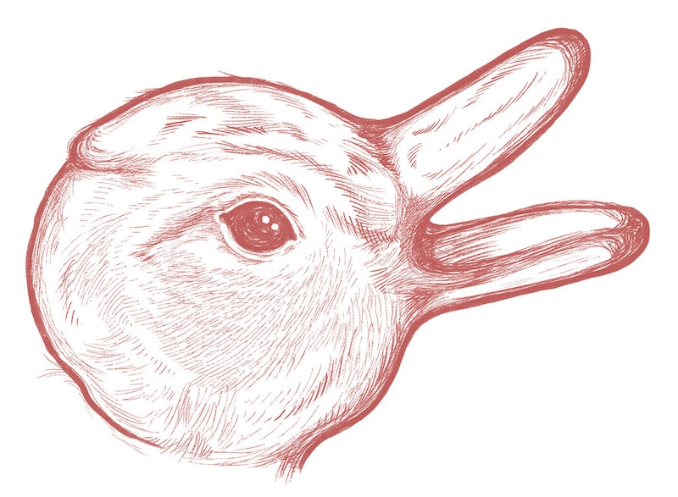
1. It is conceivable that there is information that could remove the appearance of paradox, but we don’t currently have access to it.
Begs the question of whether it is conceivable that we could gain knowledge about the world that would remove the appearance of contradiction.
Relates most closely to an empiricist or experiential approach to theological knowledge.
Angus Menuge (2010, 2018) : a physicalist account of the world cannot provide knowledge about God because ‘our valid concepts are limited to those which can be explained by a finite number of interactions between contingent, imperfect brains and a contingent, imperfect physical world’ (2018, p. 403).
Tyndale Fellowship Philosophy of Religion Study Group Conference

Slide 19
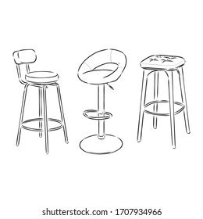
2. The appearance of paradox is not caused by our knowledge but by our assumptions about the nature of God/Christ.
Sits firmly on the boundary between epistemology and metaphysics
Does the Paradox arise due to KNOWLEDGE or ASSUMPTION?
‘we bring so much baggage to the concept of “God” that we can hardly move, let alone undertake a journey’ (Keller, 2007, p. 1).
Does the paradox remain with a “minimal definition”?
is the division that is being made one that is ontologically existent in the world in binary terms?
(a*) sui generis (their own class)
(b*) we have been incorrect in applying the class (name)
(c*) does it need to be described in non-binary terms to encompass the fact that although both descriptions are accurate, neither fully describes the object.
Tyndale Fellowship Philosophy of Religion Study Group Conference

Slide 20
3. We do not have the capacity due to our finite being to “contain” the (existent) information needed to remove the appearance of paradox.
Closest to an account of mystery
Can our “mental faculties” contain the information required to resolve the paradox?
Is there knowledge that would conceivably remove the appearance of paradox?
Could this knowledge be contained by the finite capacity of our mind?
Tyndale Fellowship Philosophy of Religion Study Group Conference

Slide 21
Any Questions?
Dr Finley Lawson
Finley.issac@gmail.com @FinnatCCCU
Tyndale Fellowship Philosophy of Religion Study Group Conference

