Slide 1
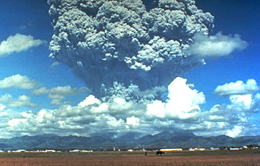
Super-volcano eruptions and their impact on hominin evolution
Callum Firth & James Cole

Slide 2
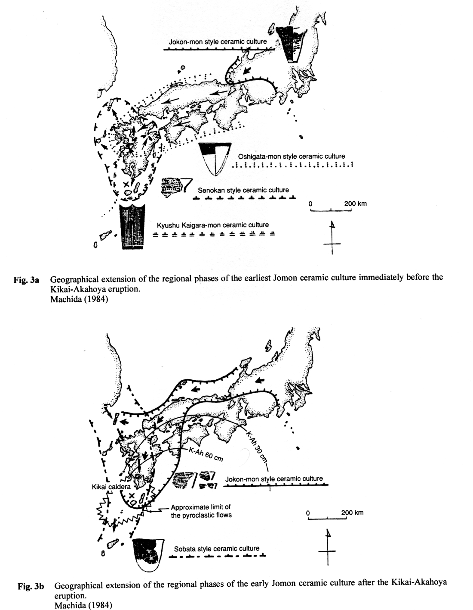
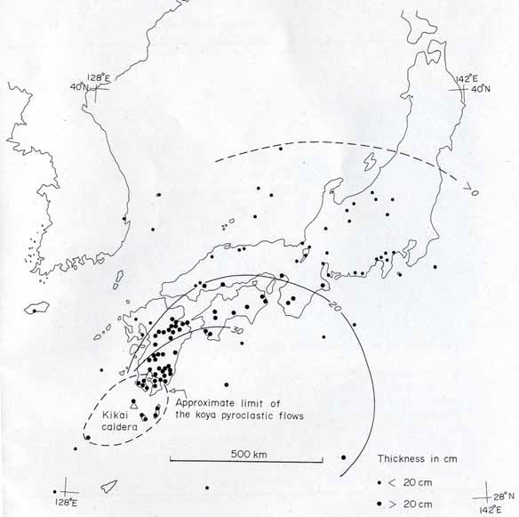
Direct Impact of Explosive Eruptions
Kikai Akahoya eruption: 7,000 years ago – 150km³ , VEI = 7
Vegetation did not recover for 800-900 years.
Neolithic Kyusha Kaigara-non ceramic culture disappears and
replaced by early Jomon ceramic culture.

Slide 3
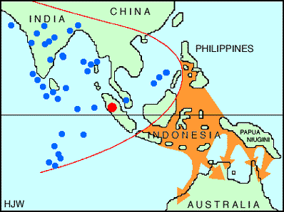
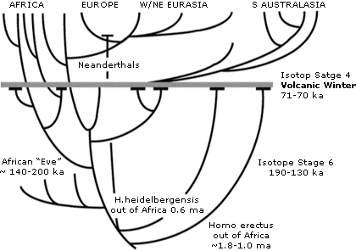
Volcanic Winters
Toba – 73,000 years ago. 2,800km³ , VEI = 8+
Volcanic Winter
Ambrose (1998) and the bottle neck theory
Lane et al. 2013 no volcanic winter in East Africa

Slide 4
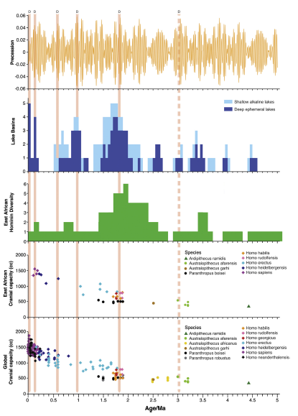
Maslin et al. (2014) Climate pulses and early human evolution
Summary diagram showing East African Hominin diversity , formation of ephemeral lakes and Hominin dispersal dates.
T
Y2
NZ
Y1
Mega eruptions
Y1 – Yellowstone – 2.059 million years - VEI 8+
NZ – New Zealand – 1.01 & 0.97 million years – VEI 7+
Y2 – Yellowstone – 639,000 years – VEI 8
T – Toba – 73,000 years VEI 8+

Slide 5
Defining Catastrophic Eruptions
Eruptions are classified by reference to the Volcanic Explosive Index (VEI) which is related to the volume of material ejected (Dense Rock Equivalent)
VEI 8 = > 1,000 km³ of DRE - Toba (73 ka)
VEI 7 = 100-999 km³ of DRE – Tambora (1815)
VEI 6 = 10-99 km³ of DRE – Krakatoa (1883)
VEI 5 = 1-9 km³ of DRE – Pinatubo (1991)
Notes:
Eruptions characterised by the volume of material ejected. All of these eruptions would place ash and gases into the upper atmosphere >25km and are likely to have an impact on global climate although this impact can be short lived (e.g. Pinatubo = 3 years). The other key point is that the VEI relates to the volume of material erupted, some as lava and some as ash. So there could be a large eruption but if most of the material was dense lava or solid rock rather than ash and gases the climatic impact would be reduced.

Slide 6
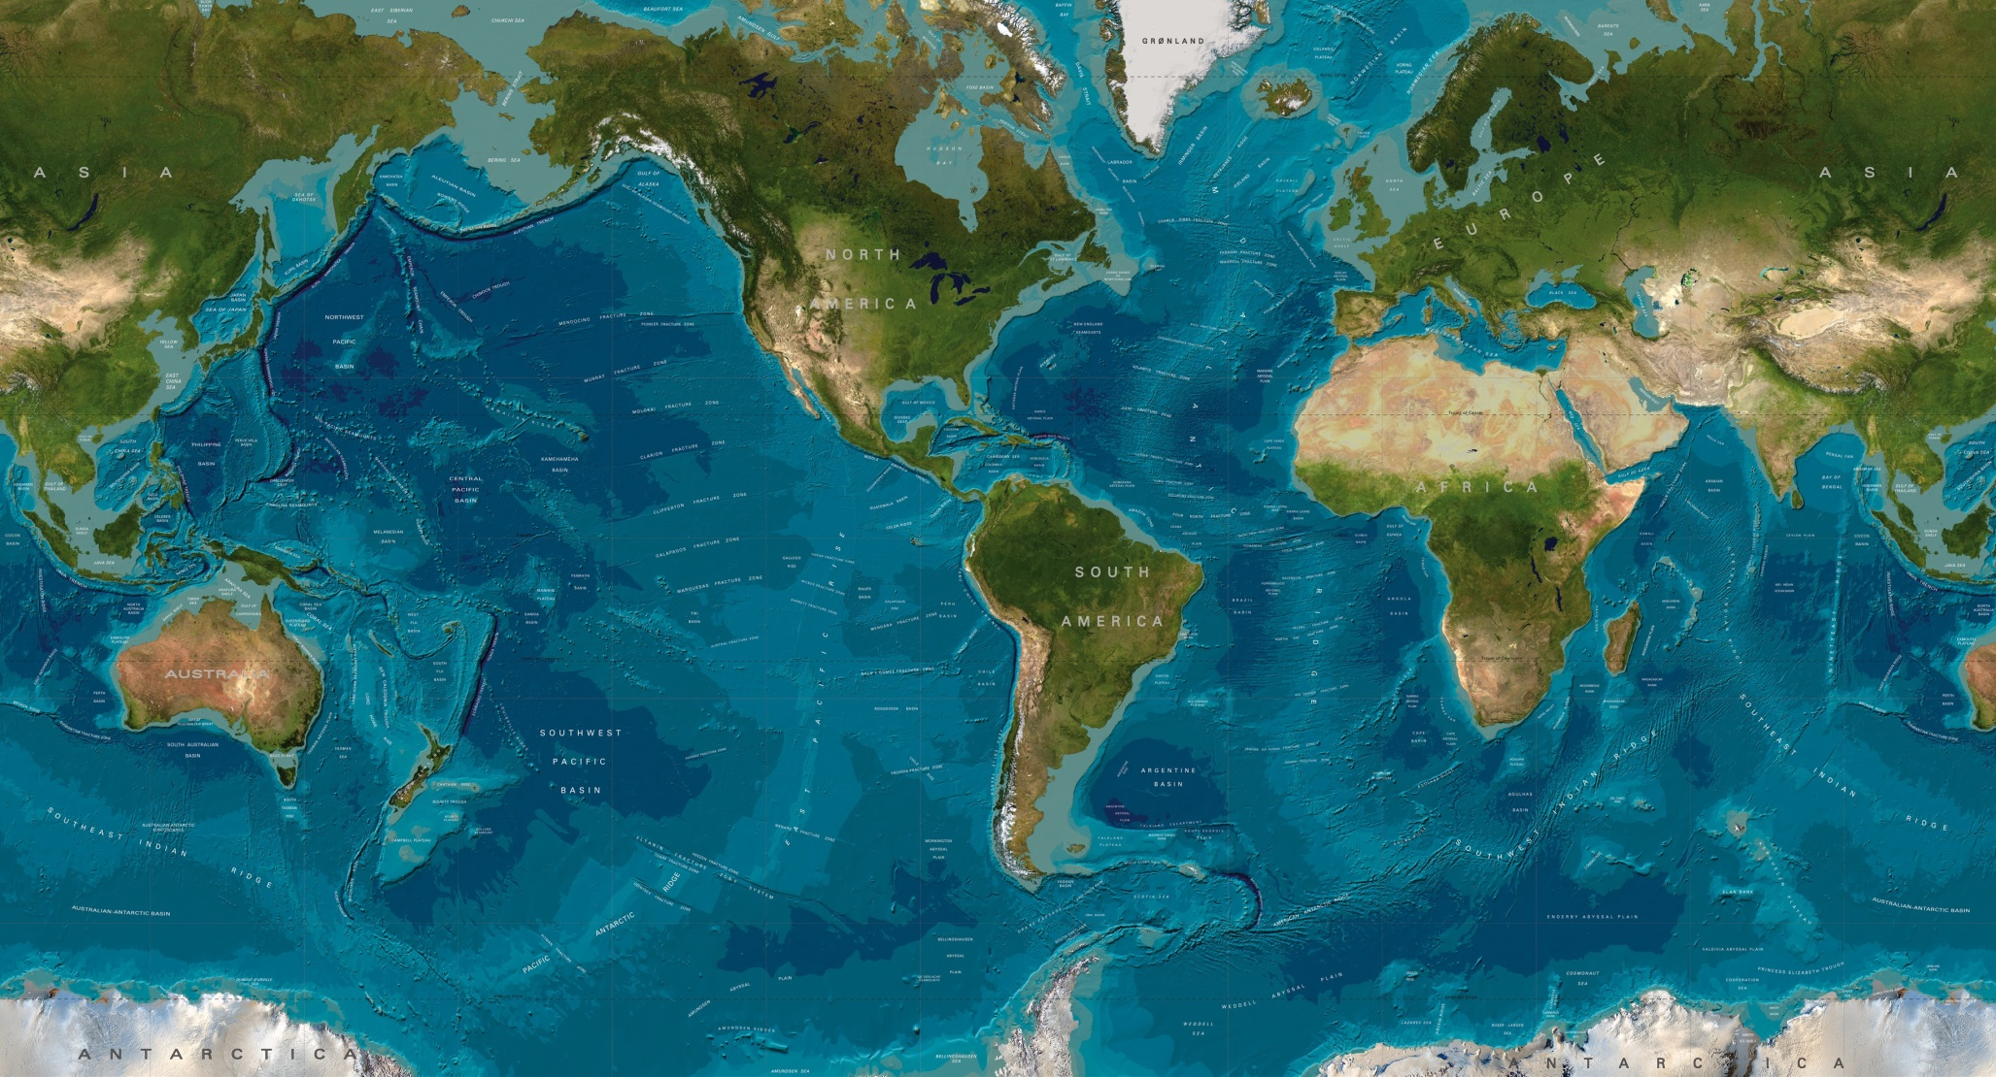
Distribution of VEI 8 Volcanoes
0.040
2.06
0.64
0.073
5.0
0.073
4.0
2.2
0.34
Notes:
The distribution of volcanoes with a VEI of 8 over the last 5 million years. It has been suggested that eruptions close to the equator are more likely to impact on global climate given the ejected material tends to drift poleward. However this is based on much smaller eruptions. We know evidence from the 73,000 Toba eruption is found at both poles. The scale of cooling in Antarctica was however limited. There is no real discussion of whether large eruptions like Yellowstone 640,000 years ago can be identified in the Antarctic ice record.

Slide 7
Distribution of VEI 7+ Volcanoes
2.8
4.3
1.75
0.76
0.024
0.084
0.79
0.79
0.45
1.23, 1.01, 0.97
4.2
0.026
0.22
Notes:
These VEI 7+ eruptions involve at least 300km3 of material. Again those close to the equator are likely to have a greater impact on global climates.

Slide 8
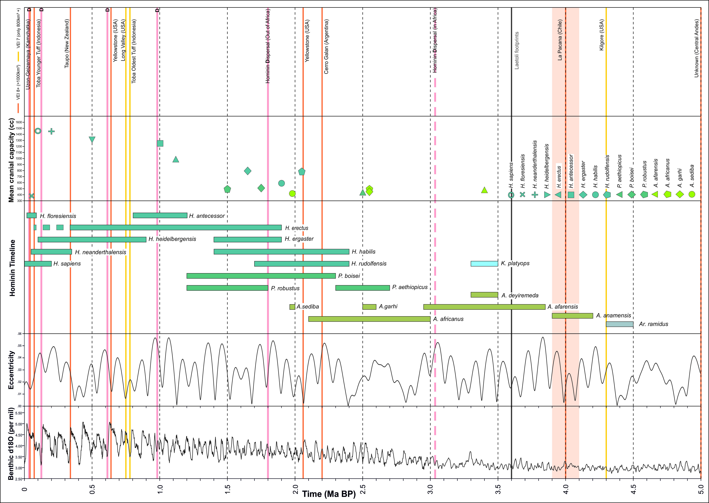
Hominin evolution & eruptions > 800km³
Notes:
So we have the benthic Oxygen isotope record at the base, then eccentricity of the orbit, then the Hominin timeline and the mean cranial capacity. There are then the African Dispersal events and the eruptions (Red = VEI 8 and Green = VEI 7 with at least 800km3 of erupted material. There is certainly no clear correspondence between major eruptions and the appearance or disappearance of particular Hominin species. Similarly the large events do not always correlate with the Hominin dispersal events. There is however potentially a linkage between super eruptions and increases in cranial capacity.
If there is a correlation between super eruption and cranial capacity the driver for capacty change is probably related to climate change as studies (Grove 2014, 2015) have shown that times of great cranial capacity increase correspond to times of great climatic change – but you make this point well further below

Slide 9
Eruptions > 300km³
Notes:
Again there is no clear link between large scale eruptions and the Hominin Timeline but this does depend on how accurate the timeline is. However major eruptions occur with no impact on a particular timeline. In contrast there does appear to be potential links between Hominin Dispersal events and some major eruptions, particularly over the last 1 million years.

Slide 10
Dispersion Events & Eruptions
Dispersion Event | Associated eruption/s
970,000-980,000 years | Mangakino, New Zealand - 1.01 million years and 970,000 years both >300km³
620,000 years | Yellowstone, North America - 639,000 years - >1,000 km³
115,000-140,000 years | None
55,000-71,000 | Toba – 73,000 years – 2,800 km³
20,000-40,000 years | Uzon-Geizemaya, Russia - 40,000 years - 1,700 km³ Taupo, New Zealand – 26,000 years - 530km³ Aira, Japan – 24,000 years – 450 km³
Notes:
In terms of the dispersion events there is a possible linkage but this really depends on how well they are dated and there would need to be more precise dating if a large eruption is going to be identified as the direct cause for the dispersal. Given most of the eruptions were in the northern hemisphere the possibility of significant ash falls in eastern or southern Africa is impossible. The only way these events could have been significant would have been if they drove broader environmental change.

Slide 11
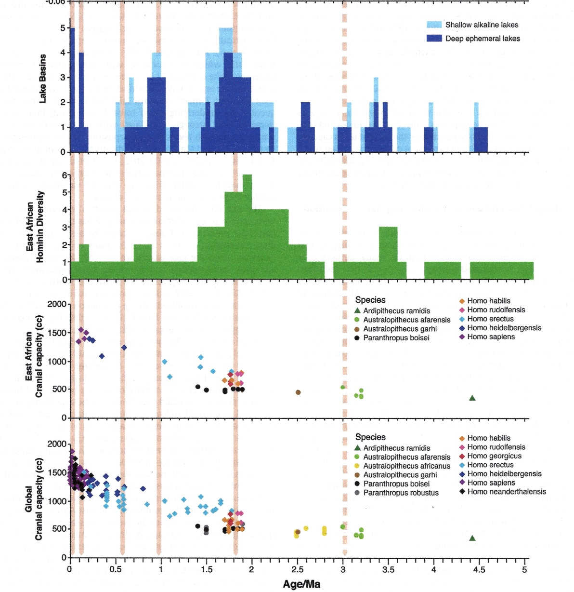
Eruptions and Environmental / Hominin Change
VEI = 8
NH VEI = 7+
NZ VEI = 7+
Notes:
If you look at the Super eruptions (VEI = 8) there is no clear pattern although changes in East African Cranial capacity tend to come after super eruptions. When you add in the Northern Hemisphere VEI = 7 there are some possible linkages with Hominin Diversity particularly prior to 1.9 million years ago but no systematic linkage with East African environmental change. It is only after you add in the New Zealand eruptions that linkages with environmental change, dispersion events and Hominin diversity start to occur but it is still not clear cut.

Slide 12
Conclusions
Limitations of comparing eruption record with the Hominin record since the later is so fragmentary.
Each step in cranial capacity possibly follows a super eruption
There may be a link between ‘Out of Africa’ dispersion events and large eruptions but not always the case and more likely to drive environmental change than impact directly on the Hominin population.
Impact of East African environmental changes on local eruption chronology not evaluated.
Notes:
Would perhaps be good to mention here that another path for future research would be to look into the volcanic record of the Rift in more of a fine grained detail to determine VEI index and age for the Rift eruptions as these volcanoes are most likely to have a direct impact on Human Evolution. I think a new NERC funded project has started on this with the BGS just recently.

