Slide 1
Examining relational practice through the unique experiences of care experienced social workers and students
Dr Janet Melville-Wiseman
Dr Trevor-Rodgers-Grey
Mike Starr
Carol Namata

Slide 2
Reflections
Relational dynamics
How we connect with or relate to the people who need social work services
How they relate to people who deliver social work services
Does this change over time
Does this change when people no longer need services
Does this change when people who needed services now deliver services
Mandated to involve service users in SW education (2004 GSCC)
Why bother?
‘Othering’ prevails
Our changing (or stuck) relationships to the need for help and support

Slide 3
Current messages – Social Work England
Guidance on the qualifying education and training standards (2021)
1. Admissions
1.4: Ensure that the admissions processes assess the suitability of applicants, including in relation to their conduct, health and character
Any criminal convictions, cautions, reprimands or warnings received in the UK or in other countries. This declaration is in addition to providers carrying out criminal record checks for applicants, further details below. Any disciplinary record or unprofessional conduct, such as having disciplinary findings against them by a professional body or having employment terminated for unprofessional behaviour or misconduct.
If they have lived experience of social work themselves and/or that they will seek medical guidance on any new or existing worsening health condition that occurs during their course, including during practice placements
Notes:
The positioning of lived experience directly alongside criminal convictions suggests that it is a problem of close or equal concern. The Pathologisation of care experience as a health issue - is this evidence based?

Slide 4
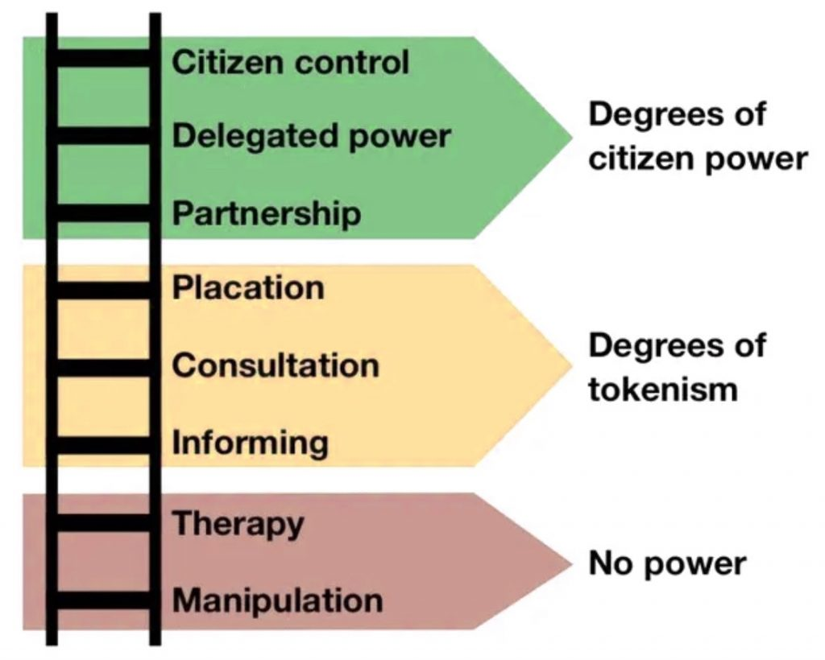
Arnstein (1969) - Ladder of participation
Where should care experienced people sit on this ladder?
Where do care experienced social workers sit on the ladder
Where should they sit?

Slide 5
Davidson (2005) Professional Relationship Boundaries
Balanced
Entangled
Rigid
Where on this continuum are our relationships with service users?
Where should they be?

Slide 6
Project
Funded through Research England's Participatory Research Challenge
Critical participation theory
Undertaken by, for and with members of the community being studied
In particular we wanted to consider:
The views of care experienced SWs and students through the lens of relational boundary theory
How this might illuminate the current approaches to professional relationship boundaries
On-line survey
Follow up interviews
Thematic analysis

Slide 7
Disclosure
“I think if anything, it can sometimes be a bit annoying if/when people praise me for being articulate and 'coming so far', which demonstrates their low expectations, but I'm a former care kid - I've got tough enough skin to handle that”
“Previously, I disclosed my experience to a trio of academics. The sound of the pin dropping was all I heard”
“I didn't want to be perceived as someone who was not 'over' my experience in Care”

Slide 8
Hidden identities
“…accusations of being ‘too close’, ‘too involved’, ‘not having the distance needed’, and other such phrases”
“I’ve never shared with anyone at work my care experienced past because I feared judgement and ‘reduction’ to only that side of me”
“I have never been able to discuss the dichotomy of being care experienced and working in social care. I often found myself wondering where I fitted. It was like I needed to choose a team. I am either a professional who has succeeded or the care experienced person who will never be professional enough”

Slide 9
Lack of authenticity and shaming
“I felt conflicted between allowing the gift of empathy to shine a light onto the path that I was walking with families, honouring how my own story could help others to start to make sense of theirs, [versus] the value of having a sense of belonging in the workplace.”
“[the] repeated lies about a fundamental part of my identity made me feel shameful.”
“I was living in the borderlands, that space where you have one foot in and out - yet don’t seem to sit anywhere”
“…we all bring powerful and monumental insight to the profession”

Slide 10
Excluded
“I was told by my manager he was concerned with me engaging with the children and young people as I would over empathise with them as a care experienced person”
“Was told not to work with children in care as it would be too triggering for me”
“Was never given parenting assessments as they felt my experience would impact me so much I’d have a positive assessment for every family ?! I’m a senior practitioner!”

Slide 11
The impact of invisibility
“…despite our expected anti-oppression values we continue to “other” service users. We ‘normal’ social workers against ‘vulnerable/care experienced/disabled/disadvantaged…’ service users whilst ignoring the fact that we are all human beings who may require or benefit from support at different stages in our lives. Hence “experts by experience” are never social workers with experience of eg care, addiction, prison etc.”

Slide 12
Considerations
Professionals engaged in ‘rigid’ relationships are described as ones who:
“...barrel ahead with their own agenda inflexibly, condescendingly, and without attending to the unique and multifaceted needs of the client. Their lack of authenticity and sensitivity while attending to the client’s needs contravenes their ethical responsibility to honour the dignity and worth of the individual. Responding rigidly exploits the client’s vulnerabilities and is an abuse of the professional’s position of power as it accentuates, and even exaggerates, the power differential between them”.
Davidson 2005 page 519
CESWs have successfully completed the same level of training as every other SW
CESW students have earned their place by right
Care experienced SWs and SW students consistently report relationships with colleagues, managers, academics and employers are problematic
Examples of support and positive views are rare
They are characterised by the rigid end of the relational boundary continuum

Slide 13
Aims References +
Arnstein SR. (1969) A ladder of citizen participation. J Am Institute of Planning. 1969;35(4):216–24
Davidson, J. C. (2005). Professional Relationship Boundaries: A Social Work Teaching Module. Social Work Education, 24 (5), 511-533

